Slide 1

Book Bans and Voting Patterns
Tyler Long
Nashville Software School
Data Analytics Cohort 7

Slide 2
Why I Chose This Topic
Avid fan of Reading Rainbow as a child
Studied English Literature for my B.A.
Curious about book bans in today’s political
landscape

Slide 3
Capstone Data Sources
MIT Election Data + Science Lab
PEN America's Index of School Book Bans

Slide 4



Capstone Technologies Used

Slide 5
Capstone Questions
Are Republican counties taking a more steadfast stance in the culture war? Do counties that demonstrate a high tendency to propose book bans demonstrate wider margins in favor of conservative candidates?
Are Democratic counties that propose book bans voting contrary to a liberal ideology? Do counties that demonstrate consistent democratic support have book bans greater than the average demonstrated in the dataset?

Slide 6
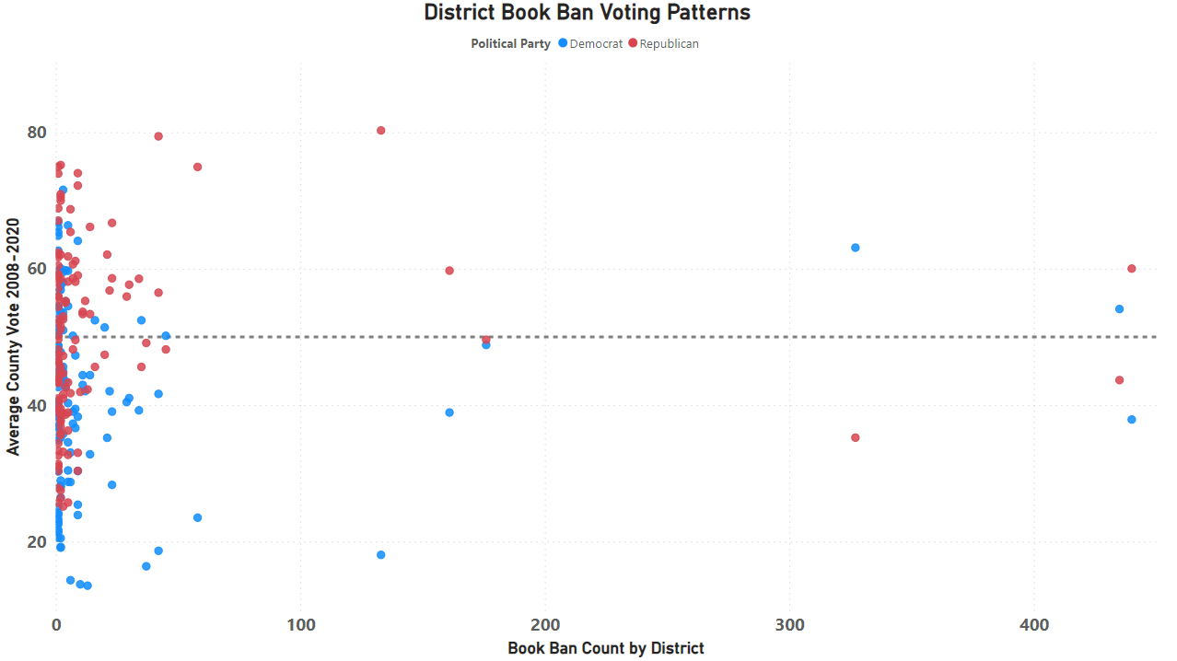
Correlation between count of book bans and election results
Vote percent is the average of years 2008 through 2020
Removed third-parties from the data
Considering outliers, average bans per district is 16 books

Slide 7
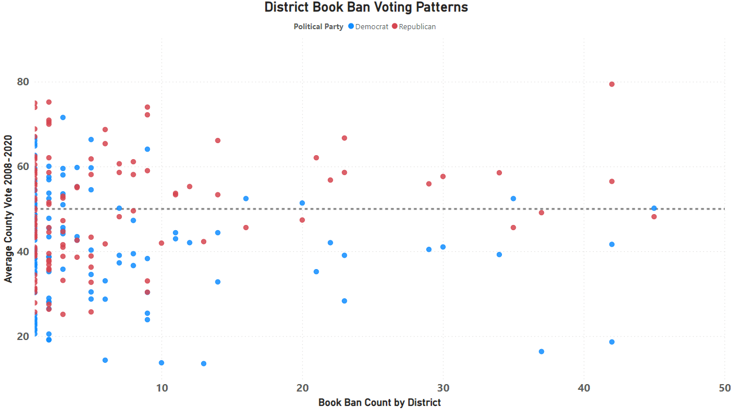
Previous slide limiting data to districts with book bans of 50 or less
Bans between 10 and 50 books show higher vote percentage for Republican counties, opposite for Democrat counties
No clear correlation between increased favor of Republican candidate and increased banned books

Slide 8
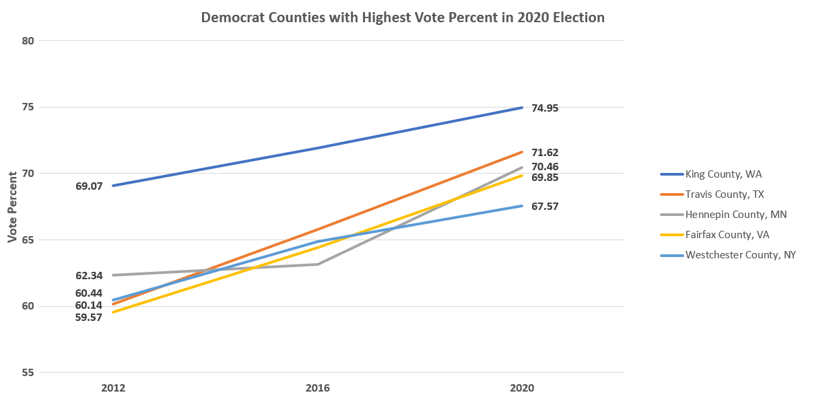
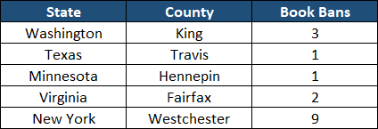
Every county demonstrated year-over-year support
Average vote percent change 2016 to 2020: 8.58%
Highest change is Travis County, TX: 11.48%
Lowest change is Westchester County, NY: 7.13%

Slide 9
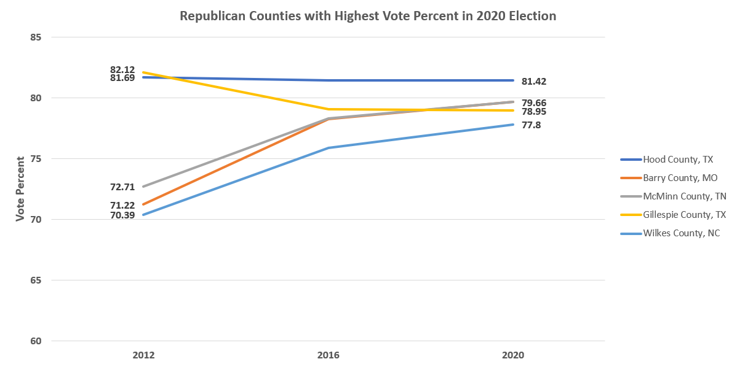
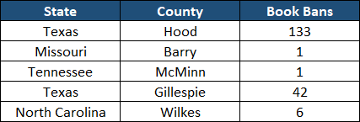
Some counties increase support (3), others decrease (2)
Average increased support 2016 to 2020: 7.60%
Average decreased support 2016 to 2020: -1.72%
Highest positive change is Berry County, MO: 8.44%
Lowest positive change is McMinn County, TN: 6.95%

Slide 10
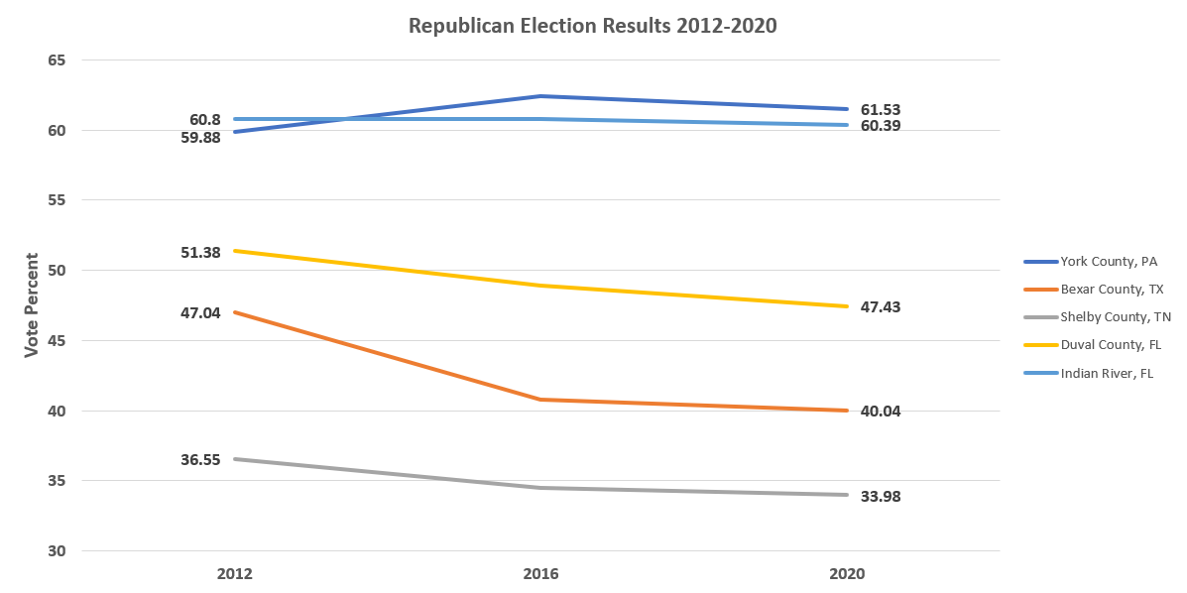
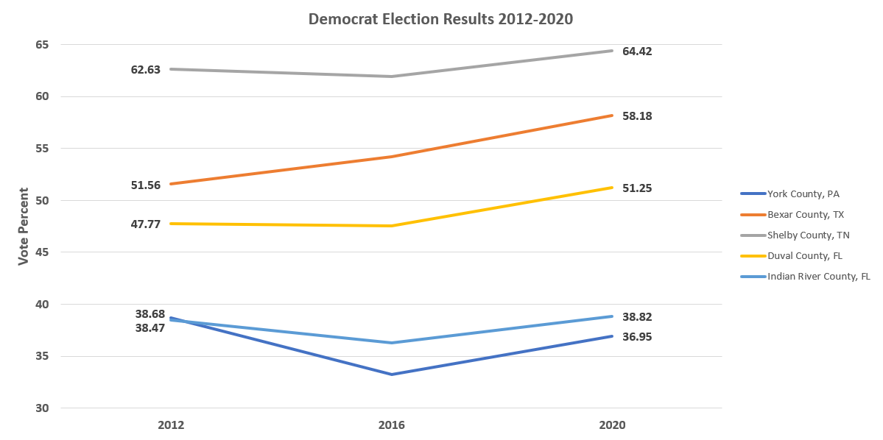
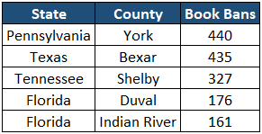
Three counties with declining Republican support are in counties anchored with a large city:
Bexar County, TX: San Antonio (71.40% county population)
Shelby County, TN: Memphis (68.09% county population)
Duval County, FL: Jacksonville (95.38% county population)
Shelby County is the only school district outside the large city

Slide 11
Conclusion: Inconclusive
Democratic counties show a strong correlation between strong, consistent support and below average book bans
Republican counties do not show consistent correlation between voting patterns and above average book bans
Highest book ban proposals are occurring in counties with decreased Republican support, and in districts within large metropolitan areas

