Slide 1
Capstone Project - The Battle of Neighbourhoods
By Thomas Long
September 2020

Slide 2
Introduction
This final project aims to explore Japanese restaurants located in the city of New York. New York city is home to thousands of different restaurants which are spread across its five boroughs. Japanese cuisine has seen a significant increase in popularity in the last few decades and this has in turn resulted in numerous Japanese restaurants populating New York city. This report will compare Japanese restaurants in New York city in order to establish the best places to find Japanese cuisine in the city. Also, the report will provide insights into the frequency and average rating of Japanese restaurants around New York city which can be used to determine where a new Japanese restaurant may have the greatest success.

Slide 3
Data
In order to carry out the analysis, data on New York City neighbourhoods, boroughs to include boundaries, latitude, longitude, restaurants, and restaurant ratings and tips are required.
New York City data containing the neighbourhoods and boroughs, latitudes, and longitudes will be obtained from the data source: https://cocl.us/new_york_dataset
All data related to locations and quality of Japanese restaurants will be obtained via the Foursquare API utilized via the Request library in Python.

Slide 4
methodology
The first step in carrying out this analysis involves obtaining the relevant data. This is done by retrieving the data from https://cocl.us/new_york_dataset. The data is then cleaned and processed into a dataframe.
Using Foursquare, Japanese restaurants and their accompanying information is collected by locating all venues and filtering the search for Japanese restaurants. The number of restaurants located in each borough is determined along with the neighbourhoods they are found in. The information will include number of likes, ratings and tips for each of the Japanese restaurants retrieved.
Following the collecting and processing of the data, restaurants with the greatest likes, ratings and tips are determined and average ratings of Japanese restaurants in each neighbourhood are generated using the dataframe. Finally, a map visualising the data is generated which pinpoints the location of each of the Japanese restaurants that are used in this analysis.

Slide 5
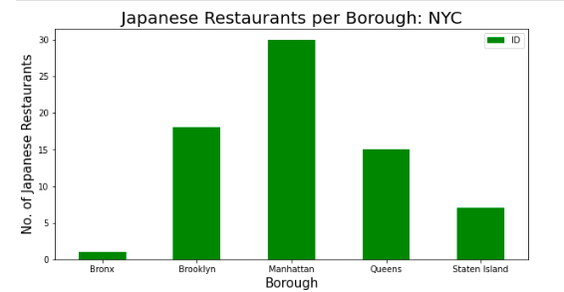
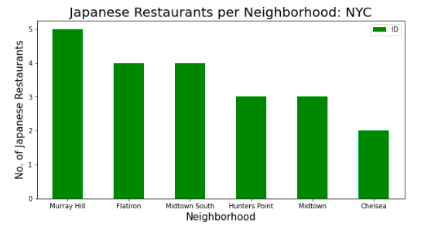
Results
Based on the data used in this analysis, Manhattan has the greatest number of Japanese restaurants in New York city by a considerable margin. The Bronx has the lowest number of Japanese restaurants. Murray Hill, Manhattan is the neighbourhood with the greatest number of Japanese restaurants in New York.

Slide 6
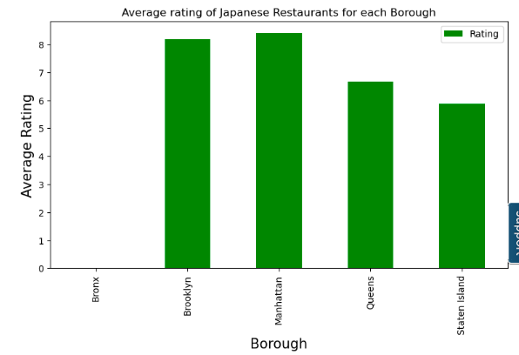
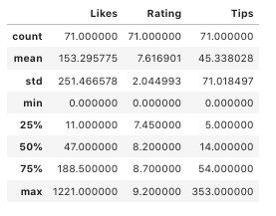
OOTOYA in the neighbourhood of Flatiron, Manhattan boasts the greatest number of likes with 1221. Kura in the neighbourhood of East Village, also in Manhattan, has the greatest rating of 9.2. The greatest number of tips for a Japanese restaurant was found to be 353 and was attributed to Morimoto in the neighbourhood of Chelsea, Manhattan.
Manhattan has the highest average rating for Japanese restaurants, followed closely by Brooklyn and Queens. The Bronx was omitted as the data for only one restaurant was obtained which may be misleading. The neighbourhood with the greatest average rating for Japanese restaurants was East Village, Manhattan followed by Cobble Hill, Brooklyn and Hunters Point, Queens.

Slide 7
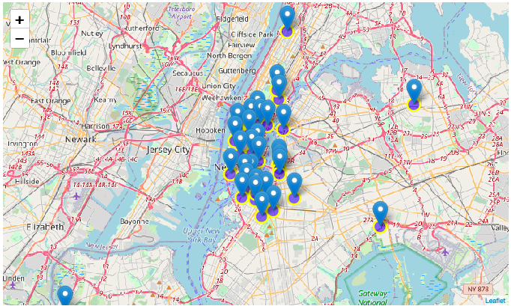

Slide 8
discussion
It is clear to see that the best place to find high quality Japanese cuisine in New York city is Manhattan. Not only does Manhattan have the greatest number of Japanese restaurants, it also has the highest average rating of all five boroughs. In addition, it is home to the Japanese restaurants with the greatest number of likes, highest rating and greatest number of tips.
The analysis provides many insights for the prospective Japanese restaurant owner. The market for Japanese cuisine is clearly greatest in the boroughs of Manhattan, Brooklyn and Queens and the average ratings for these boroughs are high. Due to the large number of Japanese restaurants already established in Manhattan, it would be advisable to open a new restaurant in Brooklyn or Queens due to the reduced competition. Also, real estate prices are an important consideration. Given the high average ratings of Brooklyn Japanese restaurants, relatively cheap real estate prices and comparatively less competition, opening a restuarant in Brooklyn may be the best option.

Slide 9
conclusion
From carrying out this analysis of Japanese restaurants in New York city, it can be concluded that Manhattan is the best place for a customer to find high quality Japanese cuisine with the greatest selection of restaurants and also the greatest average rating. High quality Japanese cuisine can be found in other boroughs such as Brooklyn and Queens which both have high averge ratings but are less frequently located in these boroughs.
For the potential business owner, to avoid competion and high real estate prices but to also retain a high rating, Brooklyn may be the best place to open a new Japanese restaurant.

