Slide 1



OpenGL BOF
Siggraph 2013
Barthold Lichtenbelt
OpenGL ARB chair

Slide 2
nvFX : Plan
What is an Effect
New Approach of nvFX
Demo
Walkthrough few Examples
Details on Key features
Conclusion

Slide 3
What Is An Effect (CgFx, HLSLFx)
Uniforms / Parameters
…
someFunction(args…)
{
Shader code
}
Technique myTechName
{
}
Pass myPassName
{
}
Samplers / Textures
Render / Shader States
…
someOtherFunction(args…)
{
Shader code
}
Pass myPassName2
{…}
Uniforms / Parameters
Technique myTechName2
{ … }
…

Slide 4
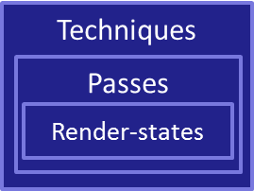
Standard Effect design
Parameters
Shader func’s
Texture Samplers
Application
Textures (D3D)
Effect file
Render states
GPU
Effect runtime
Sampler-states
Shaders
…
Set params (1 by 1 ☹)
Validate passes (builds shaders)
Bind textures/samplers
Activate a Pass

Slide 5
Issues with Existing Effect Systems
Cg
  CgFX part of Cg toolkit; written in Cg
  Source code of CgFX not available
  Specs never evolved since 2002
Microsoft DirectX ®
  HLSL Shaders Only
  Features never evolved
  Nobody using it, nowdays
Khronos Groups’s GLSL
  Nothing available
nvFX is Open-Source

Slide 6
Expectation For A New Effect Design (nvFX)
Host many Shading languages (GLSL, GLSLCompute, HLSL, CUDA…)
Effect must be as self sufficient as possible
  Everything (almost) needed for the effect to work should be inside
  Less C++ code dedicated to the effect; more code in the Effect
  Intermediate resources (Render-Targets) can be defined
Nesting of Effects
  Scene-Effect concept
  Material Effects : behavior influenced by parent (scene) Effect
  Example : Deferred shading
    Needs a scene pre/post-processing + resources (render-targets)
    Needs materials to “adapt” to Deferred-shading context or other

Slide 7
Inside An nvFX Effect
Shader Code Modules
GLSL
Resources description
Uniform
Parameters
D3D
Sampler-states
Constant
Buffers
GLSL-Compute
Texture Bind point
DXCompute
Resources
(render targets)
Render
state-groups
Open-CL
CUDA
Frame buffers
Techniques
CUDA/OptiX/Compute
[shared] Memory
Passes
New Pass-states
nvFX file
Notes:
Add missing modules (OptiX, CUDA…)

Slide 8
Simple nvFX Example
#extension GL_ARB_separate_shader_objects : enable
GLSLShader {
#version 410 compatibility
…
}
uniform vec4 scaleBias : SCBIAS = {1,0,0,0};
Namespace Object {
GLSLShader VS {
layout(location=0) in vec4 Position;
void main() { … }
}
GLSLShader PS < myAnnot=“bar”; > {
layout(location=0) in vec3 v2fWorldNormal;
uniform sampler2D diffSampler;
Main() { … }
}
}
rasterization_state myRStates {
POLYGON_MODE = FILL;
…
}
sampler_state defaultSamplerState
{
TEXTURE_MIN_FILTER = LINEAR_MIPMAP_LINEAR;
TEXTURE_MAG_FILTER = LINEAR;
}
Resource2D diffTex {
samplerState = defaultSamplerState;
defaultFile = "gargoyleMossyDiffuse.dds";
}
Technique BasicTechnique {
Pass p1 < annot1=“Foo”; annot2=3; > {
rasterization_state = myRStates;
samplerResource(diffSampler) = { diffTex, 0 };
VertexProgram = Object::VS;
FragmentProgram = Object::PS;
FragmentProgram<“light”> = LightingImpl;
Uniform(attenuation) = 0.9;
CurrentTarget = backbuffer;
}
Technique mySubTechnique1 Off
Technique mySubTechnique2 On
}

Slide 9


nvFX Effect Integration
Application
nvFX files
Shader code
nvFX runtime
Shader code
nvFX files
Techs/passes
Techs/passes
…
Application
Techs/passes
Techs/passes
…
C++
nvFX
Effects
nvFX files
Techs/passes
Application
Techs/passes
Pre-compiled shaders
Shader code
nvFX runtime
…
nvFX runtime
Pre-compiled shaders
Notes:
Effect filles + nvFX runtime + app
100% flexible. Good for prototyping and development process
Precompiled Shaders + Effect files + App
Checksum to make sure compiled shaders match effects
Precompiled Shaders + { App + .C++ Translated Effects }
Perfect for shipping in a game
Hides the effect & shaders you don’t want to share
Faster to load and execute

Slide 10
API Design
Your
Front-End
Parser
Front-End : parser (Bison)
  Parses the effect
  Does not parse the shader/compute code that is inside !
Back-End : the library to build the effect data
  Used by the Front-End to create parsed data
  Used by the application to drive the effects
Works on PC, Unix (OSX/Linux), Android… even iOS
Application
Front-End
(nvFX parser)
Custom Grammar
& Token
API
C++ Back-End
(nvFX runtime)
OpenGL
DX
CUDA
Your Gfx API layer

Slide 11
Demos…

Slide 12

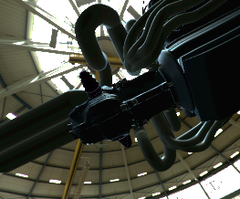



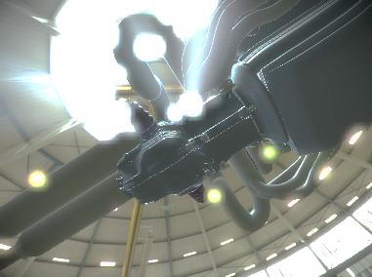
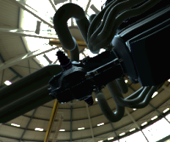








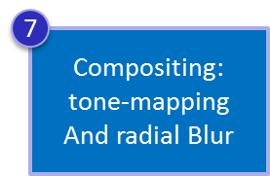
Example : HDR Rendering With Glow
1
3
5
6
2
7
Scene Effect
7
1
4
Render
Skybox in HDR
RGBA32F
Texture
(HDR)
2
Render The
Scene in HDR
Scene Graph
3
Down-scale the
texture 2x, 4x
RGBA
32F
Texture
4
Material Effect 1
Metal Pass
5
Blur texture
Horizontal
Then Vertical
6
+
Material Effect 2
Backbuffer
Plastic pass
Other ‘Effects’…

Slide 13








Example : Compute Post-Processing
Scene Effect passes
1
Render
Skybox
Scene Graph
2
Render The
Scene
Material Effect 1
RGBA
Texture
Metal Pass
Material Effect 2
Plastic pass
3
Other ‘Effects’…
Backbuffer
Triggers CUDA
(or GLSL/DX-Compute)
Kernel
4
Display result
As a fullscreen Quad

Slide 14



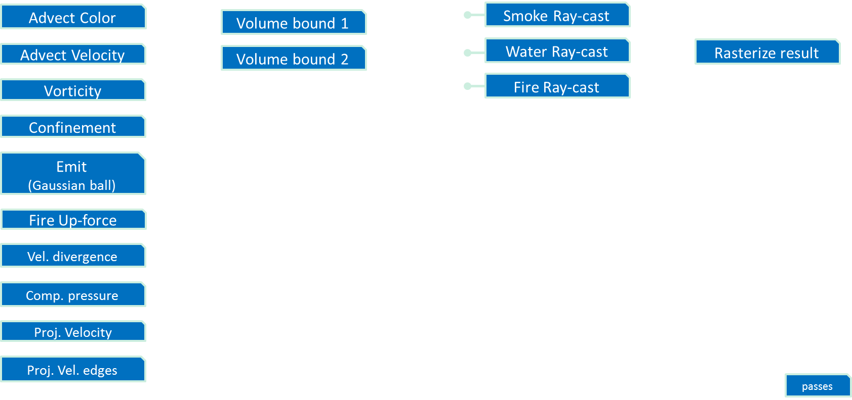

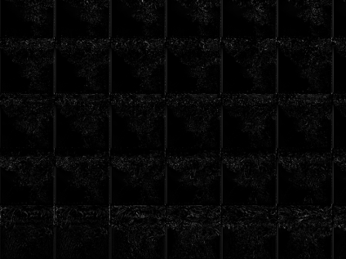
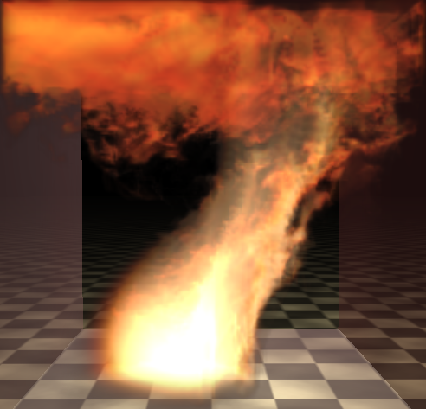
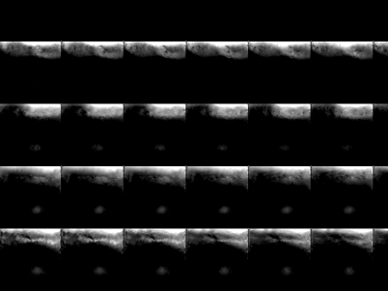
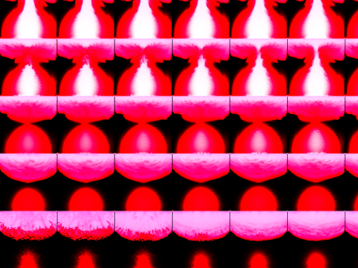
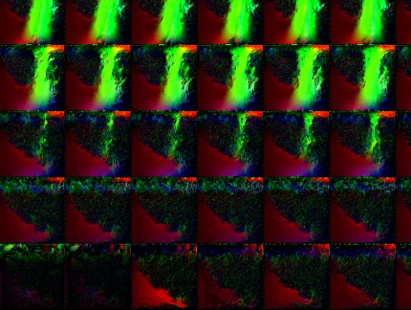

Fire (Navier-Stokes equations)
1
Simulation passes
Volume depth
Volume depth
Rasterize
2
4
3
Technique
Techniques
Notes:
~2500 C++ lines of code saved
More code on nvFX file
More flexibility outside of the C++ compiled part

Slide 15




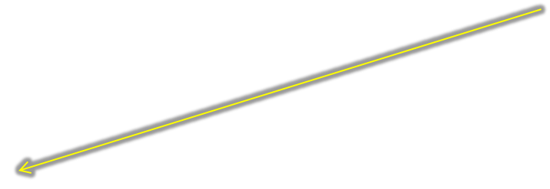

Shader Code
We rely on existing compilers
Declared within a section :
GLSLShader myShader {
layout(location=0) in vec4 Position;
void main(void) {…}
}
CUDAKernel Blur(unsigned int* data, int imgw,…) {
…Conpute code…
}
D3D10Shader myD3DShader {
…HLSL code…
}
NOT Parsed

Slide 16
Techniques & Passes
A technique hosts passes
  And can host other Techniques
A Pass carries render-pipeline setup and actions
  References to State-Groups
  Or direct References to render-states (old style as CgFX)
  References to many Shaders (Vertex, Fragment etc.)
  Value assignment to uniform parameters
    GLSL sub-routine
    ➔ each pass can setup a set of default uniform values
  Connection of images/samplers/textures with resources & Sampler-states
  Lots of other special Pass-states to drive the runtime behavior
  Clear mode (glClear mode…)
  Clear color
  Rendering Mode
  Render Group Id
  Blit action of a resource to a target
  Current Target for rendering
  Viewport Size
  Swap of 2 resources
  Loop count (to repeat passes)
  Active Pass On/Off
  CUDA Module; Shared Mem. Grid/Block…
  GLSL Compute Groups

Slide 17
Resources in nvFX
Visual Effects ⬄resources : often inter-dependent
Example : deferred shading
  G-Buffer really depends on how the effect does deferred shading
Compute ⬄ Graphics : need interaction through resources
  Compute reading from a rendered image and writing into a Textures…
  Compute kernels sometimes need temporary storage…
➔ Idea of creation of resources within an effect
nvFX creates them in a Resource-Repository

Slide 18
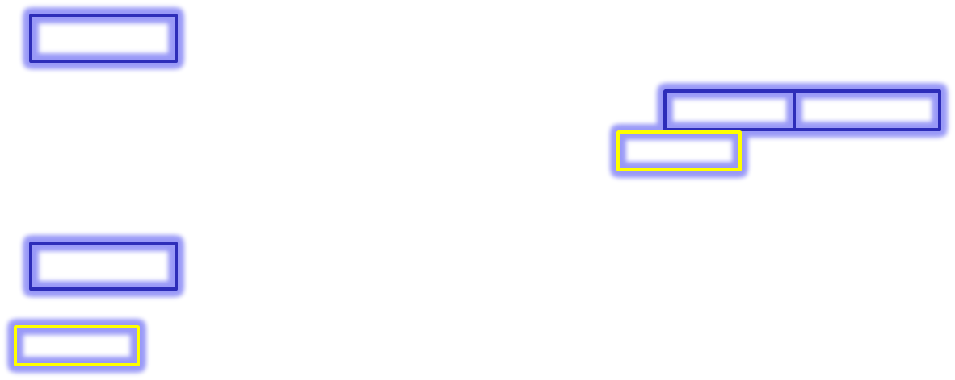




Resource Creation And Use
Create resources :
RenderTexture myRTex1
{
MSAA = {0,0};
Size = ApplicationDefined;// or {800,600};
Format = RGBA8;
}
RenderTexture myRTex2
{ … }
RenderBuffer myDST
{
MSAA = {0,0};
Size = ApplicationDefined;// or {800,600};
Format = DEPTH24STENCIL8;
}
Code on how to use these resouces
Create Frame Buffer Object
FBO myFBO
{
Color = { myRTex1, myRTex2 };
DST = myDST;
}
Use this in Passes
CurrentTarget = myFBO;//(can be backbuffer)
BlitFBOToActiveTarget = myFBOSrc;
swapResources( mFBO1, myFBO2 );
samplerResource(mySampler) = myRTex1;
You can query all from your Application, too

Slide 19
Concatenation of Shader Modules
Literally allows you to “link” Shader Objects to a program Object
A Pass hosts a program
  VertexShader = {ShaderMain, ShaderHelpers, ShaderA, ShaderB, …};
We can group shaders by name :
  VertexShader = myVtxShaderMain;
  VertexShader<“Lighting”> = {VtxLight0, VtxLight1, …}
  VertexShader<“TanBinorm”> = {computeTanBinorm, …}
Named Groups allow to Change some behavior at runtime
  From the Application thanks to the API
  From a Parent-Pass : overriding “Lighting” with another set

Slide 20
Scene-Level / Multi-Level Effects
pre/post-processing are Effects, too : at scene level
Scene-level Effects and material Effects must be consistent
  Deferred shading : Material RT’s must match the G-Buffer
  Shadowing of the scene : must tell materials how to use Shadowing
  Special scene lighting : need to tell material Shaders how to do lighting
nvFX Allows Effect (Scene-level) to override the final linkage of lower levels effects
  lower level Effect shaders compiled for the needs of the higher one
  ➔ instances of shader programs matching the scene-level requirements

Slide 21


Example of Scene-level override
Scene-level Effect
…
Pass renderScene {
ClearMode = all;
FragmentProgramOverride["out"] = forGBuff;
FragmentProgramOverride[“light"] = noLight;
CurrentTarget = myGBuffer;
renderMode = render_scenegraph_shaded;
}
Pass deferredLighting {
VertexProgram = deferredLightingVS;
FragmentProgram = deferredLightingPS;
renderMode = render_fullscreen_quad;
CurrentTarget = backbuffer;
}
Material Effect in the scene
Pass myMatPass1 {
VertexProgram = myVtxProg;
FragmentProgram = {helpers, mainEntry};
FragmentProgram[out] = simpleOutput;
FragmentProgram[light] = defaultLighting;
…
}
New instance of myMatPass1
Pass myMatPass1 {
VertexProgram = myVtxProg;
FragmentProgram = {helpers, mainEntry};
FragmentProgram[out] = forGBuff;
FragmentProgram[light] = noLight;

Slide 22
Conclusion
Less code in Application
More flexibility
Consistency of Effect code. Helps for maintenance and creativity
Updated use of modern APIs. Good for performance
Open-Source approach
  Easily debug it
  Improve it
  Customize it… make it yours or get inspiration from it
First drop now available on https://github.com/tlorach/nvFX
Feedback : tlorach@nvidia.com

Slide 23
OpenGL BOF Agenda
Latest news and features in OpenGL – Barthold Lichtenbelt, NVIDIA
Cool things you never dreamed you can do with OpenGL – Bill Licea-Kane, AMD
Left 4 Dead 2 Linux: From 6 to 300 FPS in OpenGL – Rich Geldreich, Valve
20 years of OpenGL – Kurt Akeley
Trivia throughout
Notes:
Mention t-shirts
Trivia
Grand Prizes

