Slide 1
Who wrote this piece?
Composer classification from symbolic MIDI data
Part 1 Feature-based machine learning
Part 2 Deep learning: FCNN and CNN
Lakshmi Pranathi Tummalapenta · Marella Likhita Sri Durga
Notes:
Opening. The question: can symbolic MIDI data alone tell you who composed a piece of classical piano music? Part 1 uses hand-engineered features with classic ML; Part 2 uses neural networks on the same data and the same split. The decorative bars on the right are a piano roll, which is exactly the representation the CNN in Part 2 sees.

Slide 2
245 pieces, 11 composers
PROJECT OVERVIEW
245
MIDI files, all verified to parse and non-duplicate
11
composers, Haydn to Tchaikovsky
12 – 48
pieces per composer: heavily imbalanced
Data: Classical Music MIDI dataset (S. Rakshit, Kaggle)
Notes:
245 MIDI files from 11 composers. Every file was audited: it parses, has notes, and is not a byte-identical duplicate. Classes are very uneven, from 12 pieces (Tchaikovsky) to 48 (Chopin), which is why we use class weights and macro-F1 later.

Slide 3
Each piece becomes 78 numbers
PROJECT OVERVIEW
8
5
3
General
Pitch & duration
Tonal & texture
Mean/std of pitch, duration, interval; note density
Min, max, range, median pitch; median duration
Pitch-class entropy, chromatic ratio, polyphony
12
25
25
Pitch classes
Melodic intervals
Vertical intervals
Share of notes on each of the 12 pitch classes
Steps between consecutive notes, ±12 semitones
Gaps between simultaneous notes, ±12 semitones
Notes:
78 features computed with pretty_midi. The two interval histograms (shown in purple) make up 50 of the 78 features and turn out to matter most. Caveat on melodic intervals: they are computed from all notes sorted by start time, without separating voices or hands, so they describe overall pitch movement, not a true melodic line.

Slide 4
One fair split for every model
PROJECT OVERVIEW
Train 147
Dev 49
Test 49
Baselines to beat
≈ 9%
Train fit the models
random guess among 11 composers
Dev compare models, tune, early-stop
18.4%
Test scored once, after model selection
always predict Chopin (9 of 49 test pieces)
Stratified 60/20/20, seed 42, identical for the classical models, the FCNN and the CNNs. Macro-F1 picks the winner because it weights every composer equally.
Notes:
Every model, classical or neural, is trained and compared on the same stratified 60/20/20 split with seed 42, so the numbers are directly comparable. The test set is evaluated once per model. Two baselines to keep in mind: random guessing is about 9%, and always predicting the largest class (Chopin) gets 9 of 49 test pieces, 18.4%.

Slide 5
Logistic Regression wins on macro-F1
PART 1 · FEATURE-BASED ML
Final test result
46.9%
accuracy, 23 of 49 pieces
0.451
macro-F1, 11 classes
Notes:
Five classical models on the 78 features. The SVM has the highest dev accuracy (0.531) but Logistic Regression has the best dev macro-F1 (0.479), and macro-F1 was the selection metric. On 49 development pieces the gap is small, so do not over-read the choice. Logistic Regression, refit on train plus dev, scores 46.9% accuracy and 0.451 macro-F1 on the held-out test set, which is about five times better than random. Best composers: Liszt and Haydn. Grieg was never identified.

Slide 6
Interval features carry the signal
PART 1 · FEATURE-BASED ML
Classical vs. Romantic
0.964
macro-F1 (98.0% accuracy), dev set
83% of pieces are Romantic, so accuracy alone flatters. Intervals alone reach 0.893 macro-F1.
Earlier 80/20 holdout, not comparable to the test results; 20 vs. 28 features is 8 pieces out of 49.
Notes:
Two supporting experiments. Left: adding the melodic and vertical interval histograms to the SVM raises accuracy from 0.408 to 0.571, which suggests interval information helps. This used an earlier 80/20 split, so it is not comparable to the test results, and the whole range is only 8 pieces out of 49. Right: separating Classical (Haydn, Mozart) from Romantic (everyone else) is much easier than naming the composer, 0.964 macro-F1 with all features. But 83 percent of the data is Romantic, so accuracy alone would flatter the model; interval features alone give 0.893 macro-F1. PCA showed performance peaks around 30 components, so many of the 78 features are redundant.

Slide 7
Part 2: two neural approaches
PART 2 · DEEP LEARNING
MIDI files
78 features
Fully connected NN
same as Part 1, scaled
1 hidden layer, 128 units, dropout 0.3
64 × 1536 piano roll
CNN, with and without augmentation
10 Hz, first 153.6 s
5 conv blocks, global avg pool, dropout 0.5
Augmentation: transpose ±6 semitones, shift ±15 s, mask up to 20 s
Notes:
Same data, same split. Top path: the 78 features go into a small PyTorch fully connected network, one hidden layer of 128 units with dropout 0.3, class-weighted loss, AdamW, early stopping on dev macro-F1. Bottom path: every MIDI file is converted to a 64 by 1536 piano roll, velocity as the cell value, and fed to a deliberately small CNN of five conv blocks with global average pooling. The CNN is trained twice, with and without augmentation: random transposition up to 6 semitones, time shift up to 15 seconds, and masking a random segment of up to 20 seconds. Note: the neural nets train on the training set only; the classical final model was refit on train plus dev.

Slide 8
Features beat raw piano rolls
PART 2 · DEEP LEARNING
51.0%
FCNN accuracy, 25 of 49 pieces
18.4%
majority-class baseline, the same as the plain CNN
FCNN and Logistic Regression use the 78 features; the CNNs use piano rolls.
Notes:
Final test results, every model on the same 49 pieces. The fully connected network on the 78 features is best: 0.510 accuracy, 0.502 macro-F1, 25 of 49 correct. Logistic Regression is next at 0.469. The CNNs on piano rolls are far behind: 0.265 accuracy with augmentation and 0.184 without. 0.184 equals 9 of 49, which is exactly what always predicting Chopin would score.

Slide 9
What the numbers do and don't say
PART 2 · DEEP LEARNING
1
A CNN is starved at this data size
Features already encode intervals and pitch-class use; the CNN must learn them from 147 pieces.
2
No augmentation: no better than guessing
9 of 49 correct, the same as the majority-class baseline.
3
Augmentation helped, with caution
9 to 13 correct, macro-F1 0.133 to 0.293, but dev accuracy was identical and it is one seed.
4
FCNN vs. Logistic Regression is a near tie
25 vs. 23 correct, and trained differently: FCNN on train only, LR refit on train + dev.
Notes:
Be upfront about the limits of the comparison. (1) The CNN underperforms because 147 training pieces is too little to learn style from scratch. (2) The plain CNN's 9 of 49 equals the majority-class baseline. (3) Augmentation lifted it to 13 of 49, but the dev accuracy was identical for both runs and each run is a single seed on a 49-piece test set. (4) FCNN and Logistic Regression differ by two pieces, which is not a reliable ranking, and they are not trained identically.

Slide 10
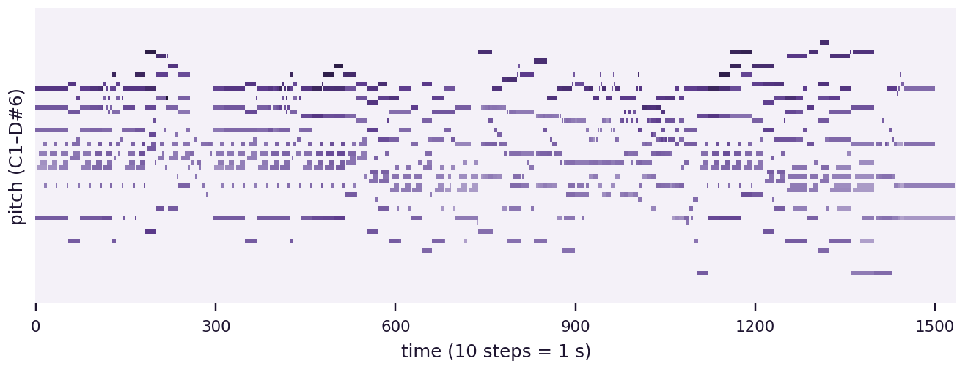
Demo: try it on a MIDI file
PART 2 · DEEP LEARNING
1
Pick or upload
Choose a dataset piece or upload any .mid file
2
See the prediction
Composer plus a probability bar chart
What the CNN sees: a 64 × 1536 piano roll (Chopin, chpn-p13)
3
Two models
Pieces that were in the training set give optimistic predictions.
CNN works on uploads; FCNN on dataset pieces only
Notes:
Streamlit app: run `python -m streamlit run src/app.py`. Trained weights are in the models folder, so it works without retraining. Pick a composer folder and file, or upload a MIDI. The app shows the piano roll and the CNN's predicted composer with class probabilities. For dataset pieces it also shows the fully connected network, because that model needs the 78 stored features, which are only precomputed for dataset files. If the piece was in the training set, the prediction is optimistic.

Slide 11
Limitations and next steps
WRAP-UP
Limitations
Next steps
Splits are per file: movements of one work can land in both train and test
49 test pieces, as few as 3 per composer; one piece is about 2 points
Neural results come from a single seed
Piano rolls crop pieces to the first 153.6 s
Split by composition (GroupKFold) and repeat over seeds
Extract a true melodic line: top voice or per hand
More data, or pretrained music models
Compute the 78 features for uploads so the FCNN works in the demo
Notes:
Be honest about what the results can and cannot support. The biggest caveat is leakage: splits are per MIDI file, not per composition, so different movements of the same work can sit in train and test, which makes the task look easier. The test set is tiny, and the neural results are single-seed. Next steps are mostly about more reliable evaluation and better inputs.

Slide 12
Takeaways
Random guess
Hand-engineered features carry real stylistic signal; interval features carry the most.
Classical vs. Romantic is far easier than naming the composer.
A CNN on raw piano rolls does not keep up at 245 pieces, though augmentation narrows the gap.
Treat the exact numbers as estimates: small, imbalanced data and file-level splits.
9.0%
Always Chopin
18.4%
Logistic Regression
46.9%
Fully connected NN
51.0%
Test accuracy, 11 composers
Notes:
Close: about 47 to 51 percent across 11 classes, several times better than chance, with the best model being the small fully connected network on engineered features. Remind the audience that the exact ordering among the top models is within noise on a 49-piece test set. Code and results: github.com/tlpranathi/midi-composer-classification

