Slide 1
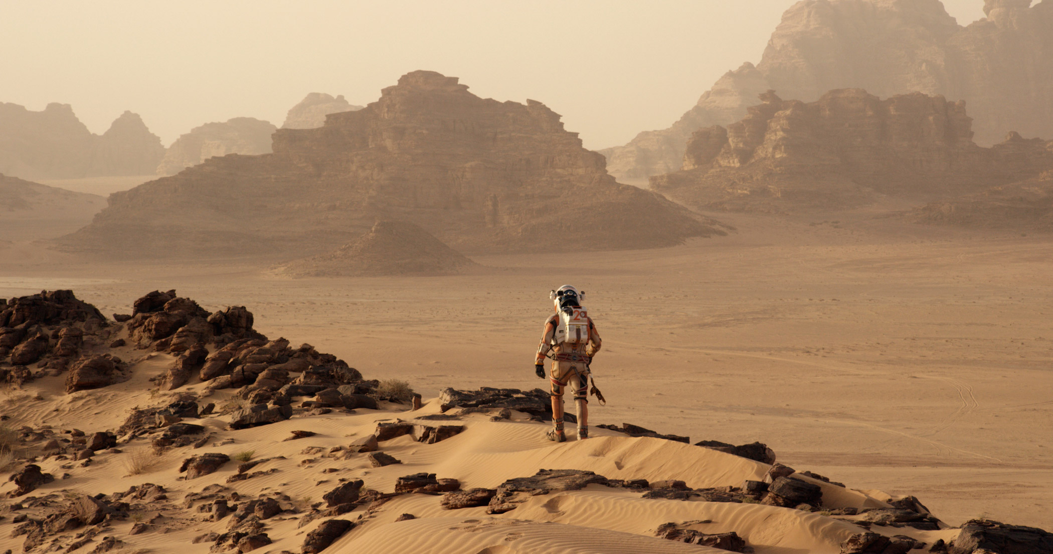
Presentation on the martian
By yotam gefen
directed by Ridley scott
main character: Mark watney

Slide 2

Did I like the movie?
I did like the movie because it didn't make the characters do things in a ridiculously sub optimal way just in order to create cheap tension that is boring and makes me want to stop watching the movie

Slide 3
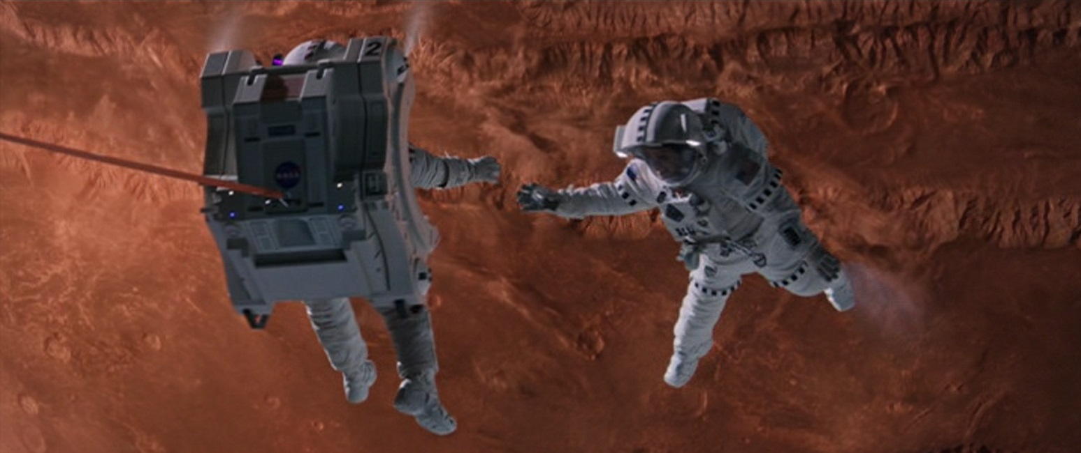
The plot:
Firstly Mark watney was left on mars while the crew of the mission he was a part of left mars because of a sandstorm in the area and he got hit by an object.
He then started trying to find how to survive for long enough to be saved, Finding sources for calories and oxygen etc, he started growing potatoes for calories and took all the vitamins through pills and such because he had enough for the amount of time he needed.
Nasa discovers mark is alive through satelite images.
Marks connects with nasa through an old pathfinder rover.
Marks habitat is suddenly breached because of stress it wasn't meant to handle and mark loses a lot of his food supply.
Marks crew decides to use a slingshot maneuver to reach him and rescue him.
Mark goes to a vehicle that can fly at a crater and removes weight from it to be able to use it to reach his crew during the slingshot.
They finally do the maneuver and mark is rescued.

Slide 4
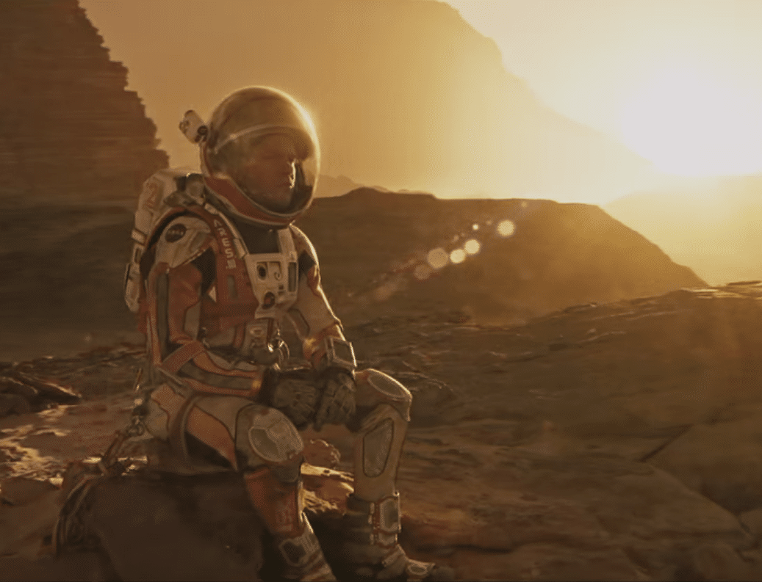
my Favorite character
My favorite character is mark because he still thought about what he can get from the situation and did research so that even if he died there the mission would still be helpful to humanity.

Slide 5
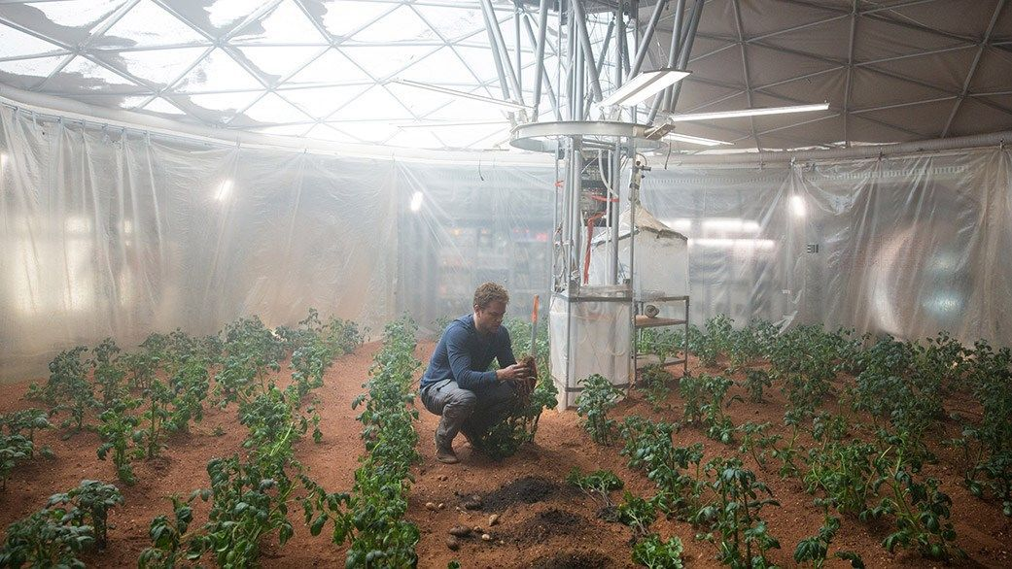
How I feel about the movie
The movie didn't really make me feel anything. though it was pretty fun to watch. I would recommend it if you like the kind of story that it is. Its not one I would universally recommend.

