Slide 1
PINNs for THz Imaging

Slide 2
Context
THz non-invasive, strong penetrating capabilities.
Applications in non-destructive testing, quality monitoring, security screening, biomedical imaging, sensing for robotics, ect.
Depth information needed in THz imaging.
Current methods: - Focus measurements
- Time of flight
- Heterodyne detection

Slide 3
Why use PINNs
Traditional, supervised NNs require large amounts of data.
Traditional NN used 60,000 training images and 10,000 validation.
THz images are difficult and expensive to generate.

Slide 4
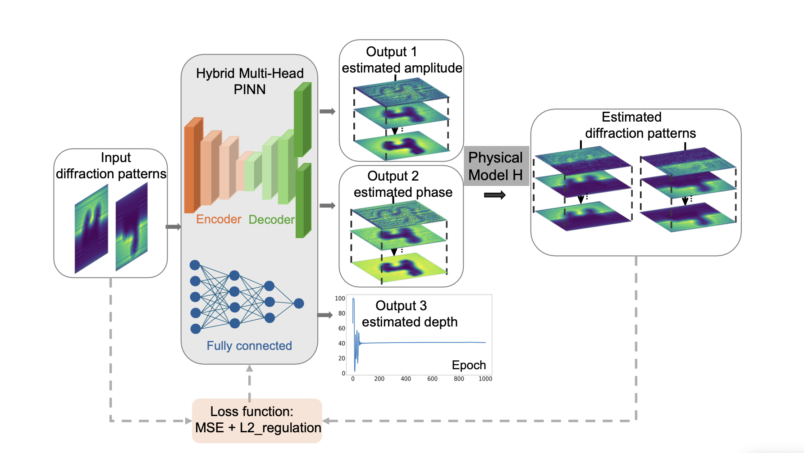
NN structure

Slide 5

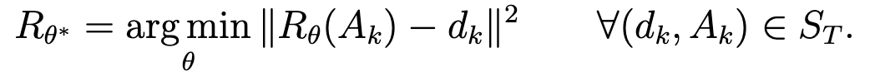
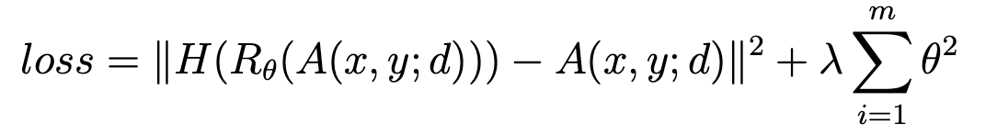
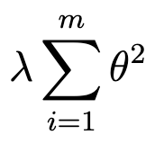
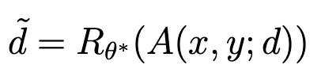
Redefine the objective
Traditional approach:
Given some labelled data set:
Learn mapping function:
PINN Approach:
Redefine loss function:
Where is a term for L2 normalization (punishes poor distribution of weights).
When this is optimized depth can be calculated:

Slide 6
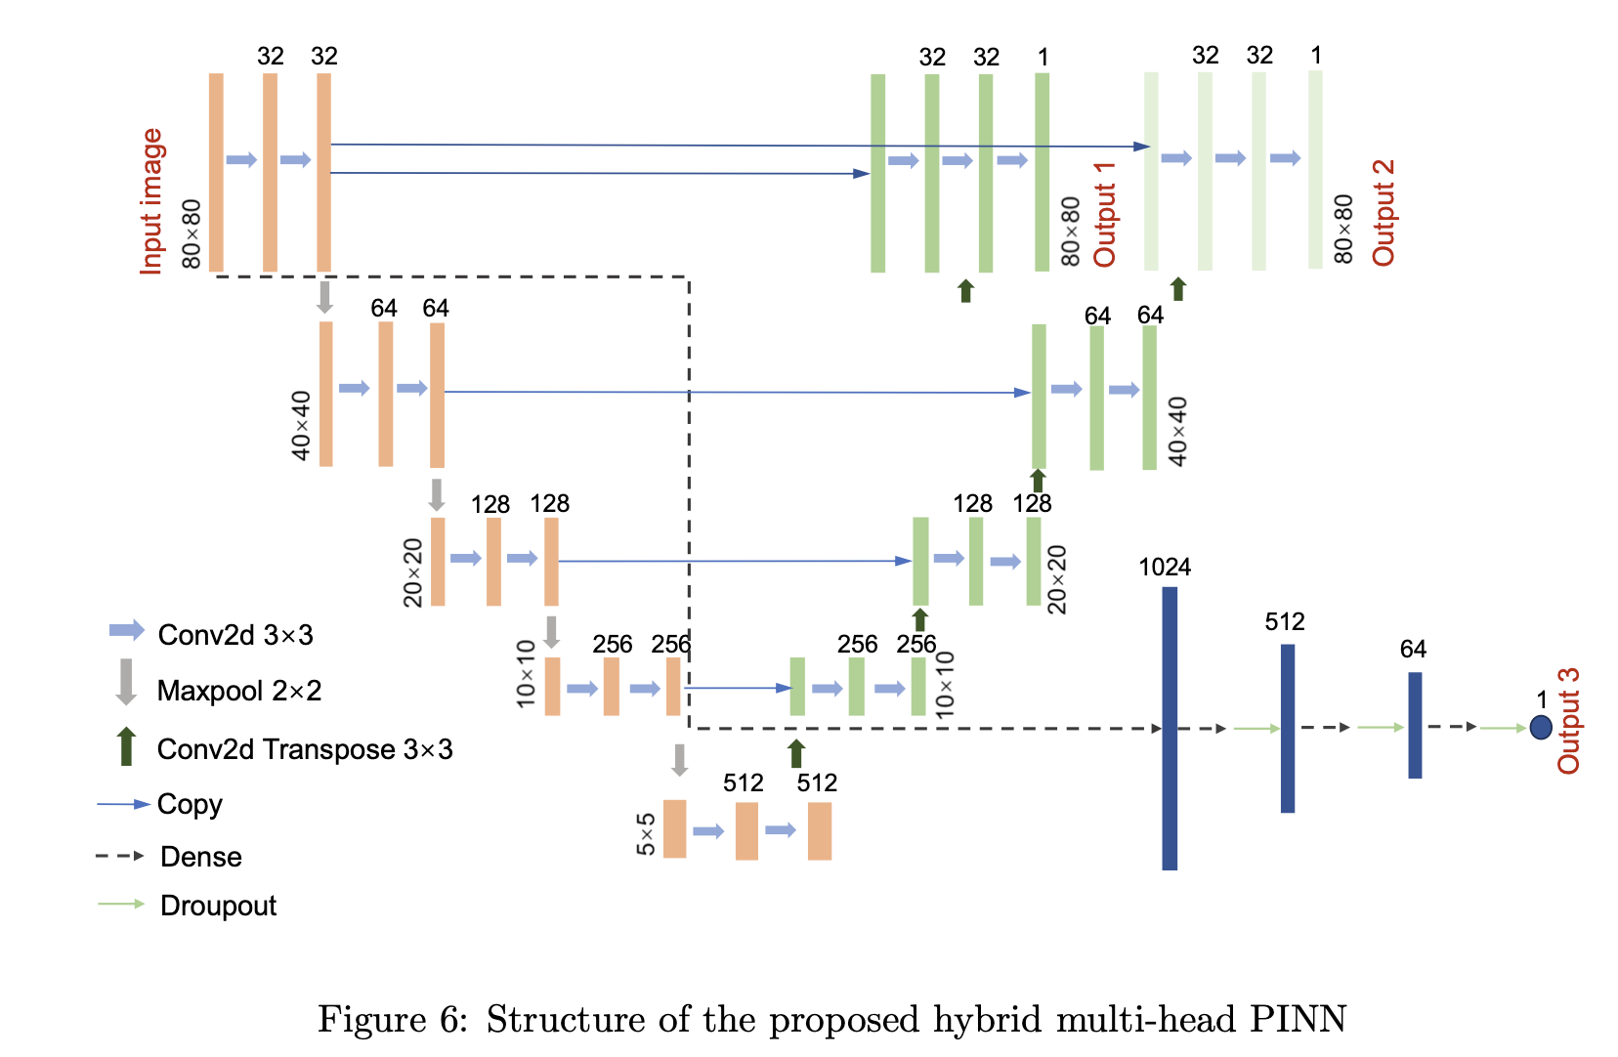
More detailed breakdown of PINN

Slide 7
Unsupervised Learning
The Encoder-Decoder structure reduces the ‘complexity’ of the image and then attempts to reconstruct the image.
Shared sampling ensure between layers ensure “correct data” is preserved.
Uses physical model H to reconstruct diffraction pattern from phase and amplitude.
MSE from output and the original image is used to optimize weights.

Slide 8
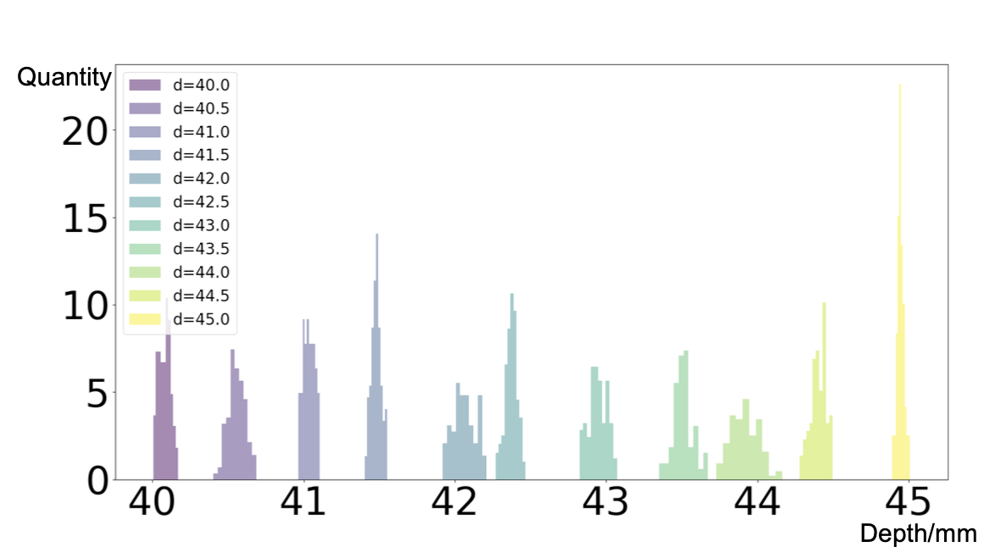
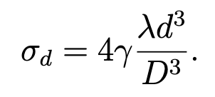
Resolution
Theoretical ideal resolution ~0.8-1.17mm
PINN achieved 0.5mm resolution

Slide 9
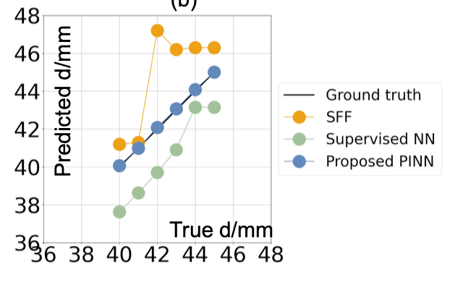
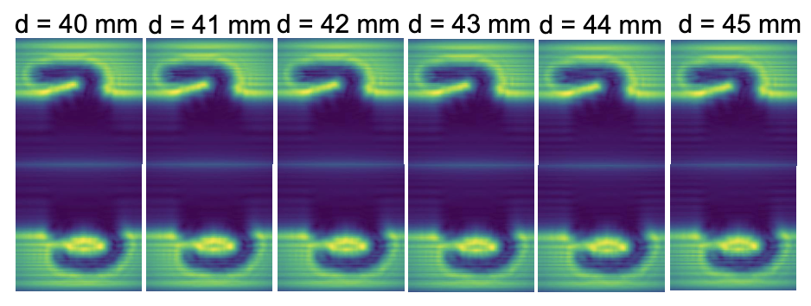
Results
Hybrid PINN much greater accuracy than supervised NN
Differences in diffraction patterns at 1mm intervals are non-trivial.

Slide 10
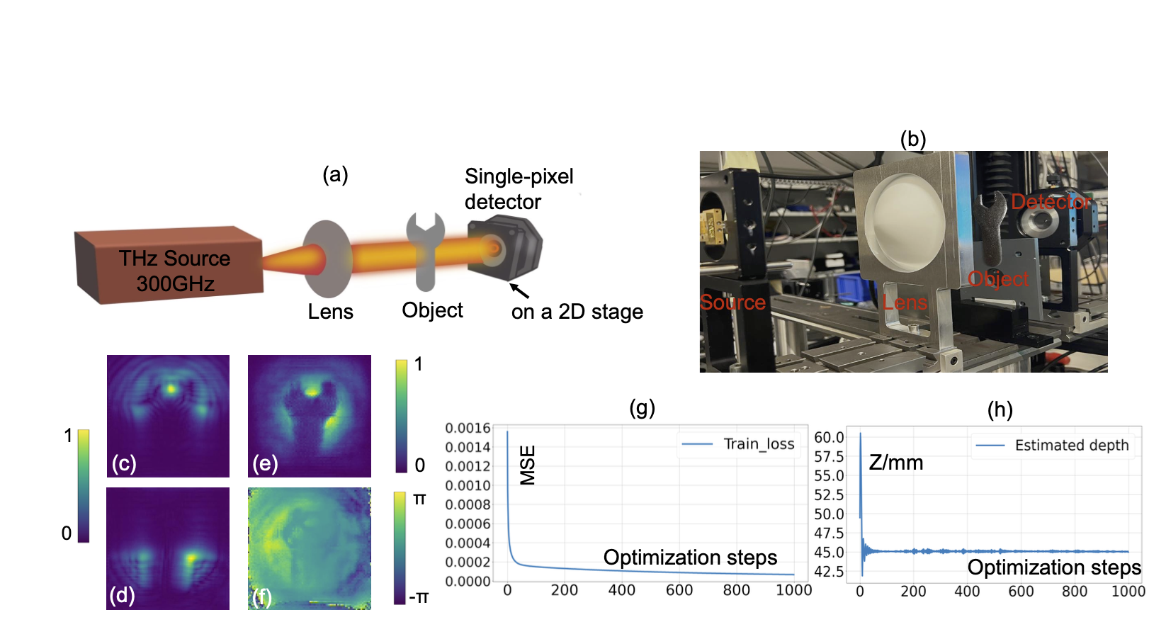
Experimental Validation
Validated on a physical wrench to test experimental performance.
~ 1mm thick metal

Slide 11
Further questions and next steps
Should work for general images but haven’t show extensive testing for this application.
Application/ efficiency of method is unclear.
Given the 1-d nature of spectroscopy data, we have a factor of N fewer data points, this could limit the efficacy of the model.

