Slide 1
Transfer learning and finetuning

Slide 2
Concept
Train models in two stages:
Pre-training on large synthesized data set
Fine tuning on experimental data
Allows for a wide basis while still understanding errors and artifacts of experimental set up.

Slide 3
Context
Exploring limitations in sim2Real training approach for Materials Science applications
This aims to improve real world predictions from the model
Focus of the paper is on the scaling law predicting the error reduction in these models

Slide 4
Method
Pre-train on simulated data:
Molecular Dynamics simulations, Quantum chemistry calculations or first principles.
Creates large database of mappings material descriptors -> property predictions
Fine-tune on experimental data:
Take the weights of pre-training as initial values (transfers “knowledge”)
Smaller dataset with a lower learning rate

Slide 5



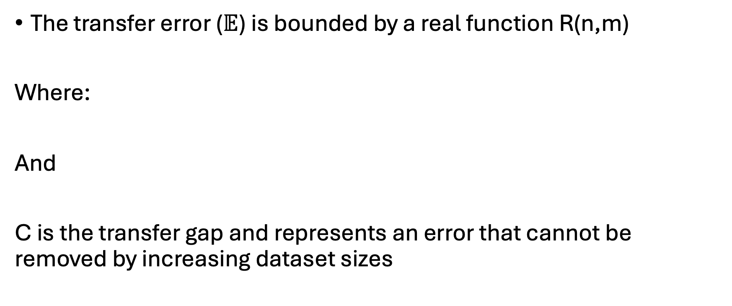
Limits of transfer training
The transfer error ($𝔼$) is bounded by a real function R(n,m)
Where:
And
C is the transfer gap and represents an error that cannot be removed by increasing dataset sizes

Slide 6
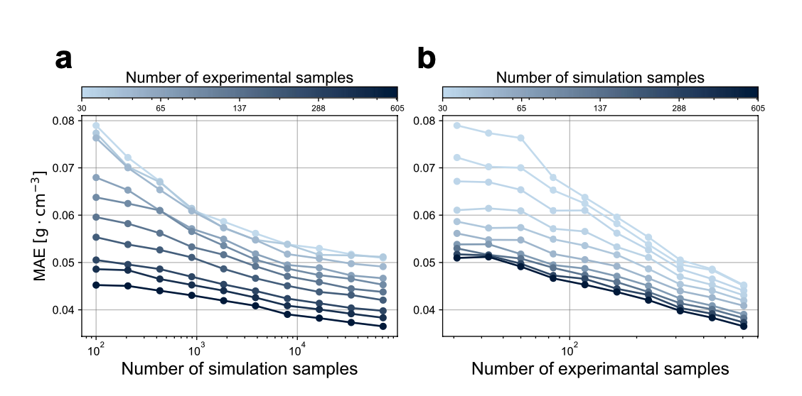
Findings
Errors in density predictions in amorphous polymers:

Slide 7
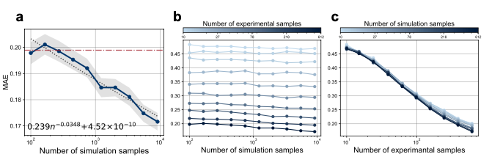
Transfer vs Direct
Red dashed line represents direct training

Slide 8
