Slide 1


RetailNext Outfit Assistant: AI-Powered Product Discovery
Executive + CTO briefing for reducing product-findability complaints using multimodal search and match intelligence.
Notes:
Open with the business framing: RetailNext has a findability problem, not a product assortment problem. Position the solution as a practical way to convert intent into purchasable items in seconds.

Slide 2


Business Situation at RetailNext
Problem 1
Problem 2
Problem 3
Findability
Intent Gap
Store Burden
Recent customer reviews cite difficulty finding updated styles or specific items before upcoming events.
Shoppers describe looks in natural language or photos; keyword/filter search misses this intent.
Associates spend time manually translating vague requests into inventory searches, slowing conversion.
Notes:
State assumptions from discovery: poor reviews are concentrated in event-driven shopping journeys and long-tail style requests. Current keyword search and manual associate lookup create friction and missed conversions.

Slide 3

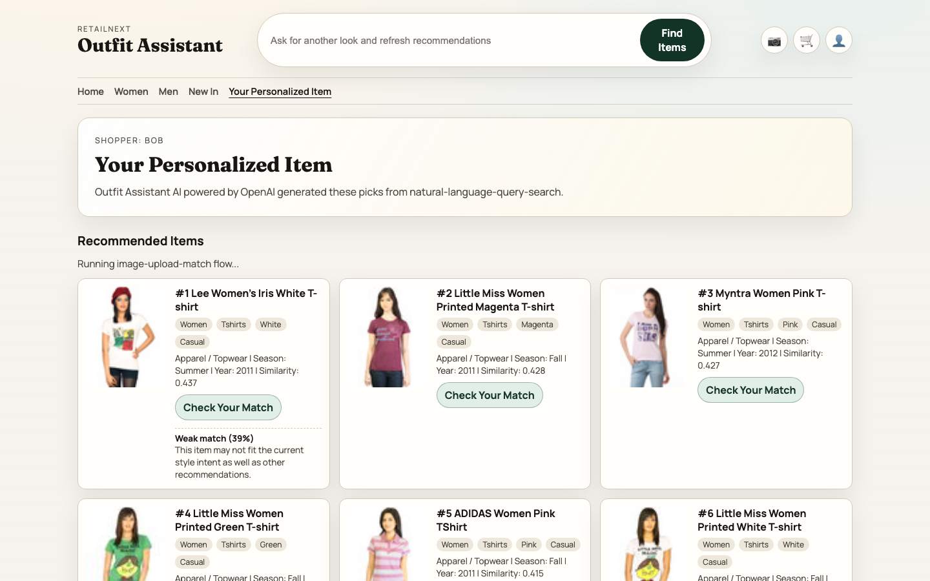
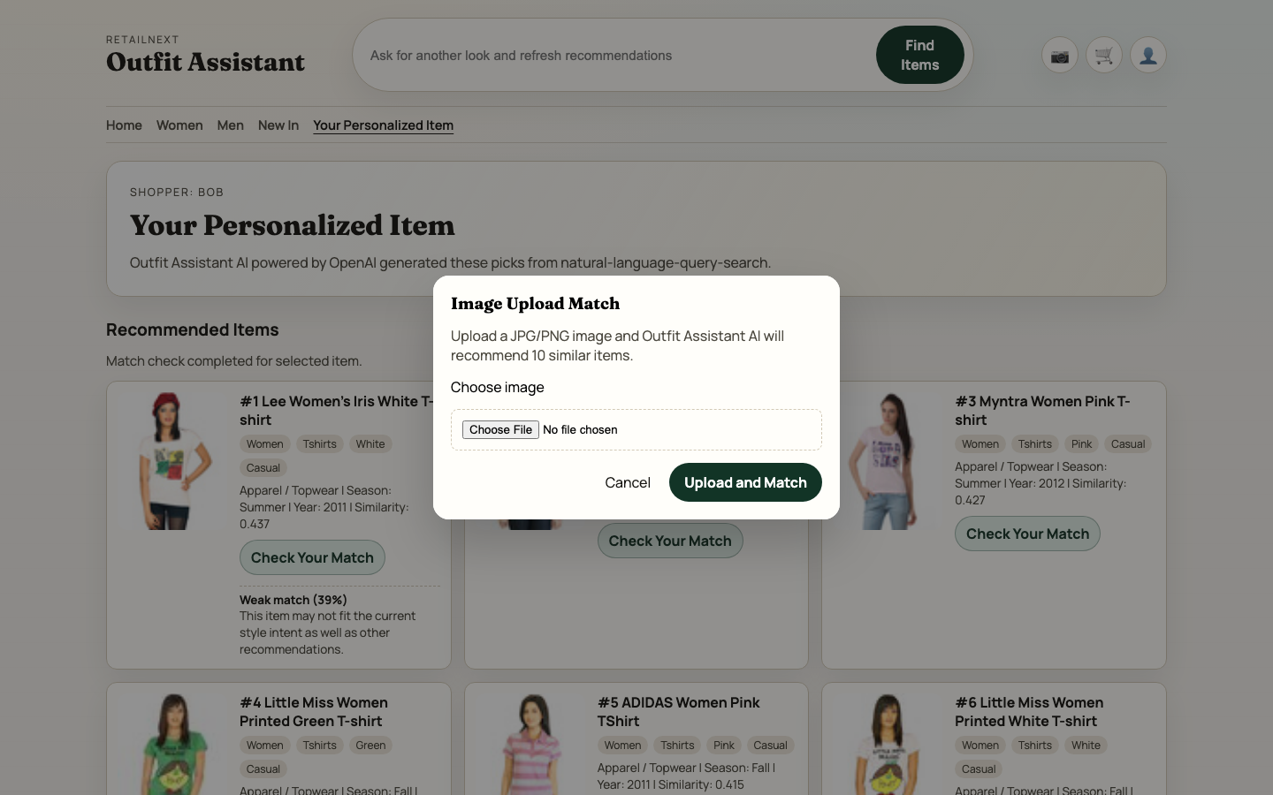
What We Built (Demo Ready Today)
A full-stack prototype built from the OpenAI cookbook sample_clothes dataset and extended for RetailNext.
Natural-Language Query Search
Bob types intent (for example: 'my wife wants a sakura season t shirt') and receives ranked similar items.
Image Upload Match
Customer uploads a photo; vision analysis extracts style attributes and generates retrieval-ready search queries.
AI Match Explainability (Added Feature)
'Check Your Match' returns verdict, rationale, and confidence for each item and persists results for follow-up.
Notes:
Walk through what was built: text search, image match, and the added Check Your Match feature. Use the screenshot as proof that the experience is functional end-to-end today.

Slide 4

OpenAI Platform Used in This Solution
Multimodal Understanding
Semantic Retrieval
Session-Aware Match Scoring
Model: text-embedding-3-large
Model/API: gpt-4o-mini via Responses API
Model: gpt-4o-mini
Embeds shopper text and generated queries; cosine similarity ranks best matches across 1,000 catalog vectors.
Evaluates each recommendation against session intent for 'Check Your Match' verdict + rationale + confidence.
Analyzes uploaded outfit images and returns structured JSON (gender, occasion, colors, article types, search queries).
Key Capability: Vision + Structured Output
Key Capability: Intent-Based Discovery
Key Capability: Explainable Recommendations
Notes:
Explain platform mapping to business function: vision for intent extraction, embeddings for retrieval, and response reasoning for explanation. Highlight that each model call has a specific job in the pipeline.

Slide 5

Solution Architecture
Orchestration
Intelligence & Data
Touchpoints
gpt-4o-mini
Vision extraction + match reasoning
Web Storefront
Home + Personalized UI
FastAPI Service Layer
Python / FastAPI
text-embedding-3-large
• Search + image-match APIs
• Session context + ranking
• Match-check persistence
Query + catalog embeddings
Associate/Kiosk Ready
Same API-backed flows
SQLite + Vector Cache
catalog_index.npz + session DB
Notes:
Describe architecture left to right: touchpoint, API orchestration, AI/data services. Mention persistence in SQLite for sessions and match checks to support analytics and future optimization.

Slide 6



Process Flow: Query to Recommendation
01
02
03
04
05
User Intent
Intent Extraction
Retrieval
Ranking + Explain
Response + Logging
Customer types a natural-language request or uploads an outfit image.
Text path embeds query. Image path uses gpt-4o-mini to create structured search queries.
Service runs cosine similarity on catalog embeddings and selects top candidates.
Product candidates are ranked; optional 'Check Your Match' call returns verdict/rationale/confidence.
Personalized results render in UI; sessions and match checks are stored in SQLite for analytics.
Numpy Vector Index
Web UI
OpenAI API
Session Reasoner
UI + Persistence
Notes:
Narrate the exact request lifecycle. Emphasize that image and text converge into the same semantic retrieval path, which keeps implementation simple and scalable.

Slide 7

Business Value & Pilot KPIs
15-20%
30-45%
10-15%
Conversion Lift Target
Faster Time-to-Item
Return Rate Reduction
Expected improvement from better relevance on event-driven and long-tail style requests.
Reduction in search friction using natural language and image-driven discovery.
Match explanation can improve confidence before checkout and reduce mismatched purchases.
Strategic Impact
Operational Gains
Capture structured customer intent data (occasion, color, style) for merchandising decisions.
Reduce associate lookup time and escalation for ambiguous customer requests.
Track query-to-click and match outcomes for continuous ranking improvements.
Increase loyalty by turning 'can't find it' moments into guided shopping experiences.
Roll out safely with API controls, monitoring, and deterministic fallback logic.
Create a reusable AI foundation across ecommerce, app, and in-store channels.
Notes:
Present these as pilot KPI targets, not guaranteed outcomes. Tie each KPI to a measurable mechanism in the built product (relevance, speed, confidence).

Slide 8

Implementation Roadmap
De-risked path from pilot to enterprise scale in 12 weeks.
Phase 1
Phase 2
Phase 3
Phase 4
Foundation
Pilot
Optimize
Scale
Weeks 1-2
Weeks 3-6
Weeks 7-9
Week 10+
•
Catalog sync + embedding cache build
•
Launch in 5 high-traffic stores
•
Latency and caching improvements
•
Regional rollout expansion
•
Associate enablement and playbooks
•
Ranking quality improvements
•
Inventory/availability integrations
•
API + session schema hardening
•
Weekly prompt/ranking tune-ups
•
KPI dashboard for funnel + match
•
Seasonal campaign activation
•
Security and guardrail baseline
•
Collect user feedback + query logs
•
A/B test against current search
•
Production governance cadence
•
Success metrics definition
Notes:
Show risk-managed execution: foundation, pilot, optimization, scale. Point out feedback loops and A/B testing before broad rollout.

Slide 9

OpenAI
Why OpenAI Platform for RetailNext
Model Breadth
One platform for multimodal reasoning, embeddings, and response generation.
Vision, text generation, and embeddings are available in a consistent API surface for faster iteration.
Enterprise Controls
API-level controls and governance patterns support secure rollout for retail customer experiences.
This enabled a fast build from cookbook dataset to full-stack prototype: understand intent, retrieve products, explain matches, and log outcomes.
Developer Velocity
SDKs and cookbook assets reduced implementation time while keeping architecture extensible.
Notes:
Frame OpenAI as the enabling platform: unified APIs, enterprise control patterns, and rapid developer iteration. Avoid abstract hype; tie claims back to what was implemented in this prototype.

Slide 10

OpenAI
Next Steps
Submission-ready plan plus onsite presentation flow.
Immediate Actions
Presentation Roles
Finalize Submission Package
Lead Presenter
Record a <6 minute technical walkthrough covering architecture, key code paths, and live UX flows.
[Your Name]
Business + technical narrative
Prepare Executive Demo
Use a 20-minute narrative: business problem, OpenAI platform, architecture, value, then live demo.
Demo/Q&A Lead
[Your Name]
Agree Pilot Success Criteria
Architecture, code, and risk questions
Align KPI targets, risk controls, and go/no-go thresholds with Head of Innovation and CTO.
Notes:
Close with concrete next steps and role clarity for the onsite format. Invite questions on architecture decisions, metrics assumptions, and rollout risks.

