Slide 1
Economics and Peacebuilding
GWU – 2/28/2017
Notes:
http://www.usip.org/sites/default/files/SR315.pdf

Slide 2


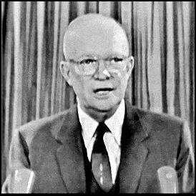
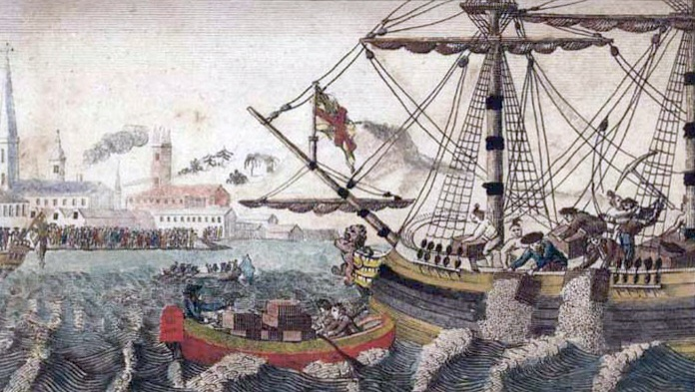

Economics and Conflict
Notes:
Sherman – civil war scorched earth – used 1860 census data to lead troops to high crop areas
Leonardo Dicaprio and Djimon Hounsou (Jaimen Hansue) in Blood Diamond, (set during Sierra Leone civil war)
President Eisenhower warning of the military industrial complex
Boston Tea Party against the Tea Act (which actually allowed for tea trade)
Iraq forces lighting oil wells in withdraw from Kuwait in Gulf War I, which it had invaded for oil

Slide 3
? Employment → Conflict ?

Slide 4
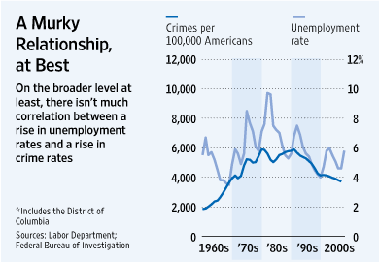
Notes:
2009 Wall Street Journal
http://www.wsj.com/articles/SB123974939828118493
But, could be ecological fallacy.
1930 study found states with more immigrants had higher literacy rates. But not because immigrants were more literate.

Slide 5
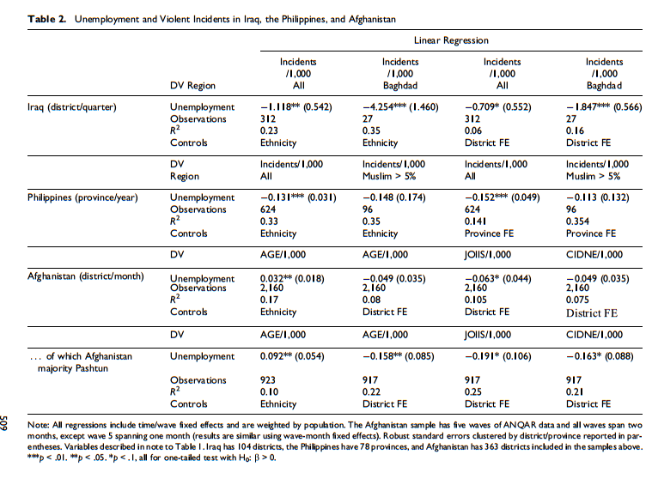
Notes:
Eli Berman (UCSD) , Michael Callen (UCSD) , Joseph H. Felter (Stanford), and Jacob N. Shapiro (Princeton)
As unemployment increases, violent incidents decrease
Either unemployment lowers costs of information or counterinsurgency efforts lower violence and hurt the businesses

Slide 6
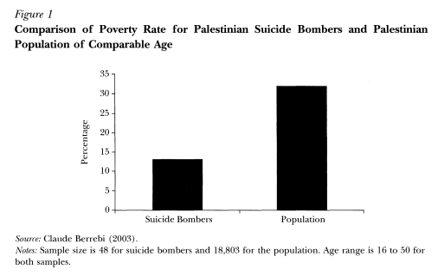
Notes:
Work by Claude Berrebi from Kuerger and Malekova 2003 – Education, Poverty, and Terrorism: Is there a Causal Connection

Slide 7
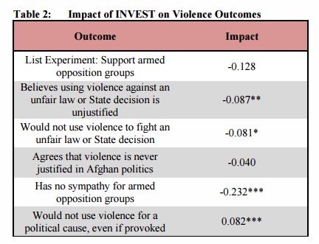
Notes:
Mercycorp Job training program in Helmand province of Afghanistan
Those who got the job training:
More likely to justify using violence against unfair laws
More likely to use violence to fight an unfair law
Has more sympathy for armed opposition groups
BUT less likely to use violence for a political cause

Slide 8
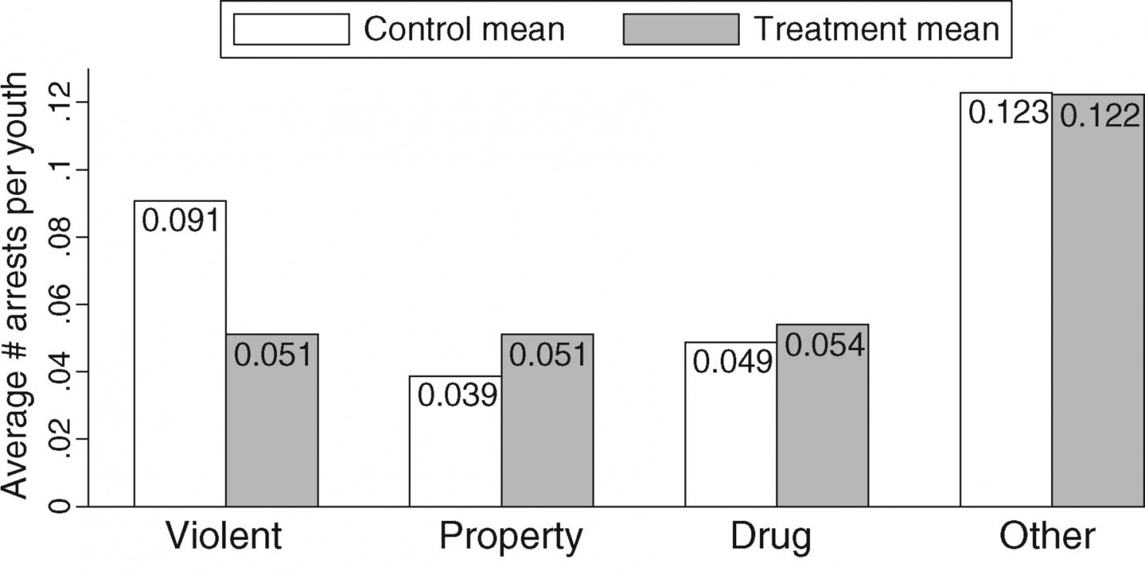
Notes:
Sara Heller, 2014 in Science magazine
Students were randomly assigned into summer job program
Worked to identify arrest rate between students in the program vs. students not in the program

Slide 9



??? Employment → Conflict ??? But jobs programs abound!
Notes:
$800 Million to TFBSO in Afghanistan
Economic stabilization to reduce violence
$675 Million to Community Stabilization Program CSP in Iraq to employ youth
$1 Billion per year - World Bank on skills programs

