Slide 1

셰이더 프로그래밍 Lecture8
2026년 1학기
담당교수 : 게임공학과 이택희

Slide 2


Bloom

Slide 3
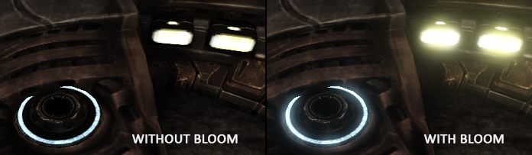












Bloom
빛샘효과
강한 빛은 실제로 빛이 발생하고 있는 영역 보다 넓은 영역을 차지함

Slide 4
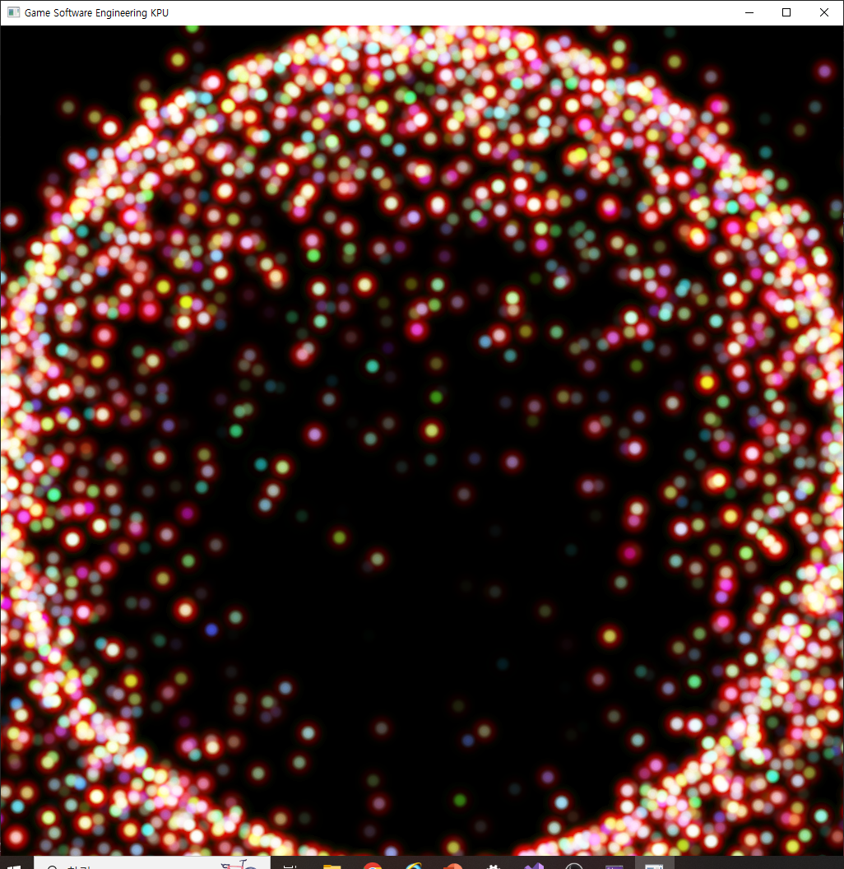
Bloom
파티클과 같이 빛을 발생시키는 오브젝트의 경우 Bloom 효과가 필수적

Slide 5
Bloom
Bloom 효과는 아래와 같은 단계로 이루어 짐
Color 의 세기를 HDR Texture에 출력
HDR Texture를 Blur 시켜 빛이 퍼지는 영역 생성
원래 영상과 합성하여 최종 렌더링

Slide 6
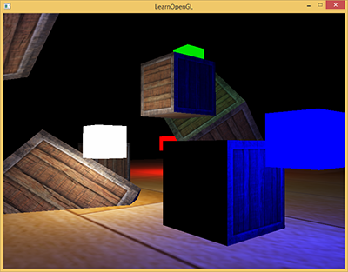
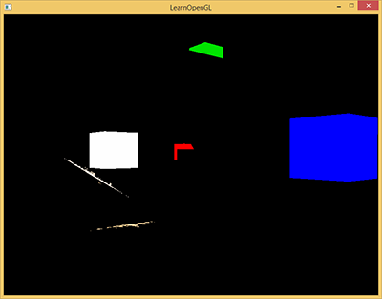










Bloom
Color 의 세기를 HDR Texture에 출력

Slide 7




Color 의 세기를 HDR Texture에 출력
m_HDRFBO
GL_COLOR_ATTACHMENT0 : 결과를 그대로 출력하는 Texture : m_HDRLowTexture
GL_COLOR_ATTACHMENT1 : 1보다 큰 결과만 출력하는 Texture : m_HDRHighTexture

Slide 8
Color 의 세기를 HDR Texture에 출력 (FBO 코드)
glGenFramebuffers(1, &m_HDRFBO);
glBindFramebuffer(GL_FRAMEBUFFER, m_HDRFBO);
glGenTextures(1, &m_HDRHighTexture);
glBindTexture(GL_TEXTURE_2D, m_HDRHighTexture);
glTexImage2D(GL_TEXTURE_2D, 0, GL_RGBA16F, m_WindowSizeX, m_WindowSizeY, 0, GL_RGBA, GL_FLOAT, NULL);
glTexParameteri(GL_TEXTURE_2D, GL_TEXTURE_MIN_FILTER, GL_LINEAR);
glTexParameteri(GL_TEXTURE_2D, GL_TEXTURE_MAG_FILTER, GL_LINEAR);
glTexParameteri(GL_TEXTURE_2D, GL_TEXTURE_WRAP_S, GL_CLAMP_TO_EDGE);
glTexParameteri(GL_TEXTURE_2D, GL_TEXTURE_WRAP_T, GL_CLAMP_TO_EDGE);
glGenTextures(1, &m_HDRLowTexture);
glBindTexture(GL_TEXTURE_2D, m_HDRLowTexture);
glTexImage2D(GL_TEXTURE_2D, 0, GL_RGBA16F, m_WindowSizeX, m_WindowSizeY, 0, GL_RGBA, GL_FLOAT, NULL);
glTexParameteri(GL_TEXTURE_2D, GL_TEXTURE_MIN_FILTER, GL_LINEAR);
glTexParameteri(GL_TEXTURE_2D, GL_TEXTURE_MAG_FILTER, GL_LINEAR);
glTexParameteri(GL_TEXTURE_2D, GL_TEXTURE_WRAP_S, GL_CLAMP_TO_EDGE);
glTexParameteri(GL_TEXTURE_2D, GL_TEXTURE_WRAP_T, GL_CLAMP_TO_EDGE);
glFramebufferTexture2D(GL_FRAMEBUFFER, GL_COLOR_ATTACHMENT0, GL_TEXTURE_2D, m_HDRLowTexture, 0);
glFramebufferTexture2D(GL_FRAMEBUFFER, GL_COLOR_ATTACHMENT1, GL_TEXTURE_2D, m_HDRHighTexture, 0);
GLenum status = glCheckFramebufferStatus(GL_FRAMEBUFFER);
if (status != GL_FRAMEBUFFER_COMPLETE)
{
std::cout << "fbo creation failed" << std::endl;
}
glBindFramebuffer(GL_FRAMEBUFFER, 0);

Slide 9
Color 의 세기를 HDR Texture에 출력 (fs 코드)
layout(location=0) out vec4 FragColor;
layout(location=1) out vec4 FragColorHigh;
void Textured()
{
vec4 result = texture(u_Texture, v_UV)*v_Color;
float brightness = dot(result.rgb, vec3(0.2126, 0.7152, 0.0722));
FragColor = result;
if(brightness > 1.0)
FragColorHigh = result;
else
FragColorHigh = vec4(0);
}
void main()
{
Textured();
}

Slide 10
Color 의 세기를 HDR Texture에 출력 (draw 코드)
glBindFramebuffer(GL_FRAMEBUFFER, m_HDRFBO);
GLenum drawbuffers[2] = { GL_COLOR_ATTACHMENT0, GL_COLOR_ATTACHMENT1 };
glDrawBuffers(2, drawbuffers);
~~~ Render particles
glBindFramebuffer(GL_FRAMEBUFFER, 0);

Slide 11
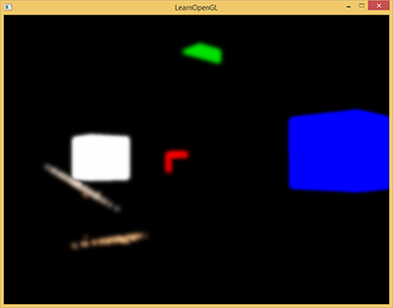








Bloom
HDR Texture를 Blur 시켜 빛이 퍼지는 영역 생성

Slide 12






HDR Texture를 Blur 시켜 빛이 퍼지는 영역 생성
m_PingpongFBO[2]
효율적인 Blur를 위한 가로방향, 세로방향 blur가 순차적으로 일어 남
m_PingpongFBO[0] 가로방향 blur → m_PingpongFBO[1] 세로방향 blur → …
각 m_PingpongFBO[i]는 Rendertarget texture 한장 씩 attach : m_PingpongTexture[i]

Slide 13















Slide 14
HDR Texture를 Blur 시켜 빛이 퍼지는 영역 생성 (FBO 코드)
glGenFramebuffers(2, m_PingpongFBO);
glGenTextures(2, m_PingpongTexture);
for (int i = 0; i < 2; i++)
{
glBindFramebuffer(GL_FRAMEBUFFER, m_PingpongFBO[i]);
glBindTexture(GL_TEXTURE_2D, m_PingpongTexture[i]);
glTexImage2D(
GL_TEXTURE_2D, 0, GL_RGBA16F, m_WindowSizeX, m_WindowSizeY, 0, GL_RGBA, GL_FLOAT, NULL
);
glTexParameteri(GL_TEXTURE_2D, GL_TEXTURE_MIN_FILTER, GL_LINEAR);
glTexParameteri(GL_TEXTURE_2D, GL_TEXTURE_MAG_FILTER, GL_LINEAR);
glTexParameteri(GL_TEXTURE_2D, GL_TEXTURE_WRAP_S, GL_CLAMP_TO_EDGE);
glTexParameteri(GL_TEXTURE_2D, GL_TEXTURE_WRAP_T, GL_CLAMP_TO_EDGE);
glFramebufferTexture2D(GL_FRAMEBUFFER, GL_COLOR_ATTACHMENT0, GL_TEXTURE_2D, m_PingpongTexture[i], 0);
status = glCheckFramebufferStatus(GL_FRAMEBUFFER);
if (status != GL_FRAMEBUFFER_COMPLETE)
{
std::cout << "fbo creation failed" << std::endl;
}
}
glBindFramebuffer(GL_FRAMEBUFFER, 0);

Slide 15
HDR Texture를 Blur 시켜 빛이 퍼지는 영역 생성 ( VS 코드)
#version 330
in vec3 a_Position;
in vec2 a_TexPos;
out vec2 v_TexPos;
void main()
{
vec4 newPosition = vec4(a_Position, 1);
gl_Position = newPosition;
v_TexPos = a_TexPos;
}

Slide 16
HDR Texture를 Blur 시켜 빛이 퍼지는 영역 생성 ( FS 코드 : 가로, m_GaussianBlurHShader)
#version 330
layout(location=0) out vec4 FragColor;
in vec2 v_TexPos;
uniform sampler2D u_Texture;
uniform float weight[5] = float[] (0.227027, 0.1945946, 0.1216216, 0.054054, 0.016216);
void main()
{
vec2 tex_offset = 1.0 / textureSize(u_Texture, 0); // gets size of single texel
vec3 result = texture(u_Texture, v_TexPos).rgb * weight[0]; // current fragment's contribution
for(int i = 1; i < 5; ++i)
{
result += texture(u_Texture, v_TexPos + vec2(tex_offset.x * i, 0.0)).rgb * weight[i];
result += texture(u_Texture, v_TexPos - vec2(tex_offset.x * i, 0.0)).rgb * weight[i];
}
FragColor = vec4(result, 1.0);
}

Slide 17
HDR Texture를 Blur 시켜 빛이 퍼지는 영역 생성 ( FS 코드 : 세로, m_GaussianBlurVShader)
#version 330
layout(location=0) out vec4 FragColor;
in vec2 v_TexPos;
uniform sampler2D u_Texture;
uniform float weight[5] = float[] (0.227027, 0.1945946, 0.1216216, 0.054054, 0.016216);
void main()
{
vec2 tex_offset = 1.0 / textureSize(u_Texture, 0); // gets size of single texel
vec3 result = texture(u_Texture, v_TexPos).rgb * weight[0]; // current fragment's contribution
for(int i = 1; i < 5; ++i)
{
result += texture(u_Texture, v_TexPos + vec2(0.0, tex_offset.y * i)).rgb * weight[i];
result += texture(u_Texture, v_TexPos - vec2(0.0, tex_offset.y * i)).rgb * weight[i];
}
FragColor = vec4(result, 1.0);
}

Slide 18
HDR Texture를 Blur 시켜 빛이 퍼지는 영역 생성 ( Draw 코드 )
void Renderer::DrawGaussianBlur(GLuint texID, GLuint targetFBOID, GLuint shader)
{
glBindFramebuffer(GL_FRAMEBUFFER, targetFBOID);
glUseProgram(shader);
GLuint posLoc = glGetAttribLocation(shader, "a_Position");
glEnableVertexAttribArray(posLoc);
GLuint texLoc = glGetAttribLocation(shader, "a_TexPos");
glEnableVertexAttribArray(texLoc);
glUniform1i(glGetUniformLocation(shader, "u_Texture"), 0);
glActiveTexture(GL_TEXTURE0);
glBindTexture(GL_TEXTURE_2D, texID);
glBindBuffer(GL_ARRAY_BUFFER, m_FullRectVBO);
glVertexAttribPointer(posLoc, 3, GL_FLOAT, GL_FALSE, sizeof(float) * 5, 0);
glVertexAttribPointer(texLoc, 2, GL_FLOAT, GL_FALSE, sizeof(float) * 5, (GLvoid*)(sizeof(float) * 3));
glDrawArrays(GL_TRIANGLES, 0, 6);
glBindFramebuffer(GL_FRAMEBUFFER, 0);
}

Slide 19
HDR Texture를 Blur 시켜 빛이 퍼지는 영역 생성 ( Draw 코드 )
DrawGaussianBlur(m_HDRLowTexture, m_PingpongFBO[0], m_GaussianBlurHShader);
for (int i = 0; i < 20; i++)
{
DrawGaussianBlur(m_PingpongTexture[0], m_PingpongFBO[1], m_GaussianBlurVShader);
DrawGaussianBlur(m_PingpongTexture[1], m_PingpongFBO[0], m_GaussianBlurHShader);
}

Slide 20
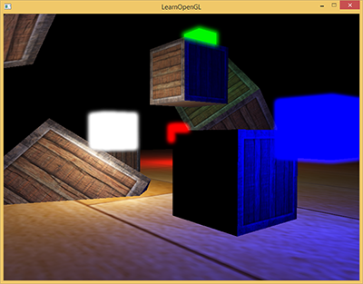
Bloom
원래 영상과 합성하여 최종 렌더링

Slide 21
원래 영상과 합성하여 최종 렌더링 (VS 코드)
#version 330
in vec3 a_Position;
in vec2 a_TexPos;
out vec2 v_TexPos;
void main()
{
vec4 newPosition = vec4(a_Position, 1);
gl_Position = newPosition;
v_TexPos = a_TexPos;
}

Slide 22
원래 영상과 합성하여 최종 렌더링 (FS 코드)
#version 330
layout(location=0) out vec4 FragColor;
in vec2 v_TexPos;
uniform sampler2D u_TexSamplerScene;
uniform sampler2D u_TexSamplerBloom;
uniform float u_Exposure;
void main()
{
const float gamma = 2.2;
vec3 hdrColor = texture(u_TexSamplerScene, v_TexPos).rgb;
vec3 bloomColor = texture(u_TexSamplerBloom, v_TexPos).rgb;
hdrColor += bloomColor;
// tone mapping
vec3 result = vec3(1.0) - exp(-hdrColor * u_Exposure);
// also gamma correct while we're at it
result = pow(result, vec3(1.0 / gamma));
FragColor = vec4(result, 1.0);
}

Slide 23
원래 영상과 합성하여 최종 렌더링 (DRAW 코드)
void Renderer::DrawMergeBloomTexture(GLuint sceneTexID, GLuint bloomTexID, float exposure)
{
GLuint shader = m_DrawMergeTextureShader;
glUseProgram(shader);
GLuint posLoc = glGetAttribLocation(shader, "a_Position");
glEnableVertexAttribArray(posLoc);
GLuint texLoc = glGetAttribLocation(shader, "a_TexPos");
glEnableVertexAttribArray(texLoc);
glUniform1i(glGetUniformLocation(shader, "u_TextureScene"), 0);
glUniform1i(glGetUniformLocation(shader, "u_TextureBloom"), 1);
glActiveTexture(GL_TEXTURE0);
glBindTexture(GL_TEXTURE_2D, sceneTexID);
glActiveTexture(GL_TEXTURE1);
glBindTexture(GL_TEXTURE_2D, bloomTexID);
GLuint exposureLoc = glGetUniformLocation(shader, "u_Exposure");
glUniform1f(exposureLoc, exposure);
glBindBuffer(GL_ARRAY_BUFFER, m_FullRectVBO);
glVertexAttribPointer(posLoc, 3, GL_FLOAT, GL_FALSE, sizeof(float) * 5, 0);
glVertexAttribPointer(texLoc, 2, GL_FLOAT, GL_FALSE, sizeof(float) * 5, (GLvoid*)(sizeof(float) * 3));
glDrawArrays(GL_TRIANGLES, 0, 6);
}

Slide 24
전체 흐름
glBindFramebuffer(GL_FRAMEBUFFER, m_HDRFBO);
GLenum drawbuffers[2] = { GL_COLOR_ATTACHMENT0, GL_COLOR_ATTACHMENT1 };
glDrawBuffers(2, drawbuffers);
//glClear(GL_COLOR_BUFFER_BIT);
DrawAlphaClear();
DrawParticleEffect();
glBindFramebuffer(GL_FRAMEBUFFER, 0);
DrawGaussianBlur(m_HDRLowTexture, m_PingpongFBO[0], m_GaussianBlurHShader);
for (int i = 0; i < 20; i++)
{
DrawGaussianBlur(m_PingpongTexture[0], m_PingpongFBO[1], m_GaussianBlurVShader);
DrawGaussianBlur(m_PingpongTexture[1], m_PingpongFBO[0], m_GaussianBlurHShader);
}
DrawTexture(-0.75, -0.75, 128, 128, m_HDRLowTexture);
DrawTexture(-0.25, -0.75, 128, 128, m_PingpongTexture[0]);
DrawMergeBloomTexture(m_HDRLowTexture, m_PingpongTexture[0], 3.f);

