Slide 1

PyTris
Online multiplayer Tetris™ clone
By Henry Brand, Thomas Smith, Eli Kell, Daniel White

Slide 2
App Description
PyTris is a client server application with the purpose of playing a multiplayer online Tetris game with friends.
Players can connect to a server over a local network and play against each other in a one-on-one battle.
Players interact by clearing lines and sending "garbage lines" to the opponent with the purpose of topping their board out and winning the game.

Slide 3
About
Tools used
PyTris was coded 100% in Python using free Python modules (sockets, json, sys, etc.).
Server was custom made using the Python socket library
Client was made with the Pygame engine
Pygame is an old, unoptimized engine but will work for the scale of this project
Goals
Make an online multiplayer game
Make it configurable (custom shapes, tuning)
Allow for local and online play
Tetris seemed like an achievable goal for an online game within a semester

Slide 4
Features
Ability to play multiplayer over a local network (not on the UT network because of socket policy)
Single Player mode
Custom shape packs, backgrounds, other tuning

Slide 5
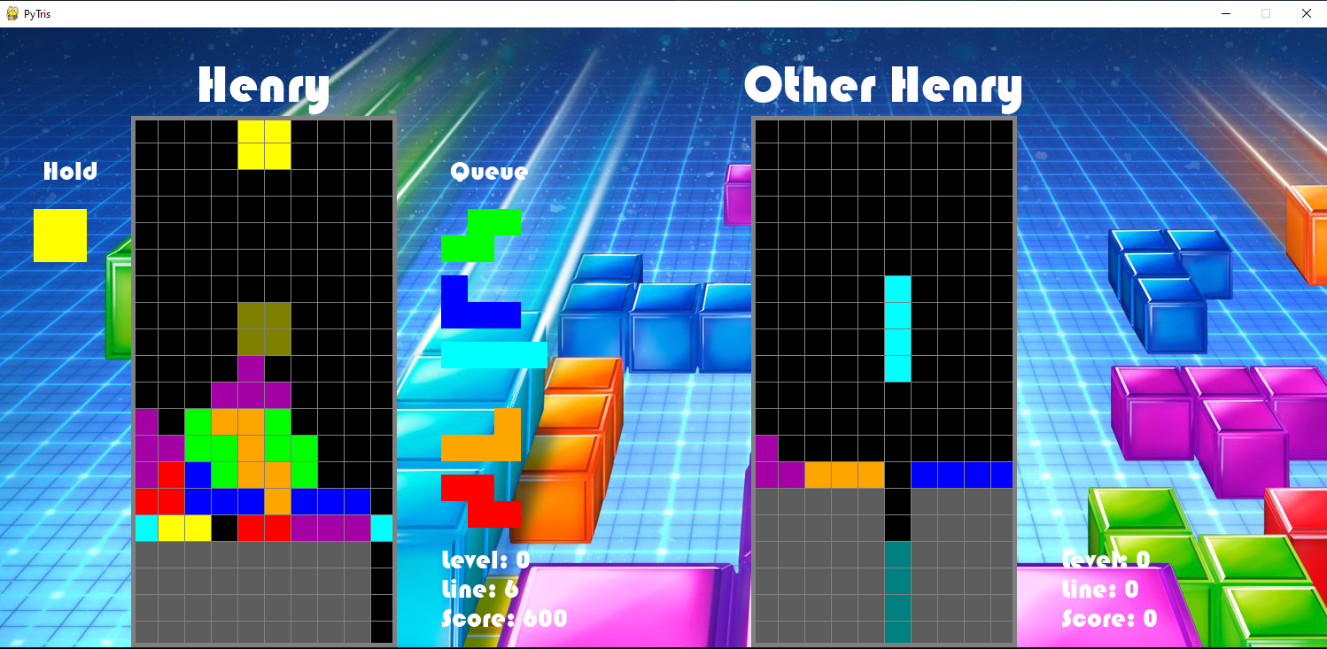
Gameplay
Old fashioned Tetris with a few modern twists that adhere to the modern Tetris™ guideline standards.
Gameplay consists of clearing lines to send garbage lines to your opponent with the hope of those lines causing them to run out of space.
Clearing a single line sends one garbage line, two sends two, and so on. The game ends when a player runs out of room on their board and “tops out”

Slide 6
Live Demo

