Slide 1


Spring MVC
FEBRUARY 13, 2017

Slide 2
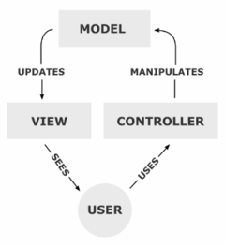
Model-View-Controller
The model is the central component of the pattern. It expresses the application's behavior in terms of the problem domain, independent of the user interface. It directly manages the data, logic and rules of the application.
A view can be any output representation of information, such as a chart or a diagram. Multiple views of the same information are possible, such as a bar chart for management and a tabular view for accountants.
The third part, the controller, accepts input and converts it to commands for the model or view.

Slide 3
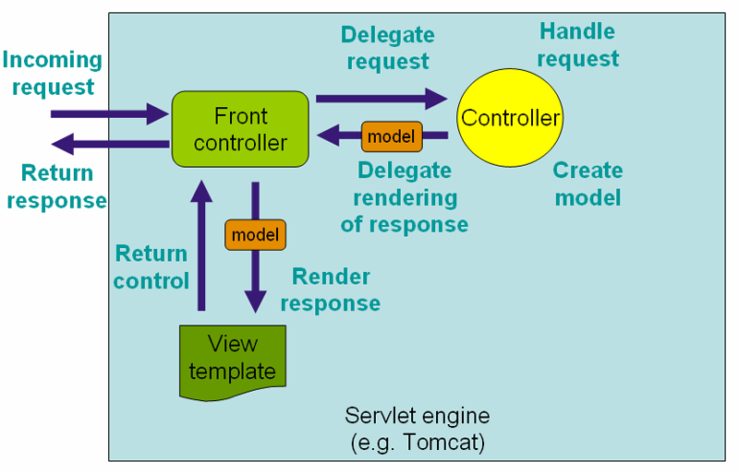
REQUEST PROCESSING FLOW

Slide 4
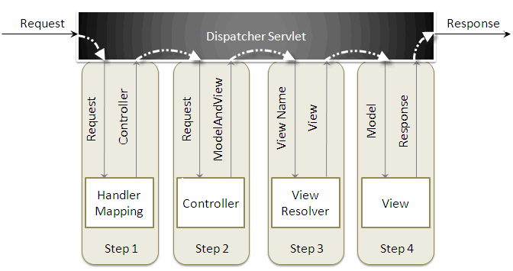
Request Processing Flow

Slide 5
Mapping Approaches
By path
@RequestMapping("/welcome")
By HTTP method
@RequestMapping(value = "/welcome", method=RequestMethod.GET)
By presence / value of query parameter
@RequestMapping(params = {"find=ByMake", "form" })
By presence / value of request header
@RequestMapping(value = "/welcome", headers="accept=text/*")

Slide 6
Mapping by HTTP Method since Spring 4.3
@GetMapping("/welcome")
@PostMapping("/welcome")
@PutMapping("/welcome")
@DeleteMapping("/welcome")

Slide 7
Request Parameters
RequestParam
/welcome?error=1
@GetMapping(“/welcome“)
public String welcome(@RequestParam(required = false) String error) { ... }

Slide 8
URL template
Path Variable
/car/15
@GetMapping(“/car/{id}“)
public String showCar(@PathVariable Long id) { ... }

Slide 9
Controller arguments
HttpSession, HttpServletRequest/HttpServletResponse
Spring’s WebRequest
java.io.InputStream, java.io.OutputStream
Model, ModelMap, java.util.Map
@RequestParam
@PathVariable
@CookieValue
BindingResult
etc (full list: https://docs.spring.io/spring/docs/current/spring-framework-reference/html/mvc.html#mvc-ann-arguments)

Slide 10
Controller return types
ModelAndView
Model / Map/ ModelMap
View
String (view name, redirect, forward)
void
etc (full list: https://docs.spring.io/spring/docs/current/spring-framework-reference/html/mvc.html#mvc-ann-return-types )

Slide 11
Controller example
@GetMapping("/cars") public String listCars(Model model) { List<Car> cars = carService.findAll(); model.addAttribute("cars", cars); return "cars"; }

Slide 12
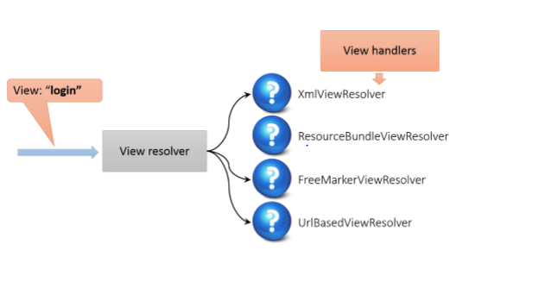
View resolving flow

Slide 13
View technologies
Supported out of the box:
• JSP / JSTL
• XML / XSLT
• Apache Velocity
• Freemarker
• Adobe PDF
• Microsoft Excel
• Jasper Reports

Slide 14
Spring boot view configuration
application.properties
spring.mvc.view.prefix: /WEB-INF/jsp/ spring.mvc.view.suffix: .jsp

Slide 15
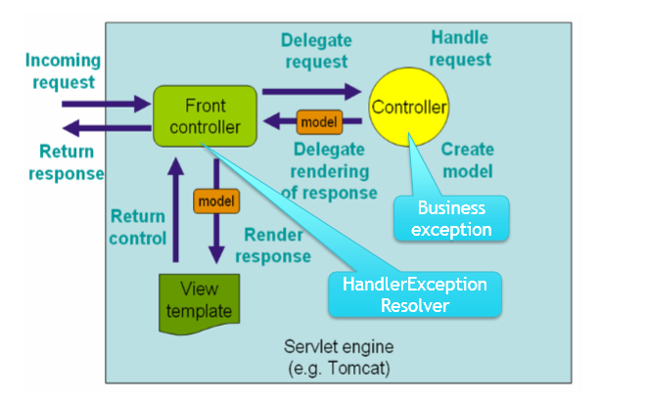
Exception handling

Slide 16
Exception handling approaches
@ExceptionHandler
@ExceptionHandler(InvalidPasswordException.class)
public String handleInvalidPasswordException(Model model) { model.addAttribute("error", "passwordError"); model.addAttribute("user", new User()); return "login"; }
@ControllerAdvice
@ControllerAdvice("com.epam.training.web.controller") public class ExceptionHandlerController { @ResponseStatus(HttpStatus.INTERNAL_SERVER_ERROR) @ExceptionHandler(RuntimeException.class) public String handleException(Model model, Exception e) { model.addAttribute("errorMessage", e.getMessage()); return "error"; } }

Slide 17
Working with session
HttpSession
@SessionAttribute
Session-scoped bean

Slide 18
HttpSession
@GetMapping("/cars") public String listCars(Model model, HttpSession session) {
User user = (User) session.getAttribute(“user”);
model.addAttribute(“user”, user);
model.addAttribute(“cars”, carService.findAll());
return “cars”; }

Slide 19
Interceptors
public abstract class HandlerInterceptorAdapter implements AsyncHandlerInterceptor { public HandlerInterceptorAdapter() { } public boolean preHandle(HttpServletRequest request, HttpServletResponse response, Object handler) throws Exception { return true; } public void postHandle(HttpServletRequest request, HttpServletResponse response, Object handler, ModelAndView modelAndView) throws Exception { } public void afterCompletion(HttpServletRequest request, HttpServletResponse response, Object handler, Exception ex) throws Exception { } public void afterConcurrentHandlingStarted(HttpServletRequest request, HttpServletResponse response, Object handler) throws Exception { } }

