Slide 1
Adaptive Resonance Theory
ART1 algorithm

Slide 2
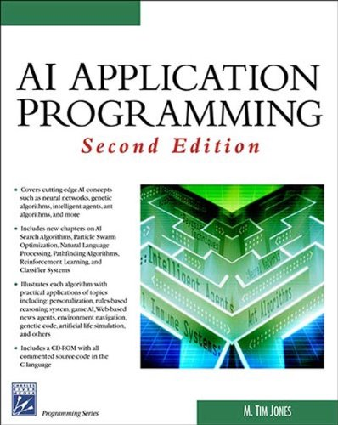
The program code was created based on the algorithm from this book.
M. Tim Jones (Author)
AI Application Programming (Programming Series) 2nd Edition

Slide 3
Goods
Hammer
Paper
Snickers
Buyer 1
SHOPPING
Screwdriver
ART1
Buyer 2
Pencil
Recommendations for customers to buy something else
Pen
Buyer 3
Kit-Kat
…..
Heath-Bar
Wrench
Buyer 10
Binder
Tape-Measure

Slide 4
Purchases
Шоколадка Snickers
Шоколадка Kit-Kat
Конфеты Heath Bar
Переплетная машина
Гаечный ключ
Счетчик ленты
Молоток
Отвертка
Карандаш
Clusters
Бумага
Ручка
Hmr
Prg
Snk
Scr
Pen
Kkt
Wrn
Pcl
Hth
Tpm
Bdr
Customer 0 0 0 0 0 0 1 0 0 1 0 0
Customer 1 0 1 0 0 0 0 0 1 0 0 1
Customer 2 0 0 0 1 0 0 1 0 0 1 0
Customer 3 0 0 0 0 1 0 0 1 0 0 1
Customer 4 1 0 0 1 0 0 0 0 0 1 0
Customer 5 0 0 0 0 1 0 0 0 0 0 1
Customer 6 1 0 0 1 0 0 0 0 0 0 0
Customer 7 0 0 1 0 0 0 0 0 1 0 0
Customer 8 0 0 0 0 1 0 0 1 0 0 0
Customer 9 0 0 1 0 0 1 0 0 1 0 0
Grouping customers into four clusters,
[0 .. 3]
0
3
2
1
2
3
2
0
1
0
ART1
Recommendations for purchases

Slide 5
Recommendations
For Customer 0,
The best recommendation is 2 (Snickers)
Owned by 2 out of 3 members of this cluster
Already owns: Kit-Kat Heath-Bar
For Customer 1,
The best recommendation is 4 (Pen)
Owned by 1 out of 2 members of this cluster
Already owns: Paper Pencil Binder
For Customer 2,
The best recommendation is 0 (Hammer)
Owned by 2 out of 3 members of this cluster
Already owns: Screwdriver Wrench Tape-Measure
For Customer 3,
No recommendation can be made.
Already owns: Pen Pencil Binder
For Customer 4,
The best recommendation is 6 (Wrench)
Owned by 1 out of 3 members of this cluster
Already owns: Hammer Screwdriver Tape-Measure
For Customer 5,
The best recommendation is 1 (Paper)
Owned by 1 out of 2 members of this cluster
Already owns: Pen Binder
For Customer 6,
The best recommendation is 9 (Tape-Measure)
Owned by 2 out of 3 members of this cluster
Already owns: Hammer Screwdriver
For Customer 7,
The best recommendation is 5 (Kit-Kat)
Owned by 2 out of 3 members of this cluster
Already owns: Snickers Heath-Bar
For Customer 8,
The best recommendation is 10 (Binder)
Owned by 1 out of 2 members of this cluster
Already owns: Pen Pencil
For Customer 9,
No recommendation can be made.
Already owns: Snickers Kit-Kat Heath-Bar

