Slide 1
Types of graph construction:
Configuration model
NSW / Navigable Small Worlds
Barabási–Albert model

Slide 2
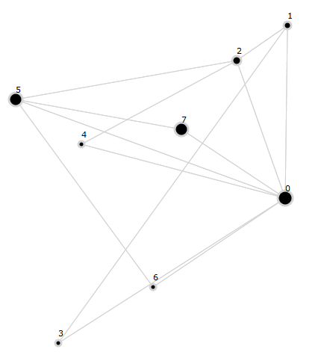
Configuration model
8 nodes in graph (length of array).
How it works
Index of array has a num how many nodes can be connected to current node:
[ 8, 3, 4, 2, 2, 7, 2, 7 ]
Schema is [8,3,4,2,2,7,2,7]
Node 0 is connected to nodes [1,2,3,4,5,6,7]
Node 1 is connected to nodes [0,2,3]
Node 2 is connected to nodes [0,1,4,5]
Node 3 is connected to nodes [0,1]
Node 4 is connected to nodes [0,2]
Node 5 is connected to nodes [0,2,6,7]
Node 6 is connected to nodes [0,5]
Node 7 is connected to nodes [0,5]
Node 0 can be max connected to 8 nodes.
Node 1 → max to 3 nodes and etc.
You can see that Node 5 can have max 7 neighbors, but it is connected only to 4 node.
Nodes 1, 3, 4 are not connected to Node 5.
It’s because of these nodes reached a limit of connection.

Slide 3

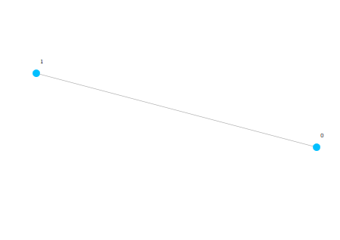
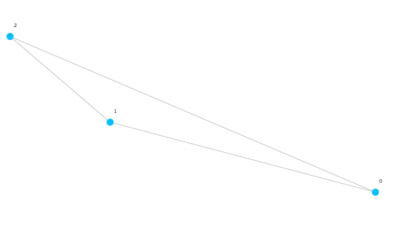
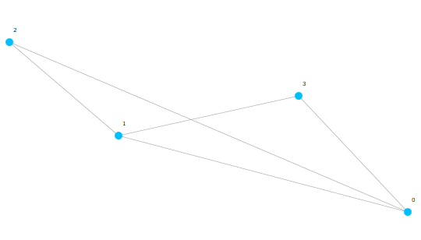
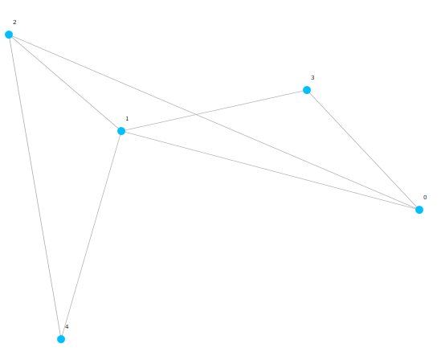
NSW / Navigable Small Worlds
New node is connected to 2 nearest neighbors.
etc.

Slide 4
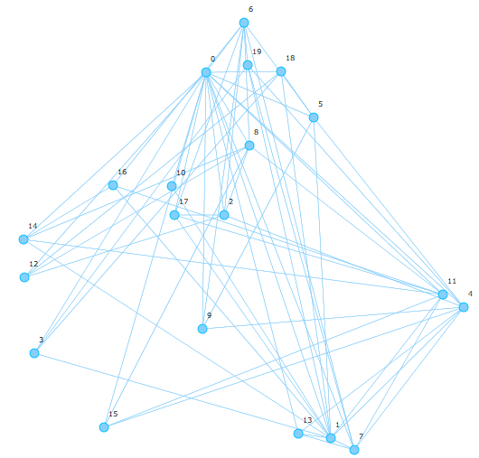
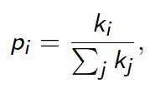
Barabási–Albert model
Nodes are added to the network sequentially.
A new node is connected to m existing nodes with probabilities proportional to the degrees of these nodes:
where ki is the degree of node i, i.e. the new nodes will be join the most connected nodes

