Slide 1

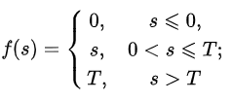
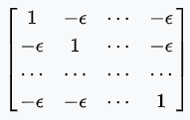




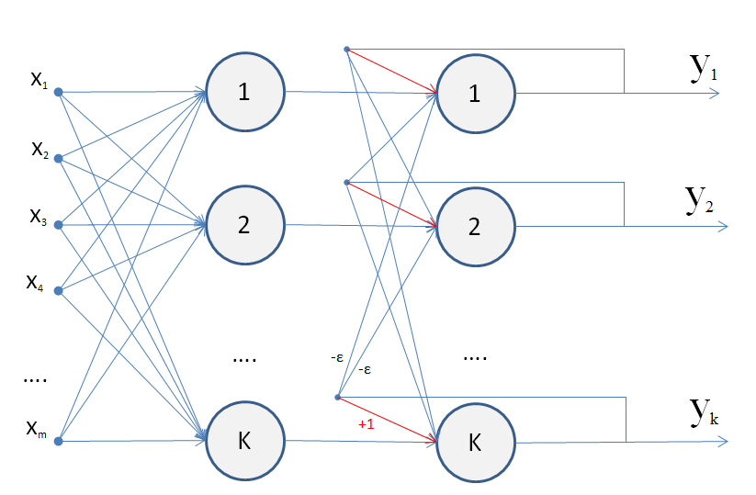

Hamming network
activation function
S
Y
W2
W1
Reference samples
x0:
-1
1
-1
1
-1
Xref[3]:
x1:
-1
1
1
1
-1
x2:
1
-1
-1
-1
1
xi = { -1, 1 }

Slide 2
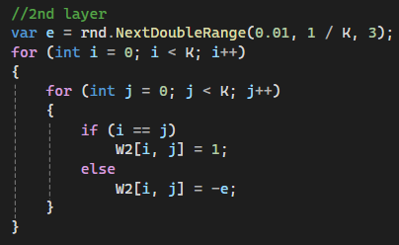
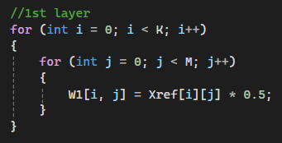
Learning
S
Y
W2
W1

Slide 3
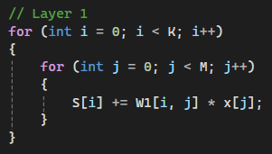
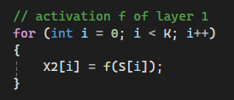
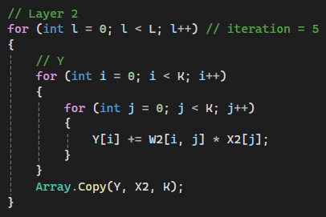

Identify
1
2
3
S
Y
W2
W1
4

