Slide 1
Kohonen network
Classification

Slide 2
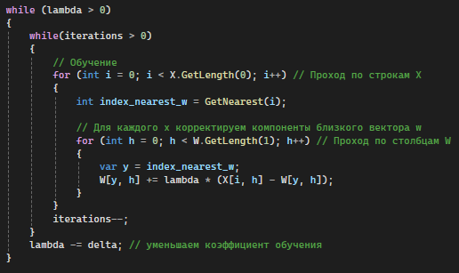
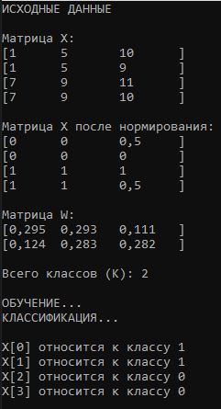

Kohonen network / Console
K – classes num
N – length of X and W
X – matrix [ … , N ]
W – weights [ K, N ]
Set the K = 2 classes
X data:
N
X[0]
1 | 5 | 10
1 | 5 | 9
7 | 9 | 11
7 | 9 | 10
normalization
0 | 0 | 0,5
0 | 0 | 0
1 | 1 | 1
1 | 1 | 0,5
X[0] → class 1
X[1] → class 1
X[2] → class 0
X[3] → class 0
X[1]
Learning
Classify
X[2]
X[3]
column normalization
N
Weights:
W[0]
0,295 | 0,293 | 0,111
0,124 | 0,283 | 0,282
K
W[1]
Fill randoms (0,1…..0,3)

Slide 3
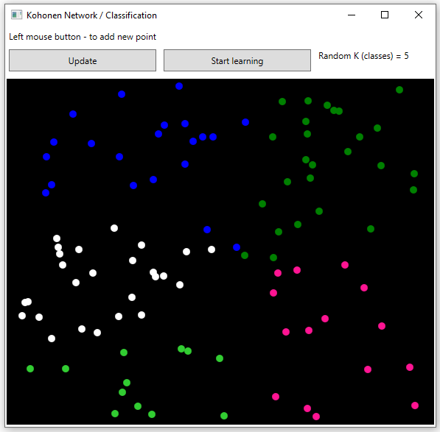
Kohonen Network / 2D points
K = 2 classes
Learning
Classify
Points List<>
normalization
Random position
Weights [ , ]

