Slide 1
Shell Project
Shell Project built based on Revature Project 0
Shell architecture used in this Revature Project 1
Develop a <insert project>
Technologies:
Java 8
Test driven development
RESTful API
Clients and Accounts resources
Javalin, JDBC, Logback / SLF4J, JUnit, Mockito, MariaDB
HTTP Endpoints (minimum of 11)
POST (2), PUT(2), DELETE (2), GET (5)
General Requirements
3 layered architecture
Controller (presentation) layer
Service (business logic) layer
Data Access layer
80-90% JUnit test coverage for the service layer
Utilize Mockito in order to mock DAO dependencies
Logging accomplished using Logback
Considerations for logging (Http Requests, Methods being executed, Exceptions)
SQL script creating a table schema and performs initial data load
Utilize Hybrid for database modeling and connectivity
Must utilize the Data Access Object (DAO) design pattern
MariaDB (locally or ideally Amazon Web Services (AWS))
Stretch Goals
Postman tests to verify API functionality

Slide 2
ERS Project Client Process Flow Model
ERS-Client
Index.html

Slide 3
ERS Project Generic<T> Process Flow Model
DB
com.tlw8253.utility
Hibernate
SessionFactorySingleton
com.tlw8253.model
<T>Model
com.tlw8253.dao
<< interface >>
Data Access Object
GenericDAO<T>
connects
creates
updates
com.tlw8253.model
<Tn>Model
implements
uses
access
returns
com.tlw8253.dto
Data Transfer Object
DTO
AddOrEditDTO
com.tlw8253.dao
<T>DAOImpl
uses
com.tlw8253.exception
BadParameterException
com.tlw8253.dao
<Tn>DAOImpl
com.tlw8253.dto
Data Transfer Object
<T>DTO
<T>AddOrEditDTO
extends
uses
com.tlw8253.dto
Data Transfer Object
<Tn>DTO
<Tn>AddOrEditDTO
com.tlw8253.exception
DatabaseException
throws
uses
com.tlw8253.service
<T>Service
controls
uses
com.tlw8253.exception
RecordNotFoundException
com.tlw8253.service
<Tn>Service
com.tlw8253.controller
<T>Controller
HTTP Request / Response
processes
com.tlw8253.controller
<Tn>Controller
com.tlw8253.exception
AuthenticationFailureException

Slide 4
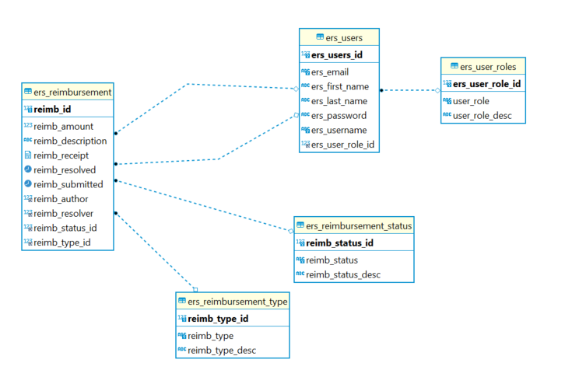
ERS Physical Database Model

Slide 5
ShellProject Conclusion
Technologies requirements all implemented
Other general requirements met or exceeded
3 layered architecture
SQL script creating a table schema and performs initial data load
Utilize JDBC for data persistence
Must utilize the Data Access Object (DAO) design pattern
MariaDB (through localhost)
Logging accomplished using Logback
HTTP Endpoints (minimum of 11)
Other considerations
Account Number Primary Key (Randomly Generated)
GenericDAO<T> used but not fully realized
Simple Add/Edit DTO stores data generically in HashMaps
JUnit test driven development not fully realized (18 tests)
Extensive utilization of Postman tests
Additional endpoints created inadvertently and by extension
Extensive Logging through program logging levels used
Postman utilize (~30+) tests

