Slide 1
Expense Reimbursement System (ERS)
ERS Project built based on Revature Project 0
Project 0 architecture modified and used in this Revature Project 1
Develop an Expense Reimbursement System
Technologies:
Java 8
RESTful API
User and Reimbursement resources
Javalin, Logback / SLF4J, JUnit, Mockito, Hibernate, JDBC, MariaDB
HTTP Endpoints
Login and Reimbursement endpoints
General Requirements
3 layered architecture
Controller (presentation) layer
Service (business logic) layer
Data Access layer
Utilize Mockito in order to mock DAO dependencies
Logging accomplished using Logback
Considerations for logging (Http Requests, Methods being executed, Exceptions)
Hibernate database modeling and connectivity
Hibernate HQL object orientated schema creation, data loads, record creation and updates
Utilize Hibernate for database modeling and connectivity
Utilizes the endpoint Controller, Service layer validation, and Data Access Object (DAO) design pattern
MariaDB (locally or ideally Amazon Web Services (AWS)) using Hibernate
Extend concepts created in Project 0
Fully implements a GenericDAO<T> DAO model
Fully extends a base Data Transfer Object (DTO) model

Slide 2
ERS Project Client Process Flow Model
create own
return
session expired
logout
session expired
logout
ERS-Client
Finance.html
ERS-Client
Index.html
ERS-Client
Reimbursement.html
FINANCE MANAGER
EMPLOYEE
verify session
verify session
login
reimbursement
reimbursement
HTTP Request / Response
com.tlw8253.controller
UserController
processes
processes
processes
com.tlw8253.controller
ReimbursementController
com.tlw8253.controller
LoginController
uses
com.tlw8253.service
ReimbursementService
uses
com.tlw8253.service
UserService
uses
uses

Slide 3
ERS Project Generic<T> Process Flow Model
DB
com.tlw8253.utility
Hibernate
SessionFactorySingleton
com.tlw8253.model
<T>Model
com.tlw8253.dao
<< interface >>
Data Access Object
GenericDAO<T>
connects
creates
updates
com.tlw8253.model
<Tn>Model
implements
uses
access
returns
com.tlw8253.dto
Data Transfer Object
DTO
AddOrEditDTO
com.tlw8253.dao
<T>DAOImpl
uses
com.tlw8253.exception
BadParameterException
com.tlw8253.dao
<Tn>DAOImpl
com.tlw8253.dto
Data Transfer Object
<T>DTO
<T>AddOrEditDTO
extends
com.tlw8253.exception
DatabaseException
uses
com.tlw8253.dto
Data Transfer Object
<Tn>DTO
<Tn>AddOrEditDTO
throws
uses
com.tlw8253.service
<T>Service
controls
uses
com.tlw8253.exception
RecordNotFoundException
com.tlw8253.service
<Tn>Service
com.tlw8253.controller
<T>Controller
HTTP Request / Response
processes
com.tlw8253.controller
<Tn>Controller
com.tlw8253.exception
AuthenticationFailureException

Slide 4
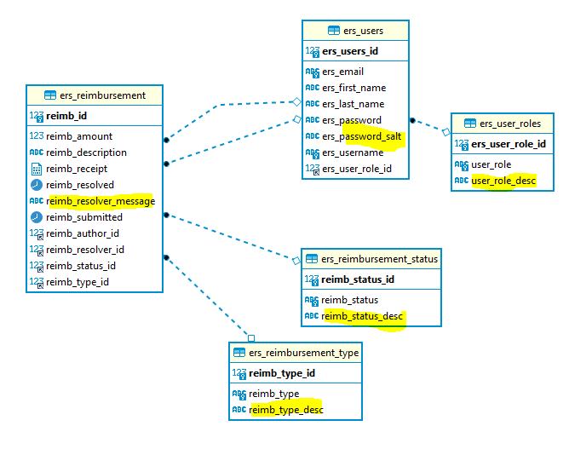
ERS Physical Database Model

Slide 5
Requirements Traceability Matrix (RTM)

Slide 6
Expense Reimbursement System (ERS) Summary
Expense Reimbursement System (ERS)
Technologies requirements all implemented
Other general requirements met or exceeded
3 layered architecture
Hibernate “create” for creating the schema
Hibernate HQL performing object data loads, record create and updates
Utilize the Controller, Service, DTO, DAO design pattern
MariaDB (through localhost)
Logging accomplished using Logback
Login session control and validation
HTTP Endpoints (Login and Reimbursement)
Front-end
Login, Reimbursement, and Finance interactive pages
Other considerations
Implementing GenericDAO<T> model fully realized
Extend Add/Edit DTO storing data generically in HashMaps
Minimal JUnit and Mockito test cases
Extensive utilization of internal driver tests
Extensive Logging through package logging levels
Postman utilize for some initial endpoint tests
Internal test drivers and Admin driver

