Slide 1
Shell Project
Shell Project built based on Revature Project 0
Shell architecture used in this Revature Project 1
Develop a <insert project>
Technologies:
Java 8
Test driven development
RESTful API
Clients and Accounts resources
Javalin, JDBC, Logback / SLF4J, JUnit, Mockito, MariaDB
HTTP Endpoints (minimum of 11)
POST (2), PUT(2), DELETE (2), GET (5)
General Requirements
3 layered architecture
Controller (presentation) layer
Service (business logic) layer
Data Access layer
80-90% JUnit test coverage for the service layer
Utilize Mockito in order to mock DAO dependencies
Logging accomplished using Logback
Considerations for logging (Http Requests, Methods being executed, Exceptions)
SQL script creating a table schema and performs initial data load
Utilize Hybrid for database modeling and connectivity
Must utilize the Data Access Object (DAO) design pattern
MariaDB (locally or ideally Amazon Web Services (AWS))
Stretch Goals
Postman tests to verify API functionality

Slide 2
Shell Project Generic<T> Database Access Model
com.tlw8253.utility
Utility
ConnectionUtility
connects
DB
com.tlw8253.dao
<< interface >>
Data Access Object
GenericDAO<T>
com.tlw8253.model
Model
<T>
implements
uses
access
com.tlw8253.dao
<T>DAOImpl
returns
com.tlw8253.exception
BadParameterException
uses
com.tlw8253.dto
Data Transfer Object
<T>DTO
<T>AddDTO
<T>EditDTO
com.tlw8253.dto
Data Transfer Object
DTO
AddDTO
EditDTO
extends
uses
com.tlw8253.exception
DatabaseException
uses
throws
com.tlw8253.service
<T>Service
uses
controls
com.tlw8253.controller
<T>Controller
com.tlw8253.exception
<T>NotFoundException
uses
com.tlw8253.service
AccountService
throws
processes
com.tlw8253.exception
AccountNotFoundException
HTTP Request / Response

Slide 3
Shell Project General Control Model
com.tlw8253.utility
Utility
ConnectionUtility
connects
DB
com.tlw8253.dao
<< interface >>
Data Access Object
GenericDAO<General>
com.tlw8253.model
Model
General
implements
uses
access
com.tlw8253.dao
GeneralDAOImpl
returns
com.tlw8253.exception
BadParameterException
returns
uses
com.tlw8253.dto
Data Transfer Object
GeneralDTO
com.tlw8253.model
Model
2nModel
com.tlw8253.exception
DatabaseException
uses
uses
extends
com.tlw8253.service
GeneralService
uses
com.tlw8253.exception
RecordNotFoundException
throws
controls
com.tlw8253.controller
GeneralController
com.tlw8253.dto
Data Transfer Object
AddOrEditClientDTO
com.tlw8253.exception
GeneralException
uses
com.tlw8253.service
2ndService
throws
processes
com.tlw8253.exception
2ndModelNotFoundException
HTTP Request / Response

Slide 4
Shell Project JUnit Test Model
com.tlw8253.utility
Utility
ConnectionUtility
connects
DB
com.tlw8253.dao
<< interface >>
Data Access Object
GenericDAO<General>
com.tlw8253.model
Model
General
implements
uses
access
com.tlw8253.dao
GeneralDAOImpl
returns
com.tlw8253.exception
BadParameterException
returns
uses
com.tlw8253.dto
Data Transfer Object
GeneralDTO
com.tlw8253.model
Model
2nModel
com.tlw8253.exception
DatabaseException
uses
uses
extends
com.tlw8253.service
GeneralService
uses
com.tlw8253.exception
RecordNotFoundException
throws
controls
test/com.tlw8253.service
GeneralServiceTest
com.tlw8253.dto
Data Transfer Object
AddOrEditClientDTO
com.tlw8253.exception
GeneralException
uses
com.tlw8253.dao
<< interface >>
Data Access Object
GenericDAO<General>
simulates
HTTP Request / Response

Slide 5
Project 0 Generic<T> Database Access Model
com.tlw8253.utility
Utility
ConnectionUtility
connects
DB
com.tlw8253.dao
<< interface >>
Data Access Object
GenericDAO<Account>
com.tlw8253.model
Account
implements
uses
access
com.tlw8253.dao
AccountDAOImpl
returns
com.tlw8253.exception
BadParameterException
uses
com.tlw8253.dto
Data Transfer Object
AccountDTO
AccountAddDTO
AccountEditDTO
com.tlw8253.dto
Data Transfer Object
DTO
AddDTO
EditDTO
extends
uses
com.tlw8253.exception
DatabaseException
uses
throws
com.tlw8253.service
AccountService
uses
Used for development purposes
controls
com.tlw8253.controller
AccountController
com.tlw8253.exception
AccountNotFoundException
processes
HTTP Request / Response

Slide 6
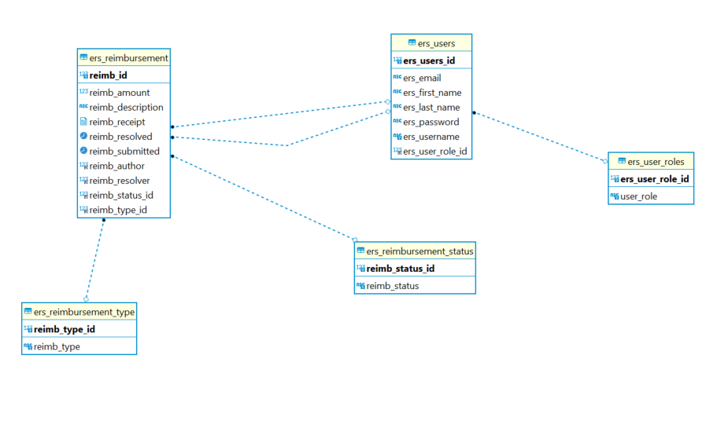
ERS Physical Database Model

Slide 7
ShellProject Conclusion
Technologies requirements all implemented
Other general requirements met or exceeded
3 layered architecture
SQL script creating a table schema and performs initial data load
Utilize JDBC for data persistence
Must utilize the Data Access Object (DAO) design pattern
MariaDB (through localhost)
Logging accomplished using Logback
HTTP Endpoints (minimum of 11)
Other considerations
Account Number Primary Key (Randomly Generated)
GenericDAO<T> used but not fully realized
Simple Add/Edit DTO stores data generically in HashMaps
JUnit test driven development not fully realized (18 tests)
Extensive utilization of Postman tests
Additional endpoints created inadvertently and by extension
Extensive Logging through program logging levels used
Postman utilize (~30+) tests

Slide 8
Project 0 High-level Database Access Model
com.tlw8253.utility
Utility
DB Connection
com.tlw8253.dao
<< interface >>
Data Access Object
GenericDAO<T>
implements
uses
com.tlw8253.dao
DAOImpl
connects
com.tlw8253.model
Model
access
DB
returns
uses
com.tlw8253.dto
Data Transfer Object
DTO
uses
uses
uses
com.tlw8253.exception
Exception
com.tlw8253.service
Service
controls
com.tlw8253.controller
Controller
throws

Slide 9
Project 0 Program Structure
com.tlw8253.application
Application
HTTP Request
GET
POST
DELETE
PUT
listener
com.tlw8253.javalin
JavalinHelper
com.tlw8253.javalin
ClientController
Sets as request hander
GET request
com.tlw8253.javelin.request
GetRequest
com.tlw8253.javelin.request
Clients
uses
GET response
HTTP Response

Slide 10
Project 0 HTTP Exception Model
com.tlw8253.utility
Utility
DB Connection
com.tlw8253.controller
<< interface >>
Controller
implements
uses
com.tlw8253.controller
ExceptionController
connects
com.tlw8253.model
Model
uses
contains
access
com.tlw8253.dto
Data Transfer Object
DTO
DB
map endpoints
returns
io.javalin.Javalin
Javalin App
io.javalin.http.ExceptionHandler
ExceptionHandler

Slide 11
com.tlw8253.dao
<< interface >>
ClientDAO
contains
List<>
com.tlw8253.model
Client
com.tlw8253.model
ClientDTO

