Slide 1
Aromatic Mountain Technologies (AMT)
Team Members
Antonio Pierre
Matthew Rho
Tom Weikel
Team Power: PoweR Rangers Coffee System
Slogan: “Power Brewed to Power Through”
Aromatic Mountain Technologies (AMT) is an online coffee store that allows customers and employees to buy coffee beans, ground coffee, syrups, coffee accessory and apparel. AMT makes use of an external free API possibly to do payment processing and/or shopping cart API. AMT has internal RESTful APIs that are consumed by the client web pages.
Thought process
Client server / login / endpoints / roles
Online Store (Like Amazon)
Customers
Admin
Employee (access to some but not all Admin areas)
Product pages (One related products, like a Starbucks Coffee and related items)
Payment process (store payment info [credit cards, paypal, electronic transfer])

Slide 2
Aromatic Mountain Technologies (AMT)
User Stories
View Catalog
Add to shopping cart
Checkout (login)
Admin user stories (controls publishing catalog)
As an Admin controls publishing of Employee catalog items and pages
Employee (in employee role and as customers) user stories
As an employee I can create catalog items / pages
As an employee I provide customer support (contact us support, online chat)
As an employee buying from the catalog I want to use my company discount benefits
Customer
As a Customer I want to view the online catalog
As a Customer I want to buy from the online catalog
As a Customer I want to create and use a secure account to make my purchases

Slide 3
AMT Project <T> Process Flow Model
AWS
DB
com.amt.utility
Hibernate
SessionFactorySingleton
com.amt.model
<T>Model
com.amt.dto
<T>DTO
connects
creates
updates
com.amt.model
<Tn>Model
com.amt.dto
<Tn>DTO
uses
access
uses
returns
com.amt.dao
<T>DAO
uses
com.amt.exception
BadParameterException
Angular
Client
com.amt.dao
<Tn>DAO
com.amt.dto
Data Transfer Object
<T>AddDTO
com.amt.exception
DatabaseException
uses
com.amt.dto
Data Transfer Object
<Tn>AddDTO
throws
uses
com.amt.service
<T>Service
controls
uses
HTTP Request / Response
Tomcat Server
com.amt.exception
RecordNotFoundException
com.amt.service
<Tn>Service
com.amt.controller
<T>Controller
processes
com.amt.controller
<Tn>Controller
com.amt.exception
AuthenticationFailureException

Slide 4
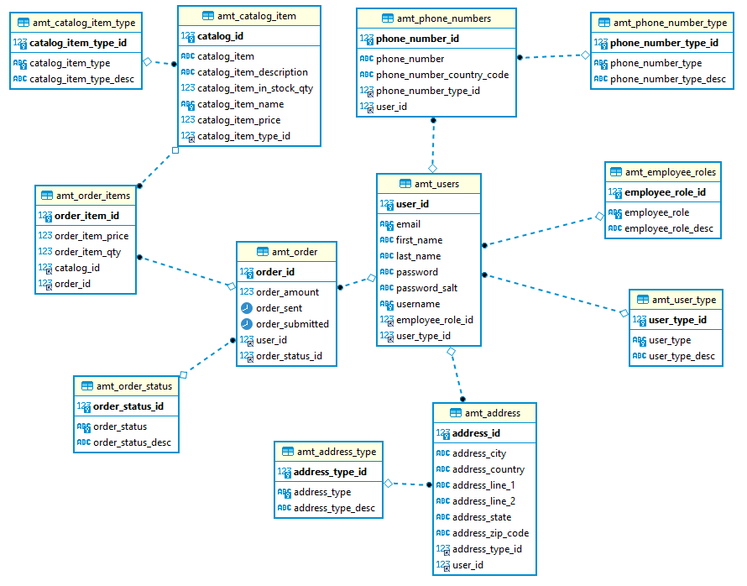
Aromatic Mountain Technologies (AMT) Physical Data Model

Slide 5
Aromatic Mountain Technologies (AMT) Summary
Started with a Javalin version of AMT
Using a deployed database on AWS RDB
Progressed to an IDE AMT-MVC Springframe on Tomcat in the IDE
Installed localhost version of Tomcat all Postman tests passed
This morning issue with localhost version of Tomcat
First it complained about a semi-colon in the CATALINA_HOME variable
Once resolved would not actually bring up the web app
Discovered the issue was using Linux .sh and not Window .bat files
Built EC2 instance installing Tomcat and a working version of AMT-MVC
Encountered cors issue with the EC2 amt-mvc program
@CrossOrigin("http://localhost:4201") still using localhost
Changed to @CrossOrigin(originPatterns = "*", allowCredentials = "true")
Redeployed on EC2.
Did not resolve the issue, tried other patterns
Eventually corrupted Tomcat on EC2
Angular learning curve

