Slide 1
Slide 1 — The Cloud Problem and the Approach
The Problem Cloud Architecture Solves Here
A storefront on one server fails at exactly the wrong moment: a product gets featured, traffic spikes 10x, and the busiest hour becomes the hour customers cannot buy. Vertical scaling is capacity you pay for year-round and still outgrow in a spike.
The cloud answer is horizontal: many small identical instances behind a load balancer, added and removed as demand moves.
What That Requires of the Application
Horizontal scaling is not a deployment trick — it constrains how the app is written. Three properties had to hold:
Requirement | Why it matters | How it was met
Stateless app tier | Any instance must serve any request | Session in a signed cookie, not server memory
Externalized config | One image, many environments | All config from environment variables
Health-reporting instances | The balancer must know who is alive | HTTP probe per instance every 5s
Cloud Concepts Implemented
Load balancing · health checking · auto-scaling simulation · stateless application tier · CDN-offloaded assets · role-based access control · containerization · CI/CD
Each is covered in the slides that follow, with the trade-offs stated rather than hidden.
Flask E-Commerce — Cloud Computing (UCBX)
1 / 5

Slide 2
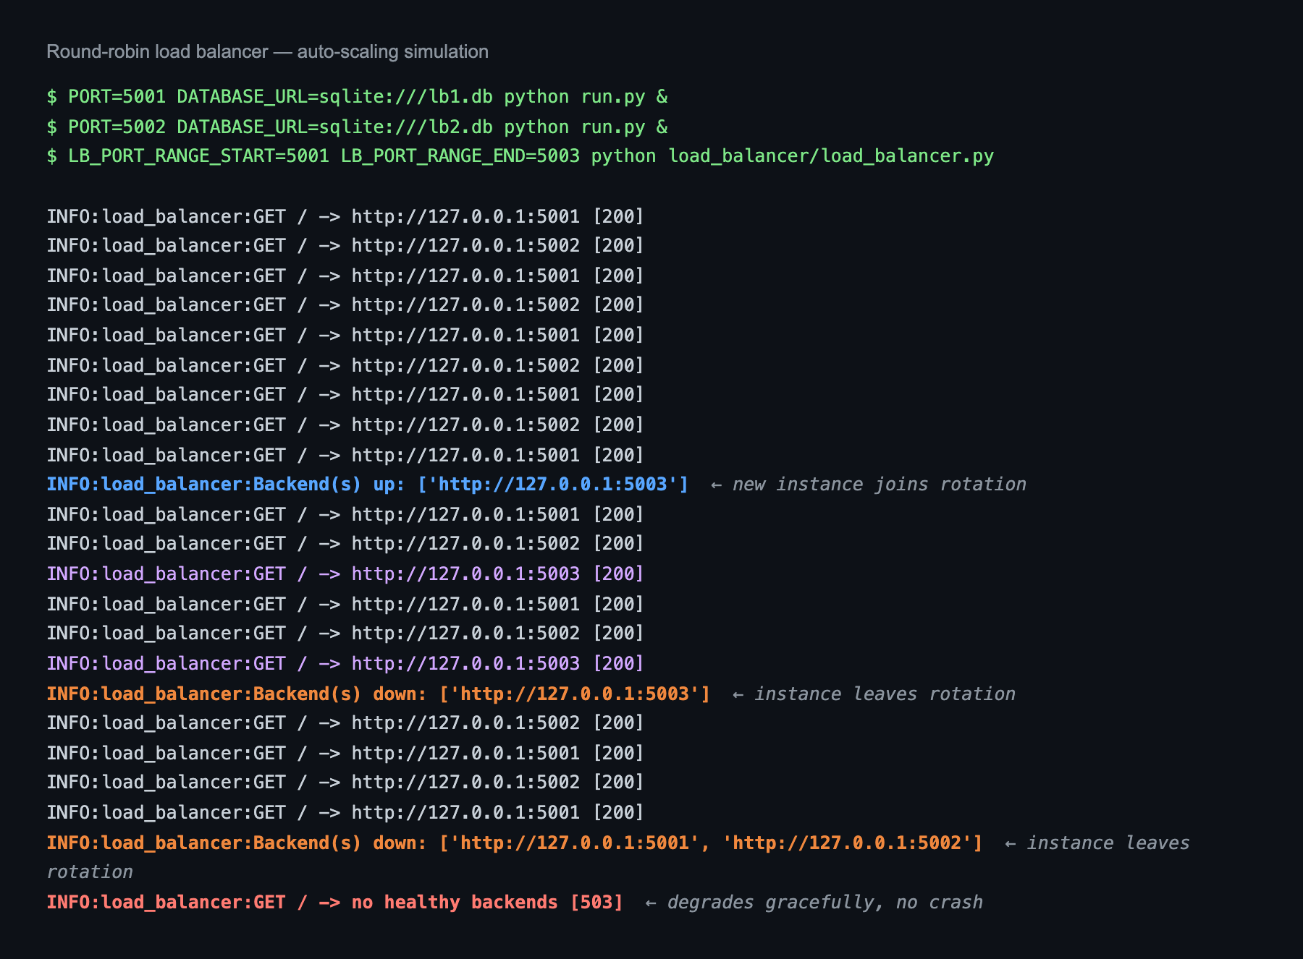
Slide 2 — Load Balancer and Elastic Capacity
Design
load_balancer/load_balancer.py — a Flask reverse proxy on :8000 implementing four behaviors:
Behavior | Implementation
Round-robin | itertools.count() cycles the healthy pool
Health checking | Daemon thread probes each backend every 5s, 2s timeout
Auto-scaling | Scans ports 5000–5010; instances join/leave on their own
Retry on failure | A request to a dead backend re-dispatches to the next
Hop-by-hop headers (connection, transfer-encoding, content-length) are stripped per RFC 7230 rather than blindly forwarded.
Failure Behavior
Condition | Response
Backend dies mid-request | Retry next target; client never sees the failure
All retries exhausted | 502 Bad Gateway
Zero healthy backends | 503 Service Unavailable — degrades, does not crash
A third instance joins a running pool in one health interval and leaves when killed — no restart, no config change.
Verified Live
Flask E-Commerce — Cloud Computing (UCBX)
2 / 5

Slide 3
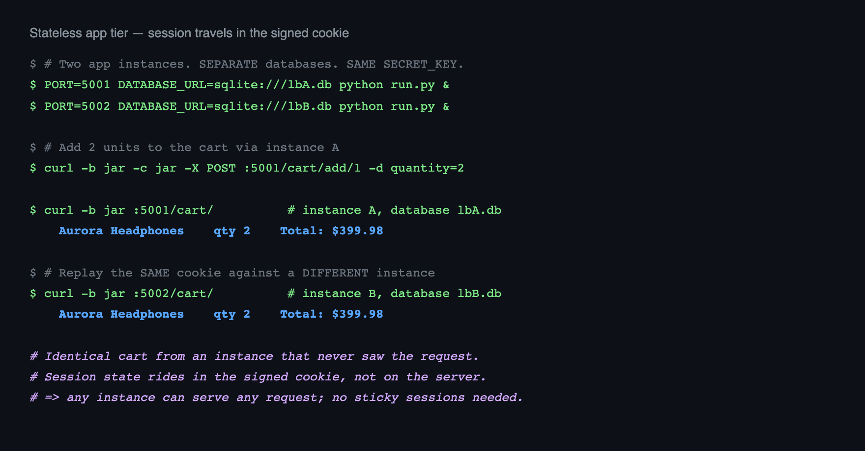
Slide 3 — Stateless Tier and Fast Image Delivery
Why the App Tier Is Stateless
Fast Image Loading
Round-robin only works if any instance can serve any request. Flask sessions are signed client-side cookies, so cart and login state travel with the request rather than living on one server.
Product images are remote URLs, never served by the app — the application ships zero binary assets, so image bandwidth never touches the instances or the load balancer. That is CDN offload in practice.
The proof: a cart built on instance A, read back from instance B — a different process with a different database — returns the identical cart.
Delivery was then tuned in the browser:
Technique | Effect
loading="lazy" | Below-the-fold images deferred until scrolled toward
decoding="async" | Decode off the main thread; no render block
Measured on throttled Slow 3G (400 kbps, 400 ms RTT):
Metric | Before | After
Catalog load (9 images) | 5,834 ms | 968 ms — 83% faster
This is why the deployment needs no sticky sessions. SECRET_KEY is shared across instances; any of them can verify the signature.
Flask E-Commerce — Cloud Computing (UCBX)
3 / 5

Slide 4
Slide 4 — Security and Role-Based Access Control
Roles: How They Work
Bootstrapping the First Admin
A single is_admin flag on User, enforced by an @admin_required decorator that aborts with 403 for anyone unauthenticated or non-admin.
Registration never sets is_admin, and the promotion UI is itself admin-gated — so a fresh database has no path to an admin through the web. flask create-admin <email> breaks the cycle from the CLI. No privilege escalation path exists through the application.
def admin_required(f):
@wraps(f)
def decorated_function(*args, **kwargs):
if (not current_user.is_authenticated
or not current_user.is_admin):
abort(403)
return f(*args, **kwargs)
return decorated_function
Defense in Depth
CSRF on every state-changing POST — a missing token returns 400 · PBKDF2-SHA256 password hashing, 8-char minimum · Field whitelisting blocks mass assignment · Signed, single-use, 1-hour reset tokens · Identical response for known and unknown emails, preventing account enumeration
Coverage: 12 admin-gated routes · 10 login-gated routes.
Four Tiers of Authorization
Tier | Rule | Example
Public | No auth | Catalog, product detail
Authenticated | @login_required | Cart, checkout, order history
Ownership | Must own the record | /orders/<id> — 403 on another user's order
Admin | @admin_required | Product CRUD, user promotion, complaints
Ownership is checked, not just login. A logged-in user requesting another's order is refused — verified in all three browser engines.
Flask E-Commerce — Cloud Computing (UCBX)
4 / 5

Slide 5
Slide 5 — SQLite Today, Managed Cloud Database Next
Why SQLite Is the Current Data Tier
Step 1 alone removes the only limitation on this slide — and it is a configuration change, not a rewrite.
Pointing several instances at one SQLite file produced database is locked under concurrent writes — SQLite allows a single writer. Each instance therefore owns its own database file.
Verified End to End
This was the deliberate trade-off:
131 pytest tests · 99/99 cross-browser checks (Chromium, Firefox, WebKit) · zero layout overflow, 12 pages × 3 widths · load balancer: round-robin, scale-up, scale-down, 502 retry, 503 total failure
Gained | Given up
Multi-instance load balancing runs anywhere, zero setup | Data is per-instance, not shared
No external service to provision for a course demo | Order written on A is invisible on B
Repository: https://github.com/tlycode/tanner-young-cloud-project
Stated plainly rather than hidden: the app tier scales correctly; the data tier is the deliberate simulation boundary of this project.
Why the Application Is Already Portable
The constraint is the storage engine, not the code. SQLAlchemy abstracts the dialect and the connection string is already an environment variable:
DATABASE_URL=sqlite:///app1.db # today
DATABASE_URL=postgresql://user:pw@rds-host/shop # one variable away
psycopg2-binary already ships in requirements.txt. No application code changes to move to PostgreSQL.
Future Improvement: Managed Cloud Database
Step | Change | Unlocks
1 | Point every instance at one managed PostgreSQL (RDS/Cloud SQL) | Shared state — any instance serves any user identically
2 | Enable Flask-Migrate (already a dependency) | Versioned schema across deploys
3 | Add a read replica | Read scaling for the catalog
4 | Move sessions to Redis | Server-side revocation, larger session payloads
Flask E-Commerce — Cloud Computing (UCBX)
5 / 5

