Slide 1
Analyses of Time to Event Data
Dan Walsh, USGS-NWHC
Kezia Manlove, Utah State University
Robin Russell, USGS-NWHC
Brought to you by: TWS Biometrics Working Group

Slide 2
Goals
Introduce the concept of time to event modeling
Present the mathematical theory behind these models
Discuss the practical applications with examples in R

Slide 3
Why Bayesian
To impress your friends?
Not so much (although Bayesian inference is cool).
Because the Bayesian framework using open source software is an easy way to fit “good” models.

Slide 4
Models of What?
Survival? – yes, but often as more of a spinoff.
Modern survival analysis often focuses on hazards because of interpretability.
Hazards are conditional on survival
Instantaneous rate of occurrence of the event

Slide 5
Example
DelGiudice, et al. 2009 in Recovery of gray wolves in the Great Lakes Region of the United States: an endangered species success story. Springer. New York, New York.

Slide 6
“Good” Estimates in General?
Classicists and Bayesians have similar ideas on this.
Good estimates arise from good models - neither too simple nor too complex.
Good models are good predictors:
MSE (MISE)
Cross validation/GCV
AIC/Bayes Factor/BIC/WAIC/DIC

Slide 7
Good Models Balance
Bias Against Variance
“Unbiasedness” is a statistical red herring:
MSE = bias² + variance

Slide 8
Open Source Software Makes It Easy To Fit “Good” Hazard Models
By “good”, I will generally mean optimal AIC or MSE; balance between data fit and model complexity.
Not exclusively Bayesian – smoothing splines, penalized likelihood, etc. can achieve similar results.
But easy to implement in open source Bayesian software (rjags, R2OpenBUGS, nimble).

Slide 9
The Bayesian Difference
Bayesians represent the uncertainty in a parameter as a probability distribution.
Parameters are random variables with distributions.
Frequentists rely on indirect measures of uncertainty - confidence intervals.
Intuitively I think most of us interpret confidence intervals in a Bayesian sense.
Q: What’s the difference in interpretation of CI between Bayesian and Frequentist?

Slide 10
Basic Bayesian Mission:
How does data change our uncertainty about a parameter?
Prior uncertainty:
p(parameters | knowns)
Posterior uncertainty:
p(parameters | data, knowns)

Slide 11
Bayesian Estimation
Given the posterior p(parameters | data, knowns)
Summary interesting features.
The posterior mean replaces the usual MLE.
The posterior percentiles (credible intervals) replace CI’s.

Slide 12
Questions?
Summary: Bayesians are cool
We will be discussing “hazard functions” as well as survival estimates
Bayesians summarize everything using posterior distributions

Slide 13
Survival Analysis – What Is It?
Biostatistical (biomedical) versus Biometrical (wildlife/ecology).
Biostatistical survival analysis focuses on a subset of the biometrical survival problems –“known fate designs”.
Subject’s event status (e.g., alive/dead) ascertained with probability 1.
Notes:
13

Slide 14

Survival Analysis – What Is It?
Assumption: Resighting probability = 1
Reasonable assumption for:
1. Many remote surveillance studies (coller and foller’).
2. Relatively immobile subjects (nests, colonies).
3. Infection/parasitism events.
4. Laboratory Trials
Q: other Examples?
British Trust for Ornithology
Notes:
14

Slide 15
Survival Analysis – What Is It?
“Survival Analysis” is a misnomer – techniques are applicable to any event occurring in time.
Death event, infection event, nest destruction, antler drop, pregnancy, marriage, etc.
Notes:
15

Slide 16
Two Types of Biological Event Processes
I – Continuous time processes.
Death, infection, nest destruction, etc.
II – Discrete time processes.
Relatively few examples in nature.
Notes:
16

Slide 17
But 3 Types of Data:
I – Continuous time processes.
1. Continuous observation
2. Discrete observation (“grouped discrete”, “interval-censored”)
II – Discrete time processes.
3. Truly discrete
Important to distinguish between underlying biological event process and how researcher observes the process.
Notes:
17

Slide 18
Continuous Time Process
Most interesting event processes are occurring in continuous time
Biostatistical models are specifically parameterized to answer questions in terms of continuous time event processes.
Hazard functions are the natural parameterization.

Slide 19
Bradley Efron: “Survival analysis…a wonderful statistical success story.”
Partially due to the power of the hazard function to model interesting processes, but more to it than that…
General approach that unpacks the problem into two distinct components:
1. modelling the biological process, and
2. modelling the data collection process.

Slide 20
Foundation: Likelihoods
Likelihood principle: all of the information about data is captured by the likelihood.
The likelihood is the probability density of the observed data. (How probable is the data given the model?)

Slide 21
Likelihood is for c.r.v. T
The biostatistical approach to survival analysis focuses on the continuous random variable T, the time at which the event of interest occurs.
Likelihoods will be constructed for the c.r.v. T, even if recorded in discrete time.

Slide 22
The Study (Observation) Design is Important, But Should Not Affect the Biological Model
Construct the likelihood in two steps:
1) The data collection process:
“macrostructure”
2) The biological process:
“microstructure”

Slide 23
Modelling the Data Collection Process: “Macrostructure”
Under the researcher’s control, set by the experimental/observational design.
Once the data are collected, macrostructure is a fixed feature.
Important but not biologically interesting.
Essentially algorithmic, involves no creativity (but not necessarily trivial to get it right).
Notes:
23

Slide 24
Modelling the Biological Process:
“Microstructure”
Hazard models.
Requires creativity to construct scientifically meaningful models.
Generally should be independent of study design/data collection.
Work before Fun;-)
Notes:
24

Slide 25
Questions?
Summary: Important to distinguish between the biological collection process and the data process.
Time to Event analyses (Survival Analyses): can related to any event in time (death, finishing college, learning a new skill)

Slide 26
Macrostructure: General Observation Structure
Many survival study observations can be described with a data triplet:
e = time (age) subject enters the study,
r = time (age) subject last known alive,
s = time (age) subject first known dead.
Likelihood contribution for subject i is Pr(e, r, s),
this is actually a statement about the event time T.
Notes:
26

Slide 27
Constructing Probability Statements About T
The event time T is a continuous random variable.
Terminology: T ≥ t - the r.v.T is greater than some specific value t.
So when I say Pr(e, r, s), I mean more specifically:
Pr(r ≤ T < s | T ≥ e)
Prob. that T is between r and s conditional on T ≥ e.

Slide 28
Constructing Probability Statements About T
Building blocks needed to compute
Pr(r ≤ T < s | T ≥ e) :
The survival function S(t):
S(t) = Pr(T ≥ t)
Notes:
28

Slide 29
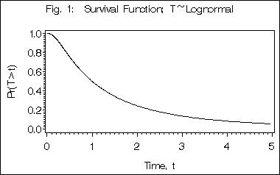
Example S(t)
Probability subject survives longer than time t.

Slide 30
Building Blocks Con’t
You might be more familiar with Pr(T < t): the cumulative distribution function (cdf).
The cdf is usually labeled F(t), but we will label it M(t).
M(t) = 1 – S(t), hence “mortality function”

Slide 31
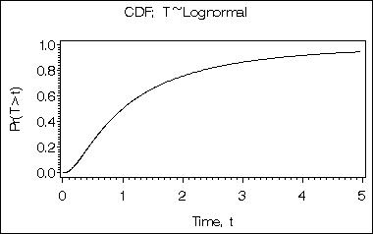
Example M(t)
Probability subject dies before time t.
Notes:
31

Slide 32
If T Known Only to an Interval:
Consider the time interval r to s:
Interested in Pr(r ≤ T < s)
Basic result: Pr(r ≤ T < s) = S(r) - S(s)

Slide 33
Conditional Survival
T is the event time. T can range between 0 and +∞.
S(65) – probability a newborn lives beyond age 65.
But sometimes we want to restrict T to a smaller range:
Probability I live beyond 65, given that I’m 58:
S(65 | 58) = Pr(T ≥ 65 | T ≥ 58 )

Slide 34
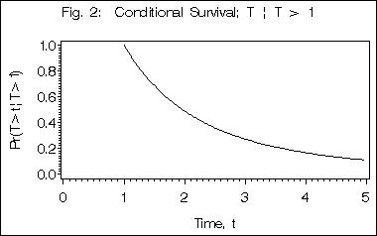
Example S(s | r ≥ 1)
Probability subject lives beyond s given alive at r = 1.
Notes:
34

Slide 35
Origins: All Survival is Conditional
The usual “unconditional” survival function can be expressed as:
S(t) = S(t | 0) = Pr(T ≥ t | T ≥ 0)
Event processes must always have an origin!

Slide 36
Conditional Mortality Function
M(s | r ) = Pr(T < s | T ≥ r ) = 1 - S(s | r )
The complement of the conditional survival function
Notes:
36

Slide 37
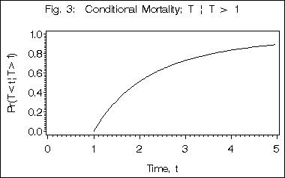
Example M(s | r = 1)
Probability subject dies before s given alive at r = 1.

Slide 38
Convenient Reformulation:
Recall: Pr(r ≤ T < s) = S(r) - S(s)
= S(r) - S(s | r) S(r)
= S(r)[1 - S(s | r)]
= S(r) M(s | r) (better for tricking Bayesian software)
Notes:
38

Slide 39
Questions?
Summary: mortality function is the inverse of the survival function
Survival is conditional
We are interested in estimating the probability that a duck survived to time s given we know it survived to time r

Slide 40
Macrostructure Contributions to the Likelihood
Recall data triplet e, r, s
Likelihood contribution: Probability that T is between r and s conditional on T > e:
Pr(r ≤ T < s | T ≥ e) = S(r | e) M(s | r)
Notes:
40

Slide 41
Properties of e, r, s:
Data triplet e, r, s
Left-truncated and interval-censored.
Left-truncated because we will not even discover subjects for which T < e.
The sample is biased toward survivors, and is not a random sample of the target population.
Notes:
41

Slide 42
Triplet Data: A Biased Sample
What is the target population for inference?
The population composed of all individuals that experienced a valid origin, that is, all subjects for whom T ≥ 0.
E.g., a birth cohort, a cohort of initiated nests, etc.
Left-truncation (delayed-entry) results in a biased sample w.r.t. the population of inferential interest.
Notes:
42

Slide 43
Conditioning on e Adjusts Likelihood
If e > 0, likelihood must be constructed to appropriately reflect the biasing effect of left-truncation.

Slide 44
Interval Censoring
Data are said to be interval-censored because T is only known to lie in the interval r to s.
Again, the likelihood needs to capture this.

Slide 45
Macrostructure Contributions to the Likelihood
Pr(r ≤ T < s | T ≥ e) = S(r| e) M(s | r)
This expression is very flexible!
Potential exceptions?
1. Event time T observed exactly?
2. Event never observed (right-censored)?

Slide 46
Potential Exceptions?
1. Death time T observed exactly?
-Could argue measurement is always finite.
-Exact death times lead to a slightly different likelihood (another class :-)
2. Death never observed?
But death is inevitable, so s = ∞
Notes:
46

Slide 47
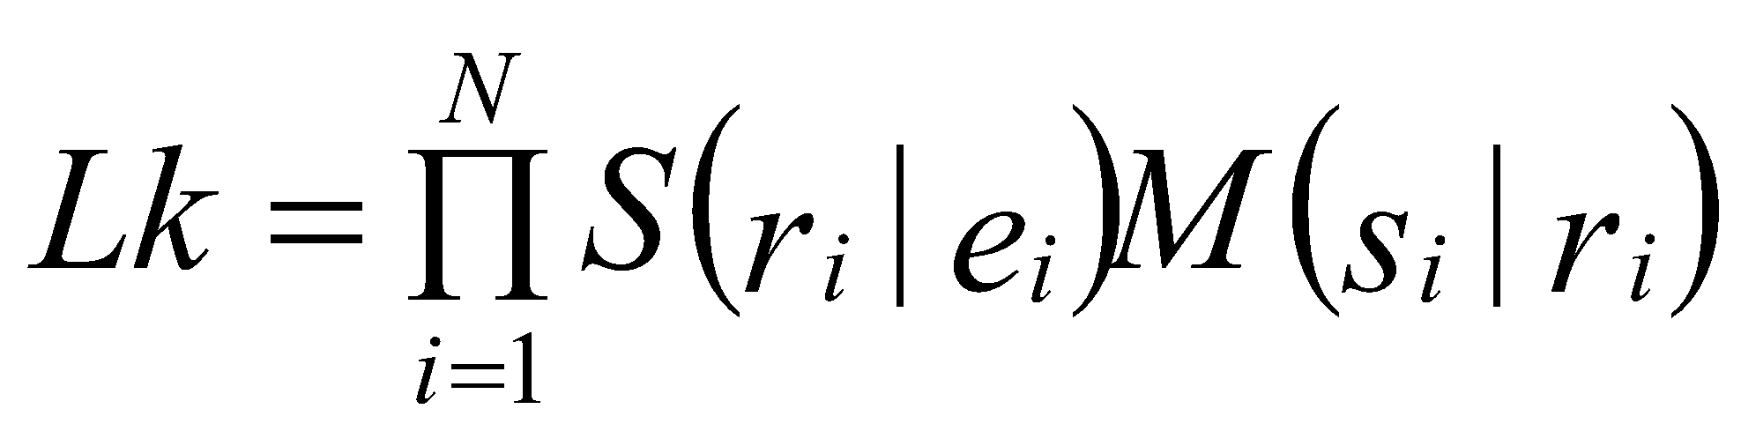
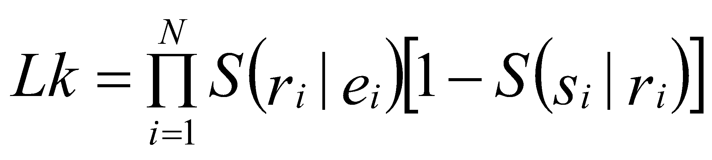
Total Data Likelihood
Product of likelihood contributions over all N subjects:
A likelihood for the continuous r.v. T.
But looks just like 2N Bernoulli trials – N successes, N failures:
Notes:
47

Slide 48
Total Data Likelihood
This equivalence to a count data (binomial) problem is of no significance other than for “tricking” software into doing the numerical computations we need.
Thinking otherwise can eventually get you in trouble.
Although likelihoods are often equivalent to GLM likelihoods for count data, this is a coincidence – the r.v. is the c.r.v. T.
Notes:
48

Slide 49
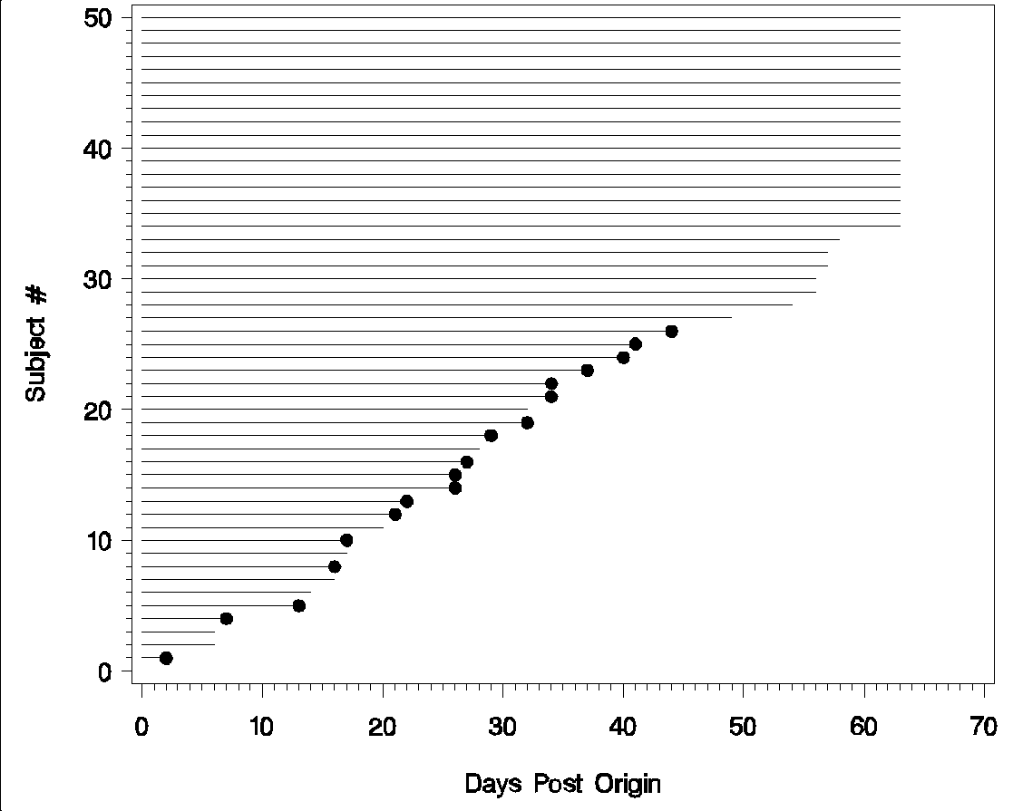
Example of Data Setup
Radiotagged Black Ducks (PWRC 1989 Biometrics)
Notes:
49

Slide 50
Data Triplets:
Example triplets from 4 ducks: 2 deaths, 2 right-censored.
Daily monitoring.
Intermediate “visits” at which the subject was still alive are not recorded.
Animal (i) Day of entry, e_{i} Day last alive, r_{i} Day first dead, s_{i}
1 1 2 3
10 1 17 18
20 1 32 ∞
30 1 56 ∞

Slide 51
To trick software, we break each data triplet into 2 records:
Example (death observed):
Animal (i) Day of entry, e_{i} Day last alive, r_{i} Day first dead, s_{i}
10 1 17 18
Becomes :
(record) left_{ij} right_{ij} censored_{ij}
10(1) 1 17 1
10(2) 17 18 0

Slide 52
To trick software, we break each data triplet into 2 records:
Animal(record) left_{ij} right_{ij} censored_{ij}
10(1) 1 17 1
10(2) 17 18 0
Recall likelihood contribution is of the form
S(r_{i} | e_{i})M(s_{i} | r_{i}).
1st record (censored=1) used to compute S(r_{i} | e_{i}).
2d record (censored=0) used to compute M(s_{i} | r_{i}).
Notes:
52

Slide 53
To trick software, we break each data triplet into 2 records:
Can economize with right-censored observations:
Animal(record) left_{ij} right_{ij} censored_{ij}
20 1 32 ∞
Becomes :
Animal(record) left_{ij} right_{ij} censored_{ij}
20(1) 1 32 1
20(2) 32 ∞ 0
But M(∞ | r_{i}) = 1 (death inevitable), multiplies Lk by 1, wasted effort.
Notes:
53

Slide 54
Black duck data
50 ducks, 18 deaths, so 68 records
Notes:
54

Slide 55

Nimble
NIMBLE extends BUGS by:
allowing you to write new functions and distributions and use them in BUGS models;
allowing you to define multiple models in the same code using conditionals evaluated when the BUGS code is processed;
supporting a variety of more flexible syntax such as R-like named parameters and more general algebraic expressions.

Slide 56
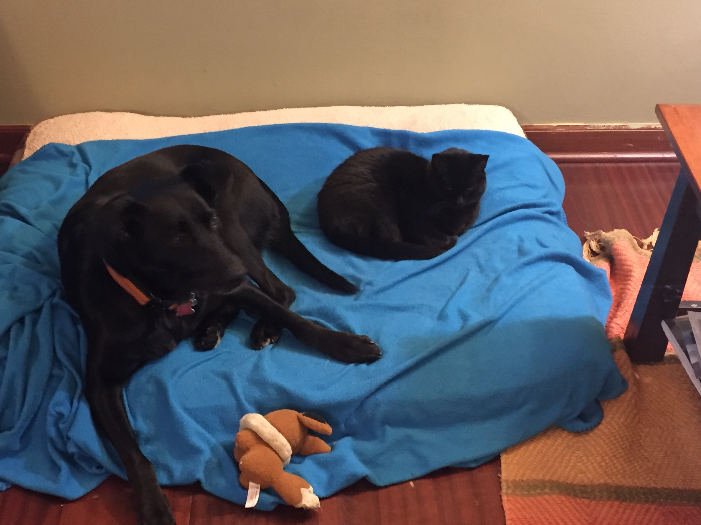
End of Lesson 1
Notes:
56

