Slide 1
Microstructure – the “Interesting Stuff”
Models biology rather than biologists;-)
All about the hazard function h(t) .
Conditional survival is a function of the hazard function:

Slide 2
One of the most important equations in ecology.
Pretty much an analytic result, doesn’t appear to hold much interesting intuition.
Just accept it; focus intuition on h(t) and

Slide 3
Hazard Function Motivation
Usually motivated as an approximation to the conditional mortality function:
M(t + d | t) ≈ h(t) d
“Prob. dead by t + d given alive at t”
Formally defined as:

Slide 4

Hazard Function Motivation
This formal definition implies that the hazard is the first derivative of the conditional mortality function at the conditional origin:
Example:
$M\left(S | R\right)=1−S\left(S | R\right)$
$S\left(S | R\right)=exp⁡(−\int_{r}^{s}{λ \text{dt}}$)
$\frac{dM(S|R)}{dt}=λexp⁡(−λ\left(s−r\right))$
$let s=r, \frac{dM(S|R)}{dt}=λ$

Slide 5
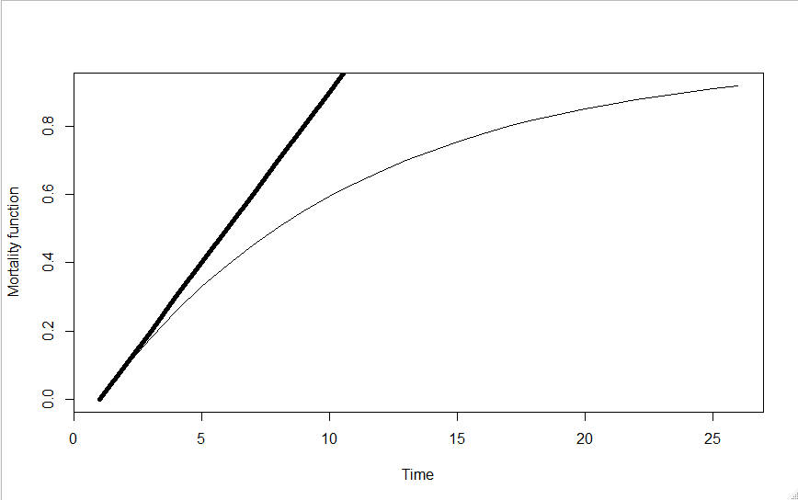
Hazard Function Motivation
Slope of this line = λ
Conditional origin = 0

Slide 6
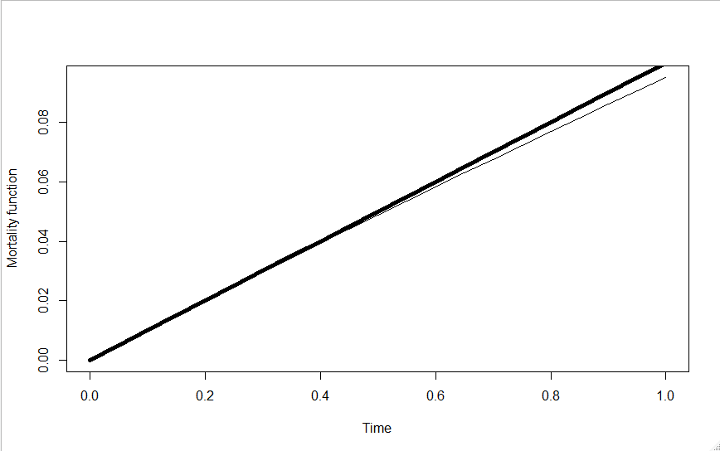
Hazard Function Motivation

Slide 7
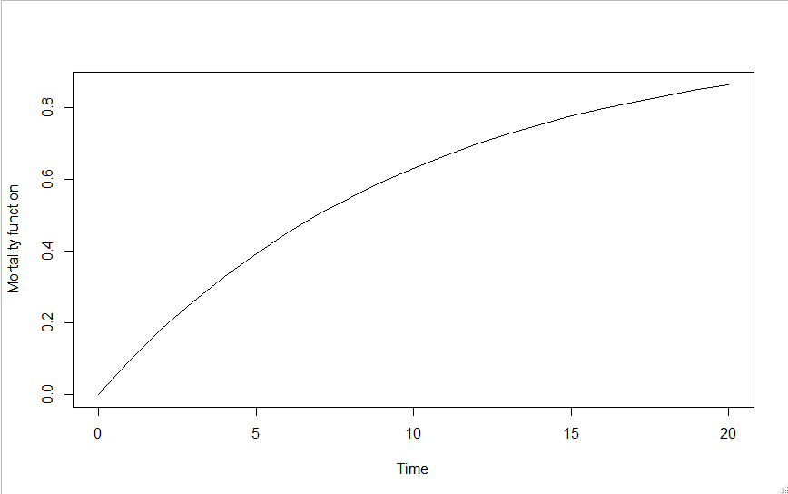
Hazard Function Motivation
M(t + d | t) ≈ h(t) d

Slide 8
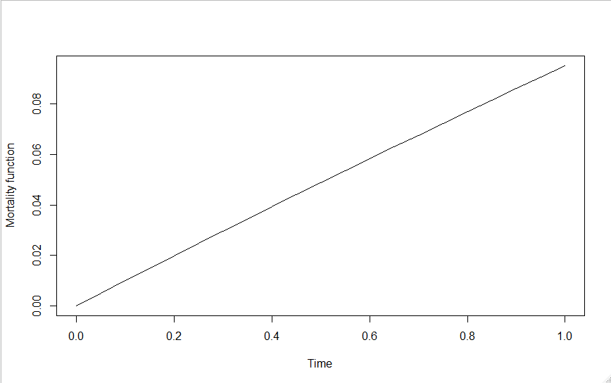
Hazard Function Motivation
M(t + Δ | t) ≈ h(t) Δ as Δ → 0⁺ approximation improves
Δ
Probability of dying in Δ

Slide 9
Hazard Function Motivation
M(t + Δ | t) ≈ h(t) Δ as Δ → 0⁺ approximation improves
Δ
h(t) Δ
Probability of dying in Δ

Slide 10
Hazard Function Motivation
M(t + Δ | t) ≈ h(t) Δ as Δ → 0⁺ approximation improves
Δ
Probability of dying in Δ

Slide 11
Hazard Function Motivation
Δ

Slide 12
Hazard Function Motivation

Slide 13
Hazard Function Motivation
Slope of this line = λ
Conditional origin = 0

Slide 14
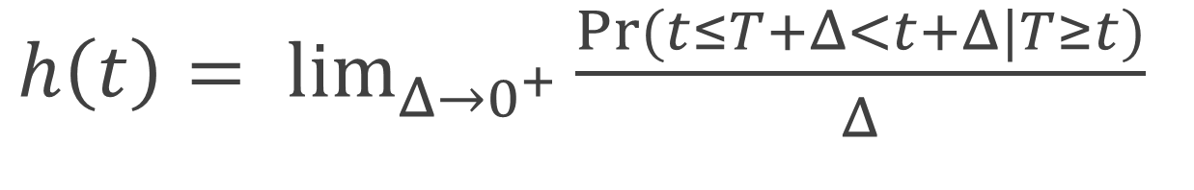
Hazard Function Motivation
$h\left(t\right)= \lim_{Δ→0^{+}}{\frac{Pr⁡(t≤T+Δ<t+Δ|T≥t)}{Δ}}$

Slide 15
Hazard Function Motivation
The basis for reasonable linear “mass-action” type models – the hazard is simply a rate, or intensity.
Because of the “compounding” behavior of S(t) and M(t), most other parameters result in complicated nonlinear responses that depend on choice of time scale.
Hazards are the probabilistic equivalent of differential equation models (“force-of-mortality”):
dN/dt = [b(t) – m(t)]N

Slide 16
Hazard Function Motivation
The natural scale for modelling biological dynamics:
Hypothetical example – prey population where predation is the only source of mortality.
Let’s say predator density P was halved – hazard will be halved:
dN/dt = [b(t) – βP]N
dN/dt = [b(t) – β(0.5∗P)]N

Slide 17
In contrast to the clean linear halving response of the hazard function, the survival function response is square-root:

Slide 18
Some Example Hazards
Used-better-than-new, New-better-than-used, bathtub, non-aging, modal: These properties are only easily recognized on the hazard scale

Slide 19
Where does this equation come from?

Slide 20
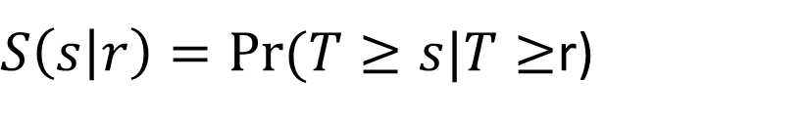


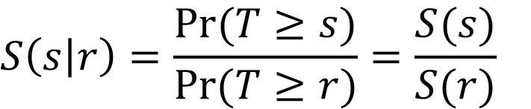
$$S$$
$$S\left(s\right)=Pr⁡(T≥s)$$
$S\left(s | r\right)=Pr⁡(T≥s|T≥$r)
$$S\left(s | r\right)=\frac{Pr⁡(T≥s)}{Pr⁡(T≥r)}=\frac{S(s)}{S(r)}$$
$$S\left(s | r\right)=S\left(r+1 | r\right)S\left(r+2 | r+1\right)…S(s|s−1)$$

Slide 21
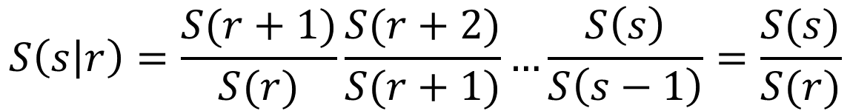
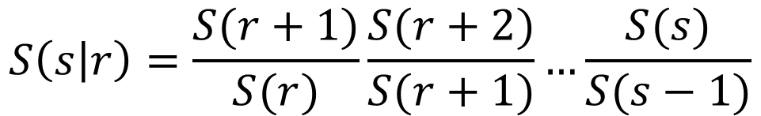
$$S$$
Prove:
$$S\left(s | r\right)=S\left(r+1 | r\right)S\left(r+2 | r+1\right)…S(s|s−1)$$
Proof:
$$S\left(s | r\right)=\frac{S(r+1)}{S(r)}\frac{S(r+2)}{S(r+1)}…\frac{S(s)}{S(s−1)}$$
$$S\left(s | r\right)=\frac{S(r+1)}{S(r)}\frac{S(r+2)}{S(r+1)}…\frac{S\left(s\right)}{S\left(s−1\right)}=\frac{S(s)}{S(r)}$$

Slide 22
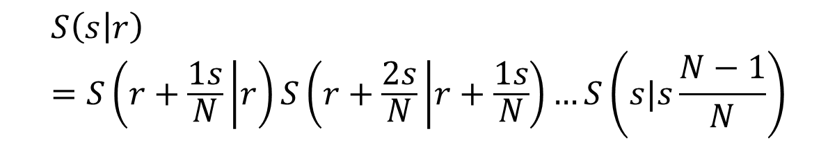
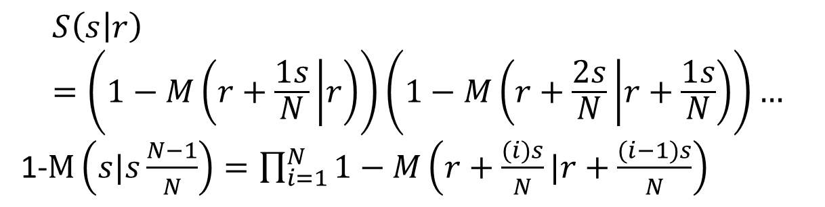
$$S\left(s | r\right)=S\left(r+1 | r\right)S\left(r+2 | r+1\right)…S(s|s−1)$$
$$S\left(s | r\right)=S\left(r+\frac{1s}{N} | r\right)S\left(r+\frac{2s}{N} | r+\frac{1s}{N}\right)…S\left(s|s\frac{N−1}{N}\right)$$
$$S\left(s | r\right)=\left(1−M\left(r+\frac{1s}{N} | r\right)\right)\left(1−M\left(r+\frac{2s}{N} | r+\frac{1s}{N}\right)\right)…$$
1-$M\left(s|s\frac{N−1}{N}\right)=\prod_{i=1}^{N}{1−M\left(r+\frac{(i)s}{N}|r+\frac{(i−1)s}{N}\right)}$

Slide 23
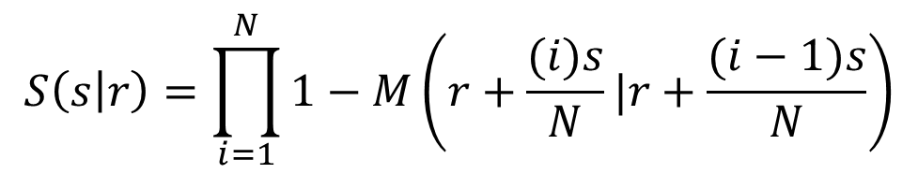
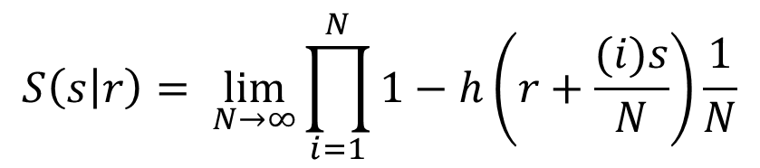
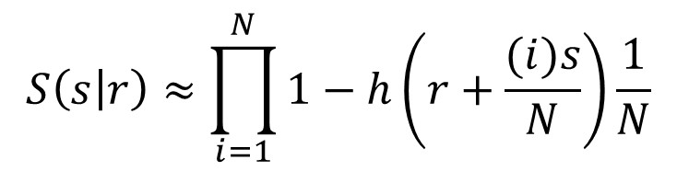
$$S\left(s | r\right)=\prod_{i=1}^{N}{1−M\left(r+\frac{(i)s}{N}|r+\frac{(i−1)s}{N}\right)}$$
$$S\left(s | r\right)=\prod_{i=1}^{N}{1−M\left(r+\frac{(i)s}{N}|r+\frac{(i−1)s}{N}\right)}$$
M(t + Δ | t) ≈ h(t) Δ
$$S\left(s | r\right)≈\prod_{i=1}^{N}{1−h\left(r+\frac{(i)s}{N}\right)\frac{1}{N}}$$
$$S\left(s | r\right)= \lim_{N→∞}{\prod_{i=1}^{N}{1−h\left(r+\frac{(i)s}{N}\right)\frac{1}{N}}}$$

Slide 24
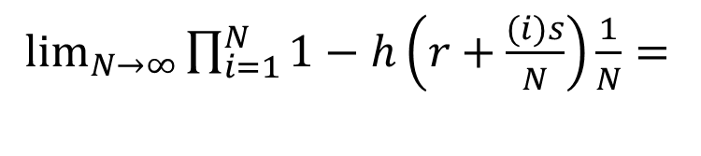
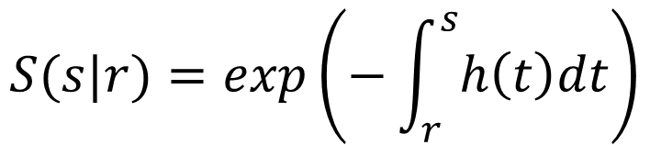
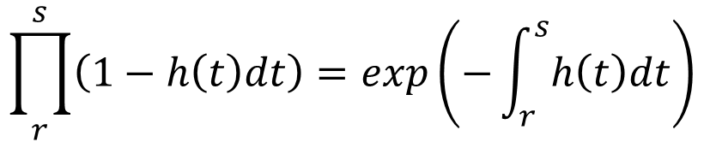
$$S\left(s | r\right)=\prod_{i=1}^{N}{1−M\left(r+\frac{(i)s}{N}|r+\frac{(i−1)s}{N}\right)}$$
$\lim_{N→∞}{\prod_{i=1}^{N}{1−h\left(r+\frac{(i)s}{N}\right)\frac{1}{N}}}=$
$$\prod_{r}^{s}{\left(1−h\left(t\right)dt\right)}=exp\left(−\int_{r}^{s}{h\left(t\right)dt}\right)$$
$$S(s|r)=exp\left(−\int_{r}^{s}{h\left(t\right)dt}\right)$$

Slide 25
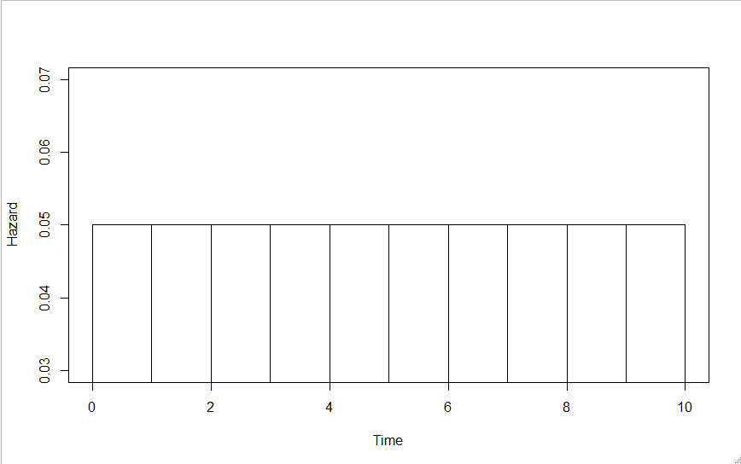
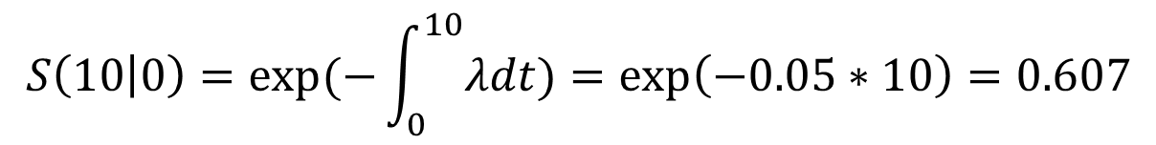

$$S\left(10 | 0\right)=(1−M\left(1 | 0\right))(1−M\left(2 | 1\right))…(1−M\left(10 | 1\right))$$
$$S\left(10 | 0\right)={0.95}^{10}=0.599$$
$$S\left(10 | 0\right)=exp⁡(−\int_{0}^{10}{λdt)}=\exp\left(−0.05∗10\right)=0.607$$
M(1|0)
M(2|1)
M(10|9)
0.05
0.05
0.05
0.05
0.05
0.05
0.05
0.05
0.05
0.05

Slide 26
Some Example Hazards
Two Tasks:
1 – Dealing with without integrals
2 - Developing Flexible Models for h(t)

Slide 27
TASK 1:
Define
is the interval (r to s) cumulative hazard.

Slide 28
Intuition Behind Cum. Hazard:
Average number of failures between s and r for a subject that can miraculously resurrect after a failure at time t, continuing on with hazard h(t).
Notes:
28

Slide 29
is the unit (r to r+1)
cumulative hazard
Two facts about integrals:
1) Additivity:
2) Mean value theorem for integrals:

Slide 30
Avoiding integrals,
we represent Λ(s|r) as:
Because of the relationship:
We can think of our models as exact models for the UCH Λ_{u}(t) or very good approximate models for the hazard h(t).

Slide 31
Why All This Fuss About Hazards?
As biologists, we should estimate biologically meaningful things.
Parameters should always have clearly stated units and clear biological interpretations.
Hazard ratios are usually fairly clear (simple rate models) and are easily extended.

Slide 32
Hazards Main Competitor: Odds
Logit models, log (P/(1-P)); well suited to truly discrete time data.
Are sometimes applied to grouped survival data by setting P = M(t+1 | t).
Models are parameterized in terms of log odds.
Odds models typical give results very similar to hazard models; but hazards easier to extend (cause-specific, frailities, etc.)

Slide 33
One Final Thing:
Hazard functions h(t) by def’n are non-negative.
Can remove this constraint by working with the log hazard, γ(t) = log (h(t))
We will see this a lot (Prentice-Gloeckler).

Slide 34
One Final Thing:
This expression is very basic in survival analysis.
It is closely related to the complementary log-log link.
It is sometime referred to the grouped data (or discrete) proportional hazards model.

Slide 35

Nimble
NIMBLE extends BUGS by:
allowing you to write new functions and distributions and use them in BUGS models;
2. allowing you to define multiple models in the same code using conditionals evaluated when the BUGS code is processed;
3. supporting a variety of more flexible syntax such as R-like named parameters and more general
algebraic expressions.

Slide 36
Example 2_1
for (k in left[j]:(right[j]-1)) {
UCH[j,k] <- exp(gamma)
}
SLR[j] <- exp(-sum(UCH[j,left[j]:(right[j]-1)]))

Slide 37
EXAMPLE 2_1
The statement:
censored[j] ~ dbern(SLR[j])
produces the correct likelihood for T.
software “knows” to multiple all probability contributions from things that look like data to construct the likelihood.
Notes:
37

Slide 38
EXAMPLE 2_1
Y~ dbern(P)
If Y = 1, the contribution is P.
If Y = 0, the contribution is 1 - P
It might take two records, but in this way the software will correctly construct the likelihood contribution for each subject’s T_{i}.
Notes:
38

Slide 39
Aside: Estimating S(t)
It is very easy to compute functions of parameters in and their uncertainty using Bayesian software in R.
For example, the survival function estimate is easily obtained from the log hazards γ as:

Slide 40
Aside: Estimating S(t)
The code for example2_1 is:
for (i in 1:64) {
UCH0[i]<-exp(gamma)
CH0[i]<-sum(UCH0[1:i])
S0[i]<-exp(-CH0[i])
}

Slide 41
TASK 2: Developing Flexible
Models for h(t)
This is equivalent to developing flexible models for the log hazard, γ(t) = log(h(t)).
The model already demonstrated is γ(t) = γ .
Let’s model γ(t) as a step function.

Slide 42
Modelling γ(t) as a Step Function
Example 2_2
list(lookup=c(rep(1,21), rep(2,21), rep(3,21))
for (i in 1:3) {gamma[i]~dflat()}
UCH[j,k] <- exp(gamma[lookup[k]])

Slide 44
Step Placement is Arbitrary
It is hard to formally judge the fit of such models.
This is because of dimensionality issues.
In addition to 3 step parameters γ, two knot positions were selected “by eyeball”.
This being said, such models have historically performed very well and have been very useful.

Slide 45
Saturated Step Model
example2_4
list(lookup=c(
17,1,17,17,17,17,2,17,17,17,17,17,3,17,17,4,5,
17,17,17,6,7,17,17,17,8,9,17,10,17,17,11,17,12,
17,17,13,17,17,14,15,17,17,16,17,17,17,17,17,17,17,17,17,17,17,17,17,17,17,17,17,17,17,17)
)
for (i in 1:16) {gamma[i]~dflat()}
gamma[17]<- -99.9 # Constrain hazard to almost zero

Slide 47
Not Very Bayesian so Far…
Clearly the hazard is too rough and violates our intuition or prior belief about such processes.
So consider an alternative approach…
Specify a very general model:
Let γ_{i} = γ + ρ_{i}
But this model is overparameterized with as many parameters as days…

Slide 48
Flexible Structure
Let γ_{i} = γ + ρ_{i}
Way too many parameters relative to data.
So specify some flexible constraint, such as the value at time i+1 should be similar to the one immediately before it at time i:
ρ_{i+1} | ρ_{i} ~ dnorm(ρ_{i}, tau)

Slide 49
Smoothing the line
Aside: In Bayesian programs, normals are often specified in terms of precision τ rather than variance σ².
Precision (tau) = 1 / variance = 1 / (sd * sd)
So a precision of tau = 20 corresponds to a sd = 0.22.
Notes:
49

Slide 50
Smoothing the line
The prior for ρ_{i} is best thought of as a prior on the differences:
ρ_{i+1}-ρ_{i} ~ Normal(0, tau) or
ρ_{i}-(ρ_{i-1}+ρ_{i+1})/2 ~ Normal(0, tau)
Several ways such ICAR1 priors can be specified in Bayesian software (see Primer, Chapter 2
Notes:
50

Slide 51
Example 2_5
Nimble Code:
rho[i]~dnorm(rho[i-1],30)
given yesterday’s residual was rho_{k-1}, today’s residual is a random variable drawn from a normal distribution with mean rho_{k-1} and precision t.
Notes:
51

Slide 52
Example 2_5
Notes:
52

Slide 53
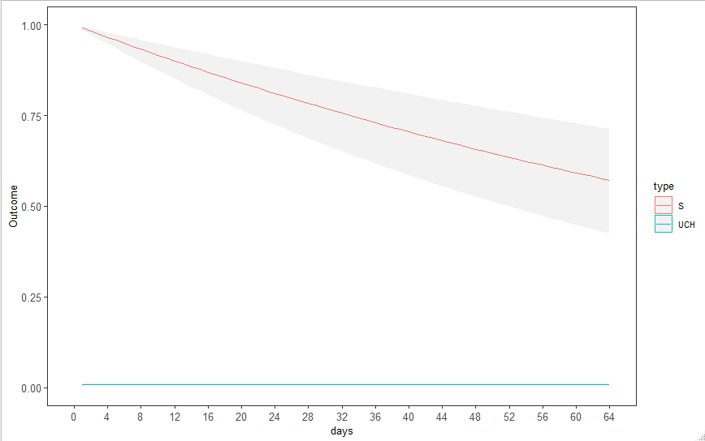
Example 2_1 – constant

Slide 54
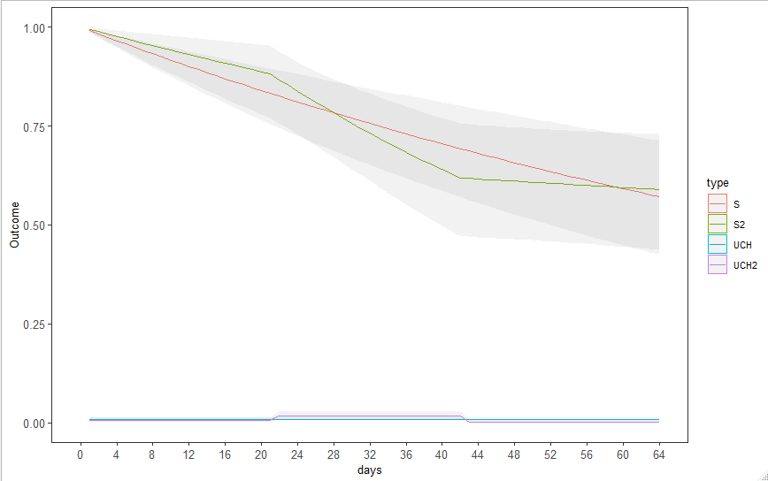
Example 2_2 – 3 different

Slide 55
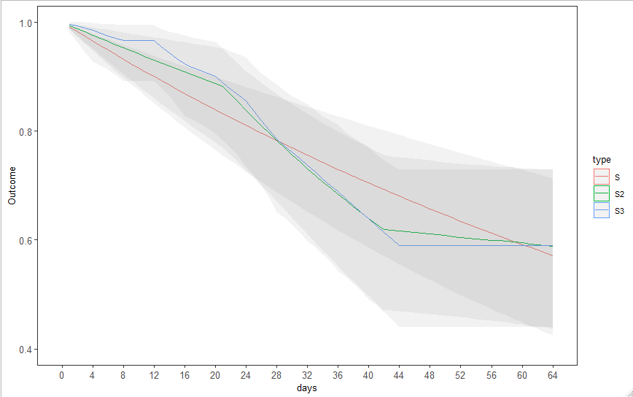
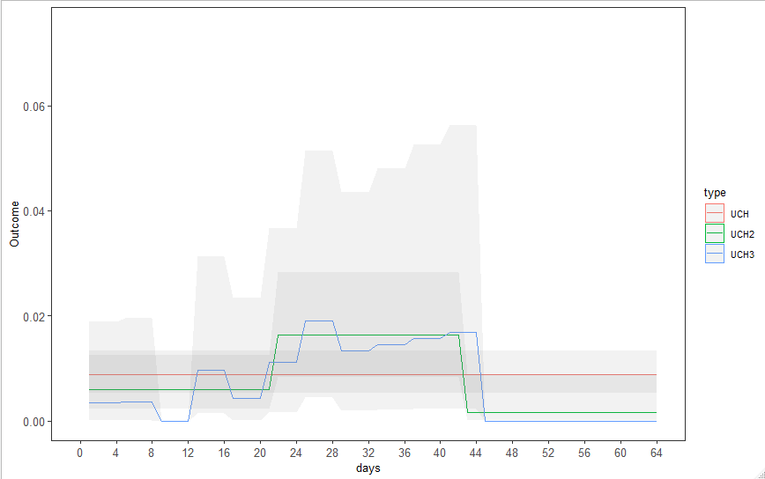
Example 2_3 – Each mortality time

Slide 56
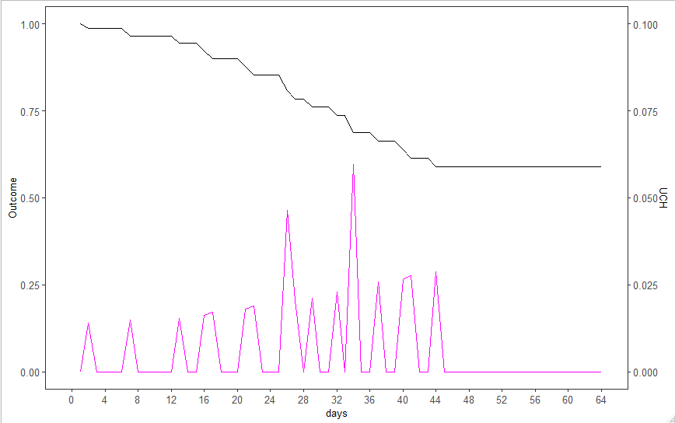
Example 2_4 – Each mortality time

Slide 57
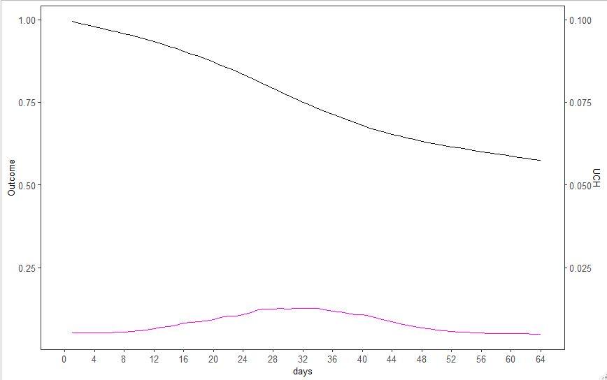
Example 2_5 - ICAR

Slide 58
Example 2_6
The dcar_normal function in Nimble
dcar_normal(adj, weights, num, tau, c, zero_mean)
adj: adjacency matrix
weights: default is1
num: number of neighboring locations
tau: precision of Gaussian CAR prior
zero_mean: zero_mean = 1 to replicate WinBUGS, not necessarily recommended
Notes:
58

Slide 59
Car.normal()
Most commonly seen in the 2-D spatial context.
In temporal applications, analogous to a linear map.
wts[], adj[], and nums[] describe the map:
wts=1
Adj=(2,1,3,2,4,3,5……etc)
Nums=(1,2,2,2,2,2…………..1)
Notes:
59

Slide 60
Example 2_6
Our (Besag, Waller, etc.) philosophy about priors such as ICAR(1):
We do not actually believe the differences are normally distributed. What we are trying to do is capture the “general texture” of the process. We don’t want any one step to be unusually large unless the data strongly supports it.
Uniquely Bayesian – a probability model applied to parameters.
Notes:
60

Slide 61

Model Evaluation - Dimensionality
Balance fit to data versus model complexity based on model’s predictive performance:
Ideally: Out-of-sample data
Next best: Cross-validation using observed data
Usual: AIC = deviance ($\hat{θ_{MLE}}$) + 2*k
DIC = deviance($\hat{θ_{Bayes}}$) +2*pDIC,
pDIC = deviance ($\hat{θ_{Bayes}}$) - $\frac{1}{S}\sum_{s=1}^{S}{\text{deviance}(θ^{s})}$
S = Number of posterior samples

Slide 62
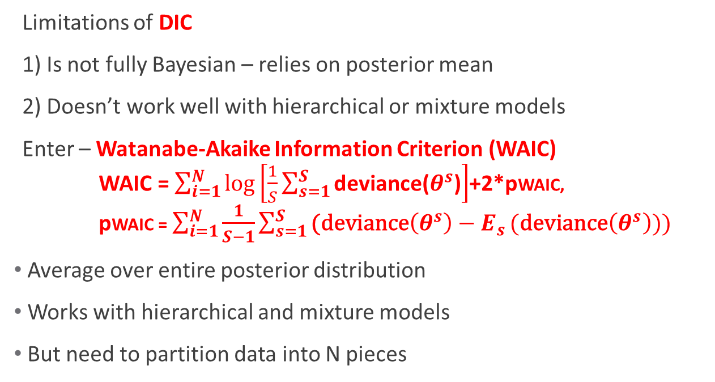
Model Evaluation - Dimensionality
Limitations of DIC
1) Is not fully Bayesian – relies on posterior mean
2) Doesn’t work well with hierarchical or mixture models
Enter – Watanabe-Akaike Information Criterion (WAIC)
WAIC = $\sum_{i=1}^{N}{\log\left[\frac{1}{S}\sum_{s=1}^{S}{\text{deviance}\text{(}θ^{s}\text{)}}\right]}$+2*pWAIC,
pWAIC = $\sum_{i=1}^{N}{\frac{1}{S−1}\sum_{s=1}^{S}{\text{(}\text{deviance}\left(θ^{s}\right)−E_{s}}(\text{deviance}\left(θ^{s}\right)))}$
Average over entire posterior distribution
Works with hierarchical and mixture models
But need to partition data into N pieces

Slide 63
Model Evaluation - Dimensionality
NIMBLE Package uses – WAIC and so shall we
WAIC and smoothing approaches are a natural combination.
“Overparameterize” the model, but include a “complexity control parameter” (tau).
Use WAIC to evaluate fit/complexity tradeoff to find optimal degree of smoothing.

Slide 64
Example 2_6 results
tau | WAIC
0.01 | 1210.537
0.1 | 228.796
1 | 211.62
5 | 205.176
10 | 203.727
15 | 203.539
20 | 204.357
25 | 203.984
30 | 204.273
40 | 204.996
9999 | 208.088
999999 | 208.067
Notes:
64

Slide 65
Example 2_6

Slide 66
Example 2_6
tau = 20 is a “good” model from the standpoint that it balances fit to the data with parameter complexity, i.e., parsimony in model selection terms.
This is the essence of the bias/variance tradeoff of good predictive models.
But so far we make no allowance for our uncertainty that tau = 20 is “best” (no model averaging).
Notes:
66

Slide 67
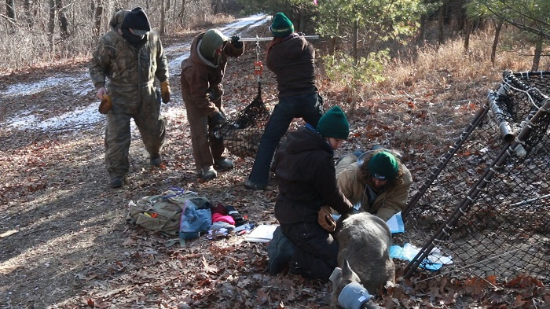
End of Lesson 2

