Slide 1
Covariate Analysis etc.
Covariate:
Something we measure that might be associated with survival.
Goal:
Assess the nature of association.

Slide 2
Assess the Nature of Association
Hazard-based models excel in this respect.
Parameters generally have clear biological interpretations.

Slide 3
Types of Covariates
Internal versus External
Fixed versus Time-Varying

Slide 4
Internal Covariates
An internal covariate is a value generated by the subject itself:
Weight, temperature, location, etc.
Typically cease after T.
Causal interpretations extremely problematic!
-Generating mechanism may share hazard parameters.

Slide 5
External Covariates
Value not generated by the subject.
Air temperature, experimental treatment group, etc.
Causal interpretations challenging unless a randomized trial.

Slide 6
Fixed versus Time-Varying
A time-varying covariate is one that varies over time (or age).
A fixed covariate takes a single constant value.
Time-varying covariates are problematic because continuous histories are difficult to obtain.
Ideally, a fixed covariate extrapolates back to the time origin.

Slide 7
Fixed versus Time-Varying: Examples
Fixed – gender, experimental treatment, etc.
Varying – weight, temperature, location, etc.
Often covariates are a bit ill-defined:
Ex. - Body weight at the time of study entry e.
-Treated as fixed, by really t.v.
- Cannot be meaningfully extrapolated to origin.
Do the best you can….

Slide 8
Hazard-based Covariate Models –
PH Models
Let X be a covariate (really X(t) in full generality).
Let f(X, β) be nonnegative function of X(t).
The proportional hazard (PH) model states:
h(t) = f(X, β) h₀(t)
h₀(t) is the baseline hazard.

Slide 9
Hazard-based Covariate Models
h(t) = f(X, β) h₀(t) : the general PH model
h₀(t) is the baseline hazard.
f(X, β) = h(t) / h₀(t) is the hazard ratio.
h(t) = h₀(t) when the hazard ratio is 1.

Slide 10
PH Models
h(t) = f(X, β) h₀(t) : the general PH model
Motivation – Generalized “mass-action” models, multiplicatively scale the hazard up or down.
Most commonly
f(X(t), β) = exp(Xβ)
Because exp(0β) = 1, often desirable to “center” X(t)

Slide 11
Example : 4_1
We model h₀(t)=exp(γ + ρ_{t})
So our log-linear PH model becomes:
h(t) = h₀(t) exp(Xβ) = exp(γ + ρ_{t}) exp(Xβ)= exp(γ + ρ_{t} + Xβ)

Slide 12
Example : 4_1
Black duck condition index =
body weight / wing length
X = Condition index – 4.30
UCH[j,k] <- exp( gamma0 + rho[k] +
lhrcond * (cond[j]-4.30))
lhrcond~dnorm(0,0.0000001)
hrcond<-exp(lhrcond)

Slide 13
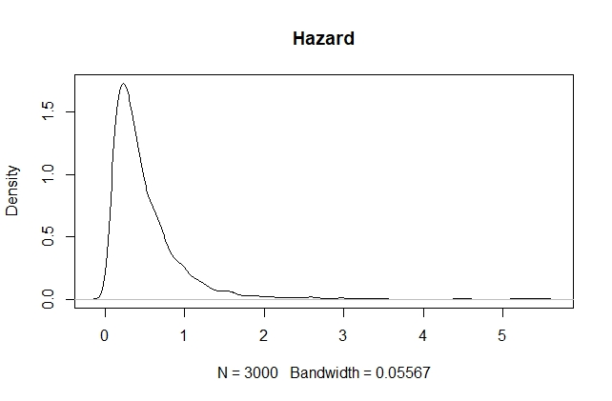
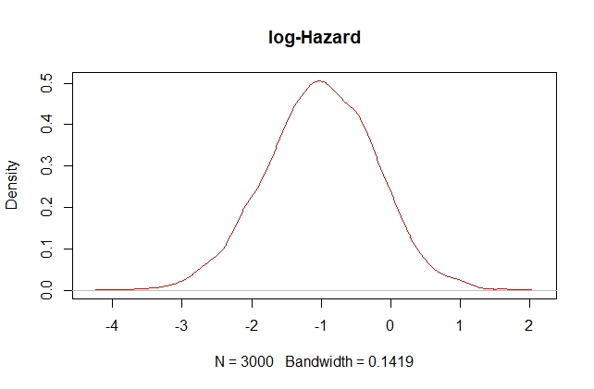
Example : 4_1
Posterior distribution of HR & log HR:

Slide 14
Aside: Point Estimates
log HR HR
Posterior mean -1.02 0.48
Posterior median -1.00 0.43
Cox MPLE* -0.93 0.39
Hazard ratios are usually more skewed than log hazard ratios.
Medians and modes possess functional invariance, means do not.
Depends on what you want.
*if you use coxph in R worth noting that events are reversed (zeros are 1, 1’s are zeros)

Slide 15
Aside: Cox vs. Our Approach
Cox requires near-continuous monitoring, can’t handle interval-censoring.
Both approaches are fitting the PH model.
Baselines handled differently.

Slide 16
Aside: Cox vs. Our Approach
Baselines handled differently:
Cox uses the infinite parameter KM approach.
By clever math, the Cox approach implicitly involves the baseline hazard, but never produces explicit estimates (“profiled out”).
Because the baseline parameters do not appear in the likelihood, said to be a “partial likelihood”.

Slide 17
Aside: Cox vs. Our Approach
Full likelihood procedures such as ours will give similar results if flexible baseline models are reasonable.
Full likelihood uses more information, hence slightly more efficient.
Treats multiple time baselines symmetrically.
Cox is still a good verification procedure.

Slide 18
Time-Varying Covariates and Multiple Time Scales
Time-varying covariates are very straightforward:
h(t) = f(X(t), β) h₀(t)
Suppose we had continuous condition data:
UCH[j,k] <- exp(gamma0 + rho[k] +lhrcond * (cond[j,k]-4.30))
That’s all there is to it (numerically speaking).

Slide 19
Multiple Baselines
We have been vague about T. Is it age, or is it calendar time? In ecology, we are often interested in both.
Suppose our data is in terms of age; k is indexing age and rho is the age effect:
UCH[j,k] <- exp(gamma0 + rho[k])

Slide 20
Multiple Time Scales
Let birthdate be a vector of data with the subjects birthdates.
We can define a calendar time effect period with ICAR structure similar to rho and include it in the model as
UCH[j,k] <- exp( gamma0 + rho[k] +
period[birthdate[j] + k])
A so-called age-period model (see Primer).

Slide 21
Age and Time as Time-Varying Covariates
Upon close inspection, we have just been treating age and time as flexibly modelled covariates.
Seque to time-varying coefficients (as distinct from time-varying covariates)….

Slide 22
Time-varying Coefficients:
Non-PH models
The PH assumption is often too rigid.
It seems unlikely that body condition has a constant effect on the mortality hazard through time.
Generalize the PH model exp(Xβ) to the non-PH model exp(Xβ(t)).
The log hazard ratio is allowed to vary with time.

Slide 23
Time-varying Coefficients
Postulates a time by covariate interaction.
Simplistic tradition approach: model β = β₀ + β₁t
Assumes the non-PH behavior is linear over time

Slide 24
Time-varying Coefficients
Simplistic tradition approach: model β = β₀ + β₁t .
We can make the model for β more flexible:
β = β₀ + β_{1k} where β_{1k} is ICAR.

Slide 25
Example 4_2

Slide 26
Time-Varying Coefficient Models With Time-Varying Covariates!
Far-fetched?
Consider a binary time-varying covariate indicating some state, such as infected/not infected, preg/not preg, etc.
Only reasonable to expect effect of covariate value (0,1) to vary with time (takes a while for infected animal to get sick).

Slide 27
End of Lesson 4

