Slide 1
Microstructure – the “Interesting Stuff”
Models biology rather than biologists;-)
All about the hazard function h(t) .
Conditional survival is a function of the hazard function:

Slide 2
One of the most important equations in ecology.
Pretty much an analytic result, doesn’t appear to hold much interesting intuition.
Just accept it; focus intuition on h(t) and

Slide 3
Hazard Function Motivation
Usually motivated as an approximation to the conditional mortality function:
M(t + d | t) ≈ h(t) d
“Prob. dead by t + d given alive at t”
where t = origin (pt. in time = estimate survival)
Formally defined as:
t
t+d
T

Slide 4

Hazard Function Motivation
This formal definition implies that the hazard is the first derivative of the conditional mortality function at the conditional origin:
Example:
$M\left(s | r\right)=1−S\left(s | r\right)$
$S\left(s | r\right)=exp⁡(−\int_{r}^{s}{λ \text{dt}}$)
$\frac{dM(s|r)}{dt}=λexp⁡(−λ\left(s−r\right))$
$let s=r, \frac{dM(s|r)}{dt}=λ$

Slide 5
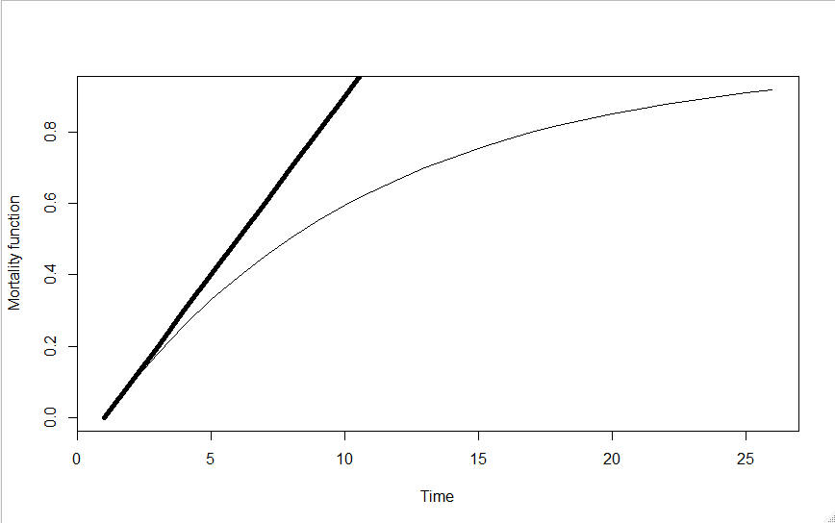
Hazard Function Motivation
Slope of this line = λ = rate of change of mortality function
Take home: If mortality function rises steeply = hazard is high
Conditional origin = 0

Slide 6
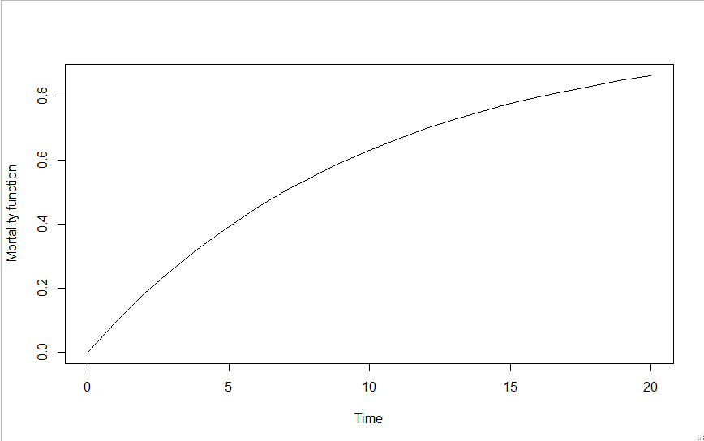
Hazard Function Motivation
M(t + Δ | t) ≈ h(t) Δ

Slide 7
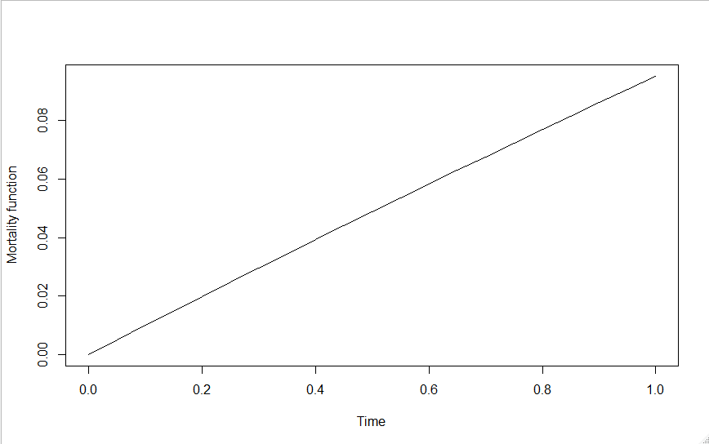
Hazard Function Motivation
M(t + Δ | t) ≈ h(t) Δ as Δ → 0⁺ approximation improves
Δ
Probability of dying in Δ given t = 0

Slide 8
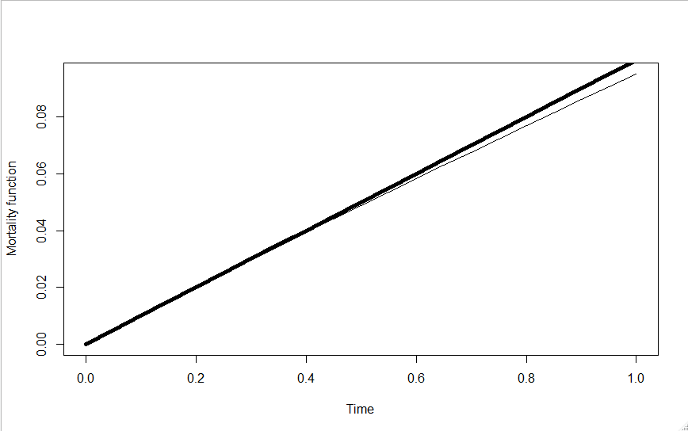
Hazard Function Motivation
h(t) Δ
Δ
M(t + Δ | t)
Error = 0.0024

Slide 9
Hazard Function Motivation
Δ
M(t + Δ | t)

Slide 10
Hazard Function Motivation
h(t) Δ
Δ
M(t + Δ | t)
Error = 0.00014

Slide 11
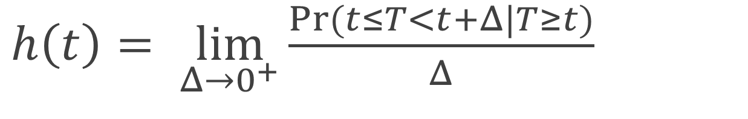
Hazard Function Motivation
$h\left(t\right)= \lim_{Δ→0^{+}}{\frac{Pr⁡(t≤T<t+Δ|T≥t)}{Δ}}$

Slide 12
Hazard Function Motivation
The basis for reasonable linear “mass-action” type models – the hazard is simply a rate, or intensity.
Because of the “compounding” behavior of S(t) and M(t), most other parameters result in complicated nonlinear responses that depend on choice of time scale.
Hazards are the probabilistic equivalent of differential equation models (“force-of-mortality”):
dN/dt = [b(t) – m(t)]N

Slide 13
Hazard Function Motivation
The natural scale for modelling biological dynamics:
Hypothetical example – prey population where predation is the only source of mortality.
Let’s say predator density P was halved – hazard will be halved:
dN/dt = [b(t) – βP]N
dN/dt = [b(t) – β(0.5∗P)]N

Slide 14
In contrast to the clean linear halving response of the hazard function, the survival function response is square-root:

Slide 15
Some Example Hazards
Used-better-than-new, New-better-than-used, bathtub, non-aging, modal: These properties are only easily recognized on the hazard scale

Slide 16
Where does this equation come from?

Slide 17
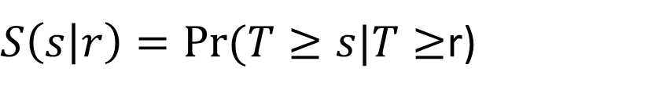


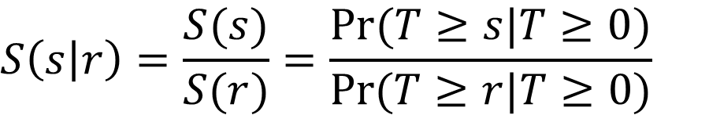
$$S$$
$$S\left(s\right)=Pr⁡(T≥s|T≥\text{0})$$
$S\left(s | r\right)=Pr⁡(T≥s|T≥$r)
$$S\left(s | r\right)=\frac{S(s)}{S(r)}=\frac{Pr⁡(T≥s|T≥\text{0})}{Pr⁡(T≥r|T≥\text{0})}$$
$$S\left(s | r\right)=S\left(r+1 | r\right)S\left(r+2 | r+1\right)…S(s|s−1)$$

Slide 18

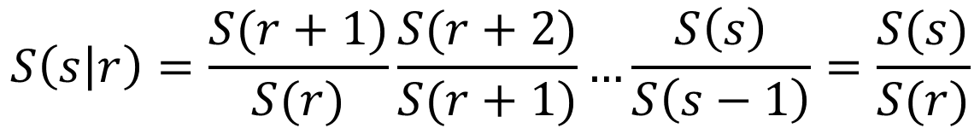
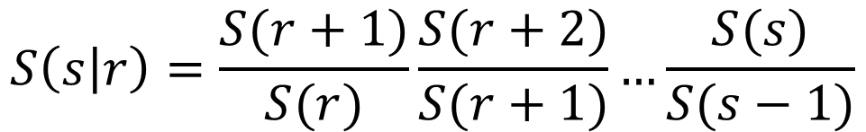
$$S$$
Prove:
$$S\left(s | r\right)=S\left(r+1 | r\right)S\left(r+2 | r+1\right)…S(s|s−1)$$
Proof:
$$S\left(s | r\right)=\frac{S(r+1)}{S(r)}\frac{S(r+2)}{S(r+1)}…\frac{S(s)}{S(s−1)}$$
$$S\left(s | r\right)=\frac{S(r+1)}{S(r)}\frac{S(r+2)}{S(r+1)}…\frac{S\left(s\right)}{S\left(s−1\right)}=\frac{S(s)}{S(r)}$$

Slide 19
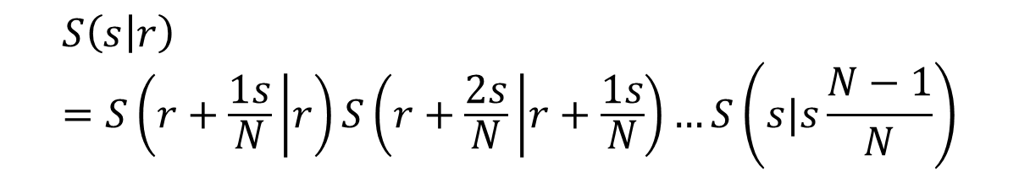
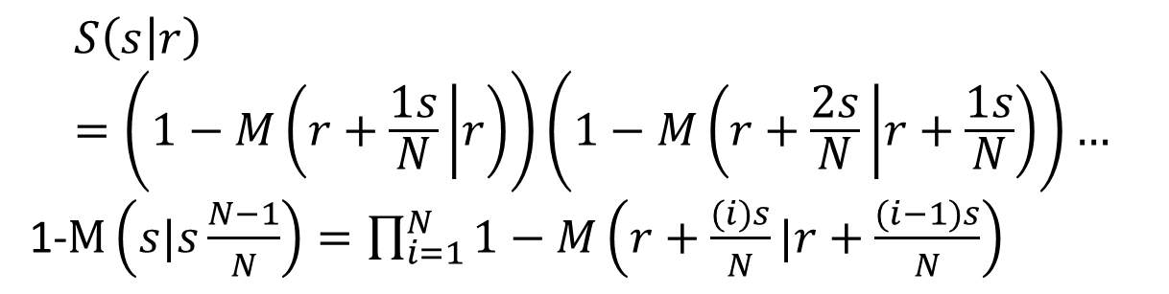
$$S\left(s | r\right)=S\left(r+1 | r\right)S\left(r+2 | r+1\right)…S(s|s−1)$$
$$S\left(s | r\right)=S\left(r+\frac{1s}{N} | r\right)S\left(r+\frac{2s}{N} | r+\frac{1s}{N}\right)…S\left(s|s\frac{N−1}{N}\right)$$
$$S\left(s | r\right)=\left(1−M\left(r+\frac{1s}{N} | r\right)\right)\left(1−M\left(r+\frac{2s}{N} | r+\frac{1s}{N}\right)\right)…$$
1-$M\left(s|s\frac{N−1}{N}\right)=\prod_{i=1}^{N}{1−M\left(r+\frac{(i)s}{N}|r+\frac{(i−1)s}{N}\right)}$

Slide 20
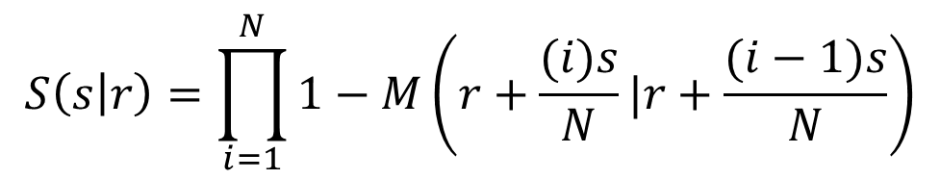
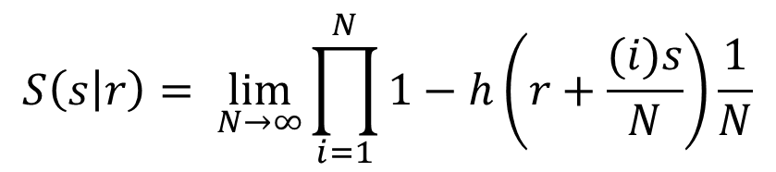
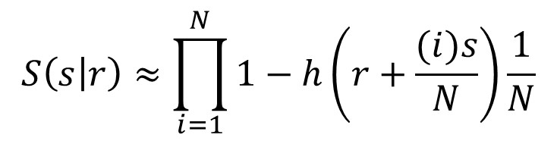
$$S\left(s | r\right)=\prod_{i=1}^{N}{1−M\left(r+\frac{(i)s}{N}|r+\frac{(i−1)s}{N}\right)}$$
$$S\left(s | r\right)=\prod_{i=1}^{N}{1−M\left(r+\frac{(i)s}{N}|r+\frac{(i−1)s}{N}\right)}$$
M(t + Δ | t) ≈ h(t) Δ
$$S\left(s | r\right)≈\prod_{i=1}^{N}{1−h\left(r+\frac{(i)s}{N}\right)\frac{1}{N}}$$
$$S\left(s | r\right)= \lim_{N→∞}{\prod_{i=1}^{N}{1−h\left(r+\frac{(i)s}{N}\right)\frac{1}{N}}}$$

Slide 21
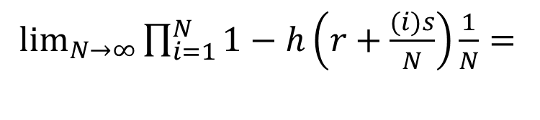
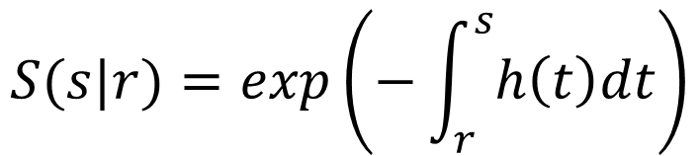
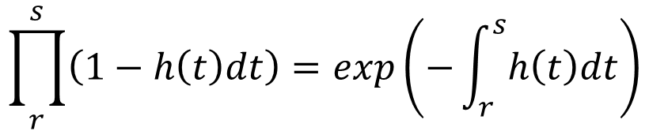
$$S\left(s | r\right)=\prod_{i=1}^{N}{1−M\left(r+\frac{(i)s}{N}|r+\frac{(i−1)s}{N}\right)}$$
$\lim_{N→∞}{\prod_{i=1}^{N}{1−h\left(r+\frac{(i)s}{N}\right)\frac{1}{N}}}=$
$$\prod_{r}^{s}{\left(1−h\left(t\right)dt\right)}=exp\left(−\int_{r}^{s}{h\left(t\right)dt}\right)$$
$$S(s|r)=exp\left(−\int_{r}^{s}{h\left(t\right)dt}\right)$$

Slide 22
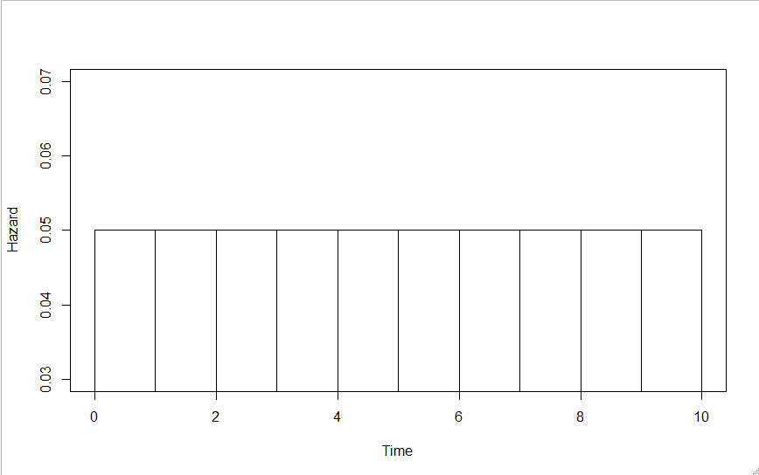
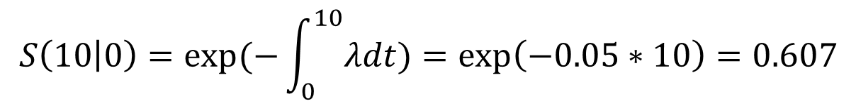

$$S\left(10 | 0\right)=(1−M\left(1 | 0\right))(1−M\left(2 | 1\right))…(1−M\left(10 | 1\right))$$
$$S\left(10 | 0\right)≈(1−h\left(1 | 0\right))(1−h\left(2 | 1\right))…(1−h\left(10 | 1\right))$$
$$S\left(10 | 0\right)≈{0.95}^{10}=0.599$$
$$S\left(10 | 0\right)=exp⁡(−\int_{0}^{10}{λdt)}=\exp\left(−0.05∗10\right)=0.607$$
h(1|0)
h(3|2)
h(10|9)
0.05
0.05
0.05
0.05
0.05
0.05
0.05
0.05
0.05
0.05

Slide 23
Goals
Two Tasks:
1 – Dealing with without integrals
2 - Developing Flexible Models for h(t)

Slide 24
TASK 1:
Define
is the interval (r to s) cumulative hazard.

Slide 25
Intuition Behind Cum. Hazard:
Average number of failures between s and r for a subject that can miraculously resurrect after a failure at time t, continuing on with hazard h(t).
Notes:
25

Slide 26
is the unit (r to r+1)
cumulative hazard
Two facts about integrals:
1) Additivity:
2) Mean value theorem for integrals:

Slide 27
Avoiding integrals,
we represent Λ(s|r) as:
Because of the relationship:
We can think of our models as exact models for the UCH Λ_{u}(t) or very good approximate models for the hazard h(t).

Slide 28
Why All This Fuss About Hazards?
As biologists, we should estimate biologically meaningful things.
Parameters should always have clearly stated units and clear biological interpretations.
Hazard ratios are usually fairly clear (simple rate models) and are easily extended.

Slide 29
Hazards Main Competitor: Odds
Logit models, log (P/(1-P)); well suited to truly discrete time data.
Are sometimes applied to grouped survival data by setting P = M(t+1 | t).
Models are parameterized in terms of log odds.
Odds models typical give results very similar to hazard models; but hazards easier to extend (cause-specific, frailities, etc.)

Slide 30
One Final Thing:
Hazard functions h(t) by def’n are non-negative.
Can remove this constraint by working with the log hazard, γ(t) = log (h(t))
We will see this a lot (Prentice-Gloeckler).

Slide 31
One Final Thing:
This expression is very basic in survival analysis.
It is closely related to the complementary log-log link.
It is sometime referred to the grouped data (or discrete) proportional hazards model.

Slide 32

Nimble
NIMBLE extends BUGS by:
allowing you to write new functions and distributions and use them in BUGS models;
2. allowing you to define multiple models in the same code using conditionals evaluated when the BUGS code is processed;
3. supporting a variety of more flexible syntax such as R-like named parameters and more general algebraic expressions.

Slide 33
Example 2_1
for (k in left[j]:(right[j]-1)) {
UCH[j,k] <- exp(gamma)
}
SLR[j] <- exp(-sum(UCH[j,left[j]:(right[j]-1)]))

Slide 34
EXAMPLE 2_1
The statement:
censored[j] ~ dbern(SLR[j])
produces the correct likelihood for T.
software “knows” to multiple all probability contributions from things that look like data to construct the likelihood.
Notes:
34

Slide 35
EXAMPLE 2_1
Y~ dbern(P)
If Y = 1, the contribution is P.
If Y = 0, the contribution is 1 - P
It might take two records, but in this way the software will correctly construct the likelihood contribution for each subject’s T_{i}.
Notes:
35

Slide 36
Aside: Estimating S(t)
It is very easy to compute functions of parameters in and their uncertainty using Bayesian software in R.
For example, the survival function estimate is easily obtained from the log hazards γ as:

Slide 37
Aside: Estimating S(t)
The code for example2_1 is:
for (i in 1:64) {
UCH0[i]<-exp(gamma)
CH0[i]<-sum(UCH0[1:i])
S0[i]<-exp(-CH0[i])
}

Slide 38
TASK 2: Developing Flexible
Models for h(t)
This is equivalent to developing flexible models for the log hazard, γ(t) = log(h(t)).
The model already demonstrated is γ(t) = γ .
Let’s model γ(t) as a step function.

Slide 39
Modelling γ(t) as a Step Function
Example 2_2
list(lookup=c(rep(1,21), rep(2,21), rep(3,21))
for (i in 1:3) {gamma[i]~dflat()}
UCH[j,k] <- exp(gamma[lookup[k]])

Slide 41
Step Placement is Arbitrary
It is hard to formally judge the fit of such models.
This is because of dimensionality issues.
In addition to 3 step parameters γ, two knot positions were selected “by eyeball”.
This being said, such models have historically performed very well and have been very useful.

Slide 42
Saturated Step Model
example2_4
list(lookup=c(
17,1,17,17,17,17,2,17,17,17,17,17,3,17,17,4,5,
17,17,17,6,7,17,17,17,8,9,17,10,17,17,11,17,12,
17,17,13,17,17,14,15,17,17,16,17,17,17,17,17,17,17,17,17,17,17,17,17,17,17,17,17,17,17,17)
)
for (i in 1:16) {gamma[i]~dflat()}
gamma[17]<- -99.9 # Constrain hazard to almost zero

Slide 44
Not Very Bayesian so Far…
Clearly the hazard is too rough and violates our intuition or prior belief about such processes.
So consider an alternative approach…
Specify a very general model:
Let γ_{i} = γ + ρ_{i}
But this model is overparameterized with as many parameters as days…

Slide 45
Flexible Structure
Let γ_{i} = γ + ρ_{i}
Way too many parameters relative to data.
So specify some flexible constraint, such as the value at time i+1 should be similar to the one immediately before it at time i:
ρ_{i+1} | ρ_{i} ~ dnorm(ρ_{i}, tau)

Slide 46
Smoothing the line
Aside: In Bayesian programs, normals are often specified in terms of precision τ rather than variance σ².
Precision (tau) = 1 / variance = 1 / (sd * sd)
So a precision of tau = 20 corresponds to a sd = 0.22.
Notes:
46

Slide 47
Smoothing the line
The prior for ρ_{i} is best thought of as a prior on the differences:
ρ_{i+1}-ρ_{i} ~ Normal(0, tau) or
ρ_{i}-(ρ_{i-1}+ρ_{i+1})/2 ~ Normal(0, tau)
Several ways such ICAR1 priors can be specified in Bayesian software (see Primer, Chapter 2
Notes:
47

Slide 48
Example 2_5
Nimble Code:
rho[i]~dnorm(rho[i-1],30)
given yesterday’s residual was rho_{k-1}, today’s residual is a random variable drawn from a normal distribution with mean rho_{k-1} and precision t.
Notes:
48

Slide 49
Example 2_5
Notes:
49

Slide 50
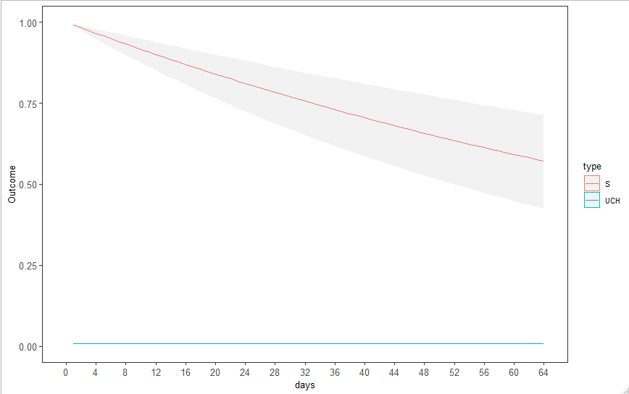
Example 2_1 – constant

Slide 51
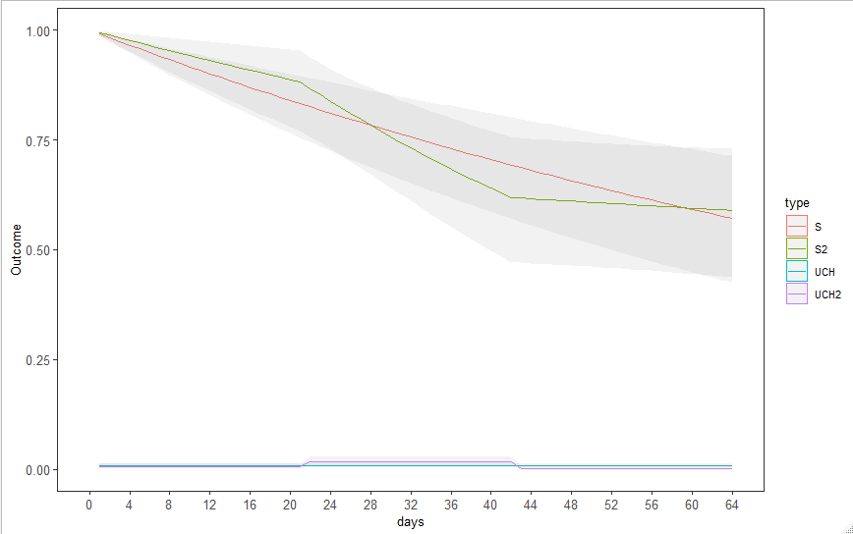
Example 2_2 – 3 different

Slide 52
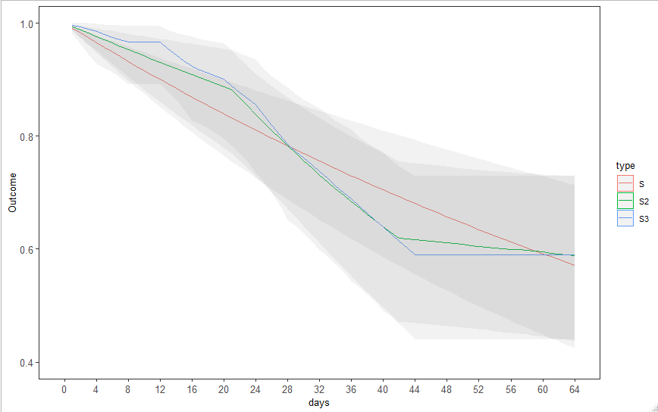
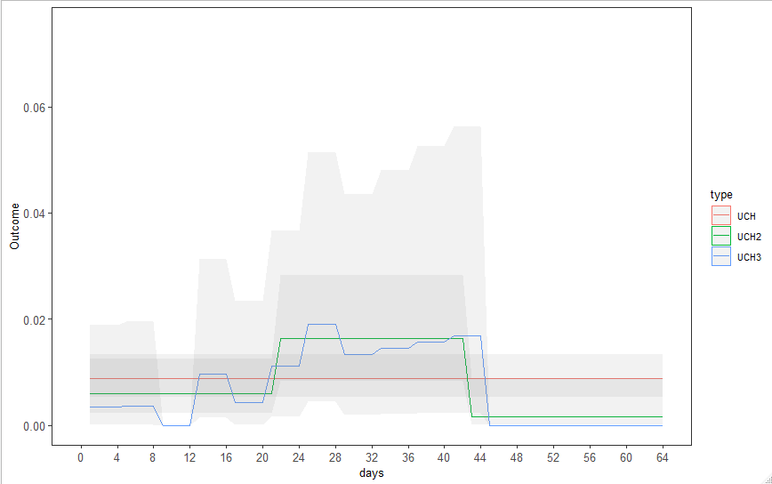
Example 2_3 – Each mortality time

Slide 53
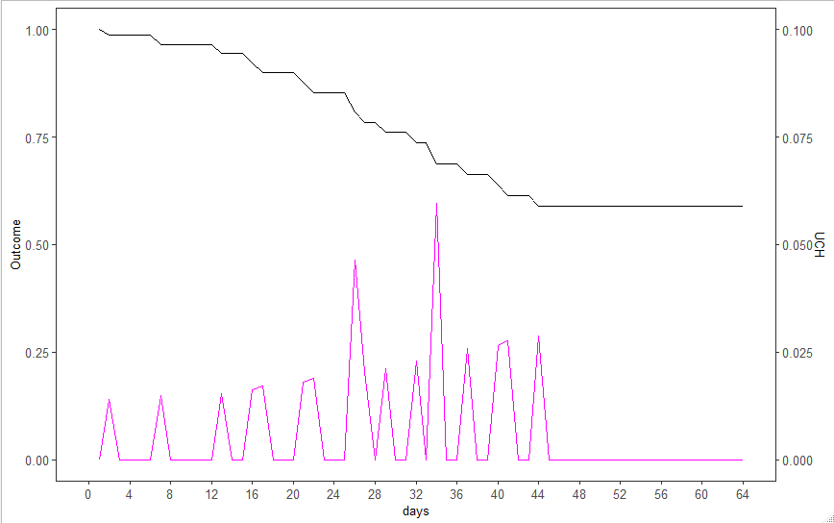
Example 2_4 – Each mortality time

Slide 54
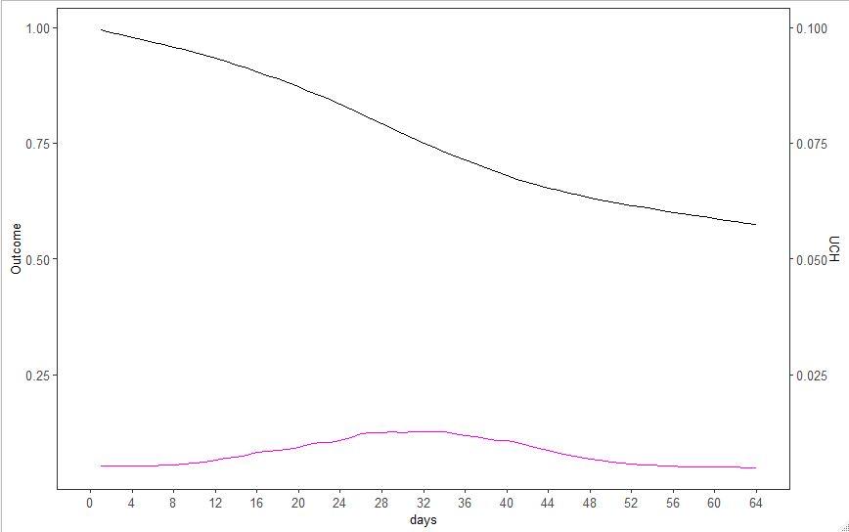
Example 2_5 - ICAR

Slide 55
Example 2_6
The dcar_normal function in Nimble
dcar_normal(adj, weights, num, tau, c, zero_mean)
adj: adjacency matrix
weights: default is1
num: number of neighboring locations
tau: precision of Gaussian CAR prior
zero_mean: zero_mean = 1 to replicate WinBUGS, not necessarily recommended
Notes:
55

Slide 56
Car.normal()
Most commonly seen in the 2-D spatial context.
In temporal applications, analogous to a linear map.
wts[], adj[], and nums[] describe the map:
wts=1
Adj=(2,1,3,2,4,3,5……etc)
Nums=(1,2,2,2,2,2…………..1)
t -1
t
t +1
Notes:
56

Slide 57
Example 2_6
Our (Besag, Waller, etc.) philosophy about priors such as ICAR(1):
We do not actually believe the differences are normally distributed. What we are trying to do is capture the “general texture” of the process. We don’t want any one step to be unusually large unless the data strongly supports it.
Uniquely Bayesian – a probability model applied to parameters.
Notes:
57

Slide 58

Model Evaluation - Dimensionality
Balance fit to data versus model complexity based on model’s predictive performance:
Ideally: Out-of-sample data
Next best: Cross-validation using observed data
Usual: AIC = deviance ($\hat{θ_{MLE}}$) + 2*k
DIC = deviance($\hat{θ_{Bayes}}$) +2*pDIC,
pDIC = deviance ($\hat{θ_{Bayes}}$) - $\frac{1}{S}\sum_{s=1}^{S}{\text{deviance}(θ^{s})}$
S = Number of posterior samples

Slide 59
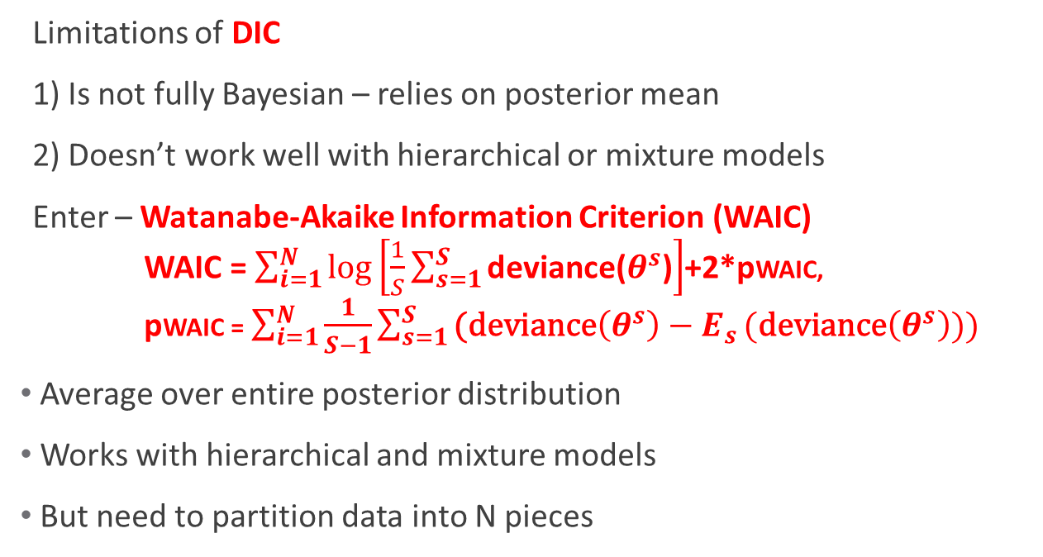
Model Evaluation - Dimensionality
Limitations of DIC
1) Is not fully Bayesian – relies on posterior mean
2) Doesn’t work well with hierarchical or mixture models
Enter – Watanabe-Akaike Information Criterion (WAIC)
WAIC = $\sum_{i=1}^{N}{\log\left[\frac{1}{S}\sum_{s=1}^{S}{\text{deviance}\text{(}θ^{s}\text{)}}\right]}$+2*pWAIC,
pWAIC = $\sum_{i=1}^{N}{\frac{1}{S−1}\sum_{s=1}^{S}{\text{(}\text{deviance}\left(θ^{s}\right)−E_{s}}(\text{deviance}\left(θ^{s}\right)))}$
Average over entire posterior distribution
Works with hierarchical and mixture models
But need to partition data into N pieces

Slide 60
Model Evaluation - Dimensionality
NIMBLE Package uses – WAIC and so shall we
WAIC and smoothing approaches are a natural combination.
“Overparameterize” the model, but include a “complexity control parameter” (tau).
Use WAIC to evaluate fit/complexity tradeoff to find optimal degree of smoothing.

Slide 61
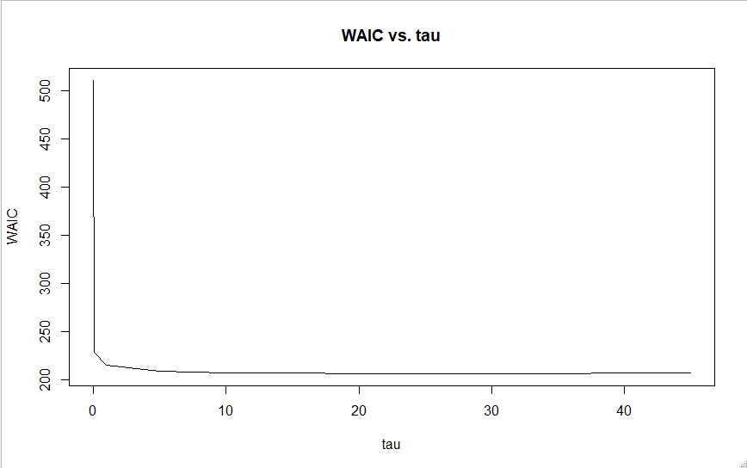
Example 2_6 results
tau | WAIC
0.01 | 510.4344
0.1 | 228.5915
1 | 215.0189
5 | 208.7191
10 | 207.1841
15 | 207.0656
20 | 206.2947
30 | 206.2387
35 | 205.9951
40 | 206.6658
45 | 207.1738
999 | 208.5123
Notes:
61

Slide 62
Example 2_6

Slide 63
Example 2_6
tau = 30 is a “good” model from the standpoint that it balances fit to the data with parameter complexity, i.e., parsimony in model selection terms.
This is the essence of the bias/variance tradeoff of good predictive models.
But so far we make no allowance for our uncertainty that tau = 30 is “best” (no model averaging).
Notes:
63

Slide 64
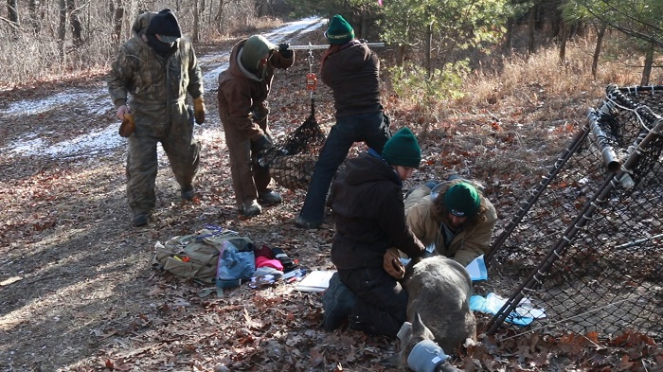
End of Lesson 2

