Slide 1
TinyNeRF: Towards 100× Compression of Voxel Radiance Fields
Tianli Zhao^{1,2,3,4}, Jiayuan Chen^{3,4,5}, Cong Leng^{2,3,4}, Jian Cheng^{2,3,4*}
¹ School of Artificial Intelligence, University of Chinese Academy of Sciences
² Institute of Automation, Chinese Academy of Sciences
³ AIRIA, ⁴ Maicro.ai, ⁵ Southeast University
Abstract
Voxel grid representation of 3D scene properties has been widely used to improve the training or rendering speed of the Neural Radiance Fields (NeRF) while at the same time achieving high synthesis quality. However, these methods ac- celerate the original NeRF at the expense of extra storage demand, which hinders their applications in many scenar- ios. To solve this limitation, we present TinyNeRF, a three- stage pipeline: frequency domain transformation, pruning and quantization that work together to reduce the storage demand of the voxel grids with little to no effects on their speed and synthesis quality. Based on the prior knowledge of visual sig- nals sparsity in the frequency domain, we convert the origi- nal voxel grids in the frequency domain via block-wise dis- crete cosine transformation (DCT). Next, we apply pruning and quantization to enforce the DCT coefficients to be sparse and low-bit. Our method can be optimized from scratch in an end-to-end manner, and can typically compress the original models by 2 orders of magnitude with minimal sacrifice on speed and synthesis quality.
Sun, and Chen 2022; Lindell, Martel, and Wetzstein 2021; Garbin et al. 2021; Liu et al. 2020; Yu et al. 2021; Reiser et al. 2021; Hedman et al. 2021; Wizadwongsa, Phongth- awee, and Yenphraphai 2021), among which the voxel grid optimization based methods have achieved great success (Yu et al. 2022; Sun, Sun, and Chen 2022; Liu et al. 2020; Yu et al. 2021). These methods explicitly store volumetric 3D scene properties into voxel grids, which enables significant acceleration by removing empty voxels without scene con- tents and also yields great synthesis quality. For example, without the requirement of any generalizable pre-training or depth information, Plenoxels (Yu et al. 2022) and DVGO (Sun, Sun, and Chen 2022) can converge in less than 10 minutes on one single GPU, compared to days for the origi- nal NeRF (Mildenhall et al. 2020). However, their methods accelerate the training and rendering process at the cost of the large model size. For example, DVGO (Sun, Sun, and
Chen 2022) needs to store two 3D grids with sizes 1 × 160³
and 12 × 160³, respectively, resulting in more than 200MB
storage demand for one single scene, which is 40× larger
1 Introduction
Synthesizing novel views of a 3D object from a sparse set of calibrated images is an appealing problem. It enhances cus- tomer experience for online product showcases and Street View maps (Tancik et al. 2022). Recently, Neural Radiance Fields (NeRF) (Mildenhall et al. 2020) has made a great breakthrough in this direction by representing the 3D radi- ance field implicitly with a coordinate neural network, yield- ing high quality of synthesized images, and the rendering quality has been further improved by many followup works (Zhang et al. 2020; Deng, Barron, and Srinivasan 2020; Bar- ron et al. 2021; Tancik et al. 2020; Sitzmann et al. 2020).
Despite its high synthesis quality, the original NeRF re-
quires a large number of computations during both training and inference. It needs to query an MLP hundreds of times for rendering one single pixel, leading to its lengthy training time and inefficiency in novel view rendering. Thus, many follow up works have been done to accelerate its training (Liu et al. 2022; Kangle et al. 2022; Yu et al. 2022; Sun, Sun, and Chen 2022) or rendering process (Yu et al. 2022; Sun,
than the original NeRF model. This limitation hinders its applications in scenarios where online model transfer is fre- quently needed and storage resources are limited. Although the model size of these methods can be reduced by voxel pruning (Liu et al. 2020) and efficient data structures can be used to store the sparse voxels (Laine and Karras 2010; Lefebvre and Hoppe 2006; Niebner et al. 2013), the com- pression is still limited, and significant voxel pruning typi- cally results in unacceptable quality degradation in render- ing, as shown in Fig. 1.
Our goal in this paper is to reduce the storage demand for voxel grid optimization based NeRF methods, while at the same time maintaining their advantages in training/inference speed and synthesis quality. To this end, we present TinyN- eRF. We take inspiration from the fact that most visual sig- nals in the real-life are smooth in the spatial domain, so they should be sparse in the frequency domain. In other words, when decomposing these signals into different frequencies, most information will be centralized in the low-frequency region as shown in Fig. 4. Taking the advantage of this prop- erty, we compress the voxel grids in the frequency domain. Specifically, we first transform the voxel grid values in the frequency domain via block-wise discrete cosine transfor- mation (DCT). After that, we apply pruning to the trans-
*The corresponding author.
Copyright © 2023, Association for the Advancement of Artificial Intelligence (www.aaai.org). All rights reserved.

Slide 2
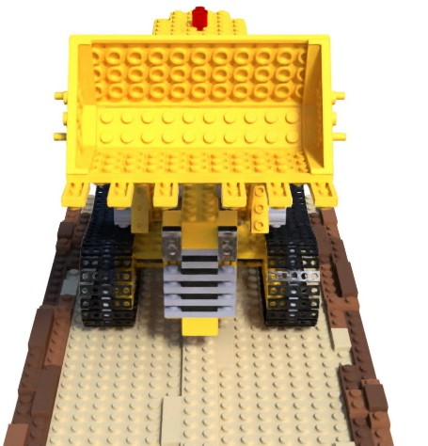
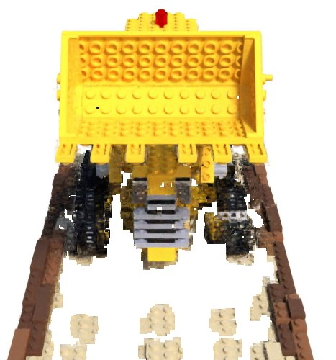
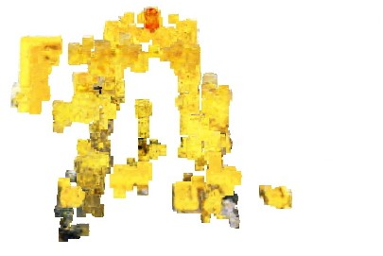
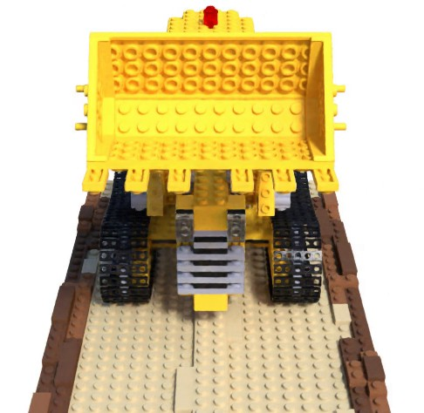
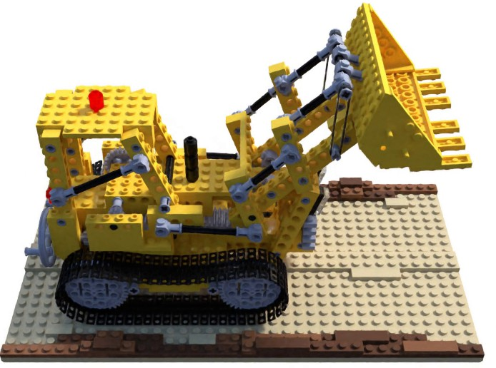
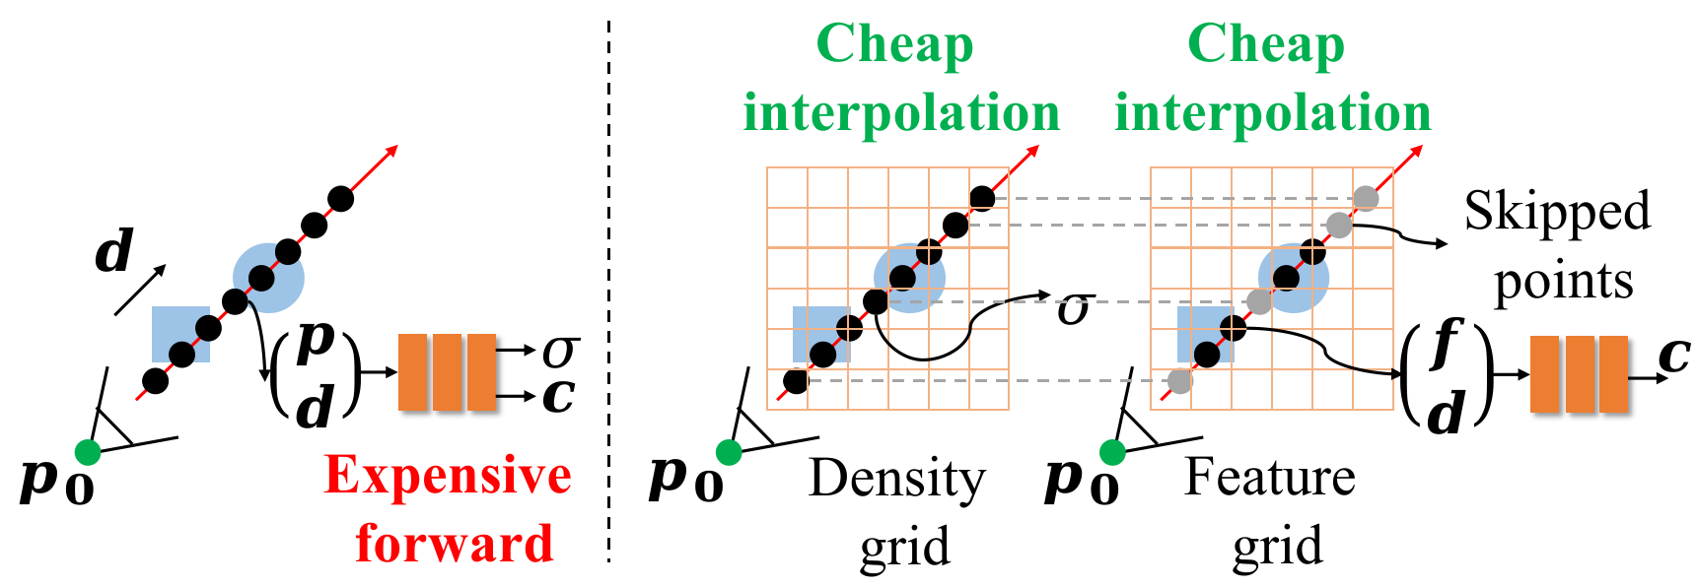
(a) DVGO (Sun, Sun, and Chen 2022) 203 MB, 3 mins
(b) DVGO+VP∗ 10 MB, 5 mins
(c) DVGO+VP∗ 1 MB, 5 mins
(d) Ours
1 MB, 6.5 mins
(e) Ours
1 MB, 6.5 mins
Figure 1: Comparison of model size and convergence time between our method and other variants, the training time is measured on one single NVIDIA A100 GPU. VP denotes voxel pruning (Liu et al. 2020) reimplemented based on DVGO, which removes low-density voxels. Significant voxel pruning (c) typically leads to unacceptable degradation in synthesizing quality. In contrast, our method (d), (e) can largely reduce the model size with minimal influence on synthesizing quality and training/inference speed.
formed grids by removing redundant DCT coefficients and retaining only the most informative coefficients. Next, we quantize the previously pruned coefficients by representing the non-zero floating-point values with low-bit integers mul- tiplied by a single floating-point scalar. As a result, the re- quired storage of the model is largely reduced. During infer- ence, we recover the original grids with inverse discrete co- sine transformation (IDCT) and apply the common volume rendering. We empirically show that the additional IDCT has only little effect on the rendering speed.
Our method can compress the voxel grids by more than
Figure 2: The comparison between the original NeRF (left) and the voxel grid optimization based NeRF (right). In the original NeRF, to render the pixel value of a camera ray r = (p₀, d), the model must apply the expensive forward computation of an MLP on hundreds of sampled points along the ray to get their density values and colors. The voxel grid optimization-based methods explicitly store the position-dependent density values and scene feature embed- dings into voxel grids. This design allows the model to skip the low-density points by efficiently querying the density grid with trilinear interpolation, leading to significant accel- eration in training and rendering.
100× with minimal sacrifice on rendering quality and speed.
For example, we build our codes based on the recent state- of-the-art voxel grid based NeRF implementation DVGO (Sun, Sun, and Chen 2022)¹, the model size can be signif- icantly reduced from 200MB to 2MB, while the training time only grows from 3 minutes to 6.5 minutes on a single NVIDIA A100 GPU with only 0.2 degradation in PSNR and
0.003 degradation in SSIM on the synthetic nerf dataset.
2 Preliminaries
Neural radiance fields. To synthesize the image of a 3D object in novel views, NeRF represents the properties of the 3D scene implicitly into an MLP, which takes the location
h i
∫
t
exp − σ(p(s))ds is the probability that a beam of light
0
coordinate p ∈ R³ and the viewing direction d ∈ R² as
emitting from the origin p₀ along the direction d hits the
inputs, and outputs the corresponding density values σ ∈ R
point p(t). Note that the volume density σ is restricted to be only dependent on the location p to encourage the scene rep- resentation to be multiview consistent, while the color c is dependent on both location p and direction d to model view- dependent scene. In practice, the intractable integral in Eq.
(2) can be approximated by aggregating the densities and
colors of densely sampled points along the ray (Max 1995; Mildenhall et al. 2020):
N
and colors c ∈ R³:
{σ(p), ν(p)} = f_{θ} (p), c(p, d) = g_{ϕ}(ν(p), d) (1)
where θ and ϕ are the parameters of the MLP. The rendered
pixel value C^{ˆ} (r) of the camera ray r = (p₀, d) can be com- puted using the principles of the traditional volume render- ing (Kajiya and Hersen 1984):
ˆ
∫
+∞
Σ
C(r) = T (t)σ(p(t))c(p(t), d)dt (2)
C^{ˆ} (r) ≈ T_{i}α_{i}c_{i} (3)
0
i=1
where p₀ and d are the origin and the direction of the camera ray, respectively, p(t) = p₀ + td², and T (t) =
where α = 1 − exp(−σ δ ), T =
Q
i−1
(1 − α ). σ
i i i i
j=1
i i
¹https://github.com/sunset1995/DirectVoxGO
²In practice, the direction d is often represented by a unit 3-d vector
and c_{i} are the density and color of the ith sampled point,
respectively, and δ_{i} is the distance between the ith sampled point and the next sampled point.

Slide 3
The rendering process of Eq. 3 is fully differentiable, so the parameters of the network can be optimized end-to-end by minimizing the following loss function:
3 Method
In this section, we introduce the proposed TinyNeRF. Be- fore going into more details, we give a brief overview of our pipeline, which is illustrated in Fig. 3. We first transform the original voxel grid values to the frequency domain by expressing them with the combination of cosine basis wave functions oscillating at different frequencies via block-wise discrete cosine transformation (DCT) (the top left of the fig- ure, Sec. 3.1). After the transformation, most of the signals information will be centralized in the low-frequency region. We next apply pruning (middle left at the top of the figure, Sec. 3.2) and quantization (middle right at the top of the fig- ure, Sec. 3.3) to the transformed grids by removing less in- formative coefficients with lower magnitudes and represent- ing the remained values with low-bit integers. In this way, we generate a rather sparse and low-bit model which can be stored in the disk or transferred online with little storage and network flow. The original grid values can be efficiently re- covered from the compressed coefficients via block-wise in- verse discrete cosine transformation (IDCT) to perform the following rendering (the bottom of the figure). The whole framework can be optimized in an end-to-end manner, and can be easily implemented with only little modification to the existing voxel grid optimization-based implementations.
3.1 Voxel grids with cosine basis
Discrete cosine transformation. The first step of our method is to transform the original voxel grids to the fre- quency domain. Here we utilize the discrete cosine transfor- mation (DCT) which is a Fourier-related transformation and has been widely used in image and video compression (Wal- lace 1992; Wiegand et al. 2003) because of its high degree
L =
1
Σ
∥C^{ˆ} (r) − C(r)∥² (4)
|R| _{r∈R}
where R is the set of camera rays sampled in a mini batch,
and C(r) is the true pixel value corresponding to the camera ray r.
Voxel grid optimization. Despite its high rendering quality,
the original NeRF requires heavy computation cost, because Eq. (3) typically needs to perform the forward of an MLP hundreds of times to render a single pixel. Voxel grid opti- mization based methods solve this problem by storing and optimizing position-dependent modalities of interest (e.g. density σ(p), features ν(p) in Eq. (1)) explicitly into voxel grid cells, and query their value at any position p via inter- polation:
(σ) (ν)
σ(p) = a(interp(p, V )), ν(p) = interp(p, V ) (5)
where p is the queried location, and V^{(σ)} ∈ R^{1×Nx×Ny ×Nz}
and V^{(ν)} ∈ R^{C×Nx×Ny ×Nz} are the voxel grids correspond-
ing to the density and features, respectively. C is the di- mension of the position-dependent feature, and N_{x}, N_{y}, N_{z}
are the number of voxels along the three dimensions. a(·) is
the density activation function such as shifted softplus (Sun, Sun, and Chen 2022). Note that the interpolation operation in Eq. (5) can be performed efficiently, which allows the model to directly skip low-density or occluded points dur- ing rendering:
ˆ
Σ
C(r) ≈ T α c (6)
i∈Ω(r)
i i i
where Ω(r) = {i : α > τ , T > τ }. τ and τ₂ are two
of spectral compaction. For a 3D grid V ∈ R^{C×Bx×By ×Bz} ,
i 1 i 2 1
where C is the dimension of the feature stored in each voxel,
user defined thresholds. T_{i}, α_{i}, c_{i} are all the same as defined
and B_{x} × B_{y} × B_{z} the shape of the grid. The discrete cosine
in Eqs. (1,3). In this way, the required number of MLP for- ward is largely reduced, resulting in significant acceleration. A graphical illustration of this process is shown in the right of Fig. 2.
Limitations of existing methods. The voxel grid optimiza-
tion based methods accelerate the original NeRF by prevent- ing the rendering of points without scene content. However, these methods achieve the acceleration at the expense of extra storage demand. The key components of these meth- ods are the two pre-stored 3D grids which allow efficient querying via trilinear interpolation while requiring a large number of storage resources. Our main insight is that most visual signals in our real life are smooth in the spatial do- main, which makes them tend to be sparse in the frequency domain. Thus, we transform the original voxel grids from spatial domain to the frequency domain with DCT and ap- ply pruning and quantization to their DCT coefficients to re- duce the storage demand. Although previous methods such as NSVF (Liu et al. 2020), Plenoxels (Yu et al. 2022) and DVGO (Sun, Sun, and Chen 2022) all prune empty voxels with no scene contents, while the pruning rate is still limited because of the large foreground-background ratio. Besides, the training time of NSVF is still too long because of the deep MLP in its scene representation.
transformation (DCT) and inverse discrete cosine transfor- mation (IDCT) can be defined by:
¯
Σ
u u u
V
c,i,j,k
= √
i j k
V ×
B B B
c,i,j,k
x,y,z
x y z
π
cos( i(x + )) cos( j(y + )) cos( k(z + ))
1
π
1
π
1
B_{x}
Vc,x,y,z =
Σ
2
B_{y}
2
×
B_{z}
2
u u u
¯
√
i j k
V
c,i,j,k
B B B
i,j,k
x y z
π
cos( i(x + )) cos( j(y + )) cos( k(z + ))
1
π
1
π 1
B_{x} 2 B_{y} 2 B_{z}
2
(7)
where x, y, z and i, j, k span from [1, 1, 1] to [B_{x}, B_{y}, B_{z} ],
and u_{i} is 1 at i = 0 and √2 otherwise. V¯ ∈ R^{C×Bx×By ×Bz}
is the transformed coefficients grid. In the remaining of this paper, we use the symbols with overbar to denote the DCT coefficients of the corresponding grids.
Signals sparsity in the DCT domain. In the view of sig- nal decomposition, the transformation defined in Eq. (7) can be seen as factorizing the original grid V with cosine ba-
sis functions, where V¯ are the magnitudes corresponding to

Slide 4
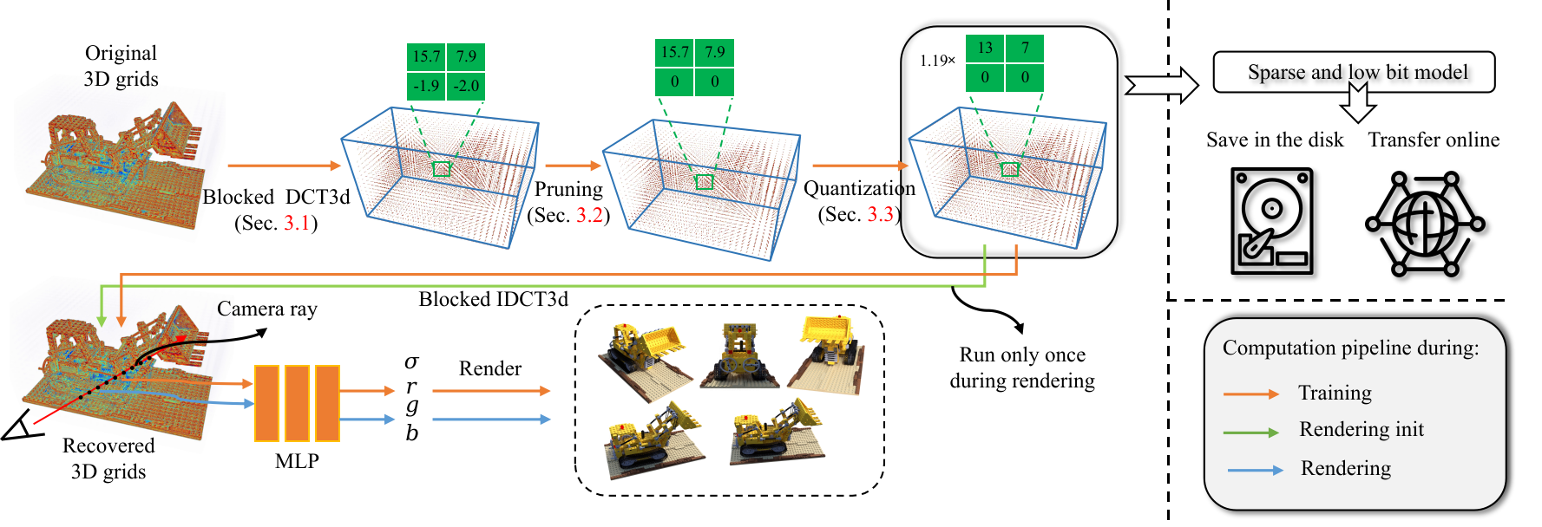
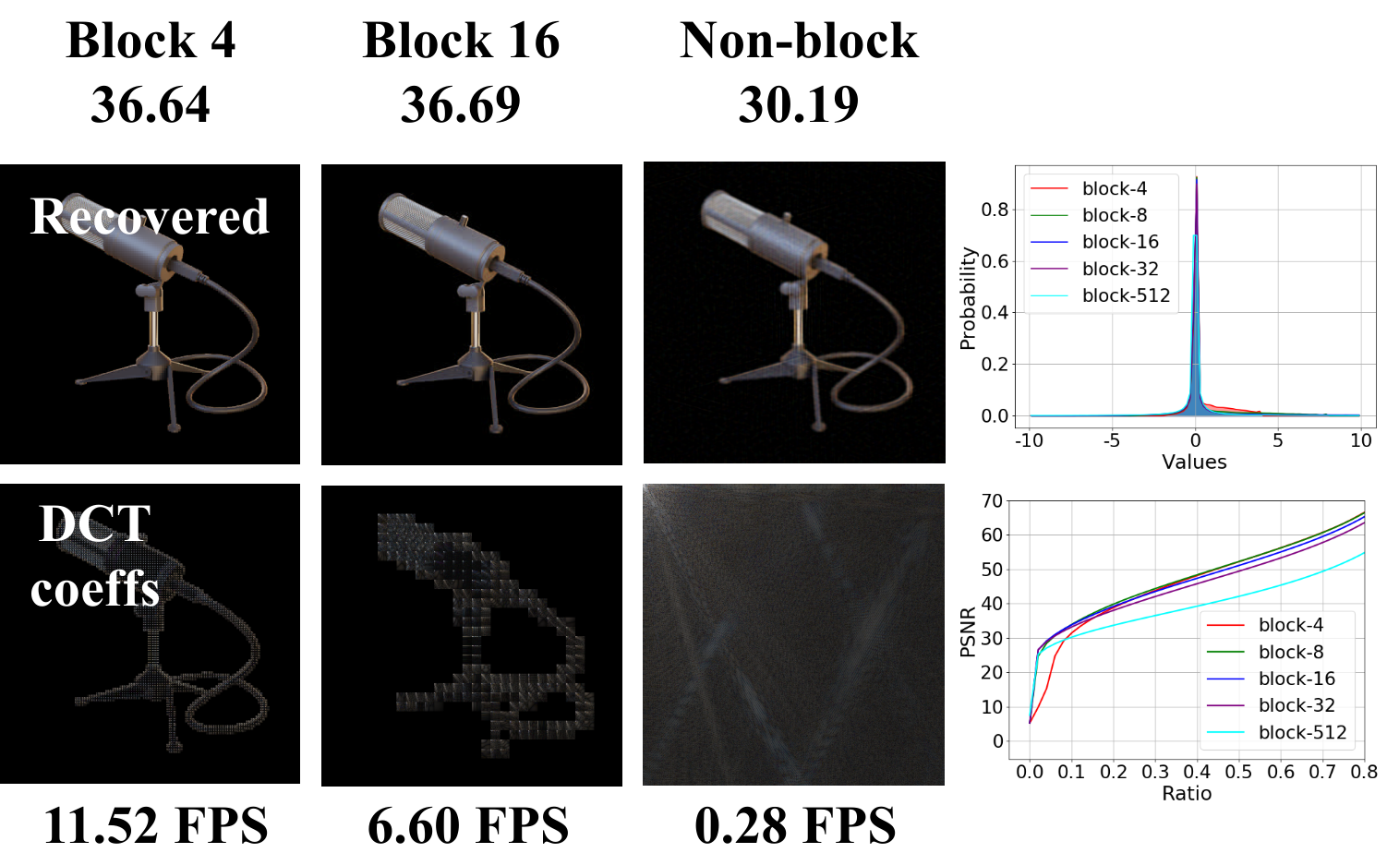
Figure 3: The overview framework of our method. Our method is inspired by the fact that most 3D scenes in our true life are smooth in the spatial field, so they tend to be sparse in the frequency field. We apply pruning and quantization to the DCT coefficients of the learnable scene properties stored in the 3D voxel grids, resulting in a rather sparse and low-bit model which requires little storage demand.
where we randomly collect 100 images and report the dis- tribution of their DCT coefficients. We find that most of the coefficients are centralized to zero after transformation. The left of the figure shows that the original image can be recov- ered with high quality even when 98% of the DCT coeffi- cients are removed.
Block-wise DCT. In practice, during transformation, instead of applying DCT to the whole grid, we divide the voxels into blocks and apply block-wise DCT. Specifically, for a 3D grid V ∈ R^{C×Nx×Ny ×Nz} we first divide the grid into
N Ny N
x
× × blocks of sub-grids, each with size C ×
z
Bx By Bz
B_{x} × B_{y} × B_{z} , where B_{x}, B_{y}, B_{z} are the block size along
the three dimensions, and apply the DCT transformation to each of these blocks independently.
Several advantages motivate us to apply block-wise trans- formation. First, block-wise transformation requires less computation and thus is faster as shown in the left of Fig.
4. We show in the appendix that the number of required
multiply-accumulate operations grows with the block-size. Second, block-wise transformation leads to less numerical errors as shown in the bottom right of the Fig. 4. Theoret- ically, the transformation defined in Eq. (7) is strictly ac- curate, while in practice, its computation suffers truncation errors because of the limited floating point precision in com- puters. As the block size grows, the required number of float- ing point operations grows, and so do the numerical errors. Third, the block-wise transformed coefficients are also con- centrated around zero as shown in the top right of Fig. 4.
3.2 Pruning
After transformation, most of the signals information will be centralized on the low-frequency region as shown in the middle left at the top of Fig. 3. We then prune the trans- formed coefficients by enforcing the low-magnitude coeffi- cients to be zero and only retaining the more informative ones. In other words, we sort the coefficients in descending
Figure 4: A toy example for the illustration of signals spar- sity in the frequency domain. For all the examples in the left,
we prune the DCT coefficients by 50× and recover the im-
age with IDCT. The statistics in the right are averaged on 100 randomly sampled images. The running speed is mea- sured on a single Intel Core i7-8700 CPU. Smaller block size typically leads to faster running speed (left). Proper se- lection of block size makes the DCT coefficients more cen- tralized to zero and leads to lower numerical errors when recovering the signal from pruned DCT coefficients (right).
different frequencies. The high-frequency components are related to part of the original signals oscillating wildly in the spatial domain, such as edges. However, for most visual signals in the real life, edges are very sparse and nearby lo- cations often share similar properties. Thus, after transfor- mation, most information will be concentrated in the low- frequency region. As a result, the transformed coefficients
V¯ will be rather sparse and can be roughly compressed with
negligible information loss.
In Fig. 4 we further illustrate this with a toy example,

Slide 5
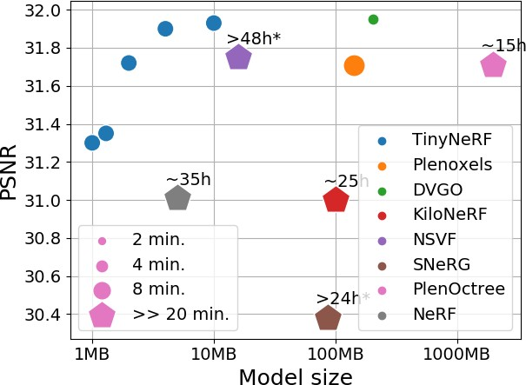
order according to their absolute values and only retain the top K coefficients, where K is the expected number of re- tained coefficients.
We denote V¯_{P} the pruned DCT coefficients. During the
pruning aware training, we apply the volume rendering with the approximately recovered grid V_{P} = IDCT(V¯_{P} ) and
Model size | Density Ratio Bit-width | Feature Ratio Bit-width
10MB | 0.4 24 | 0.1 8
4MB | 0.3 10 | 0.07 6
2MB | 0.3 8 | 0.03 4
1.3MB | 0.09 8 | 0.03 4
1MB | 0.08 8 | 0.03 4
compute the gradients w.r.t. the learnable grid with straight through estimator (STE) (Bengio, Leonard, and Courville 2013), which can be formulated by the following equation:
Table 1: Pruning ratios and quantization bit-widths for dif- ferrent model sizes.
∂L ≈ ∂L
where V_{P} = IDCT(V¯_{P} ) (8)
∂V ∂V_{P}
3.3 Quantization
After applying pruning aware training for several iterations, we quantize the pruned coefficients to further improve the compression by reducing the number of bits required to store each non-zero value. Specifically, let V¯_{P} be the DCT coef- ficients after pruning, we quantize the retained values in V¯_{P} by approximating them with low-bit integers multiplied by a single floating point scalar: V¯_{P} ≈ αV¯_{Q}, where α ∈ R, V¯_{Q} is the quantized coefficients, in which each value is repre- sented by a low bit integer. At the initialization of the quanti- zation aware training, the values of α and V¯_{Q} can be approx-
imated by iterating the following two equations alternatively (Choukroun et al. 2019; Wang et al. 2019):
Figure 5: Comparison of model size & PSNR between TinyNeRF and state-of-the-art baseline NeRF methods. The size of each dot indicates the training time. The methods with very lengthy training time are plotted in pentagons, be- cause they will be too large to fit in a figure. Instead, we write the actual training time for these methods in texts.
the recent state-of-the-art voxel grid based NeRF implemen- tation DVGO (Sun, Sun, and Chen 2022)³. By default, the
_{V}¯
_{V}¯_{P}
_{Q} = clip([ ], Q_{min}, Q_{max})
(9a)
α
< V
¯ ¯
, V >
α =
P Q
(9b)
< V¯_{Q}, V¯_{Q} >
where [·] is the round operator, Q_{min} and Q_{max} are the
minimum and maximum quantized values. For example, for b-bit quantization, they can be computed by: Q_{min} =
block size for the block-wise DCT is set to 4 × 4 × 4 be-
−2^{b−1}, Q_{max} = 2^{b−1} − 1. < ·, · > denotes the inner prod-
cause we find it achieves good trade-off between compres- sion, synthesizing quality and training speed. We keep all the hyper parameters the same with DVGO (Sun, Sun, and Chen 2022) for fair comparison. The grid resolutions for all the scenes are set to 160³. The pruning and quantization are only enabled during the fine-stage training. We keep the total optimization iterations to be 20000 with 8192 camera rays per batch, where the pruning aware training is enabled af- ter 5000 iterations of common training, and the quantization aware training is further enabled after 12000 iterations. The whole training process typically finishes in less than 10 min- utes. The detailed pruning ratios and quantization bit widths for different target model sizes are shown in Tab. 1.
4.2 Comparisons
We evaluate our method on five inward-facing datasets, in- cluding Synthetic-NeRF (Mildenhall et al. 2020) which con- tains 8 objects with relistic images, Synthetic-NSVF (Liu et al. 2020) which contains 8 objects synthesized by NSVF, BlendedMVS (Yao et al. 2020) with realistic ambient light- ing from real image blending, DeepVoxels (Sitzmann et al. 2019) with 4 Lambertian objects, and a real world data set
³https://github.com/sunset1995/DirectVoxGO
uct operator defined by summing up all the values in the element-wise multiplication of the two grids. Please refer to the Appendix for a detailed derivation of the above alternat- ing optimization algorithm.
After the above initialization, we freeze the α and fur-
ther refine the learnable voxels V. We call this process the
quantization aware training. Similarly, during the quantiza-
tion aware training, we compute V¯_{Q} with Eq. (9a), render
the sampled camera rays with the recovered grid V_{Q} =
IDCT(αV¯_{Q}), and the gradients w.r.t. the original learnable
voxel grids V are approximated with STE (Bengio, Leonard,
and Courville 2013):
^{∂L} ≈ ^{∂L} , where V = IDCT(αV¯ ) (10)
∂V ∂V_{Q}
Q Q
In this way, the whole framework can be optimized in an end-to-end manner.
4 Experimental results
4.1 Experimental setup
We implement our method in PyTorch with the block-wise DCT implemented in CUDA. The codes are built based on

Slide 6
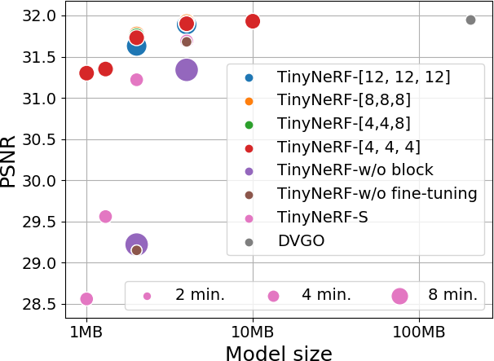
Methods | Synthetic NeRF #params PSNR↑ SSIM↑ _{(MB)↓} | Synthetic-NSVF #params PSNR↑ SSIM↑ _{(MB)↓} | Blended MVS #params PSNR↑ SSIM↑ _{(MB)↓} | T&T #params PSNR↑ SSIM↑ _{(MB)↓}
Methods taking hours to days to train
NeRF | 31.01 | 0.947 | 5 | 30.81 | 0.952 | 5 | 24.15 | 0.828 | 5 | 25.78 | 0.864 | 5
PlenOctree | 31.71 | 0.958 | 1976 | - | - | - | - | - | - | 27.99 | 0.917 | 1976
SNeRG | 30.38 | 0.95 | 87 | - | - | - | - | - | - | - | - | -
FastNeRF | 29.97 | 0.941 | - | - | - | - | - | - | - | - | - | -
AutoInt | 25.55 | 0.91 | - | - | - | - | - | - | - | - | - | -
NSVF KiloNeRF | 31.75 31.00 | 0.953 0.95 | 3.2∼16 ∼100 | 35.18 33.37 | 0.979 0.97 | 3.2∼16 ∼100 | 26.89 27.39 | 0.898 0.92 | 3.2∼16 ∼100 | 28.48 28.41 | 0.901 0.91 | 3.2∼16 ∼100
Methods taking minutes to train
Plenoxels | 31.71 | 0.958 | 143 | - | - | - | - | - | - | 20.40 | 0.696 | 143
DVGO | 31.95 | 0.957 | 203 | 35.08 | 0.975 | 203 | 28.02 | 0.922 | 203 | 28.41 | 0.911 | 203
TinyNeRF(10MB) | 31.93 | 0.956 | 10 | 34.95 | 0.975 | 10 | 28.15 | 0.922 | 10 | 28.33 | 0.911 | 10
TinyNeRF(4MB) | 31.90 | 0.956 | 4 | 34.88 | 0.975 | 4 | 28.11 | 0.922 | 4 | 28.32 | 0.91 | 4
TinyNeRF(2MB) | 31.72 | 0.954 | 2 | 34.62 | 0.968 | 2 | 28.02 | 0.919 | 2 | 28.19 | 0.908 | 2
Table 2: Comparisons on model size, training time and synthesizing quality with state-of-the-art NeRF methods.
Tanks&Temples (Knapitsch et al. 2017). Quantitative results are shown in Tab. 2, and the results on the NeRF Synthetic data set are plotted in Fig. 5. The actual training time of each methods are also shown in the figure. Comparing the dots in Fig. 5, our method achieves a better trade-off between model size and rendering quality. Comparing the sizes of the dots in the figure, our method has only little influence on the training time, typically converging in less than 8 minutes. We refer the readers to the Appendix for detailed per-scene comparisons and the results on the DeepVoxels dataset.
4.3 Ablation study
In this section, we study the influence of different com- ponents in our method, including compression in the fre- quency domain, utilizing block-wise transformation. We fur- ther study the sensitivity of our method to different choices of hyper parameters, including transformation block sizes, pruning ratios and quantization bit widths. To this end, we implement different variants of our method and compare them on the synthetic nerf data set. We report the main re- sults in Fig. 6 and Tab. 3, and detailed quantitative results are given in the Appendix.
Pruning in the spatial v.s. frequency domain. To study the influence of frequency domain compression, we implement a variant of TinyNeRF which applies pruning and quantiza- tion in the spatial domain, named TinyNeRF-S. Specifically, for the density grid, we prune the voxels with low density, and for the feature grid, we enforce the low-magnitude fea- ture values to be zero. Besides, we also quantize the retained density and features with the same method described in Sec.
3.3. We keep all the other hyper parameters the same with
our TinyNeRF. Results are shown in Fig. 6.
Our TinyNeRF (the red dots) consistently outperforms TinyNeRF-S by a large margin. For example, when com- pressing the original model to 2MB, TinyNeRF achieves
0.5 higher PSNR than TinyNeRF-S. The improvements
are even near or more than 2db under the model size of 1MB and 1.3MB, respectively. In general, the advantages of frequency-domain compression are more obvious on smaller
Figure 6: Comparison of model size & PSNR between TinyNeRF and its other variants. The size of each dot in- dicates the training time. Here, the text TinyNerf-[x, y, z]
means TinyNeRF with the DCT block size of x × y ×
z. TinyNeRF-w/o block means applying the DCT to the whole grids without any blocking. TinyNeRF-w/o fine- tuning means directly transforming, pruning and quantiz- ing the grid coefficients without any retraining. TinyNeRF-S means pruning and quantizing the grid values in the spatial domain instead of frequency domain.
model sizes. These results support that it is better to com- press the voxel grids in their frequency domain.
Influence of block-wise DCT. Another key design of our method is to apply compression to the block-wise transfor- mation of the original grids. To study the influence of block- wise DCT, we further implement a variant of TinyNeRF which performs DCT to the whole voxel grids while keep- ing all the other components the same with our method. The results are shown in Fig. 6 labeled by TinyNeRF-w/o block.
We see from the figure that (1) Without block-wise DCT, compression in the frequency domain performs even worse than compressing in the spatial domain. This result implies that naively applying the compression in the frequency do-

Slide 7
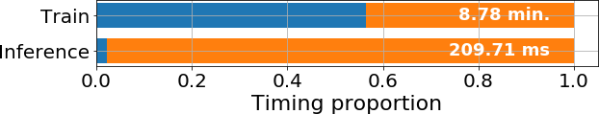
Density | Ratio | 0.3 | 0.15 | 0.3 | 0.15
grid
 | Bit width | 8 | 16 | 8 | 16
Feature | Ratio | 0.03 | 0.03 | 0.015 | 0.015
grid
 | Bit width | 4 | 4 | 8 | 8
PSNR |  | 31.72 | 31.59 | 31.59 | 31.54
in 3 minutes per scene, and original model size is 203 MB. We see from the figure that even without fine-tuning, our method can still compress the original model by 50× with little sacrifice on PSNR (31.95 → 31.68).
Timing analysis. Our method requires additional computa-
Table 3: Ablation on the sensitivity to hyper parameters on the synthetic nerf data set. Ratio denotes the ratio of non- zero elements for pruning. We compress the original model to around 2MB with different configurations of pruning ra- tios and bit widths, while keep all the other hyper parameters the same.
main doesn’t result in satisfactory results. (2) With block- wise DCT, TinyNeRF achieves much better trade-off be- tween model size and synthesizing quality. (3) By compar- ing the sizes of the dots, we conclude that TinyNeRF with smaller block-size converge faster than TinyNeRF without block-wise DCT. All these results support that block-wise DCT requires fewer multiply-accumulate operations, and thus can be computed faster and suffers fewer truncation er- rors caused by the limited precision in computers.
Sensitivity to hyper-parameters. There are some hyper pa- rameters that may affect the effectiveness of our method, such as block sizes, pruning ratios, and quantization bit widths. To study their influences, we compare TinyNeRF with 1) different block sizes which is shown in Fig. 6, and 2) different pruning ratios and quantization bit widths which is shown in Tab. 3.
From Fig. 6, we see that the performance gaps between TinyNeRF with different DCT block-sizes are rather small. These results support that our method is not sensitive to the choice of DCT block size, as long as the block size is rela- tively small.
To study the sensitivity of our method to different con- figurations of pruning ratios and quantization bit widths, we adjust the pruning ratios and quantization bit widths of both the density grid and feature grid to compress the model to 2 MB. The detailed configurations and results on the synthetic nerf data set are shown in Tab. 3. We see from the table that TinyNeRF with different compression configurations per- form very similarly, which indicates that our method is also not sensitive to different pruning ratios and quantization bit widths.
Compression without fine tuning. Interestingly, our method can also be used to compress a trained voxel grid based NeRF model without any fine tuning. Specifically, for a pre-trained NeRF model with voxel grids, we can directly transform the grids with block-wise DCT and apply pruning and quantization to the transformed coefficients without re- fining the compressed grids. Note that once the NeRF model is trained, this compression process can complete in seconds (most of the time is spared on the iterative algorithm to com- pute the scaling factor for quantization), thus the required time of this method is dominated by the pre-training pro- cess. To illustrate this, we compress the pre-trained DVGO (Sun, Sun, and Chen 2022) models on 8 scenes of the syn- thetic nerf data set, and the results are shown in Fig. 6 labled by ”TinyNeRF-w/o fine tuning”. The DVGO can converge
tions such as DCT, IDCT, pruning, quantization, dequanti- zation during both training and inference. A common con- cern about our method may be: How do these additional pro- cesses affect the training and inference time of the original models? To investigate this, we plot in the following figure the proportion of time spent on the additional computations during both training and inference. The time of all the pro- cesses are normalized to the total run time, and the detailed numerical results are shown in the Appendix.
In the figure, the blue bars denote the run time of the addi- tional computations, and the orange bars denote the run time of the original models. We see from the figure that the ad- ditional computations contribute very little to the inference time (5 ms / 209 ms). Interestingly, we find the during train- ing, almost all of the additional run time are consumed in the pruning process (3.97 min. / 4.96 min.). Fortunately, this expensive operation is not required in the inference process. As a result, the additional run time of the inference time is far less than that of the training time.
5 Discussions and limitations
In this paper, we present TinyNeRF, a method with three- step pipeline: frequency domain transformation, pruning and quantization that work together to reduce the disk storage demand for voxel radiance fields. Thanks to the priori of signals sparsity in the frequency domain, our method can typically compress the voxel grids by 2 orders of magnitude with little effect on synthesizing quality.
Although achieving high compression, there are still some limitations in our method that may potentially be very inter- esting future directions. First, our method needs to recover the original voxel grids during rendering. Thus, the runtime computation and memory requirements are not reduced. An interesting improvement is to avoid the runtime grid recov- ering to further reduce its memory demands during infer- ence. Second, in this paper, we only show the usage of our method in voxel grid based NeRF. It is interesting to con- sider whether it is also applicable in grid-based solutions to other problems such as 3D surface reconstruction. Third, there are some other transformations that also lead to sparse coefficients. It is worth considering that are there any other choices of frequency domain transformations that are more suitable to voxel grids compression.
Acknowledgements
This work was supported in part by the National Key Re- search and Development Program of China under Grant

Slide 8
2021ZD0201504, National Natural Science Foundation of China under Grant 61972396.
References
Barron, J. T.; Mildenhall, B.; Tancik, M.; Hedman, P.; Martin-Brualla, R.; and Srinivasan, P. P. 2021. Mip-NeRF: A Multiscale Representation for Anti-Aliasing Neural Radi- ance Fields. In International Conference on Computer Vi- sion, (ICCV).
Bengio, Y.; Leonard, N.; and Courville, A. 2013. Estimating or Propagating Gradients Through Stochastic Neurons for Conditional Computation. aeXiv:1308.3432.
Choukroun, Y.; Eravchik, E.; Yang, F.; and Kisilev, P. 2019. Low-bit Quantization of Neural Networks for Efficient In- ference. In International Conference on Computer Vision, (ICCV).
Deng, B.; Barron, J. T.; and Srinivasan, P. P. 2020. JaxNeRF: an efficient JAX implementation of NeRF.
Garbin, S. J.; Kowalski, M.; Johnson, M.; Shotton, J.; and Valentin, J. 2021. FastNeRF: High-Fidelity Neural Render- ing at 200FPS. In International Conference on Computer Vision, (ICCV).
Hedman, P.; Srinivasan, P. P.; Mildenhall, B.; Barron, J. T.; and Debevec, P. 2021. Baking Neural Radiance Fields for Real-Time View Synthesis. In International Conference on Computer Vision, (ICCV).
Kajiya, J. T.; and Hersen, B. P. V. 1984. Ray Tracing Volume Densities. Computer Graphics, 18(3).
Kangle, D.; Andrew, L.; Jun-Yan, Z.; and Deva, R. 2022. Depth-supervised NeRF: Fewer Views and Faster Training for Free. In IEEE Conference on Computer Vision and Pat- tern Recognition, (CVPR).
Knapitsch, A.; Park, J.; Zhou, Q.-Y.; and Koltun, V. 2017. Tanks and temples: Benchmarking large-scale scene rescon- struction. ACM Transactions on Graphics, 36(4).
Laine, S.; and Karras, T. 2010. Efficient Sparse Voxel Oc- trees. In ACM SIGGRAPH Symposium on Interactive 3D Graphics and Games, (I3D).
Lefebvre, S.; and Hoppe, H. 2006. Perfect spatial hashing.
ACM Transactions on Graphics, 25.
Lindell, D. B.; Martel, J. N.; and Wetzstein, G. 2021. Au- toInt: Automatic Integration for Fast Neural Volume Ren- dering. In IEEE Conference on Computer Vision and Pattern Recognition, (CVPR).
Liu, L.; Gu, J.; Lin, K. Z.; Chua, T.-S.; and Theobalt, C. 2020. Neural Sparse Voxel Fields. In International Confer- ence on Neural Information Processing Systems, (NeurIPS).
Liu, Y.; Peng, S.; Liu, L.; Wang, Q.; Wang, P.; Theoboalt, C.; Zhou, X.; and Wang, W. 2022. Neural Rays for Occlusion- aware Image-based Rendering. In IEEE Conference on Computer Vision and Pattern Recognition, (CVPR).
Max, N. 1995. Optical models for direct volume rendering. IEEE Transactions on Visualization and Computer Graph- ics, 1.
Mildenhall, B.; Srinivasan, P. P.; Barron, J. T.; Ramamoor- thi, R.; and Ng, R. 2020. Representing Scences as Neural Radiance Fields for View Synthesis. In European Confer- ence on Computer Vision, (ECCV).
Niebner, M.; Zollhofer, M.; Izadi, S.; and Stamminger, M. 2013. Readl-time 3D reconstruction at scale using voxel hashing. ACM Transactions on Graphics, 32(6).
Reiser, C.; Peng, S.; Liao, Y.; and Geiger, A. 2021. KiloN- eRF: Speeding up Neural Radiance Fields with Thousands of Tiny MLPs. In International Conference on Computer Vision, (ICCV).
Sitzmann, V.; Martel, J. N.; Bergman, A. W.; Lindell, D. B.; and Wetzstein, G. 2020. Implicit Neural Representation with Periodic Activation Functions. In International Conference on Neural Information Processing Systems, (NeurIPS).
Sitzmann, V.; Thies, J.; Heide, F.; Niebner, M.; Wetzstein, G.; and Zollhofer, M. 2019. DeepVoxels: Learning Persis- tent 3D Feature Embeddings. In IEEE Conference on Com- puter Vision and Pattern Recognition, (CVPR).
Sun, C.; Sun, M.; and Chen, H.-T. 2022. Direct Voxel Grid Optimization: Super-Fast Convergence for Radiance Fields Reconstruction. In IEEE Conference on Computer Vision and Pattern Recognition, (CVPR).
Tancik, M.; Casser, V.; Yan, X.; Pradhan, S.; Mildenhall, B.; Srinivasan, P. P.; Barron, J. T.; and Kretzschmar, H. 2022. Block-NeRF: Scalable Large Scene Neural View Synthesis. arXiv:2202.05263.
Tancik, M.; Srinivasan, P. P.; Mildenhall, B.; Fridovich-Keil, S.; Raghavan, N.; Singhal, U.; Ramamoorthi, R.; Barron,
J. T.; and Ng, R. 2020. Fourier Features Let Networks Learn
High Frequency Functions in Low Dimensional Domains. In International Conference on Neural Information Processing Systems, (NeurIPS).
Wallace, G. K. 1992. The JPEG Still Picture Compres- sion Standard. IEEE Transactions on Computer Eletronics, 38(1).
Wang, P.; Hu, Q.; Zhang, Y.; Zhang, C.; Liu, Y.; and Cheng,
J. 2019. Two-Step Quantization for Low-bit Neural Net- works. In IEEE Conference on Computer Vision and Pattern Recognition, (CVPR).
Wiegand, T.; Sullivan, G.; Bjontegaard, G.; and Luthra, A. 2003. Overview of the H.264/AVC Video Coding Standard. IEEE Transactions on Circuits and Systems for Video Tech- nology, 13.
Wizadwongsa, S.; Phongthawee, P.; and Yenphraphai, J. 2021. NeX: Real-time View Synthesis with Neural Basis Expansion. In IEEE Conference on Computer Vision and Pattern Recognition, (CVPR).
Yao, Y.; Luo, Z.; Li, S.; Zhang, J.; Ren, Y.; Zhou, L.; Fang, T.; and Quan, L. 2020. BlendedMVS: A Large-Scale Dataset for Generalized Multi-view Stero Networks. In IEEE Conference on Computer Vision and Pattern Recog- nition, (CVPR).
Yu, A.; Fridovich-Keil, S.; Tancik, M.; Chen, Q.; Recht, B.; and Kanazawa, A. 2022. Plenoxels: Radiance Fields without Neural Networks. In IEEE Conference on Computer Vision and Pattern Recognition, (CVPR).

Slide 9
Yu, A.; Li, R.; Tancik, M.; Li, H.; Ng, R.; and Kanazawa,
A. 2021. PlenOctrees for Real-time Rendering of Neural Radiance Fields. In IEEE Conference on Computer Vision and Pattern Recognition, (CVPR).
Zhang, K.; Riegler, G.; Snavely, N.; and Koltun, V. 2020. NeRF++: Analyzing and Improving Neural Radiance Fields. arXiv:2010.07492v2.

