Slide 1
Binomial Coefficients February 23, 2026
CSCI 246: Discrete Structures
Textbook Reference: Ch 3. Sec 17

Slide 2
Agenda
Lecture (~ 10 minutes)
Group Exercise (~40 minutes)

Slide 3
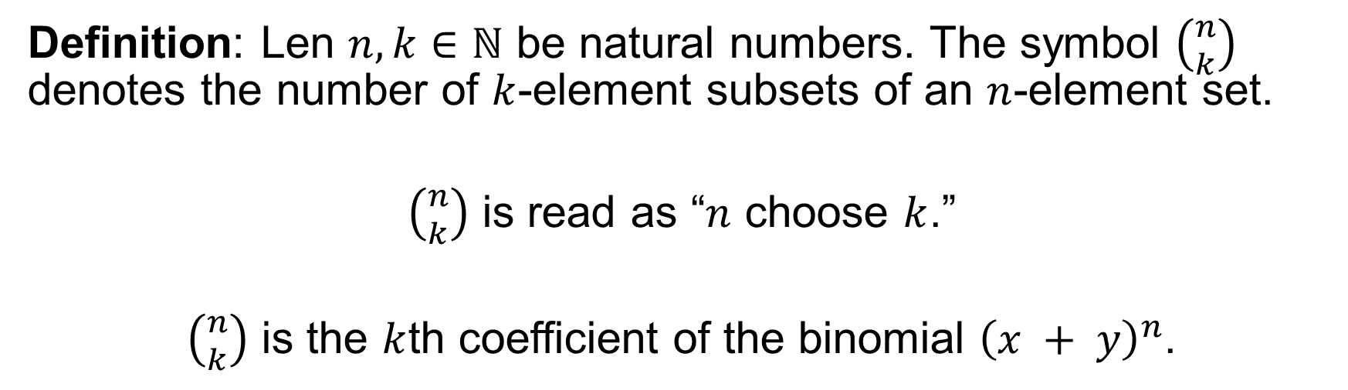
Binomial Coefficients
Definition: Len $n, k∈ℕ$ be natural numbers. The symbol $\left({n \atop k}\right)$ denotes the number of $k$-element subsets of an $n$-element set.
$\left({n \atop k}\right)$ is read as “$n$ choose $k$.”
$\left({n \atop k}\right)$ is the $k$th coefficient of the binomial ${\left(x + y\right)}^{n}$.

Slide 4
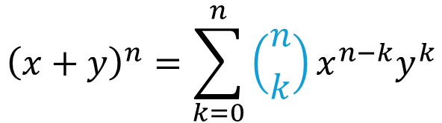
Binomial Coefficients
$${\left(x+y\right)}^{n}=\sum_{k=0}^{n}{\left({n \atop k}\right)x^{n−k}y^{k}}$$
$${\left(x+y\right)}^{n}= \left({n \atop 0}\right)x^{n}+{\left({n \atop 1}\right)x}^{n−1}y+…+\left({n \atop n−1}\right)xy^{n−1}+\left({n \atop n}\right)y^{n}$$
$${\left(x+y\right)}^{n}={ 1x}^{n}+ { n x}^{n−1}y+…+ n xy^{n−1}+ 1y^{n}$$

Slide 5



Binomial Coefficients
$${\left(x+y\right)}^{0}=1$$
$${\left(x+y\right)}^{1}=1x+1y$$
$${\left(x+y\right)}^{2}=1x^{2}+2xy+ 1y^{2}$$
$${\left(x+y\right)}^{3}=1x^{3}+3x^{2}y+3{xy}^{2}+1y^{3}$$
$${\left(x+y\right)}^{4}=1x^{4}+4x^{3}y+6x^{2}y^{2}+4{xy}^{3}+1y^{4}$$

Slide 6


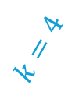




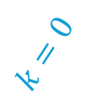








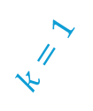
Pascal’s Triangle
$$k=0$$
$$n=0$$
$$1$$
$$k=1$$
$$n=1$$
$$1 1$$
$$k=2$$
$$n=2$$
$$1 2 1$$
$$k=3$$
$$n=3$$
$$1 3 3 1$$
$$k=4$$
$$n=4$$
$$1 4 6 4 1$$
$$k=5$$
$$n=5$$
$$1 5 10 10 5 1$$

Slide 7





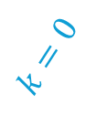
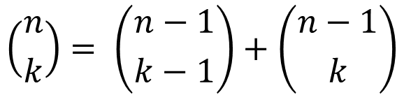





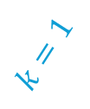

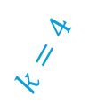



Pascal’s Identity
$$k=0$$
$$n=0$$
$$1$$
$$k=1$$
$$n=1$$
$$1 1$$
$$k=2$$
$$\left({n \atop k}\right)= \left({n−1 \atop k−1}\right)+\left({n−1 \atop k}\right)$$
$$n=2$$
$$1 2 1$$
$$k=3$$
$$n=3$$
$$1 3 3 1$$
$$k=4$$
$$n=4$$
$$1 4 6 4 1$$
$$k=5$$
$$n=5$$
$$1 5 10 10 5 1$$

Slide 8
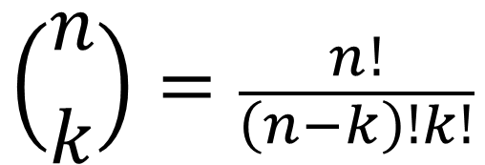
Binomial Coefficient Formula
$$\left({n \atop k}\right)=\frac{n!}{\left(n−k\right)!k!}$$

Slide 9
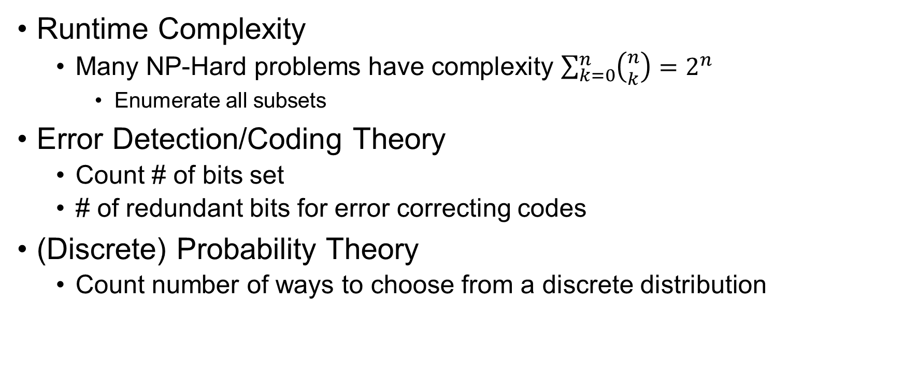
Binomial Coefficients in CS
Runtime Complexity
Many NP-Hard problems have complexity $\sum_{k=0}^{n}{\left({n \atop k}\right)}=2^{n}$
Enumerate all subsets
Error Detection/Coding Theory
Count # of bits set
# of redundant bits for error correcting codes
(Discrete) Probability Theory
Count number of ways to choose from a discrete distribution

Slide 10
Group Exercises
Form groups of 3-4

