Slide 1


Quantified Linear Arithmetic Satisfiability via Fine-Grained Strategy Improvement
Charlie Murphy
University of Wisconsin-Madison
Zachary Kincaid
Princeton University
July 24, 2024

Slide 2
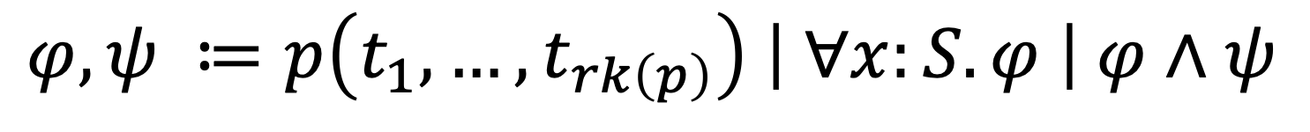
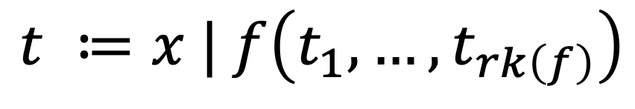
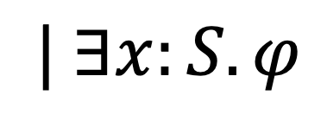
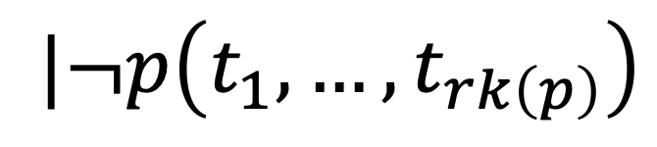
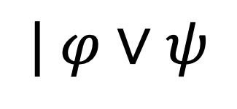
First Order Logic
Terms
$$t ≔x | f\left(t_{1},…,t_{rk\left(f\right)}\right)$$
$$φ,ψ ≔p\left(t_{1},…,t_{rk\left(p\right)}\right) \left| ∀x:S. φ \right| φ∧ψ$$
$$|¬p\left(t_{1},…,t_{rk\left(p\right)}\right)$$
$$| ∃x:S. φ$$
$$| φ∨ψ$$
Formulas
Negation Normal Form

Slide 3

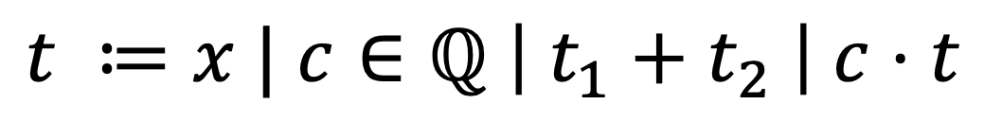
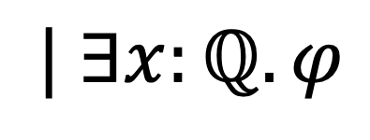
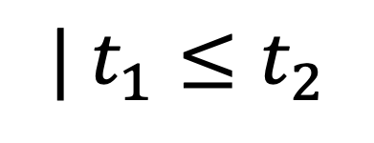
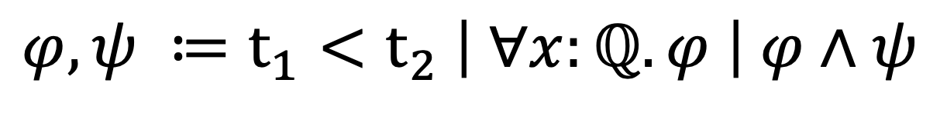
Linear Rational Arithmetic
Terms
$$t ≔x | c∈ℚ \left| t_{1}+t_{2} \right| c⋅t$$
$$φ,ψ ≔t_{1}<t_{2} \left| ∀x:ℚ. φ \right| φ∧ψ$$
$$| t_{1}≤t_{2}$$
$$| φ∨ψ$$
$$| ∃x:ℚ. φ$$
Formulas
Negation Normal Form

Slide 4
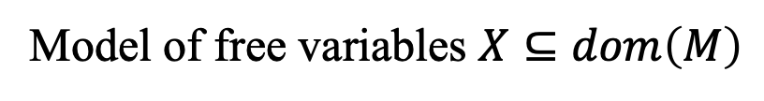
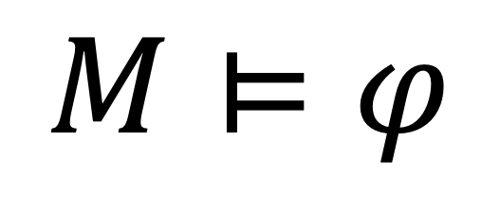
Satisfiability
$$M⊨φ$$
Model of free variables $X⊆dom\left(M\right)$
Formula with free variables X

Slide 5
Satisfiability Game
SAT
UNSAT
Controls Angelic Choice
Existential Quantifiers, Disjunction
Controls Demonic Choice
Universal Quantifiers, Conjunction

Slide 6
Satisfiability Game
SAT
UNSAT
$$M⊨φ$$

Slide 7
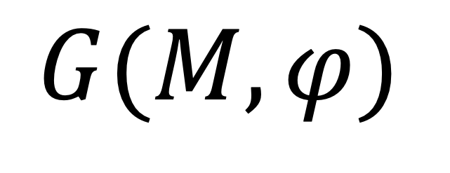
Satisfiability Game
SAT
UNSAT
$$G(M,φ)$$
State of the game

Slide 8
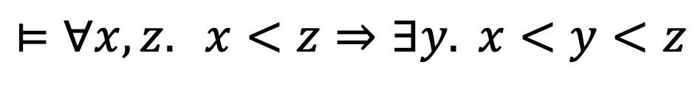
Satisfiability Game
$$⊨∀x, z. x<z⇒∃y. x<y<z$$
SAT
UNSAT
Density Property of Rationals

Slide 9
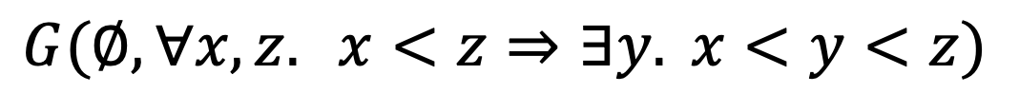
Satisfiability Game
$$G(∅,∀x, z. x<z⇒∃y. x<y<z)$$
SAT
UNSAT

Slide 10
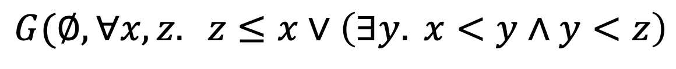
Satisfiability Game
$$G(∅,∀x, z. z≤x∨\left(∃y. x<y∧y<z\right)$$
SAT
UNSAT
Rewrite to negation normal form

Slide 11
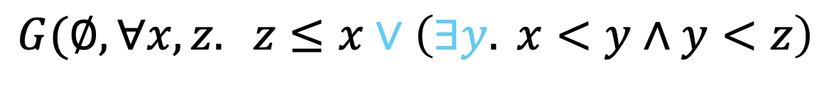
Satisfiability Game
$$G(∅,∀x, z. z≤x∨\left(∃y. x<y∧y<z\right)$$
SAT
UNSAT
Controlled by SAT

Slide 12
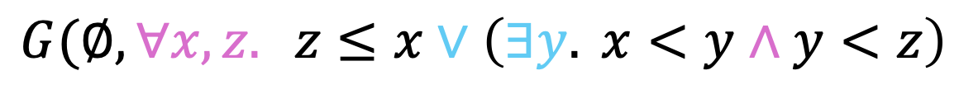
Satisfiability Game
$$G(∅,∀x, z. z≤x∨\left(∃y. x<y∧y<z\right)$$
SAT
UNSAT
Controlled by UNSAT

Slide 13



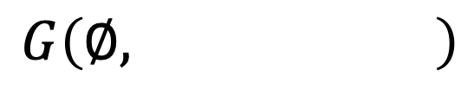




Satisfiability Game
$$∀x, z.$$
$$∨$$
SAT
$$G\left(∅, \right)$$
UNSAT
$$z≤x$$
$$∃y$$
$$∧$$
$$x<y$$
$$y<z$$
Represent formula as abstract syntax tree (AST)

Slide 14
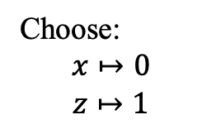
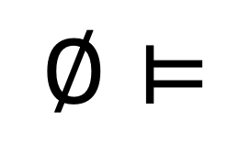
Satisfiability Game
$$∀x, z.$$
UNSAT’s choice
$$∨$$
SAT
$$∅⊨$$
UNSAT
$$z≤x$$
$$∃y$$
Choose:
$$x↦0$$
$$z↦1$$
$$∧$$
$$x<y$$
$$y<z$$
Sequence of actions played so far (by either player).
Play: 0 1

Slide 15

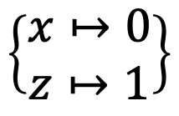
Satisfiability Game
SAT’s choice
$$∨$$
SAT
$$∅⊨$$
UNSAT
$$\left\{\begin{matrix}x↦0 \\ z↦1\end{matrix}\right\}$$
$$z≤x$$
$$∃y$$
Choose right
$$∧$$
$$x<y$$
$$y<z$$
Play: 0 1 R
Play: 0 1

Slide 16
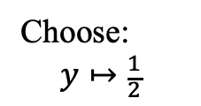




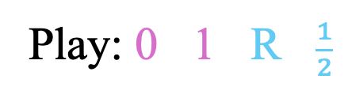
Satisfiability Game
SAT’s choice
SAT
$$∃y$$
UNSAT
$$∅⊨$$
$$\left\{\begin{matrix}x↦0 \\ z↦1\end{matrix}\right\}$$
$$∧$$
Choose:
$$y↦\frac{1}{2}$$
$$x<y$$
$$y<z$$
Play: 0 1 R $\frac{1}{2}$
Play: 0 1 R

Slide 17

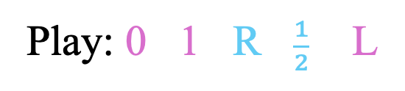

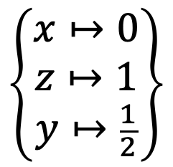

Satisfiability Game
$$\left\{\begin{matrix}x↦0 \\ z↦1 \\ y↦\frac{1}{2}\end{matrix}\right\}$$
UNSAT’s choice
SAT
$$∅⊨$$
UNSAT
$$∧$$
Choose left
$$x<y$$
$$y<z$$
Play: 0 1 R $\frac{1}{2}$ L
Play: 0 1 R $\frac{1}{2}$

Slide 18

Satisfiability Game
SAT
$$\left\{\begin{matrix}x↦0 \\ z↦1 \\ y↦\frac{1}{2}\end{matrix}\right\}$$
UNSAT
$$∅⊨$$
$$x<y$$
The chosen model satisfies the chosen atom.
SAT wins.
Play: 0 1 R $\frac{1}{2}$ L

Slide 19
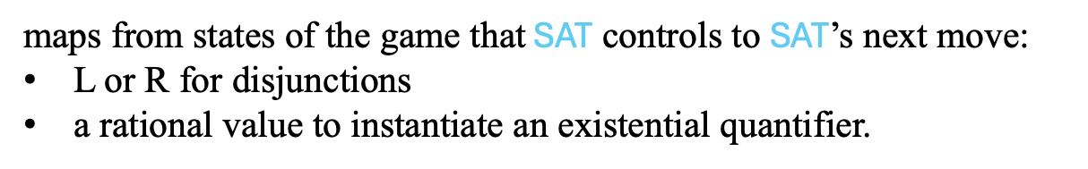
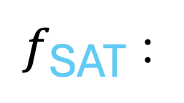
Strategies
$f_{\text{SAT}}$ :
maps from states of the game that $\text{SAT}$ controls to $\text{SAT}$’s next move:
L or R for disjunctions
a rational value to instantiate an existential quantifier.

Slide 20
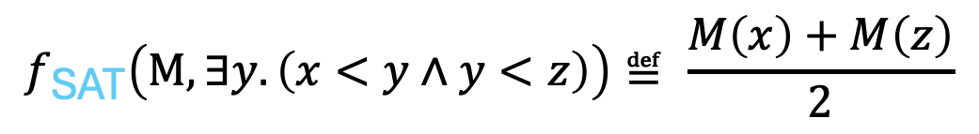

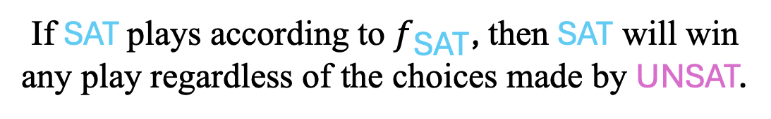
Strategies
$$f_{\text{SAT}}\left(M, z≤x∨∃y. \left(x<y∧y<z\right)\right)≝if M\left(z\right)≤M\left(x\right) then L else R$$
$$f_{\text{SAT}}\left(M, ∃y. \left(x<y∧y<z\right)\right)≝ \frac{M\left(x\right)+M\left(z\right)}{2}$$
The formula must
be satisfiable
$f_{\text{SAT}}$ is a winning strategy:
If $\text{SAT}$plays according to $f_{\text{SAT}}$, then $\text{SAT}$ will win any play regardless of the choices made by UNSAT.

Slide 21
How do we compute a winning strategy?

Slide 22


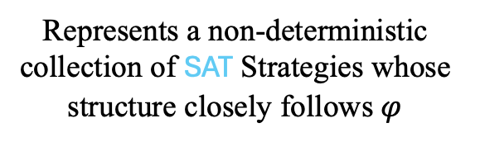















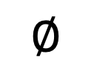







Strategy Skeletons
$$∅$$
SAT Skeleton $S^{∗}$
$$M:$$
$$φ:$$
$$∀x, z.$$
$$∙$$
$$∀x$$
$$∙$$
$$∨$$
$$∀z$$
$$z≤x$$
$$∃y$$
$$L$$
$$R$$
$$∨$$
$$∧$$
$$z≤x$$
$$\frac{x+z}{2}$$
$$∃y$$
$$x<y$$
$$y<z$$
$$L$$
$$R$$
$$∧$$
$$x<y$$
$$y<z$$
Represents a non-deterministic collection of SAT Strategies whose structure closely follows $φ$

Slide 23




Strategy Improvement
$$∅$$
SAT Skeleton $S_{0}$
$$M:$$
$$φ:$$
$$∀x, z.$$
$$∙$$
Start with an arbitrary SAT skeleton
$$∀x$$
$$∙$$
$$∨$$
$$∀z$$
Is it winning?
$$z≤x$$
$$∃y$$
$$L$$
$$∨$$
$$z≤x$$
$$∧$$
$$x<y$$
$$y<z$$

Slide 24







Winning Formula
$$∅$$
Winning formula of $S_{0}$
$$M:$$
$$φ:$$
$$∀x, z.$$
$$∙$$
$$∀x. ∀z. z≤x$$
$$\overline{z}≤\overline{x}$$
$$∀x$$
Herbandize
$$∙$$
$$∨$$
$$∀z. z≤x$$
$$∀z$$
$$z≤x$$
$$z≤x$$
$$∃y$$
$$L$$
$$∨$$
$$z≤x$$
$$z≤x$$
$$∧$$
$$x<y$$
$$y<z$$
Valid if and only if $S_{0}$ is winning

Slide 25



Winning Formula
$$∅$$
Winning formula of $S_{0}$
$$M:$$
$$φ:$$
$$∀x, z.$$
$$M_{0}≝\left\{\begin{matrix}\overline{x}↦0 \\ \overline{z}↦1\end{matrix}\right\}⊨$$
$$\overline{x}<\overline{z}$$
$$∨$$
$$z≤x$$
$$∃y$$
$$∧$$
$$x<y$$
$$y<z$$
Satisfiable if and only if $S_{o}$ is losing

Slide 26



Strategy Improvement
$$∅$$
SAT Skeleton $S_{0}$
$$M:$$
$$φ:$$
$$∀x, z.$$
$$∙$$
$$∀x$$
$$∙$$
$$∨$$
$$∀z$$
$$z≤x$$
$$∃y$$
$$L$$
$$∨$$
$$z≤x$$
$$∧$$
$$x<y$$
$$y<z$$
$S_{o}$ is not winning
$S_{o}$ has a counter-strategy
$$M_{0}≝\left\{\begin{matrix}\overline{x}↦0 \\ \overline{z}↦1\end{matrix}\right\}⊨lose(φ, S_{0})$$

Slide 27
Computing a Counter-Strategy

Slide 28









Counter Strategy
$$∅$$
SAT Skeleton $S_{0}$
UNSAT Skeleton $U_{0}$
$$M:$$
$$φ:$$
$$∀x, z.$$
$$∙$$
$$∀x$$
$$∨$$
$$∙$$
$$∀z$$
$$z≤x$$
$$∃y$$
$$∨$$
$$L$$
$$∧$$
$$z≤x$$
$$x<y$$
$$y<z$$
$$M_{0}≝\left\{\begin{matrix}\overline{x}↦0 \\ \overline{z}↦1\end{matrix}\right\}⊨lose(φ, S_{0})$$

Slide 29



Counter Strategy
$$M:$$
$$\left\{x↦0\right\}$$
$$φ:$$
SAT Skeleton $S_{0}$
UNSAT Skeleton $U_{0}$
$$∀x, z.$$
$$∙$$
$$∀x$$
$$∨$$
$$∙$$
$$∀z$$
$$z≤x$$
$$∃y$$
$$∨$$
$$L$$
$$∧$$
$$z≤x$$
$$x<y$$
$$y<z$$
$$M_{0}≝\left\{\begin{matrix}\overline{x}↦0 \\ \overline{z}↦1\end{matrix}\right\}⊨lose(φ, S_{0})$$

Slide 30


Counter Strategy
$$M:$$
$$\left\{\begin{matrix}x↦0 \\ z↦1\end{matrix}\right\}$$
$$φ:$$
SAT Skeleton $S_{0}$
UNSAT Skeleton $U_{0}$
$$∀x, z.$$
$$∙$$
$$∀x$$
$$∨$$
$$∙$$
$$∀z$$
$$z≤x$$
$$∃y$$
$$∨$$
$$L$$
$$∧$$
$$z≤x$$
$$x<y$$
$$y<z$$
$$M_{0}≝\left\{\begin{matrix}\overline{x}↦0 \\ \overline{z}↦1\end{matrix}\right\}⊨lose(φ, S_{0})$$

Slide 31







Counter Strategy
$$M:$$
$$\left\{\begin{matrix}x↦0 \\ z↦1\end{matrix}\right\}$$
$$φ:$$
SAT Skeleton $S_{0}$
UNSAT Skeleton $U_{0}$
$$∀x, z.$$
$$∙$$
$$∀x$$
$$∨$$
$$∙$$
$$∀z$$
$$z≤x$$
$$∃y$$
$$∨$$
$$L$$
$$∧$$
$$z≤x$$
$$x<y$$
$$y<z$$
$$M_{0}≝\left\{\begin{matrix}\overline{x}↦0 \\ \overline{z}↦1\end{matrix}\right\}⊨lose(φ, S_{0})$$

Slide 32


Counter Strategy
$$M:$$
$$\left\{\begin{matrix}x↦0 \\ z↦1\end{matrix}\right\}$$
$$φ:$$
SAT Skeleton $S_{0}$
UNSAT Skeleton $U_{0}$
$$∀x, z.$$
$$∙$$
$$∀x$$
$$∨$$
$$∙$$
$$∀z$$
$$z≤x$$
$$∃y$$
$$∨$$
$$L$$
$$L$$
$$∧$$
$$z≤x$$
$$z≤x$$
$$x<y$$
$$y<z$$
$$M_{0}≝\left\{\begin{matrix}\overline{x}↦0 \\ \overline{z}↦1\end{matrix}\right\}⊨lose(φ, S_{0})$$

Slide 33
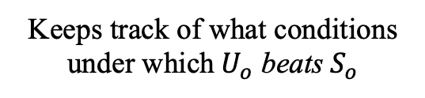

Counter Strategy
$$M:$$
$$\left\{\begin{matrix}x↦0 \\ z↦1\end{matrix}\right\}$$
$$φ:$$
SAT Skeleton $S_{0}$
UNSAT Skeleton $U_{0}$
$$∀x, z.$$
$$∙$$
$$∀x$$
$$∨$$
$$∙$$
$$∀z$$
$$z≤x$$
$$∃y$$
$$∨$$
$$L$$
$$L$$
$$∧$$
$$z≤x$$
$$z≤x$$
$$x<y$$
$$y<z$$
$$M_{0}≝\left\{\begin{matrix}\overline{x}↦0 \\ \overline{z}↦1\end{matrix}\right\}⊨lose(φ, S_{0})$$
Keeps track of what conditions under which $U_{o}$ beats $S_{o}$
$$G≝x<z$$

Slide 34
Counter Strategy
$$M:$$
$$\left\{\begin{matrix}x↦0 \\ z↦1\end{matrix}\right\}$$
$$φ:$$
SAT Skeleton $S_{0}$
UNSAT Skeleton $U_{0}$
$$∀x, z.$$
$$∙$$
$$∀x$$
$$∨$$
$$∙$$
$$∀z$$
$$z≤x$$
$$∃y$$
$$∨$$
$$L$$
$$L$$
$$∧$$
$$z≤x$$
$$z≤x$$
$$x<y$$
$$y<z$$
$$M_{0}≝\left\{\begin{matrix}\overline{x}↦0 \\ \overline{z}↦1\end{matrix}\right\}⊨lose(φ, S_{0})$$
$$G≝x<z$$

Slide 35


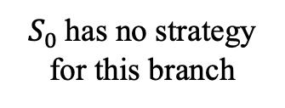

Counter Strategy
$$M:$$
$$\left\{\begin{matrix}x↦0 \\ z↦1\end{matrix}\right\}$$
$$φ:$$
SAT Skeleton $S_{0}$
UNSAT Skeleton $U_{0}$
$$∀x, z.$$
$$∙$$
$$∀x$$
$$∨$$
$$∙$$
$$∀z$$
$$z≤x$$
$$∃y$$
$$∨$$
$$L$$
$$L$$
$$∧$$
$$z≤x$$
$$z≤x$$
$$x<y$$
$$y<z$$
$$M_{0}≝\left\{\begin{matrix}\overline{x}↦0 \\ \overline{z}↦1\end{matrix}\right\}⊨lose(φ, S_{0})$$
$S_{0}$ has no strategy for this branch
$$G≝x<z∧$$

Slide 36







Counter Strategy
$$M:$$
$$\left\{\begin{matrix}x↦0 \\ z↦1\end{matrix}\right\}$$
$$φ:$$
SAT Skeleton $S_{0}$
UNSAT Skeleton $U_{0}$
$$∀x, z.$$
$$∙$$
$$∀x$$
$$∨$$
$$∙$$
$$∀z$$
$$z≤x$$
$$∃y$$
$$∨$$
$$L$$
$$L$$
$$R$$
$$∨$$
$$∧$$
$$z≤x$$
$$z≤x$$
$$∙$$
$$∃y$$
$$x<y$$
$$y<z$$
$$M_{0}≝\left\{\begin{matrix}\overline{x}↦0 \\ \overline{z}↦1\end{matrix}\right\}⊨lose(φ, S_{0})$$
$$L$$
$$∧$$
$$x<y$$
Choose any strategy
$S_{0}$ has no strategy for this branch
$$G≝x<z∧true$$

Slide 37

Counter Strategy
$$M:$$
$$\left\{\begin{matrix}x↦0 \\ z↦1\end{matrix}\right\}$$
$$φ:$$
SAT Skeleton $S_{0}$
UNSAT Skeleton $U_{0}$
$$∀x, z.$$
$$∙$$
$$∀x$$
$$∨$$
$$∙$$
$$∀z$$
$$z≤x$$
$$∃y$$
$$∨$$
$$L$$
$$L$$
$$R$$
$$∨$$
$$∧$$
$$z≤x$$
$$z≤x$$
$$∙$$
$$∃y$$
$$x<y$$
$$y<z$$
$$M_{0}≝\left\{\begin{matrix}\overline{x}↦0 \\ \overline{z}↦1\end{matrix}\right\}⊨lose(φ, S_{0})$$
$$L$$
$$∧$$
$$x<y$$
Combine Sub-strategies
$$G≝x<z∧true$$

Slide 38



Counter Strategy
$$M:$$
$$\left\{\begin{matrix}x↦0 \\ z↦1\end{matrix}\right\}$$
$$φ:$$
SAT Skeleton $S_{0}$
UNSAT Skeleton $U_{0}$
$$∀x,z.$$
$$∙$$
$$∀x$$
$$∨$$
$$∙$$
?
$$∀z$$
$$∀z$$
$$z≤x$$
$$∃y$$
$$∨$$
$$L$$
$$L$$
$$R$$
$$∨$$
$$∧$$
$$z≤x$$
$$z≤x$$
$$∙$$
$$∃y$$
$$x<y$$
$$y<z$$
$$M_{0}≝\left\{\begin{matrix}\overline{x}↦0 \\ \overline{z}↦1\end{matrix}\right\}⊨lose(φ, S_{0})$$
$$L$$
$$∧$$
$$x<y$$
$$G≝x<z$$

Slide 39
Model-based Term Selection

Slide 40
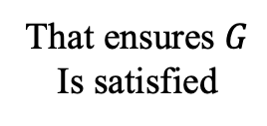
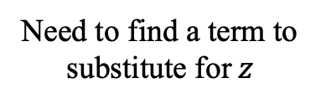
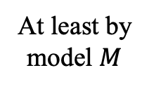
Term Selection
$$M:$$
$$\left\{\begin{matrix}x↦0 \\ z↦1\end{matrix}\right\}$$
$$φ:$$
SAT Skeleton $S_{0}$
UNSAT Skeleton $U_{0}$
$$∙$$
Need to find a term to
substitute for $z$
$$∀x,z.$$
$$∀x$$
$$∨$$
$$∙$$
?
$$∀z$$
$$∀z$$
At least by
model $M$
$$z≤x$$
$$∃y$$
$$∨$$
$$L$$
$$L$$
$$R$$
$$∨$$
$$∧$$
$$z≤x$$
$$z≤x$$
$$∙$$
$$∃y$$
$$x<y$$
$$y<z$$
$$M_{0}≝\left\{\begin{matrix}\overline{x}↦0 \\ \overline{z}↦1\end{matrix}\right\}⊨lose(φ, S_{0})$$
$$L$$
$$∧$$
$$x<y$$
That ensures $G$
Is satisfied
$$G≝x<z$$

Slide 41
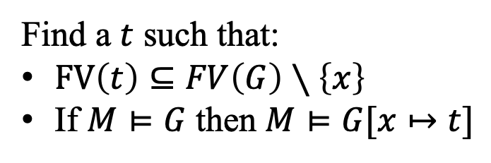

Term Selection
$$t≝select\left(x,M, G\right)$$
Find a $t$ such that:
$FV\left(t\right)⊆FV\left(G\right)∖\left\{x\right\}$
If $M⊨G$ then $M⊨G[x↦t]$

Slide 42
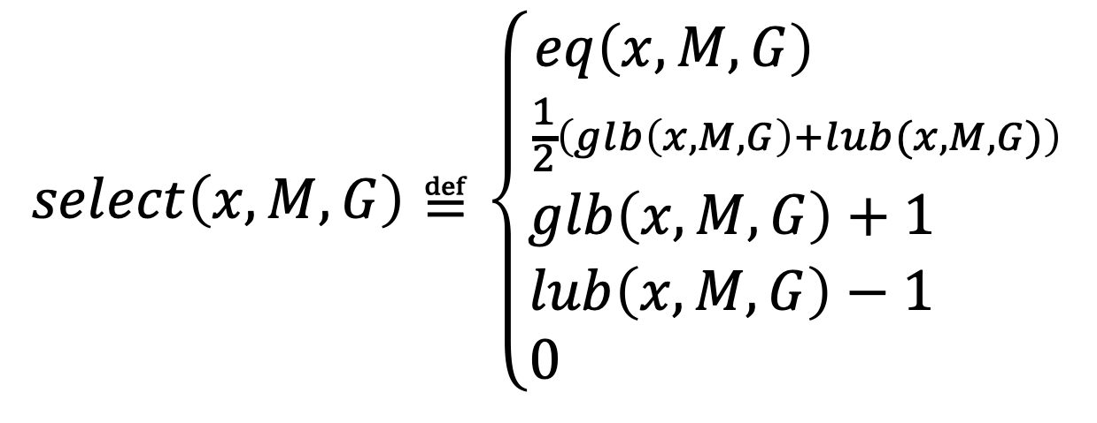
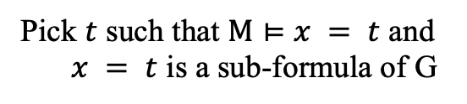
LRA Term Selection
Pick $t$ such that $M⊨x = t$ and
$x = t$ is a sub-formula of G
$$select\left(x,M, G\right)≝\left\{\begin{matrix}eq\left(x, M, G\right) \\ \frac{1}{2}\left(glb\left(x,M,G\right)+lub(x,M,G)\right) \\ \begin{matrix}glb\left(x,M,G\right)+1 \\ \begin{matrix}lub\left(x,M,G\right)−1 \\ 0 \end{matrix} \end{matrix}\end{matrix}\right.$$

Slide 43
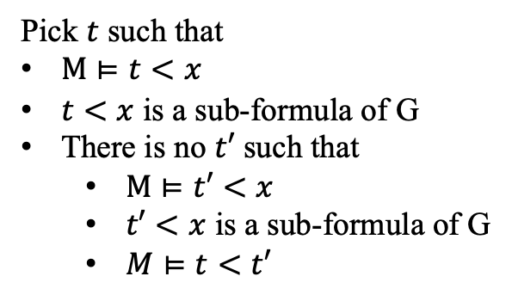
LRA Term Selection
$$select\left(x,M, G\right)≝\left\{\begin{matrix}eq\left(x, M, G\right) \\ \frac{1}{2}\left(glb\left(x,M,G\right)+lub(x,M,G)\right) \\ \begin{matrix}glb\left(x,M,G\right)+1 \\ \begin{matrix}lub\left(x,M,G\right)−1 \\ 0 \end{matrix} \end{matrix}\end{matrix}\right.$$
Pick $t$ such that
$M⊨t<x$
$t<x$ is a sub-formula of G
There is no $t′$ such that
$M⊨t′<x$
$t′<x$ is a sub-formula of G
$M⊨t<t′$

Slide 44
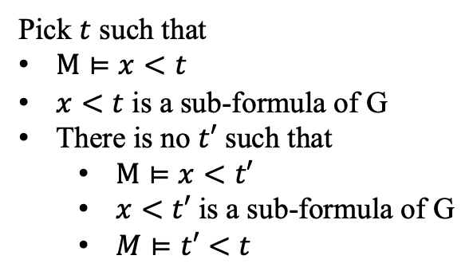
LRA Term Selection
$$select\left(x,M, G\right)≝\left\{\begin{matrix}eq\left(x, M, G\right) \\ \frac{1}{2}\left(glb\left(x,M,G\right)+lub(x,M,G)\right) \\ \begin{matrix}glb\left(x,M,G\right)+1 \\ \begin{matrix}lub\left(x,M,G\right)−1 \\ 0 \end{matrix} \end{matrix}\end{matrix}\right.$$
Pick $t$ such that
$M⊨x<t$
$x<t$ is a sub-formula of G
There is no $t′$ such that
$M⊨x<t′$
$x<t′$ is a sub-formula of G
$M⊨t′<t$

Slide 45

LRA Term Selection
$$select\left(x,M, G\right)≝\left\{\begin{matrix}eq\left(x, M, G\right) \\ \frac{1}{2}\left(glb\left(x,M,G\right)+lub(x,M,G)\right) \\ \begin{matrix}glb\left(x,M,G\right)+1 \\ \begin{matrix}lub\left(x,M,G\right)−1 \\ 0 \end{matrix} \end{matrix}\end{matrix}\right.$$
$x$ does not appear in G

Slide 46
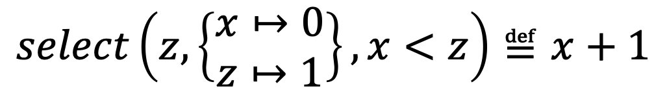
LRA Term Selection
$$select\left(z,\left\{\begin{matrix}x↦0 \\ z↦1\end{matrix}\right\}, x<z\right)≝x+1$$

Slide 47
Computing a Counter Strategy

Slide 48


Counter Strategy
$$M:$$
$$\left\{\begin{matrix}x↦0 \\ z↦1\end{matrix}\right\}$$
$$φ:$$
SAT Skeleton $S_{0}$
UNSAT Skeleton $U_{0}$
$$∀x,z.$$
$$∙$$
$$∀x$$
$$∨$$
$$∙$$
$$∀z$$
$$x+1$$
$$∀z$$
$$z≤x$$
$$∃y$$
$$∨$$
$$L$$
$$L$$
$$R$$
$$∨$$
$$∧$$
$$z≤x$$
$$z≤x$$
$$∙$$
$$∃y$$
$$x<y$$
$$y<z$$
$$M_{0}≝\left\{\begin{matrix}\overline{x}↦0 \\ \overline{z}↦1\end{matrix}\right\}⊨lose(φ, S_{0})$$
$$L$$
$$∧$$
$$x<y$$
$$G≝x<z$$

Slide 49




Counter Strategy
$$M:$$
$$\left\{x↦0\right\}$$
$$φ:$$
SAT Skeleton $S_{0}$
UNSAT Skeleton $U_{0}$
$$∀x,z.$$
$$∙$$
$$?$$
$$∀x$$
$$∀x$$
$$∨$$
$$∙$$
$$∀z$$
$$x+1$$
$$∀z$$
$$z≤x$$
$$∃y$$
$$∨$$
$$L$$
$$L$$
$$R$$
$$∨$$
$$∧$$
$$z≤x$$
$$z≤x$$
$$∙$$
$$∃y$$
$$x<y$$
$$y<z$$
$$M_{0}≝\left\{\begin{matrix}\overline{x}↦0 \\ \overline{z}↦1\end{matrix}\right\}⊨lose(φ, S_{0})$$
$$L$$
$$∧$$
$$x<y$$
$$G≝x<x+1$$

Slide 50



Counter Strategy
$$M:$$
SAT Skeleton $S_{0}$
UNSAT Skeleton $U_{0}$
$$∅$$
$$φ:$$
$$∀x,z.$$
$$∙$$
$$0$$
$$∀x$$
$$∀x$$
$$∨$$
$$∙$$
$$∀z$$
$$x+1$$
$$∀z$$
$$z≤x$$
$$∃y$$
$$∨$$
$$L$$
$$L$$
$$R$$
$$∨$$
$$∧$$
$$z≤x$$
$$z≤x$$
$$∙$$
$$∃y$$
$$x<y$$
$$y<z$$
$$M_{0}≝\left\{\begin{matrix}\overline{x}↦0 \\ \overline{z}↦1\end{matrix}\right\}⊨lose(φ, S_{0})$$
$$L$$
$$∧$$
$$x<y$$
$$G≝true$$

Slide 51
Computing a winning skeleton

Slide 52

Strategy Improvement
$$M:$$
SAT Skeleton $S_{0}$
UNSAT Skeleton $U_{0}$
$$∅$$
$$φ:$$
$$∀x,z.$$
$$∙$$
$$0$$
$$∀x$$
$$∀x$$
$$∨$$
$$∙$$
$$∀z$$
$$x+1$$
$$∀z$$
$$z≤x$$
$$∃y$$
$$∨$$
$$L$$
$$L$$
$$R$$
$$∨$$
$$∧$$
$$z≤x$$
$$z≤x$$
$$∙$$
$$∃y$$
$$x<y$$
$$y<z$$
$$L$$
$$∧$$
$$x<y$$
$U_{0}$ beats $S_{0}$

Slide 53
















Strategy Improvement
$$M:$$
UNSAT Skeleton $U_{0}$
$$∅$$
$$φ:$$
$$∀x,z.$$
$$0$$
$$∀x$$
$$∨$$
$$x+1$$
Fix the leading moves of $U_{0}$
$$∀z$$
$$z≤x$$
$$∃y$$
$$L$$
$$R$$
$$∨$$
$$∧$$
$$z≤x$$
$$∙$$
$$∃y$$
$$x<y$$
$$y<z$$
$$L$$
$$∧$$
$$x<y$$

Slide 54
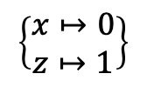


Strategy Improvement
$$M:$$
$$\left\{\begin{aligned}x↦0 \\ z↦1\end{aligned}\right\}$$
$$φ:$$
UNSAT Skeleton $U_{0}$
$$∀x,z.$$
$$0$$
$$∀x$$
$$∨$$
$$x+1$$
Fix the leading moves of $U_{0}$
$$∀z$$
$$z≤x$$
$$∃y$$
$$L$$
$$R$$
$$∨$$
$$∧$$
$$z≤x$$
$$∙$$
$$∃y$$
$$x<y$$
$$y<z$$
$$L$$
$$∧$$
$$x<y$$

Slide 55









Strategy Improvement
$$M:$$
$$\left\{\begin{aligned}x↦0 \\ z↦1\end{aligned}\right\}$$
$$φ:$$
UNSAT Skeleton $U_{0}$
SAT Skeleton $S_{1}^{′}$
$$∀x,z.$$
$$0$$
$$∀x$$
$$∨$$
$$x+1$$
$$∀z$$
$$z≤x$$
$$∃y$$
$$L$$
$$R$$
$$∨$$
$$R$$
$$∨$$
$$∧$$
$$z≤x$$
$$∙$$
$$∃y$$
$$\frac{x+z}{2}$$
$$∃y$$
$$x<y$$
$$y<z$$
$$L$$
$$∧$$
$$x<y$$
$$L$$
$$R$$
$$∧$$
$$x<y$$
$$y<z$$
Swap roles and recursively solve the resulting sub-game

Slide 56



Strategy Improvement
$$M:$$
UNSAT Skeleton $U_{0}$
SAT Skeleton $S_{1}^{′}$
$$∅$$
$$φ:$$
$$∀x,z.$$
$$0$$
$$∙$$
$$∀x$$
$$∀x$$
$$∨$$
$$x+1$$
$$∙$$
$$∀z$$
$$∀z$$
$$z≤x$$
$$∃y$$
$$L$$
$$R$$
$$∨$$
$$R$$
$$∨$$
$$∧$$
$$z≤x$$
$$∙$$
$$∃y$$
$$\frac{x+z}{2}$$
$$∃y$$
$$x<y$$
$$y<z$$
$$L$$
$$∧$$
$$x<y$$
$$L$$
$$R$$
$$∧$$
$$x<y$$
$$y<z$$
$S_{1}^{′}$ beats $U_{0}$
Generalize sub-strategy

Slide 57







Strategy Improvement
$$M:$$
UNSAT Skeleton $U_{0}$
SAT Skeleton $S_{1}$
$$∅$$
$$φ:$$
$$∀x,z.$$
$$∙$$
$$0$$
$$∀x$$
$$∀x$$
$$∨$$
$$∙$$
$$x+1$$
$$∀z$$
$$∀z$$
$$z≤x$$
$$∃y$$
$$L$$
$$R$$
$$∨$$
$$L$$
$$R$$
$$∨$$
$$∧$$
$$z≤x$$
$$∙$$
$$z≤x$$
$$∃y$$
$$\frac{x+z}{2}$$
$$∃y$$
$$x<y$$
$$y<z$$
$$L$$
$$∧$$
$$x<y$$
$$L$$
$$R$$
$$∧$$
$$x<y$$
$$y<z$$
Combine with $S_{0}$

Slide 58

Strategy Improvement
$$M:$$
UNSAT Skeleton $U_{0}$
SAT Skeleton $S_{1}$
$$∅$$
$$φ:$$
$$∀x,z.$$
$$∙$$
$$0$$
$$∀x$$
$$∀x$$
$$∨$$
$$∙$$
$$x+1$$
$$∀z$$
$$∀z$$
$$z≤x$$
$$∃y$$
$$L$$
$$R$$
$$∨$$
$$L$$
$$R$$
$$∨$$
$$∧$$
$$z≤x$$
$$∙$$
$$z≤x$$
$$∃y$$
$$\frac{x+z}{2}$$
$$∃y$$
$$x<y$$
$$y<z$$
$$L$$
$$∧$$
$$x<y$$
$$L$$
$$R$$
$$∧$$
$$x<y$$
$$y<z$$
$S_{0}⊆S_{1}$ and $S_{1}$ beats $U_{0}$

Slide 59

Strategy Improvement
$$M:$$
SAT Skeleton $S_{1}$
$$∅$$
$$φ:$$
$$∀x,z.$$
$$∙$$
$$∀x$$
$$∨$$
$$∙$$
$S_{1}$ is winning
$$∀z$$
$$z≤x$$
$$∃y$$
$$L$$
$$R$$
$$∨$$
$$∧$$
$$z≤x$$
$$\frac{x+z}{2}$$
$$∃y$$
$$x<y$$
$$y<z$$
$$L$$
$$R$$
$$∧$$
$$x<y$$
$$y<z$$

Slide 60
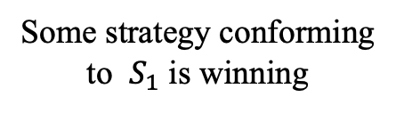
Strategy Improvement
$$M:$$
SAT Skeleton $S_{1}$
$$∅$$
$$φ:$$
$$∀x,z.$$
$$∙$$
$$∀x$$
$$∨$$
Some strategy conforming to $S_{1}$ is winning
$$∙$$
$$∀z$$
$$z≤x$$
$$∃y$$
$$L$$
$$R$$
$$∨$$
$$∧$$
$$z≤x$$
$$\frac{x+z}{2}$$
$$∃y$$
$$x<y$$
$$y<z$$
$$L$$
$$R$$
$$∧$$
$$x<y$$
$$y<z$$

Slide 61
Computing a strategy

Slide 62















Strategy Synthesis
Winning SAT Skeleton
$$∙$$
$$∀x$$
$$lose_{0}$$
Associate each node of skeleton with an uninterpreted relation representing when the sub-skeleton rooted at the node is losing
$$∙$$
$$∀z$$
$$lose_{1}$$
$$∨$$
$$lose_{2}(x, z)$$
$$∧$$
$$lose_{3}(x, z)$$
$$L$$
$$R$$
$$z≤x$$
$$\frac{x+z}{2}$$
$$∃y$$
$$lose_{4}(x, z)$$
$$∧$$
$$lose_{5}(x, z)$$
$$lose_{6}(x, z)$$
$$L$$
$$R$$
$$x<y$$
$$y<z$$

Slide 63



Strategy Synthesis
Winning SAT Skeleton
$$∙$$
$$∀x$$
$$lose_{0}$$
$$∙$$
$$∀z$$
$$lose_{1}$$
$$∨$$
$$lose_{2}(x, z)$$
$$∧$$
$$lose_{3}(x, z)$$
$$L$$
$$R$$
$$z≤x$$
$$\frac{x+z}{2}$$
$$∃y$$
$$x<z$$
$$lose_{4}(x, z)$$
$$∧$$
$$lose_{5}(x, z)$$
$$lose_{6}(x, z)$$
$$L$$
$$R$$
$$x<y$$
$$y<z$$
$$\frac{x+z}{2}≤x$$
$$z≤\frac{x+z}{2}$$
Label each atomic skeleton with the dual of its atom

Slide 64

Strategy Synthesis
$$false$$
Winning SAT Skeleton
$$∙$$
Assert that the root is not losing
$$∀x$$
$$lose_{0}$$
$$∙$$
$$∀z$$
$$lose_{1}$$
$$∨$$
$$lose_{2}(x, z)$$
$$∧$$
$$lose_{3}(x, z)$$
$$L$$
$$R$$
$$z≤x$$
$$\frac{x+z}{2}$$
$$∃y$$
$$x<z$$
$$lose_{4}(x, z)$$
$$∧$$
$$lose_{5}(x, z)$$
$$lose_{6}(x, z)$$
$$L$$
$$R$$
$$x<y$$
$$y<z$$
$$\frac{x+z}{2}≤x$$
$$z≤\frac{x+z}{2}$$

Slide 65







Strategy Synthesis
$$false$$
Solve the system of constraints:
Winning SAT Skeleton
$$∙$$
$$∀x$$
$$lose_{0}$$
$$lose_{0}≝false$$
$$∙$$
$$∀z$$
$$lose_{1}$$
$$lose_{1}≝false$$
$$lose_{2}(x,z)≝x<z$$
$$∨$$
$$lose_{2}(x, z)$$
$$∧$$
$$lose_{3}(x, z)$$
$$L$$
$$R$$
$$lose_{3}\left(x,z\right)≝z≤x$$
$$z≤x$$
$$lose_{4}\left(x,z\right)≝z≤x$$
$$\frac{x+z}{2}$$
$$∃y$$
$$x<z$$
$$lose_{4}(x, z)$$
$$lose_{5}\left(x,z\right)≝z≤x$$
$$lose_{5}(x, z)$$
$$lose_{6}\left(x,z\right)≝z≤x$$
$$L$$
$$R$$
$$∧$$
$$lose_{6}(x, z)$$
$$x<y$$
$$y<z$$
$$\frac{x+z}{2}≤x$$
$$z≤\frac{x+z}{2}$$

Slide 66



Strategy Synthesis
$$¬lose_{2}(x,z)$$
Solve the system of constraints:
Winning SAT Skeleton
$$∙$$
$$∀x$$
$$lose_{0}≝false$$
$$∙$$
$$f_{∙∙}\left(x,z\right)≝if z≤x L else R$$
$$∀z$$
$$lose_{1}≝false$$
$$f_{∙∙R}\left(x,z\right)≝ \frac{x+z}{2}$$
$$lose_{2}(x,z)≝x<z$$
$$L$$
$$R$$
$$∨$$
$$lose_{3}\left(x,z\right)≝z≤x$$
$$z≤x$$
$$lose_{4}\left(x,z\right)≝z≤x$$
$$\frac{x+z}{2}$$
$$∃y$$
$$lose_{5}\left(x,z\right)≝z≤x$$
$$lose_{6}\left(x,z\right)≝z≤x$$
$$L$$
$$R$$
$$∧$$
$$x<y$$
$$y<z$$

Slide 67
Evaluation

Slide 68
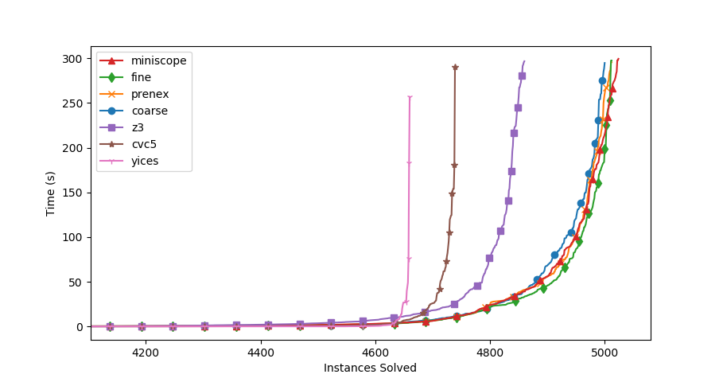
Evaluation

Slide 69
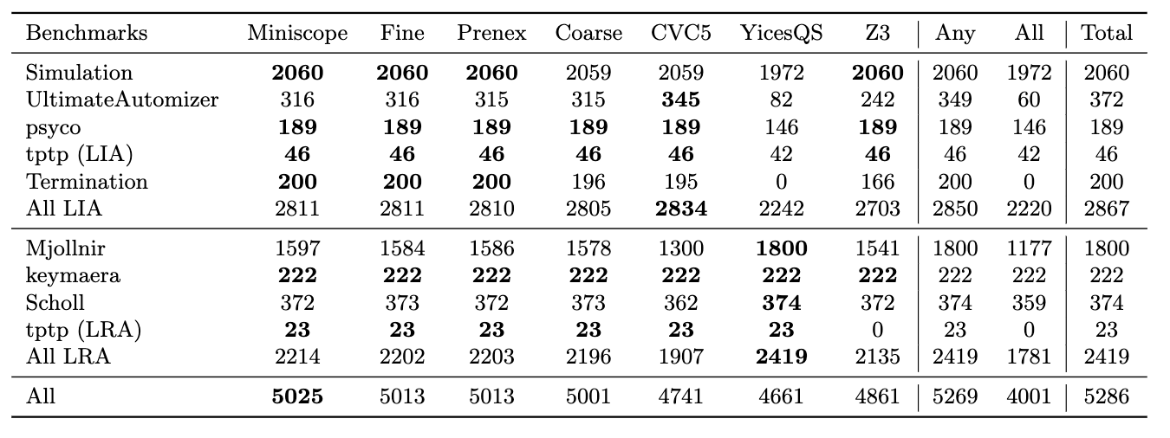
Evaluation

Slide 70
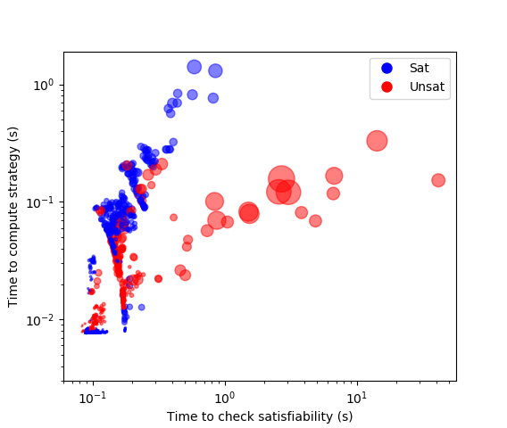
Evaluation

Slide 71
Questions
Thank you!

Slide 72
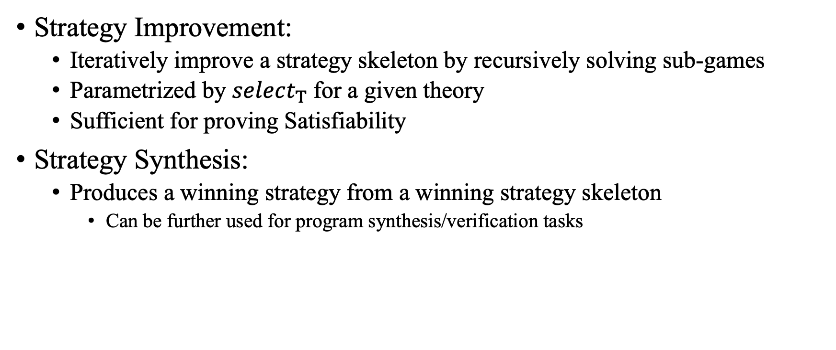
Questions
Strategy Improvement:
Iteratively improve a strategy skeleton by recursively solving sub-games
Parametrized by $select_{Τ}$ for a given theory
Sufficient for proving Satisfiability
Strategy Synthesis:
Produces a winning strategy from a winning strategy skeleton
Can be further used for program synthesis/verification tasks

