Slide 1
First Order Logic With Fixed-points and Cyclic Proofs
Charlie Murphy
April 26, 2024

Slide 2
Overview
First Order Logic with Fixed-Points
First Order Logic
Fixed-Points
First Order Logic with Fixed-Points
Proof Systems
Inference Rules / Non-Cyclic Case
Cyclic Proof Systems
Property Directed Reachability as Cyclic Proof Search

Slide 3
First Order Logic

Slide 4
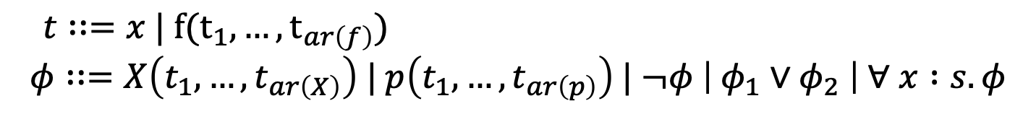
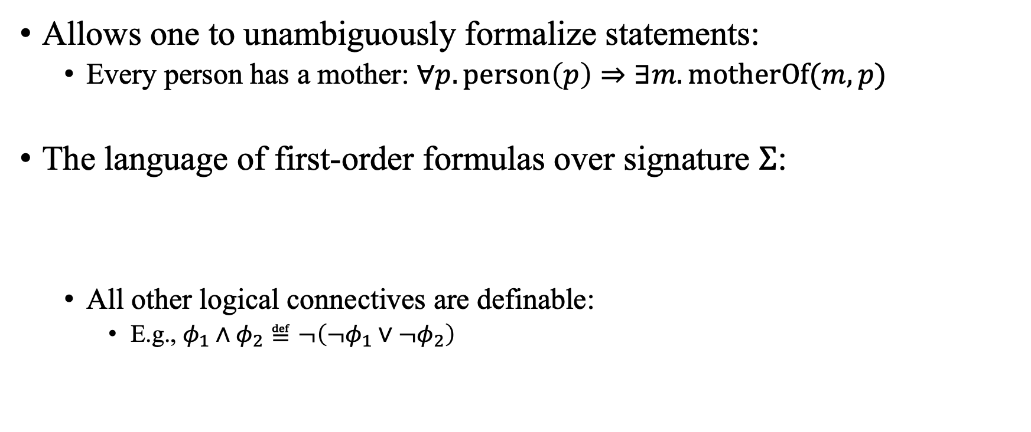
First Order Logic
Allows one to unambiguously formalize statements:
Every person has a mother: $∀p. person\left(p\right)⇒∃m. motherOf(m, p)$
The language of first-order formulas over signature $Σ$:
All other logical connectives are definable:
E.g., $φ_{1}∧φ_{2}≝¬\left(¬φ_{1}∨¬φ_{2}\right)$
$t∷=x | f(t_{1},…, t_{ar\left(f\right)})$
$$φ∷=X\left(t_{1},…,t_{ar\left(X\right)}\right) | p\left(t_{1},…,t_{ar\left(p\right)}\right) | ¬φ \left| φ_{1}∨φ_{2} \right| ∀ x :s. φ$$

Slide 5
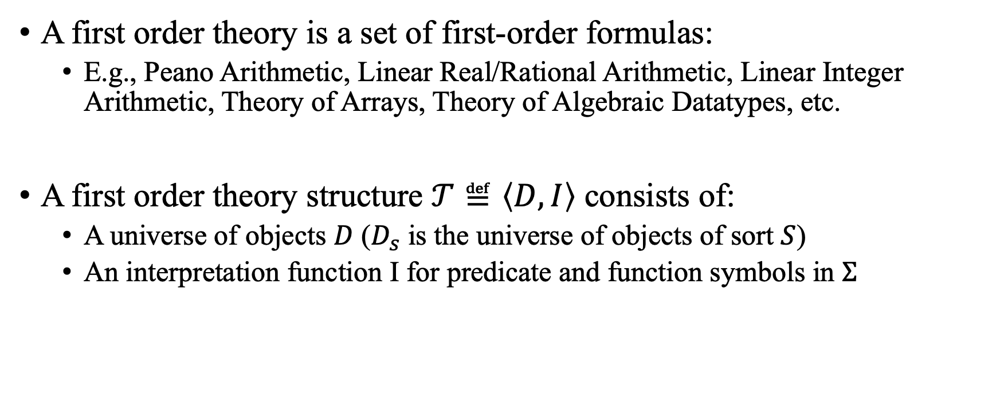

First Order Theories (over signature $Σ$)
A first order theory is a set of first-order formulas:
E.g., Peano Arithmetic, Linear Real/Rational Arithmetic, Linear Integer Arithmetic, Theory of Arrays, Theory of Algebraic Datatypes, etc.
A first order theory structure $𝒯≝\left\langle D,I\right\rangle$ consists of:
A universe of objects $D$ ($D_{s}$ is the universe of objects of sort $S$)
An interpretation function I for predicate and function symbols in $Σ$

Slide 6

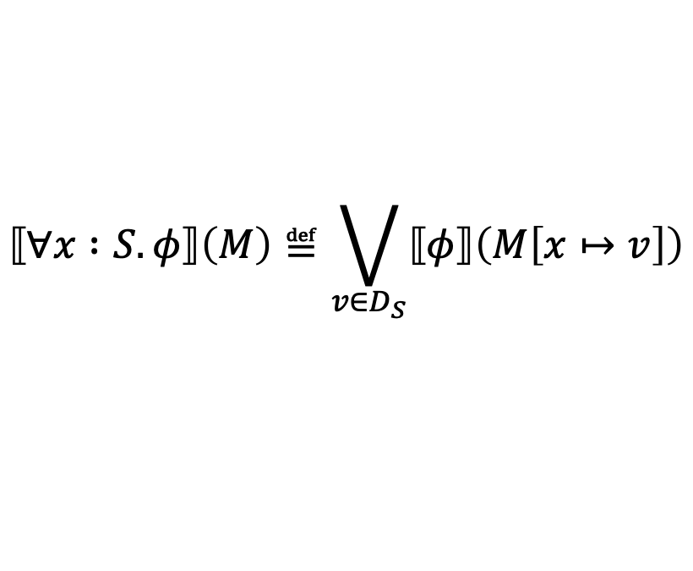






First Order Satisfiability
Let $𝒯≝\left\langle D,I\right\rangle$ be a first order structure over signature $Σ$ and
$M$ a model that maps variables to elements of universe $D$.
$⟦x⟧\left(M\right)≝M\left(x\right)$
$⟦f\left(\overline{t}\right)⟧\left(M\right)≝I(f)(⟦\overline{t}⟧(M))$
$⟦¬φ⟧\left(M\right)≝¬⟦φ⟧(M)$
$⟦φ_{1}∨φ_{2}⟧\left(M\right)≝⟦φ_{1}⟧\left(M\right)∨ ⟦φ_{2}⟧(M)$
$⟦X\left(\overline{t}\right)⟧\left(M\right)≝M(X)(⟦\overline{t}⟧(M))$
$⟦p\left(\overline{t}\right)⟧\left(M\right)≝I(p)(⟦\overline{t}⟧(M))$
$$⟦∀x :S. φ⟧\left(M\right)≝\bigvee_{v∈D_{S}}{⟦φ⟧\left(M\left[x↦v\right]\right)}$$

Slide 7
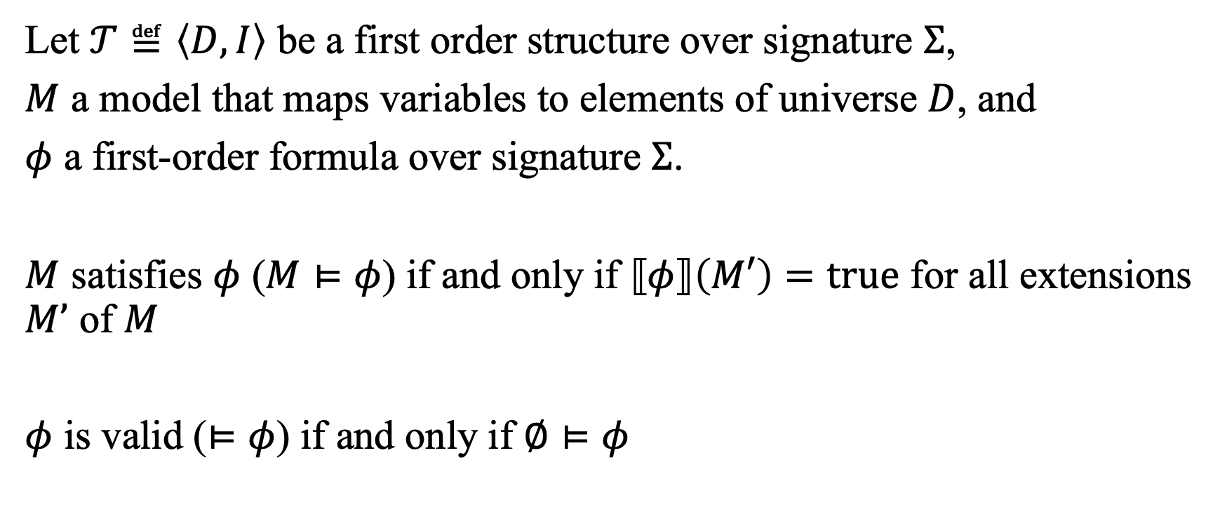
First Order Satisfiability
Let $𝒯≝\left\langle D,I\right\rangle$ be a first order structure over signature $Σ$,
$M$ a model that maps variables to elements of universe $D$, and
$φ$ a first-order formula over signature $Σ$.
$M$ satisfies $φ$ ($M⊨φ$) if and only if $⟦φ⟧\left(M′\right)=true$ for all extensions $M’$ of $M$
$φ$ is valid ($⊨φ$) if and only if $∅⊨φ$

Slide 8
Fixed-points

Slide 9
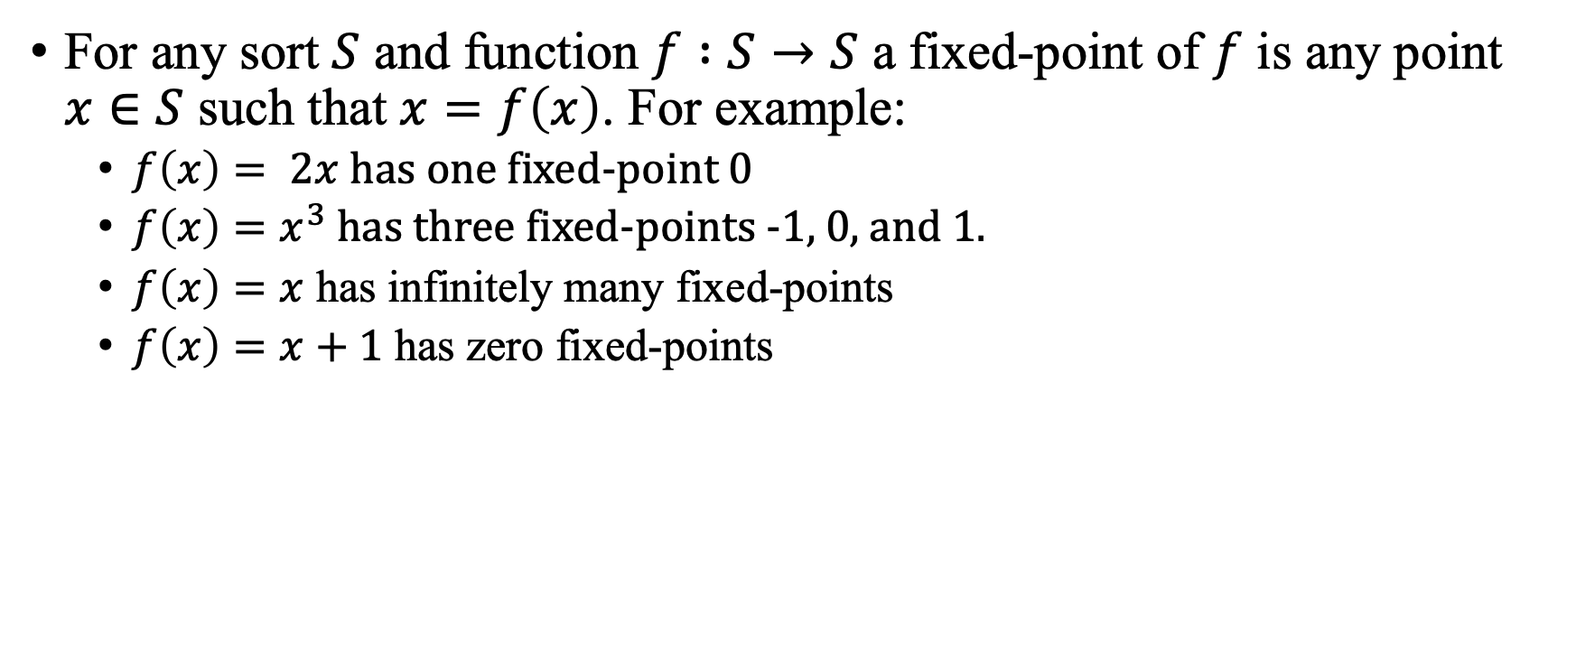
Fixed-points
For any sort $S$ and function $f :S→S$ a fixed-point of $f$ is any point $x∈S$ such that $x=f\left(x\right)$. For example:
$f\left(x\right)= 2x$ has one fixed-point 0
$f\left(x\right)=x^{3}$ has three fixed-points -1, 0, and 1.
$f\left(x\right)=x$ has infinitely many fixed-points
$f\left(x\right)=x+1$ has zero fixed-points

Slide 10
Occurrences of Fixed-points
Program Semantics (e.g., while loops, recursive functions)
Algebraic Data Types
Induction and Co-Induction
Abstract Interpretation
Invariant Generation
Model Checking

Slide 11
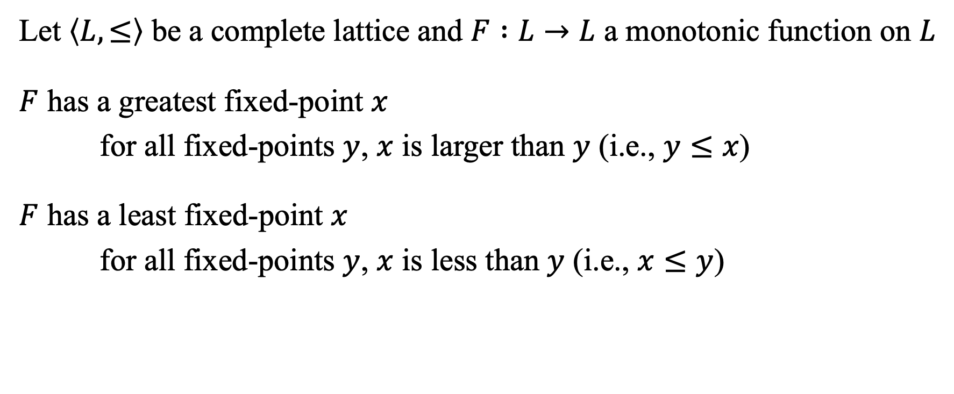
Greatest and Least Fixed-points
Let $\left\langle L, ≤\right\rangle$ be a complete lattice and $F :L→L$ a monotonic function on $L$
$F$ has a greatest fixed-point $x$
for all fixed-points $y$, $x$ is larger than $y$ (i.e., $y≤x$)
$F$ has a least fixed-point $x$
for all fixed-points $y$, $x$ is less than $y$ (i.e., $x≤y$)
[Knaster Tarski Fixed-point Theorem]

Slide 12
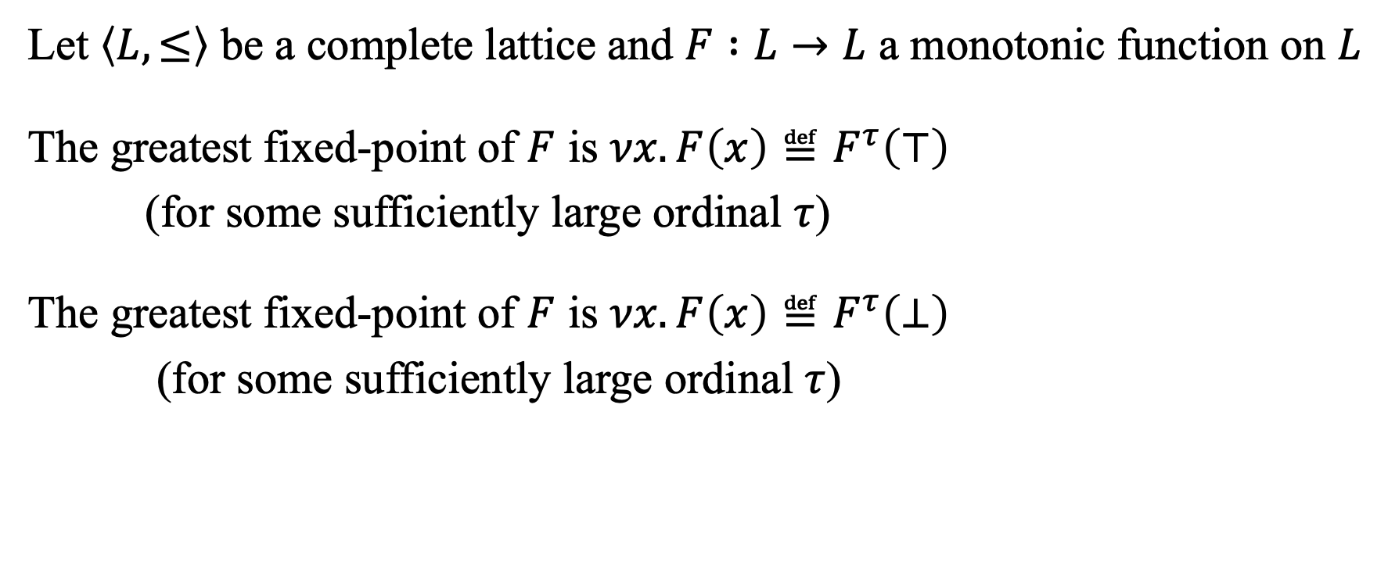
Greatest and Least Fixed-points
Let $\left\langle L, ≤\right\rangle$ be a complete lattice and $F :L→L$ a monotonic function on $L$
The greatest fixed-point of $F$ is $νx. F\left(x\right)≝F^{τ}\left(⊤\right)$
(for some sufficiently large ordinal $τ$)
The greatest fixed-point of $F$ is $νx. F\left(x\right)≝F^{τ}\left(⊥\right)$
(for some sufficiently large ordinal $τ$)
[Knaster Tarski Fixed-point Theorem]

Slide 13
First Order Logic with Fixed-points

Slide 14
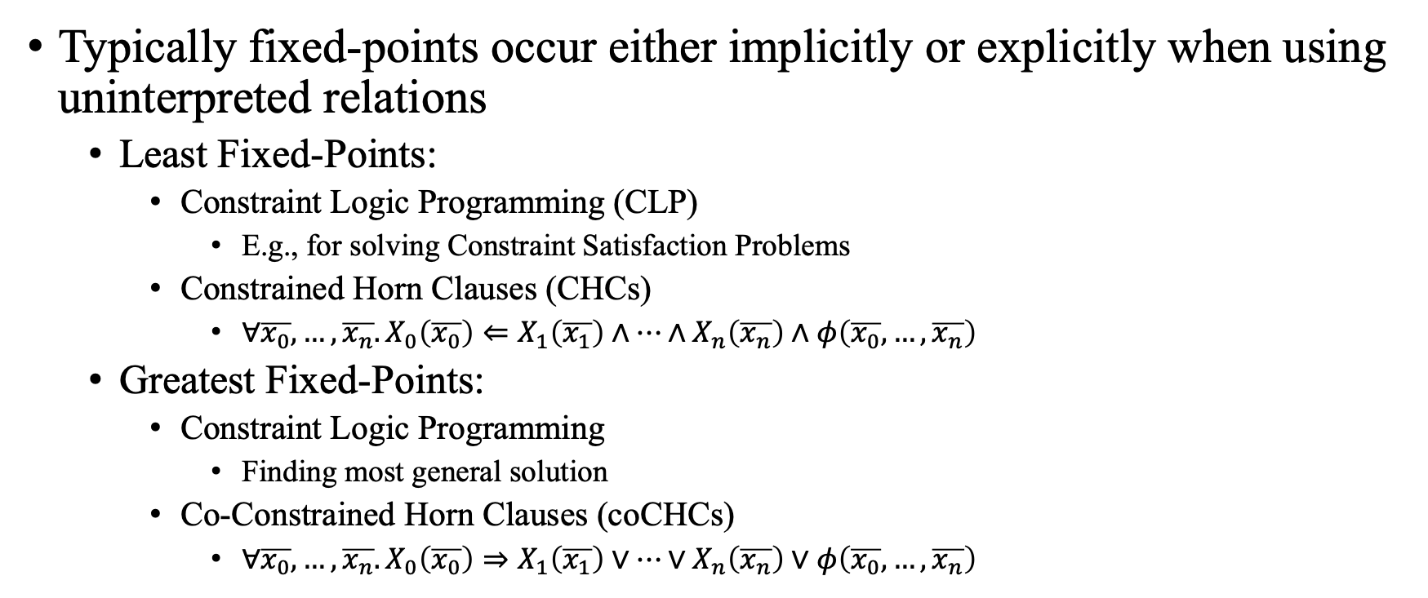
Fixed-points in First Order Logic
Typically fixed-points occur either implicitly or explicitly when using uninterpreted relations
Least Fixed-Points:
Constraint Logic Programming (CLP)
E.g., for solving Constraint Satisfaction Problems
Constrained Horn Clauses (CHCs)
$∀\overline{x_{0}},…,\overline{x_{n}}. X_{0}\left(\overline{x_{0}}\right)⇐X_{1}\left(\overline{x_{1}}\right)∧…∧X_{n}\left(\overline{x_{n}}\right)∧φ\left(\overline{x_{0}}, …, \overline{x_{n}}\right)$
Greatest Fixed-Points:
Constraint Logic Programming
Finding most general solution
Co-Constrained Horn Clauses (coCHCs)
$∀\overline{x_{0}},…,\overline{x_{n}}. X_{0}\left(\overline{x_{0}}\right)⇒X_{1}\left(\overline{x_{1}}\right)∨…∨X_{n}\left(\overline{x_{n}}\right)∨φ\left(\overline{x_{0}}, …, \overline{x_{n}}\right)$

Slide 15

















CHCs as Least Fixed-Points
0: While 0 < x
1: x--;
2: y++;
$$0≥x$$
$$x=x′$$
$$y=y′$$
$$sem^{0}(x, y,x^{′},y′)$$
$$0<x$$
$$sem^{1,2}(x,y,x^{′′},y′′)$$
$$sem^{0}(x′′,y′′,x^{′},y′)$$
$$sem^{0}(x, y,x^{′},y′)$$
$$x^{′}=x−1$$
$$y=y′$$
$$sem^{1}(x, y,x^{′},y′)$$
$$sem^{1}\left(x,y,x^{′′},y^{′′}\right)$$
$$sem^{2}\left(x^{′′},y^{′′},x^{′},y^{′}\right)$$
$$sem^{1,2}(x, y,x^{′},y′)$$
$$x^{′}=x$$
$$y^{′}=y+1$$
$$sem^{1}(x, y,x^{′},y′)$$

Slide 16
muCLP Calculus
muCLP extends Constraint Logic Programming (CLP)
Adds explicit use of least and greatest fixed-point operators to define the meaning of uninterpreted relations
Generalizes both CHCs and coCHCs
Unno et. al. “Modular Primal-Dual Fixpoint Logic Solving for Temporal Verification.” POPL, 2023.

Slide 17

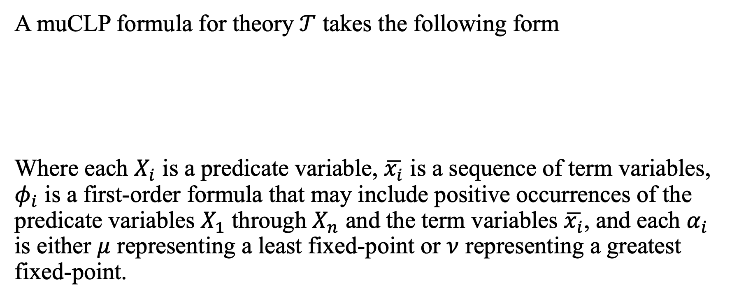
muCLP Calculus
A muCLP formula for theory $𝒯$ takes the following form
Where each $X_{i}$ is a predicate variable, $\overline{x_{i}}$ is a sequence of term variables, $φ_{i}$ is a first-order formula that may include positive occurrences of the predicate variables $X_{1}$ through $X_{n}$ and the term variables $\overline{x_{i}}$, and each $α_{i}$ is either $μ$ representing a least fixed-point or $ν$ representing a greatest fixed-point.
$φ_{0} s.t.$
$X_{1}\left(\overline{x_{1}}\right)=_{α_{1}}φ_{1}$;
$…$;
$X_{n}\left(\overline{x_{n}}\right)=_{α_{n}} φ_{n}$

Slide 18
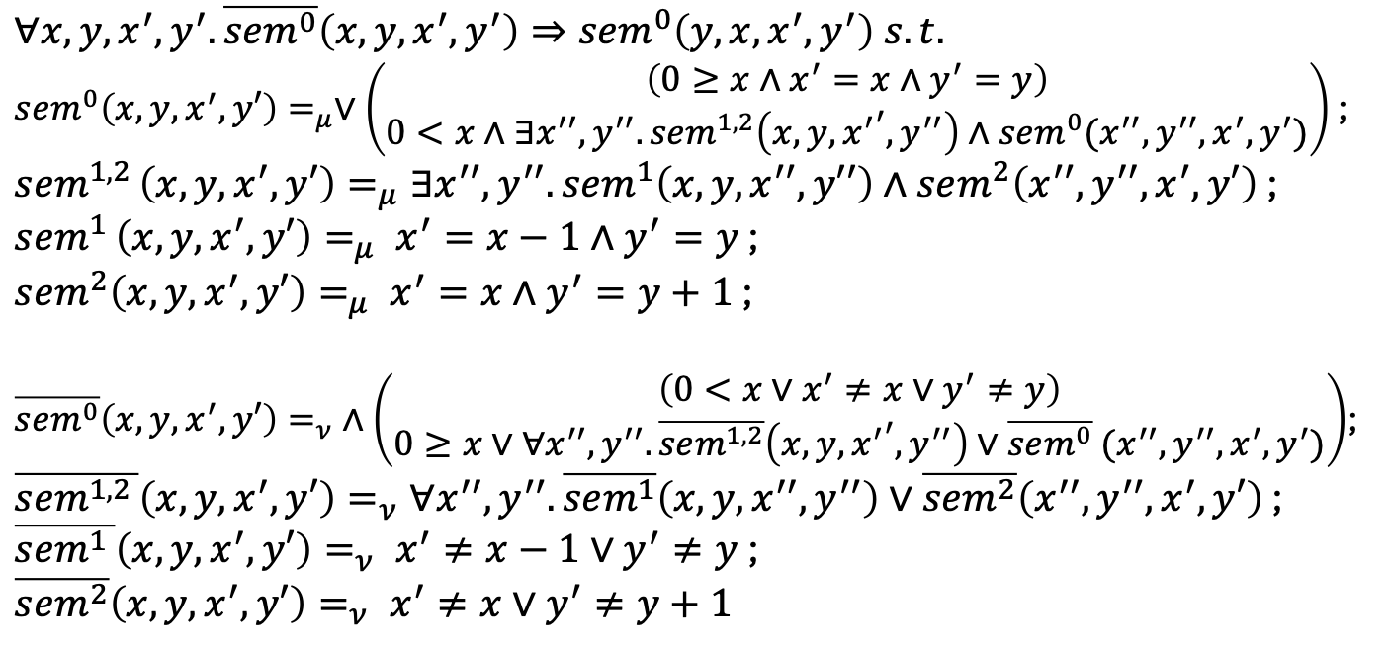
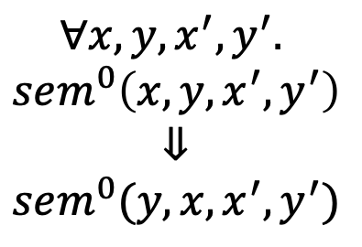
muCLP Example
Semantics
0: While 0 < x
1: x--;
2: y++;
$∀x,y,x^{′},y^{′}. \overline{sem^{0}}\left(x, y, x^{′},y^{′}\right)⇒sem^{0}\left(y,x,x^{′},y^{′}\right) s.t.$
$sem^{0}\left(x,y,x^{′},y′\right)=_{μ}∨\left(\begin{matrix}\left({0≥x∧x}^{′}=x∧y^{′}=y\right) \\ 0<x∧∃x^{′′},y^{′′}. sem^{1,2}\left(x,y,{x^{′}}^{′},y^{′′}\right)∧sem^{0}(x^{′′},y^{′′},x^{′},y^{′})\end{matrix}\right)$ ;
$sem^{1,2 }\left(x,y,x^{′},y′\right)=_{μ}∃x^{′′},y^{′′}. sem^{1}\left(x,y,x^{′′},y′′\right)∧sem^{2}\left(x^{′′},y^{′′},x^{′},y′\right)$ ;
$sem^{1 }\left(x,y,x^{′},y′\right)=_{μ} x^{′}=x−1∧y^{′}=y$ ;
$sem^{2}\left(x,y,x^{′},y′\right)=_{μ} x^{′}=x∧y^{′}=y+1$ ;
$\overline{sem^{0}}\left(x,y,x^{′},y′\right)=_{ν} ∧\left(\begin{matrix}\left({0<x∨x}^{′}≠x∨y^{′}≠y\right) \\ 0≥x∨∀x^{′′},y^{′′}. \overline{sem^{1,2}}\left(x,y,{x^{′}}^{′},y^{′′}\right)∨\overline{sem^{0}} (x^{′′},y^{′′},x^{′},y^{′})\end{matrix}\right)$;
$\overline{sem^{1,2 }}\left(x,y,x^{′},y′\right)=_{ν}∀x^{′′},y^{′′}. \overline{sem^{1}}\left(x,y,x^{′′},y^{′′}\right)∨\overline{sem^{2}}\left(x^{′′},y^{′′},x^{′},y′\right)$ ;
$\overline{sem^{1 }}\left(x,y,x^{′},y′\right)=_{ν} x^{′}≠x−1∨y^{′}≠y$ ;
$\overline{sem^{2}}\left(x,y,x^{′},y′\right)=_{ν} x^{′}≠x∨y^{′}≠y+1$
$$∀x,y,x^{′},y^{′}.$$
$$sem^{0}\left(x, y, x^{′}, y^{′}\right)$$
$$⇓$$
$$sem^{0}(y,x,x^{′},y^{′})$$
Dual Semantics

Slide 19
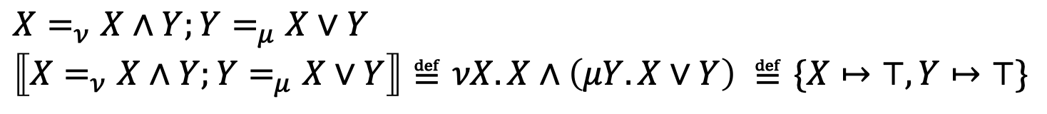

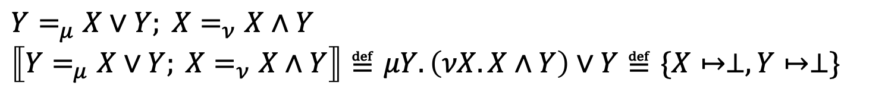
muCLP Satisfiability
A muCLP formula $𝒫≝φ s.t. P$ is satisfiable if and only if $⟦P⟧\left(∅\right)⊨φ$,
where $⟦P⟧\left(∅\right)$ maps each predicate variable defined in $P$ to its fixed-point.
$X=_{ν}X∧Y;Y=_{μ}X∨Y$
$⟦X=_{ν}X∧Y;Y=_{μ}X∨Y⟧≝νX. X∧\left(μY. X∨Y\right) ≝\{X↦⊤,Y↦⊤\}$
$Y=_{μ}X∨Y; X=_{ν}X∧Y$
$⟦Y=_{μ}X∨Y; X=_{ν}X∧Y⟧≝μY. \left(νX. X∧Y\right)∨Y≝\{X↦⊥,Y↦⊥\}$

Slide 20

muCLP Example
0: While 0 < x
1: x--;
2: y++;
$∀x,y,x^{′},y^{′}. \overline{sem^{0}}\left(x, y, x^{′},y^{′}\right)⇒sem^{0}\left(y,x,x^{′},y^{′}\right) s.t.$
$sem^{0}\left(x,y,x^{′},y′\right)=_{μ}∨\left(\begin{matrix}\left({0≥x∧x}^{′}=x∧y^{′}=y\right) \\ 0<x∧∃x^{′′},y^{′′}. sem^{1,2}\left(x,y,{x^{′}}^{′},y^{′′}\right)∧sem^{0}(x^{′′},y^{′′},x^{′},y^{′})\end{matrix}\right)$ ;
$sem^{1,2 }\left(x,y,x^{′},y′\right)=_{μ}∃x^{′′},y^{′′}. sem^{1}\left(x,y,x^{′′},y′′\right)∧sem^{2}\left(x^{′′},y^{′′},x^{′},y′\right)$ ;
$sem^{1 }\left(x,y,x^{′},y′\right)=_{μ} x^{′}=x−1∧y^{′}=y$ ;
$sem^{2}\left(x,y,x^{′},y′\right)=_{μ} x^{′}=x∧y^{′}=y+1$ ;
$\overline{sem^{0}}\left(x,y,x^{′},y′\right)=_{ν} ∧\left(\begin{matrix}\left({0<x∨x}^{′}≠x∨y^{′}≠y\right) \\ 0≥x∨∀x^{′′},y^{′′}. \overline{sem^{1,2}}\left(x,y,{x^{′}}^{′},y^{′′}\right)∨\overline{sem^{0}} (x^{′′},y^{′′},x^{′},y^{′})\end{matrix}\right)$;
$\overline{sem^{1,2 }}\left(x,y,x^{′},y′\right)=_{ν}∀x^{′′},y^{′′}. \overline{sem^{1}}\left(x,y,x^{′′},y^{′′}\right)∨\overline{sem^{2}}\left(x^{′′},y^{′′},x^{′},y′\right)$ ;
$\overline{sem^{1 }}\left(x,y,x^{′},y′\right)=_{ν} x^{′}≠x−1∨y^{′}≠y$ ;
$\overline{sem^{2}}\left(x,y,x^{′},y′\right)=_{ν} x^{′}≠x∨y^{′}≠y+1$
$$∀x,y,x^{′},y^{′}.$$
$$sem^{0}\left(x, y, x^{′}, y^{′}\right)$$
$$⇓$$
$$sem^{0}(y,x,x^{′},y^{′})$$
$$sem^{0}≝λx,y,x^{′},y^{′}. \left(0≥x∧x^{′}=x∧y^{′}=y\right)∨\left(0<x∧ 0=x^{′}∧ y^{′}=y+x\right)$$
$$\overline{sem^{0}}≝λx,y,x^{′},y^{′}. \left(0<x∨x^{′}≠x∨y^{′}≠y\right)∧\left(0≥x∨ 0≠x^{′}∨ y^{′}=y+x\right)$$

Slide 21
Proof Systems

Slide 22
Proof Systems
A proof system consists of
A set of axioms (or schematic axioms)
Rules of Inference
Example Proof Systems:
Resolution (e.g., for formulas in conjunctive normal form)
Hilbert Proof System (e.g., axioms and modus ponens)
Sequent Calculus (e.g., for propositional and first-order logic)

Slide 23




























Sequent Calculus (Propositional Logic)
$$Γ, A⊢Δ,A$$
Atom
$$Γ, A,B⊢Δ$$
$$Γ, A⊢Δ$$
$$Γ, B⊢Δ$$
$$Γ⊢Δ,A$$
$$Γ, B⊢Δ$$
$$Γ⊢Δ,A$$
$$∧L$$
$$∨L$$
$$→L$$
$$¬L$$
$$Γ, A∧B⊢Δ$$
$$Γ, A∨B⊢Δ$$
$$Γ, A→B⊢Δ$$
$$Γ, ¬A⊢Δ$$
$$Γ⊢Δ, A$$
$$Γ⊢Δ, B$$
$$Γ⊢Δ,A,B$$
$$Γ,A⊢Δ$$
$$∧R$$
$$∨R$$
$$Γ,A⊢Δ,B$$
$$Γ⊢Δ, A∧B$$
$$Γ⊢Δ, A∨B$$
$$→R$$
$$Γ⊢Δ,¬A$$
$$¬R$$
$$Γ, A→B⊢Δ$$

Slide 24





Sequent Calculus Example Proof
Atom
$$A⊢A$$
$$¬R$$
$$⊢A,¬A$$
$$∨R$$
$$⊢A∨¬A$$
Law of excluded middle

Slide 25
Cyclic Proof Systems

Slide 26
Cyclic Proof System
A cyclic proof system is a proof system that allows using recursive reasoning via back-links:
pre-proof
Global
Trace Condition
A
D
E
F
G
Recursive Reasoning Principle
B
C
A

Slide 27
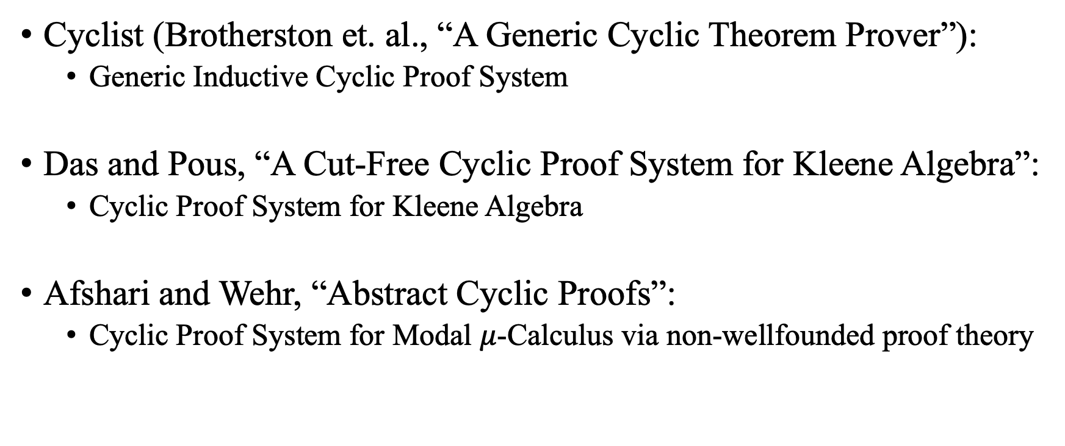
Cyclic Proof Systems
Cyclist (Brotherston et. al., “A Generic Cyclic Theorem Prover”):
Generic Inductive Cyclic Proof System
Das and Pous, “A Cut-Free Cyclic Proof System for Kleene Algebra”:
Cyclic Proof System for Kleene Algebra
Afshari and Wehr, “Abstract Cyclic Proofs”:
Cyclic Proof System for Modal $μ$-Calculus via non-wellfounded proof theory

Slide 28
Goal Oriented Proof Search
Proof Constructed from the bottom up
Begin at the goal and work backwards
Iteratively expand the incomplete proof one leaf at a time
Pick some leaf that isn’t an axiom or have a backlink
Try to match leaf with ancestor
Find ancestor with same sequent
Ensure global trace condition is preserved
E.g., by finding appropriate invairants and/or proving well-foundedness
Apply sequent rule
[Tsukada and Unno. “Software Model-Checking as Cyclic-Proof Search.” POPL 2022.]

Slide 29



















Other Techniques as Cyclic Proof Search
Original View
Cyclic Proof View
A
$$a_{b}$$
$$a_{c}$$
$$G$$
B
C
$$⟦f_{g}⟧(G)$$
$$E$$
$$F$$
$$b_{d}$$
$$⟦d_{e}⟧(E)$$
$$⟦d_{f}⟧(F)$$
D
$$D$$
$$d_{e}$$
$$d_{f}$$
$$⟦b_{d}⟧(D)$$
E
F
$$B$$
$$C$$
$$f_{g}$$
$$⟦a_{b}⟧(B)$$
$$⟦a_{c}⟧(C)$$
$$A$$
G

Slide 30
Other Techniques as Cyclic Proof Search
Property Directed Reachability
Satisfiability of Constrained Horn Clauses
Program Safety (via Impact algorithm) [McMillan, “Lazy abstraction with interpolants.”]
Strategy Synthesis Algorithms
Reachability Games [Kincaid and Farzan, “Strategy Synthesis for Linear Arithmetic Games.”]
Simulation Games [Murphy and Kincaid, “Relational Verification via Simulation Synthesis.”]
Symbolic Execution and Bounded Model Checking

