Slide 1
Introduction to Game Semantics and Logical Games
Charlie Murphy
3/31/2020

Slide 2
Overview
Finite Games
Game Semantics
Strategy Synthesis
Infinite Games

Slide 3
Finite Games

Slide 4
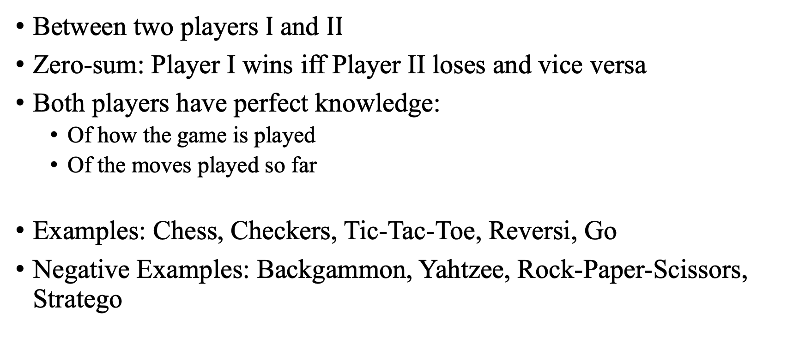
Two-person Perfect Information Finite Games
Finite Games
Between two players $I$ and $II$
Zero-sum: Player I wins iff Player II loses and vice versa
Both players have perfect knowledge:
Of how the game is played
Of the moves played so far
Examples: Chess, Checkers, Tic-Tac-Toe, Reversi, Go
Negative Examples: Backgammon, Yahtzee, Rock-Paper-Scissors, Stratego
[Khomskii, 2010]

Slide 5




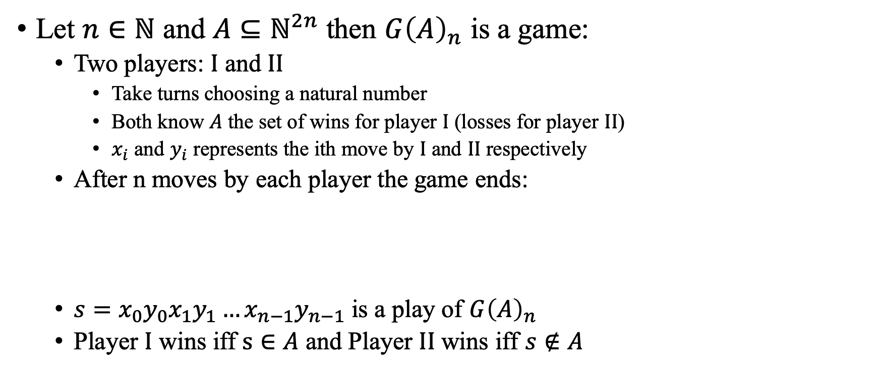






Finite Games
Let $n∈ℕ$ and $A⊆ℕ^{2n}$ then $G{\left(A\right)}_{n}$ is a game:
Two players: $I$ and $II$
Take turns choosing a natural number
Both know $A$ the set of wins for player $I$ (losses for player $II$)
$x_{i}$ and $y_{i}$ represents the ith move by $I$ and $II$ respectively
After n moves by each player the game ends:
$s=x_{0}y_{0}x_{1}y_{1}…x_{n−1}y_{n−1}$ is a play of $G{\left(A\right)}_{n}$
Player $I$ wins iff $s∈A$ and Player $II$ wins iff $s∉A$
$$I$$
$$x_{0}$$
$$x_{1}$$
$$⋯$$
$$x_{n−1}$$
$$II$$
$$y_{0}$$
$$y_{1}$$
$$⋯$$
$$y_{n−1}$$
[Khomskii, 2010]

Slide 6








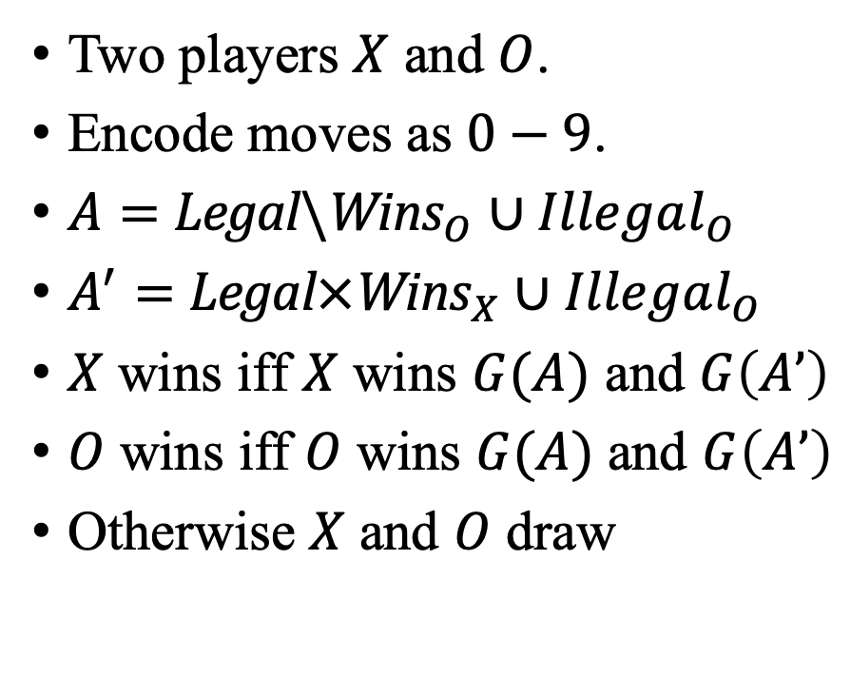













Tic-Tac-Toe
$$0$$
$$1$$
$$2$$
Two players $X$ and $O$.
Encode moves as $0−9$.
$A=$ $\text{Legal}\backslash {\text{Wins}}_{O}∪Illegal_{O}$
$A^{′}=$ $\text{Legal}×{\text{Wins}}_{X}∪Illegal_{O}$
$X$ wins iff $X$ wins $G(A)$ and $G\left(A’\right)$
$O$ wins iff $O$ wins $G(A)$ and $G\left(A’\right)$
Otherwise $X$ and $O$ draw
$$3$$
$$4$$
$$5$$
$$6$$
$$7$$
$$8$$
$$X$$
$$0$$
$$6$$
$$5$$
$$1$$
$$8$$
$$O$$
$$4$$
$$3$$
$$7$$
$$2$$
$$9$$

Slide 7





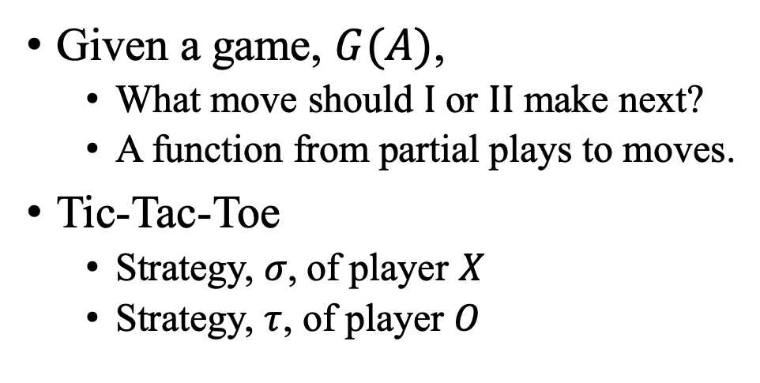





Strategies
$$0$$
$$1$$
$$2$$
Given a game, $G(A)$,
What move should $I$ or $II$ make next?
A function from partial plays to moves.
Tic-Tac-Toe
Strategy, $σ$, of player $X$
Strategy, $τ$, of player $O$
$$3$$
$$4$$
$$5$$
$$6$$
$$7$$
$$8$$
$$σ\left(ε\right)=0$$
$$σ\left(04\right)=6$$
$$σ\left(0463\right)=5$$
$$σ\left(046357\right)=1$$
$$σ\left(04635712\right)=8$$
$$τ\left(0\right)=4$$
$$τ\left(046\right)=3$$
$$τ\left(04635\right)=7$$
$$τ\left(0463571\right)=2$$
$$τ\left(046357128\right)=9$$

Slide 8
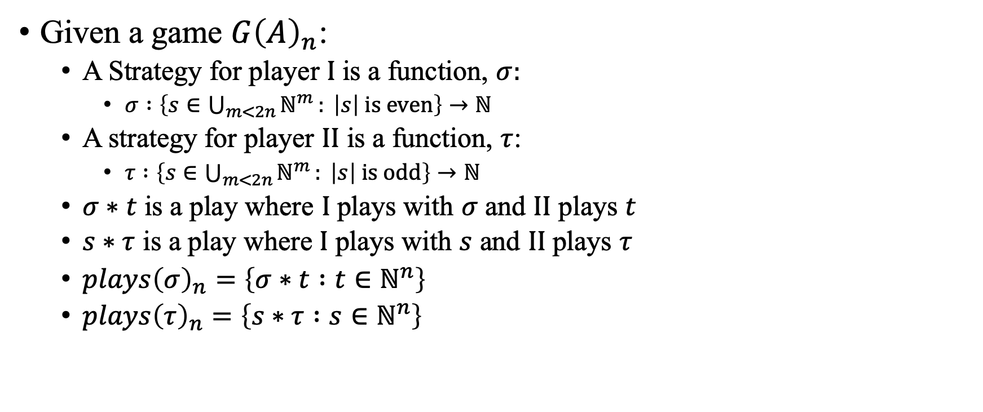
Strategies
Given a game $G{\left(A\right)}_{n}$:
A Strategy for player $I$ is a function, $σ:$
$σ :\left\{s∈\bigcup_{m<2n}{ℕ^{m}}: \left|s\right| is even\right\}→ℕ$
A strategy for player $II$ is a function, $τ$:
$τ :\left\{s∈\bigcup_{m<2n}{ℕ^{m}}: \left|s\right| is odd\right\}→ℕ$
$σ∗t$ is a play where $I$ plays with $σ$ and $II$ plays $t$
$s∗τ$ is a play where $I$ plays with $s$ and $II$ plays $τ$
$plays{\left(σ\right)}_{n}=\left\{σ∗t :t∈ℕ^{n}\right\}$
$plays{\left(τ\right)}_{n}=\left\{s∗τ :s∈ℕ^{n}\right\}$
[Khomskii, 2010]

Slide 9
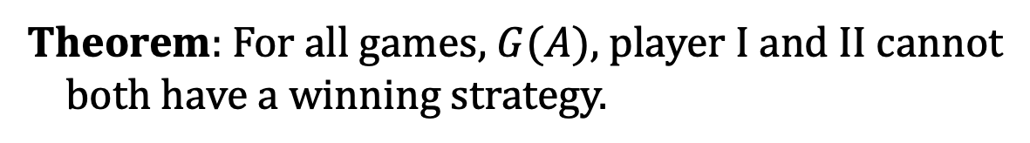

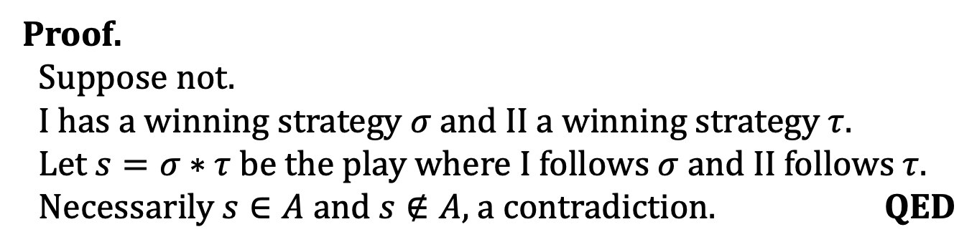
Winning Strategies
Given a game $G{\left(A\right)}_{n}$:
$σ$ is a winning strategy iff $plays{\left(σ\right)}_{n}⊆A$
$τ$ is a winning strategy iff $plays{\left(τ\right)}_{n}⊆ℕ^{2n}\backslash A$
Theorem: For all games, $G(A)$, player $I$ and $II$ cannot
both have a winning strategy.
Proof.
Suppose not.
I has a winning strategy $σ$ and II a winning strategy $τ$.
Let $s=σ∗τ$ be the play where I follows $σ$ and II follows $τ$.
Necessarily $s∈A$ and $s∉A$, a contradiction. QED

Slide 10
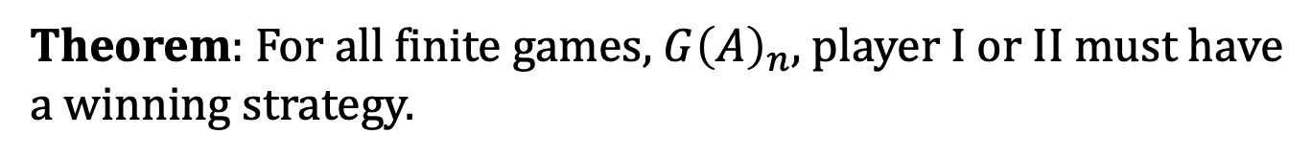

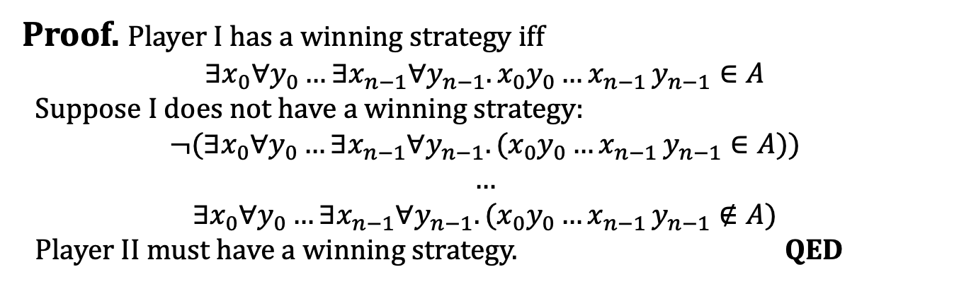
Determinacy
A game G(A) is determined iff Player $I$ or $II$ has a winning strategy
There is at most one winner
Is there at least one winner?
Theorem: For all finite games, $G{\left(A\right)}_{n}$, player $I$ or $II$ must have
a winning strategy.
Proof. Player I has a winning strategy iff
$$∃x_{0}∀y_{0}…∃x_{n−1}∀y_{n−1}. x_{0}y_{0}…x_{n−1 }y_{n−1}∈A$$
Suppose I does not have a winning strategy:
$$¬(∃x_{0}∀y_{0}…∃x_{n−1}∀y_{n−1}. (x_{0}y_{0}…x_{n−1 }y_{n−1}∈A))$$
…
$$∃x_{0}∀y_{0}…∃x_{n−1}∀y_{n−1}. (x_{0}y_{0}…x_{n−1 }y_{n−1}∉A)$$
Player II must have a winning strategy. QED

Slide 11
Game Semantics

Slide 12
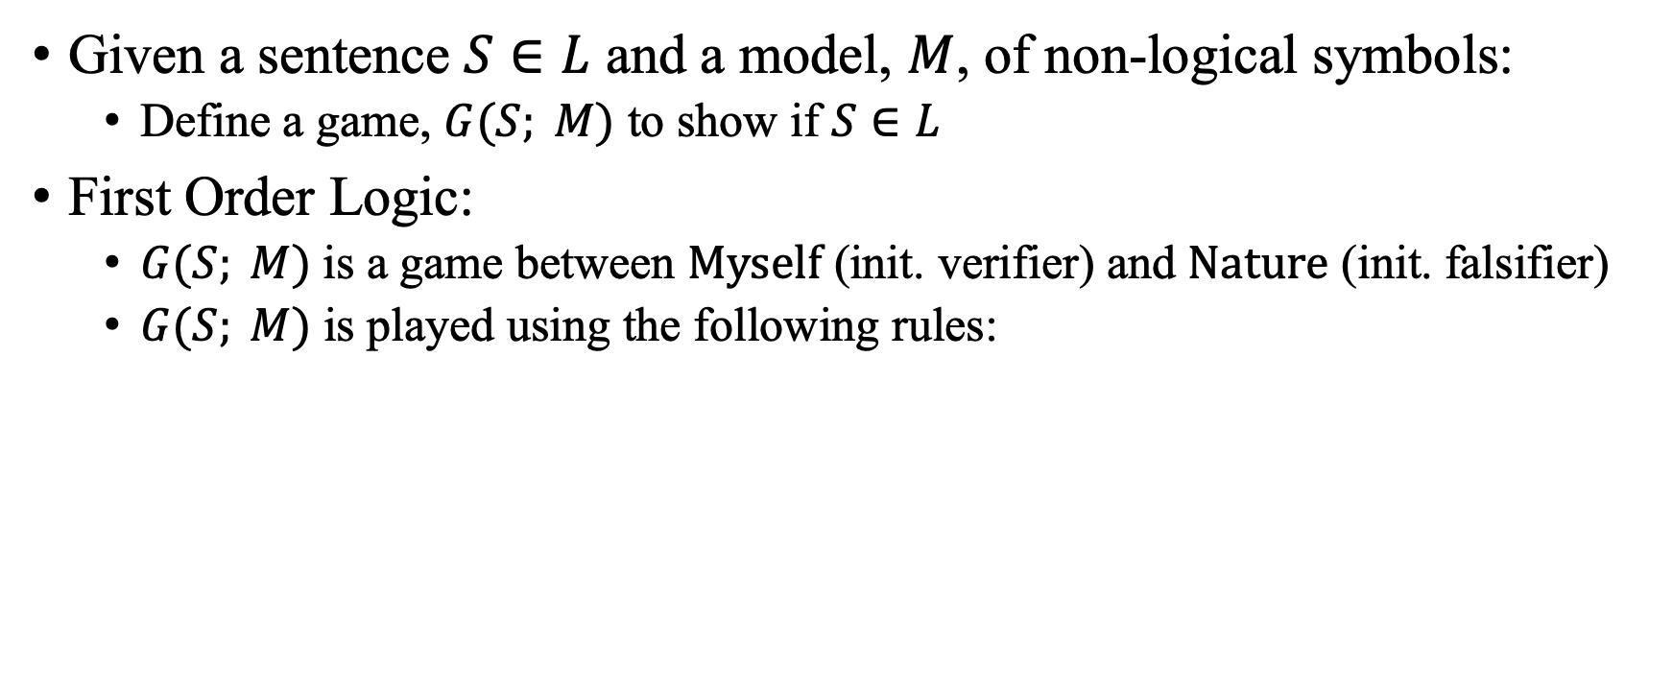
Game Semantics
Given a sentence $S∈L$ and a model, $M$, of non-logical symbols:
Define a game, $G(S; M)$ to show if $S∈L$
First Order Logic:
$G(S; M)$is a game between Myself (init. verifier) and Nature (init. falsifier)
$G(S; M)$ is played using the following rules:
$R∨. G(S_{1}∨S_{2};M)$ verifier chooses to continue as $G\left(S_{1};M\right)$ or $G(S_{2};M)$
$R∧. G(S_{1}∧S_{2};M)$ falsifier chooses to continue as $G\left(S_{1};M\right)$ or $G(S_{2};M)$
$R ∃. G(∃x. S;M)$ verifier chooses $c∈do(M)$ and continues as $G(S\left[c/x\right];M)$
$R ∀. G(∀x. S;M)$ falsifier chooses $c∈do(M)$ and continues as $G(S\left[c/x\right];M)$
$R ¬. G(¬S;M)$ falsifier and verifier swap roles and play $G(S;M)$
$R atom. G(c_{a};M)$ the current verifier wins if $c_{a}$ interpreted in $M$ is true otherwise falsifier wins
[Hintikka, 1982]

Slide 13
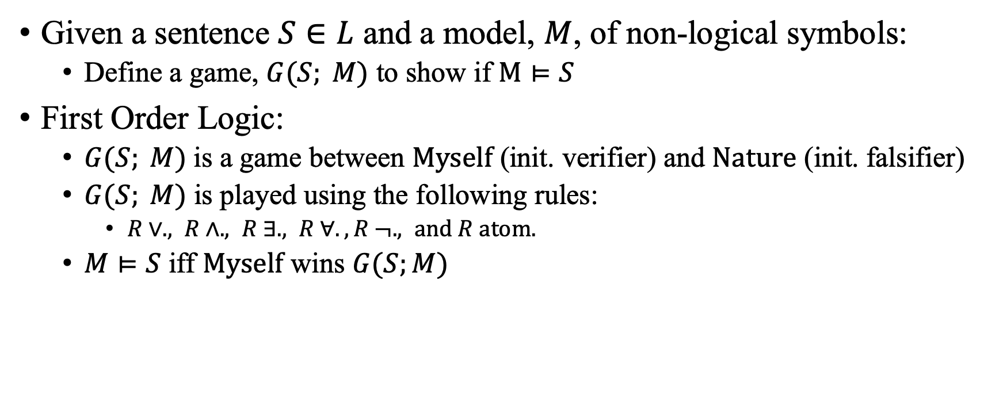
Game Semantics
Given a sentence $S∈L$ and a model, $M$, of non-logical symbols:
Define a game, $G(S; M)$ to show if $M⊨S$
First Order Logic:
$G(S; M)$is a game between Myself (init. verifier) and Nature (init. falsifier)
$G(S; M)$ is played using the following rules:
$R∨. , R∧. , R ∃. , R ∀. , R ¬. , and R atom.$
$M⊨S$ iff Myself wins $G(S;M)$
[Hintikka, 1982]

Slide 14















First Order Logic
$$M=ℤ∪\{abs, <, +,=\}$$
$$S=∀x∃y.abs(x)=y$$
$$S_{x,y}$$
$$G(S;M)$$
$$…$$
$$G(∃y. S_{−1,y};M)$$
$$G(∃y.S_{0,y};M)$$
$$G(∃y. S_{1,y};M)$$
$$…$$
$$…$$
$$G(1=0;M)$$
$$G(1=1;M)$$
$$…$$
$$…$$
$$G(0=0;M)$$
$$…$$
$$…$$
$$G(1=1;M)$$
$$…$$

Slide 15




First Order Logic
$$M=ℤ∪\{abs, <, +,=\}$$
$$S=∀x∃y.abs(x)=y$$
$$S_{x,y}$$
$$G(S;M)$$
$$Falsifier Chooses c$$
$$G(∃y.S_{c,y};M)$$
$$Verifier Chooses abs(c)$$
$$G(abs(c)=abs(c);M)$$

Slide 16
Strategy Synthesis

Slide 17
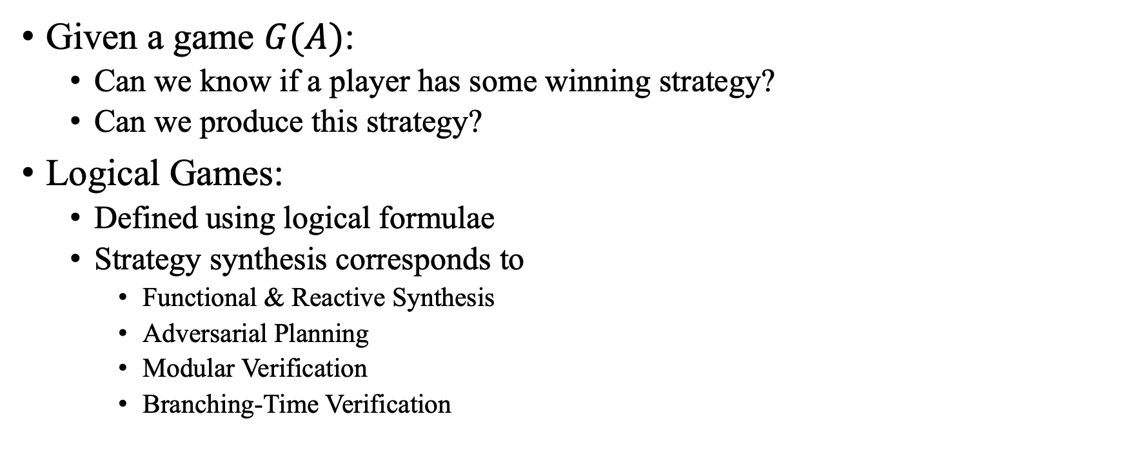
Strategy Synthesis
Given a game $G(A)$:
Can we know if a player has some winning strategy?
Can we produce this strategy?
Logical Games:
Defined using logical formulae
Strategy synthesis corresponds to
Functional & Reactive Synthesis
Adversarial Planning
Modular Verification
Branching-Time Verification
[Farzan & Kincaid, 2016]

Slide 18

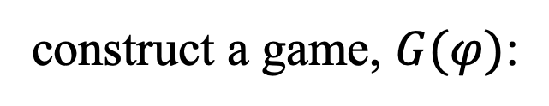

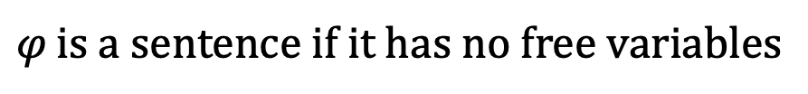

Satisfiability Games
Linear Arithmetic Satisfiability Games
construct a game, $G(φ)$:
Given a sentence, $φ$, in Linear Arithmetic
Two players SAT and UNSAT take turns instantiating quantifiers
SAT controls existentials and wants to prove $φ$
UNSAT controls universals and wants to disprove $φ$
SAT wins a play $c_{0}…c_{n}$ if $[x_{0}↦c_{0},…,x_{n}↦c_{n}]⊨F$
If SAT has a winning strategy $φ$ is satisfiable
Given a sentence in some theory (e.g. Linear Arithmetic)
$$s,t∈Term ∷=c \left| x \right| s+t | c⋅t$$
F$,G∈Formula ∷=t<0 \left| t=0 \right| F∧G | F∨G$
$φ∷=Q_{0}x_{0}…Q_{n}x_{n}. F$ $Q_{i}∈\{∀, ∃\}$
$φ$ is a sentence if it has no free variables
[Farzan & Kincaid, 2016]

Slide 19
Strategy Improvement
We first compute a strategy skeleton for SAT
[Farzan & Kincaid, 2016]

Slide 20



Skeleton Strategy
$$∃w∀x∃y∀z. \left(y<1∨2w<y\right)∧(z<y∨x<z)$$
$$0$$
$$x$$
$$2x$$
[Farzan & Kincaid, 2016]

Slide 21
Strategy Improvement
We first compute a strategy skeleton for SAT
Is this strategy winning?
[Farzan & Kincaid, 2016]

Slide 22







Winning Condition
$$∃w∀x∃y∀z. \left(y<1∨2w<y\right)∧(z<y∨x<z)$$
$$F(w,x,y,z)$$
$$∀x\left(∀z.F\left(0,x,x,z\right)\right)∨(∀z.F\left(0,x,2x,z\right))$$
$$0$$
$$∀x\left(∀z.F\left(w,x,x,z\right)\right)∨(∀z.F\left(w,x,2x,z\right))$$
$$∀z.F(w,x,x,z)$$
$$x$$
$$2x$$
$$∀z.F(w,x,2x,z)$$
$$∀z.F(w,x,y,z)$$
$$∀z.F(w,x,y,z)$$
[Farzan & Kincaid, 2016]

Slide 23
Strategy Improvement
We first compute a strategy skeleton for SAT
Is this strategy winning?
Yes, return winning strategy skeleton
No, compute UNSAT’s counter-strategy
[Farzan & Kincaid, 2016]

Slide 24








Counter Strategy
$¬win$ is sat iff $∃M. M⊨¬F\left(0,\underline{x},\underline{x},\underline{z_{1}}\right)∧¬F\left(0, \underline{x},2\underline{x},\underline{z_{2}}\right)$
$$¬win=∃x\left(∃z. ¬F\left(0,x,x,z\right)\right)∧\left(∃z. ¬F\left(0,x,2x,z\right)\right)$$
$$win= ∀x\left(∀z.F\left(0,x,x,z\right)\right)∨\left(∀z.F\left(0,x,2x,z\right)\right)$$
$$M=\{\underline{x}↦−2,\underline{z_{1}}↦−2,\underline{z_{2}}↦−3\}$$
$$S$$
$$M^{π}=\{w↦0,x↦−2,y↦−2,z↦−2\}$$
$$M^{π}=\{w↦0,x↦−2\}$$
$$M^{π}=\{w↦0,x↦−2,y↦−2\}$$
$$M^{π}=\{w↦0\}$$
$$0$$
$$x$$
$$2x$$
$$¬F(w,x,y,z)$$
[Farzan & Kincaid, 2016]

Slide 25

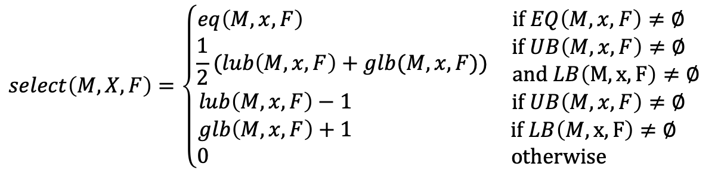

Model-based Term Selection
$$select\left(M,X,F\right)=\left\{\begin{matrix}\begin{aligned}eq\left(M,x,F\right) \\ \frac{1}{2}(lub\left(M,x,F\right)+glb(M,x,F)) \\ lub\left(M,x,F\right)−1 \\ glb\left(M,x,F\right)+1 \\ 0 \end{aligned} & \begin{aligned}if EQ\left(M,x,F\right)≠∅ \\ if UB\left(M,x,F\right)≠∅ \\ and LB\left(M,x,F\right)≠∅ \\ if UB\left(M,x,F\right)≠∅ \\ if LB\left(M,x,F\right)≠∅ \\ otherwise \end{aligned}\end{matrix}\right.$$
$$EQ\left(M,x,F\right)=\left\{s :x=s∈F_{x}∧{⟦x⟧}^{M}={⟦s⟧}^{M}\right\}$$
$$UB\left(M,x,F\right)=\left\{s :x<s∈F_{x}∧{⟦x⟧}^{M}<{⟦s⟧}^{M}\right\}$$
$$UB\left(M,x,F\right)=\left\{s :s>x∈F_{x}∧{⟦s⟧}^{M}<{⟦x⟧}^{M}\right\}$$
Properties of select
$$M⊨F⇒M⊨F[select(M,x,F)/x]$$
$\left\{select\left(M,x,F\right):M⊨F\right\}$ is finite

Slide 26


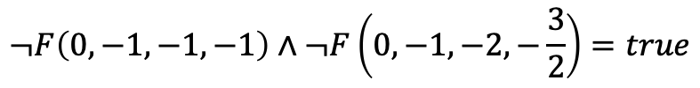
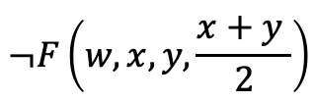








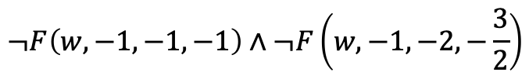


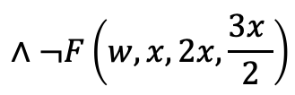
Counter Strategy
$¬win$ is sat iff $∃M. M⊨¬F\left(0,\underline{x},\underline{x},\underline{z_{1}}\right)∧¬F\left(0, \underline{x},2\underline{x},\underline{z_{2}}\right)$
$$M=\{\underline{x}↦−2,\underline{z_{1}}↦−2,\underline{z_{2}}↦−3\}$$
$$U$$
$$¬F\left(0,−1,−1,−1\right)∧¬F\left(0,−1,−2,−\frac{3}{2}\right)=true$$
$$M^{π}=\{w↦0,x↦−2,y↦−4,z↦−3\}$$
$$¬F\left(w,−1,−1,−1\right)∧¬F\left(w,−1,−2,−\frac{3}{2}\right)$$
$$M^{π}=\{w↦0,x↦−2,y↦−4\}$$
$$M^{π}=\{w↦0,x↦−2\}$$
$$M^{π}=\{w↦0,x↦−2,y↦−2,z↦−2\}$$
$$M^{π}=\{w↦0,x↦−2,y↦−2\}$$
$$M^{π}=\{w↦0\}$$
$$M^{π}=\{\}$$
$$0$$
$$−1$$
$$¬F(w,x,x,x)$$
$$∧¬F\left(w,x,2x,\frac{3x }{2}\right)$$
$$¬F(w,x,y,y)$$
$$x$$
$$2x$$
$$¬F\left(w,x,y,\frac{x+y }{2}\right)$$
$$y$$
$$\frac{x+y}{2}$$
$$¬F(w,x,y,z)$$
$$¬F(w,x,y,z)$$
[Farzan & Kincaid, 2016]

Slide 27













Strategy Improvement
We first compute a strategy skeleton for SAT
Is this strategy winning?
Yes, return winning strategy skeleton
No, compute UNSAT’s counter-strategy
, trade roles, and repeat
$$S_{0}$$
$$⊆$$
$$S_{1}$$
$$⊆$$
$$S_{2}$$
$$…$$
$$beats$$
$$U_{0}$$
$$⊆$$
$$U_{1}$$
$$⊆$$
$$U_{2}$$
$$…$$
[Farzan & Kincaid, 2016]

Slide 28
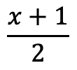



Winning Strategy Skeleton
$$∃w∀x∃y∀z. \left(y<1∨2w<y\right)∧(z<y∨x<z)$$
$$S$$
$$0$$
$$\frac{x+1}{2}$$
$$x+2$$
[Farzan & Kincaid, 2016]

Slide 29


Strategy Synthesis
A winning strategy skeleton isn’t a strategy:
Some strategy conforming skeleton, S, is winning
Can we compute a winning strategy from S?
Label skeleton node’s with deterministic guards
Computed using Tree Interpolants
Interpolants represent plays reaching a node where UNSAT may win
$$S$$
YES
$$0$$
$$\frac{x+1}{2}$$
$$x+2$$
[Farzan & Kincaid, 2018]

Slide 30


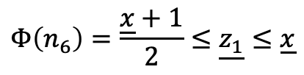










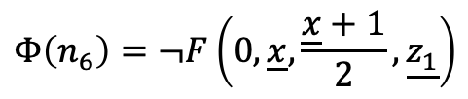
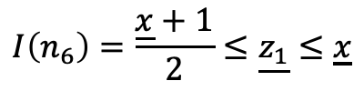
Tree Interpolation
$$∃w∀x∃y∀z. \left(y<1∨2w<y\right)∧(z<y∨x<z)$$
$$F(w,x,y,z)$$
$$S$$
$I\left(n_{0}\right)=$false
$$0$$
$$Φ\left(n_{0}\right)=true$$
$$Φ\left(n_{1}\right)=true$$
$I\left(n_{1}\right)=$false
$$I\left(n_{3}\right)=1≤\underline{x}$$
$$Φ\left(n_{3}\right)=true$$
$$\frac{x+1}{2}$$
$$x+2$$
$I\left(n_{4}\right)=$false
$$Φ\left(n_{4}\right)=true$$
$$Φ\left(n_{6}\right)=\frac{\underline{x}+1}{2}≤\underline{z_{1}}≤\underline{x}$$
$$I\left(n_{6}\right)=\frac{\underline{x}+1}{2}≤\underline{z_{1}}≤\underline{x}$$
$$Φ\left(n_{6}\right)=¬F\left(0,\underline{x},\frac{\underline{x}+1}{2},\underline{z_{1}}\right)$$
$$Φ\left(n_{6}\right)=¬F\left(0,\underline{x},\underline{x}+2,\underline{z_{2}}\right)$$
$$Φ\left(n_{6}\right)=1≤\underline{x}≤0∨\underline{x}≤\underline{z_{2}}≤\underline{x}+2$$
$I\left(n_{6}\right)=$ false
$Φ\left(n_{6}\right)=$ false

Slide 31


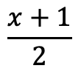





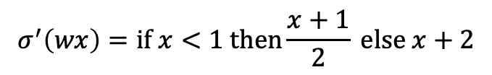




Strategy Synthesis
$$∃w∀x∃y∀z. \left(y<1∨2w<y\right)∧(z<y∨x<z)$$
$$σ\left(ε\right)=0$$
$$σ^{′}\left(ε\right)=0$$
$$S$$
or
$$σ^{′}\left(wx\right)=if x<1 then\frac{x+1}{2} else x+2$$
or …
$$σ\left(wx\right)=x+2$$
$$0$$
$$[true]$$
$$[true]$$
$$[x<1]$$
$$\frac{x+1}{2}$$
$$x+2$$
$$[true]$$
$$[x<1]$$
$$[true]$$

Slide 32
Infinite Games

Slide 33





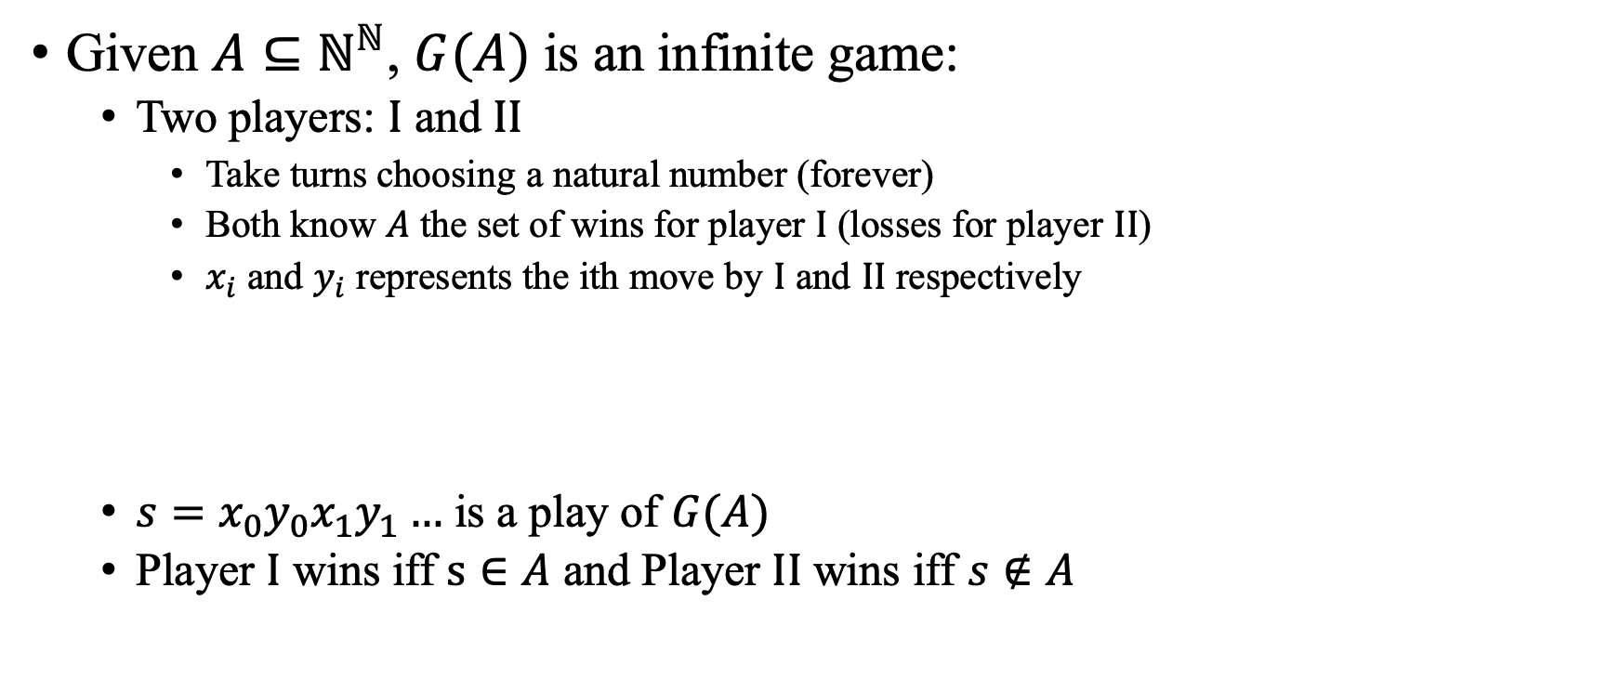






Infinite Games
Given $A⊆ℕ^{ℕ}$, $G(A)$ is an infinite game:
Two players: $I$ and $II$
Take turns choosing a natural number (forever)
Both know $A$ the set of wins for player $I$ (losses for player $II$)
$x_{i}$ and $y_{i}$ represents the ith move by $I$ and $II$ respectively
$s=x_{0}y_{0}x_{1}y_{1}…$ is a play of $G(A)$
Player $I$ wins iff $s∈A$ and Player $II$ wins iff $s∉A$
$$I$$
$$x_{0}$$
$$x_{1}$$
$$⋯$$
$$x_{i}$$
$$⋯$$
$$II$$
$$y_{0}$$
$$y_{1}$$
$$⋯$$
$$y_{i}$$
$$⋯$$
[Khomskii, 2010]

Slide 34
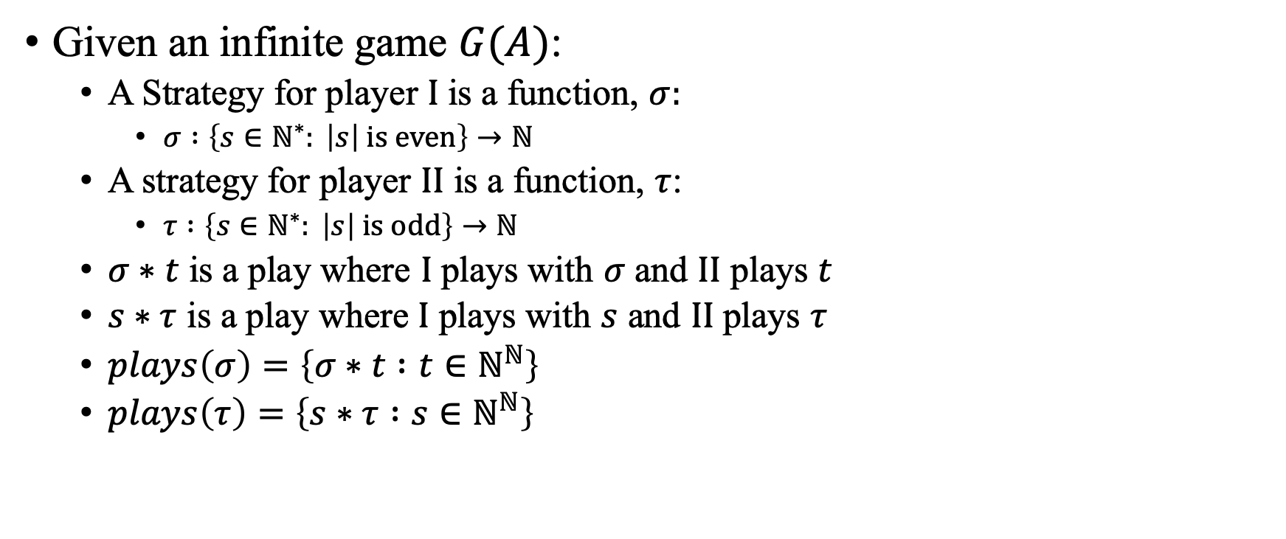
Strategies
Given an infinite game $G(A)$:
A Strategy for player $I$ is a function, $σ:$
$σ :\left\{s∈ℕ^{∗}: \left|s\right| is even\right\}→ℕ$
A strategy for player $II$ is a function, $τ$:
$τ :\left\{s∈ℕ^{∗}: \left|s\right| is odd\right\}→ℕ$
$σ∗t$ is a play where $I$ plays with $σ$ and $II$ plays $t$
$s∗τ$ is a play where $I$ plays with $s$ and $II$ plays $τ$
$plays\left(σ\right)=\left\{σ∗t :t∈ℕ^{ℕ}\right\}$
$plays\left(τ\right)=\left\{s∗τ :s∈ℕ^{ℕ}\right\}$
[Khomskii, 2010]

Slide 35

Winning Strategies
Given a game $G(A)$:
$σ$ is a winning strategy iff $plays(σ)⊆A$
$τ$ is a winning strategy iff $plays(τ)⊆ℕ^{ℕ}\backslash A$
Theorem: For all games, $G(A)$, player $I$ and $II$ cannot
both have a winning strategy.
Proof.
Suppose not.
I has a winning strategy $σ$ and II a winning strategy $τ$.
Let $s=σ∗τ$ be the play where I follows $σ$ and II follows $τ$.
Necessarily $s∈A$ and $s∉A$, a contradiction. QED

Slide 36
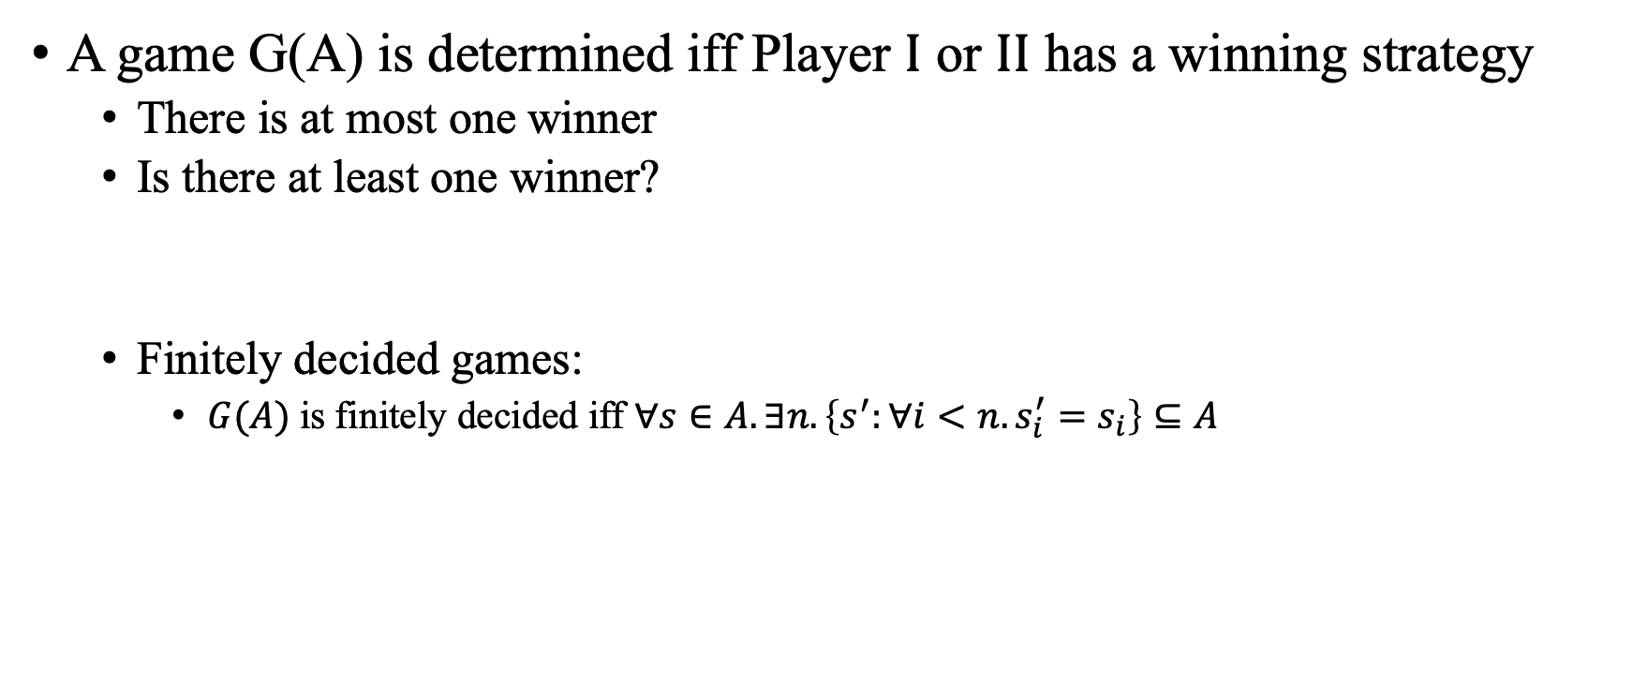
Determinacy
A game G(A) is determined iff Player $I$ or $II$ has a winning strategy
There is at most one winner
Is there at least one winner?
Finitely decided games:
$G(A)$ is finitely decided iff $∀s∈A. ∃n. \left\{s^{′}:∀i<n. s_{i}^{′}=s_{i}\right\}⊆A$
Theorem: There exists an infinite game that is not determined.
Theorem: All finitely decided games are determined.
[Khomskii, 2010]

Slide 37
Strategy Synthesis
(for infinite games)

Slide 38
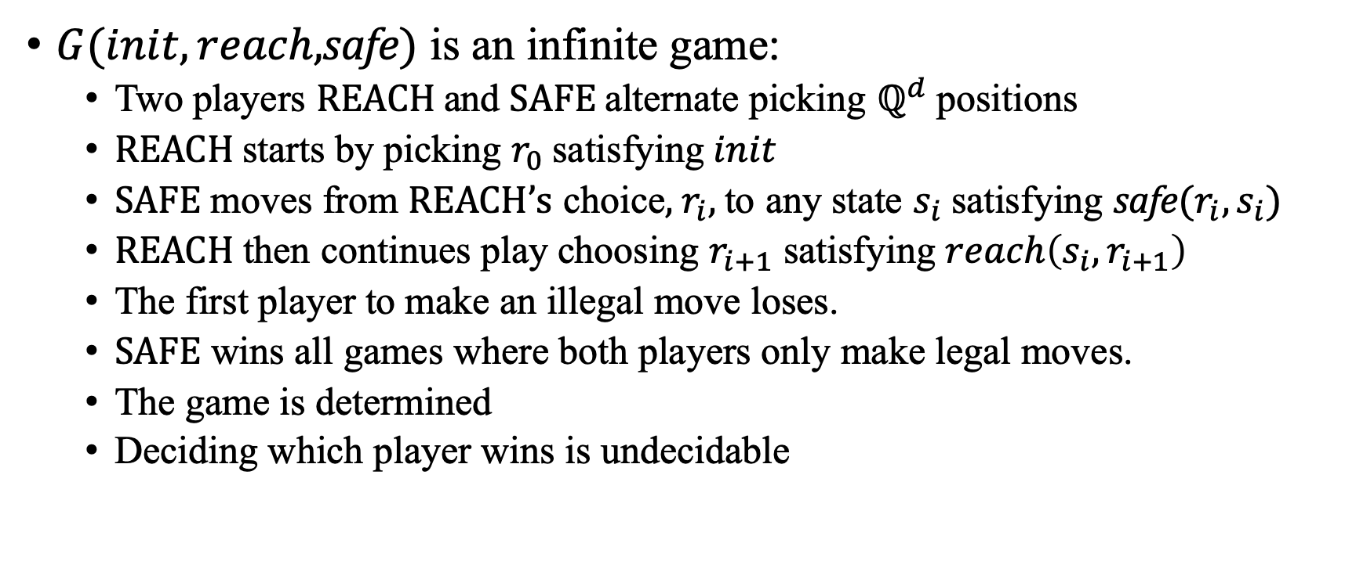
Reachability Games
$G(init,reach,$safe$)$ is an infinite game:
Two players REACH and SAFE alternate picking $ℚ^{d}$ positions
REACH starts by picking $r_{0}$ satisfying $init$
SAFE moves from REACH’s choice, $r_{i}$, to any state $s_{i}$ satisfying safe$(r_{i},s_{i})$
REACH then continues play choosing $r_{i+1}$ satisfying $reach\left(s_{i},r_{i+1}\right)$
The first player to make an illegal move loses.
SAFE wins all games where both players only make legal moves.
The game is determined
Deciding which player wins is undecidable
[Farzan & Kincaid, 2018]

Slide 39
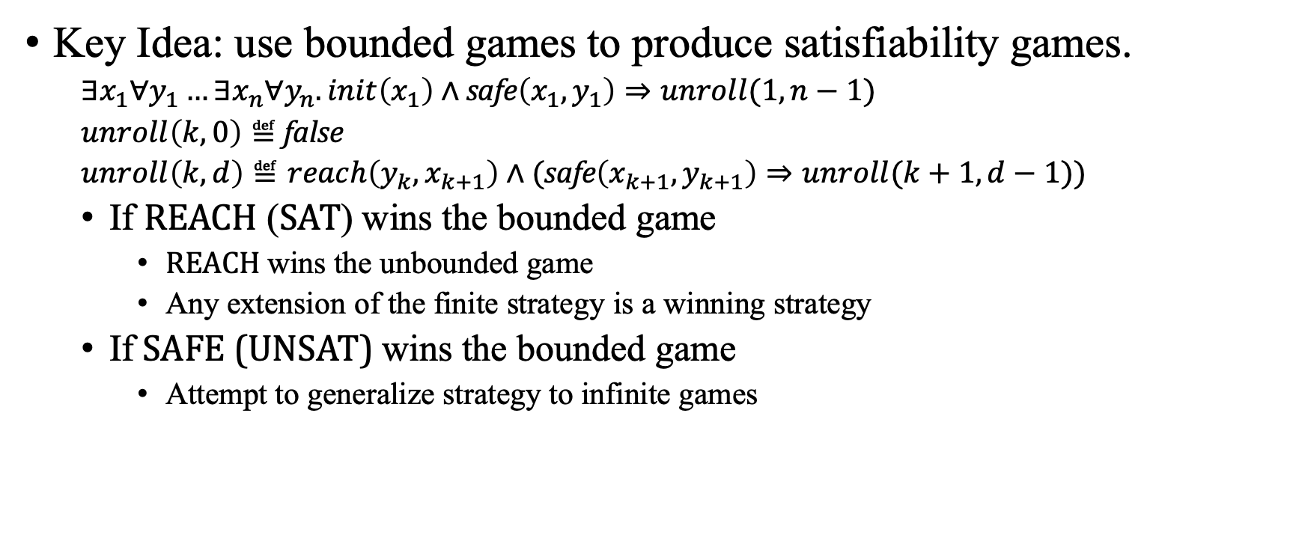
Strategy Synthesis
Key Idea: use bounded games to produce satisfiability games.
$∃x_{1}∀y_{1}…∃x_{n}∀y_{n}.init\left(x_{1}\right)∧$ safe$\left(x_{1},y_{1}\right)⇒unroll(1,n−1)$
$unroll\left(k, 0\right)≝$ false
$unroll\left(k,d\right)≝reach\left(y_{k},x_{k+1}\right)∧($safe$\left(x_{k+1},y_{k+1}\right)⇒unroll(k+1,d−1))$
If REACH (SAT) wins the bounded game
REACH wins the unbounded game
Any extension of the finite strategy is a winning strategy
If SAFE (UNSAT) wins the bounded game
Attempt to generalize strategy to infinite games
[Farzan & Kincaid, 2018]

Slide 40





Cinderella-Stepmother Game
Two players Cinderella and her Stepmother.
Each round
Stepmother adds 1L of water to a buckets (3L capacity)
Cinderella can empty two adjacent buckets
Cinderella wins if no bucket overflows
$$b_{1}$$
0
$$b_{5}$$
0
0
$$b_{2}$$
0
0
$$b_{3}$$
$$b_{4}$$
[Farzan & Kincaid, 2018]

Slide 41







Safety Tree
$$n_{1}:b≤3,3,1,1,1∧\left(b_{3}+b_{5}\right)≤1$$
$$true : \left\langle 0,0,b_{3},b_{4},b_{5}\right\rangle$$
$$n_{2}:b≤3,3,2,2,2∧\left(b_{3}+b_{5}\right)≤2$$
$$true : \left\langle 0,0,b_{3},b_{4},b_{5}\right\rangle$$
$$n_{3}:b≤1,1,3,3,3∧\left(b_{3}+b_{5}\right)≤3$$
$$true : \left\langle 0,0,b_{3},b_{4},b_{5}\right\rangle$$
$$n_{3}:b≤1,1,4,4,4∧\left(b_{3}+b_{5}\right)≤4$$
[Farzan & Kincaid, 2018]

Slide 42


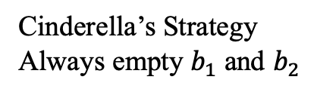



Cinderella-Stepmother Game
Cinderella’s Strategy
Always empty $b_{1}$ and $b_{2}$
$$b_{1}$$
0
Round
3:
1:
2:
4:
$$b_{5}$$
0
0
$$b_{2}$$
Stepmother fills $b_{3}$
0
3
1
4
2
0
$$b_{3}$$
$$b_{4}$$
[Farzan & Kincaid, 2018]

Slide 43








Refine Safety Tree
$$n_{1}:b≤3,3,1,1,1∧\left(b_{3}+b_{5}\right)≤1$$
$$true : \left\langle 0,0,b_{3},b_{4},b_{5}\right\rangle$$
$$n_{2}:b≤3,3,2,2,2∧\left(b_{3}+b_{5}\right)≤2$$
$$true : \left\langle 0,0,b_{3},b_{4},b_{5}\right\rangle$$
$$n_{3}:b≤1,1,3,3,3∧\left(b_{3}+b_{5}\right)≤3$$
$$b_{5}≤2 : \left\langle b_{1},b_{2},0,0,b_{5}\right\rangle$$
$$b_{3}≤2 : \left\langle b_{1},b_{2},b_{3},0,0\right\rangle$$
$$n_{4}:b≤3,3,1,1,3$$
$$n_{5}:b≤2,2,3,3,1$$
$$true : \left\langle 0,0,b_{3},b_{4},b_{5}\right\rangle$$
$$true : \left\langle 0,0,b_{3},b_{4},b_{5}\right\rangle$$
$$n_{6}:b≤1,1,2,2,4∧\left(b_{3}+b_{5}\right)≤4$$
$$n_{7}:b≤1,1,4,2,2∧\left(b_{3}+b_{5}\right)≤4$$

Slide 44


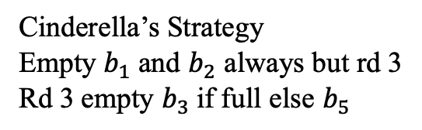
Cinderella-Stepmother Game
Cinderella’s Strategy
Empty $b_{1}$ and $b_{2}$ always but rd 3
Rd 3 empty $b_{3}$if full else $b_{5}$
$$b_{1}$$
0
Round
5:
3:
1:
4:
2:
$$b_{5}$$
0
0
$$b_{2}$$
Stepmother fills
$$b_{3}$$
$$b_{1}$$
0
3
1
4
2
0
$$b_{3}$$
$$b_{4}$$
[Farzan & Kincaid, 2018]

Slide 45









Refine Safety Tree
$$n_{1}:b≤3,3,1,1,1∧\left(b_{3}+b_{5}\right)≤1$$
$$true : \left\langle 0,0,b_{3},b_{4},b_{5}\right\rangle$$
$$n_{2}:b≤3,3,2,2,2∧\left(b_{3}+b_{5}\right)≤2$$
$$true : \left\langle 0,0,b_{3},b_{4},b_{5}\right\rangle$$
$$n_{3}:b≤1,1,3,3,3∧\left(b_{3}+b_{5}\right)≤3$$
$$b_{5}≤2 : \left\langle b_{1},b_{2},0,0,b_{5}\right\rangle$$
$$b_{3}≤2 : \left\langle b_{1},b_{2},b_{3},0,0\right\rangle$$
$$n_{4}:b≤2,2,1,3,3$$
$$n_{5}:b≤2,2,3,3,1$$
$$true : \left\langle b_{1},b_{2},b_{3},0,0\right\rangle$$
$$true : \left\langle b_{1},b_{2},0,0,b_{5}\right\rangle$$
$$n_{6}:b≤3,3,2,2,2∧\left(b_{3}+b_{5}\right)≤2$$
$$n_{7}:b≤3,3,2,2,2∧\left(b_{3}+b_{5}\right)≤2$$
$$true : \left\langle 0,0,b_{3},b_{4},b_{5}\right\rangle$$
$$true : \left\langle 0,0,b_{3},b_{4},b_{5}\right\rangle$$
$$n_{8}:b≤1,1,3,3,3∧\left(b_{3}+b_{5}\right)≤3$$
$$n_{9}:b≤1,1,3,3,3∧\left(b_{3}+b_{5}\right)≤3$$
[Farzan & Kincaid, 2018]

Slide 46
Conclusion
Finite Games
Game Semantics
Connection between quantification and choices
Satisfiability Games
Strategy Improvement & Strategy Synthesis
Infinite Games
Reachability Games
Strategy Synthesis by generalizing bounded game strategies

Slide 47
References
Farzan, Azadeh and Kincaid, Zachary. Linear Arithmetic Satisfiability via Strategy Improvement. IJCAI. 2016.
Farzan, Azadeh and Kincaid, Zachary. Strategy Synthesis for Linear Arithmetic Games. Proc. ACM Program. Lang. 2,
POPL, Article 61 (January 2018)
Hintikka, Jaakko. 1982. Game-theoretical semantics: insights and prospects. Notre Dame Journal of Formal Logic Notre-Dame,
Ind. 23, 2 (1982), 219–241.
Khomskii, Yurii. Infinite Games. Lecture Notes. University of Sofia, Bulgaria. July 19, 2010. Accessed March 28, 2020. [link]

