Slide 1
Smallest Counter-Example February 27, 2026
CSCI 246: Discrete Structures
Textbook Reference: Ch 4. Sec 21

Slide 2
Agenda
Lecture (~ 5 minutes)
Group Exercise (~45 minutes)

Slide 3



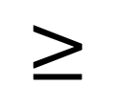

Order (non-strict)
Definition: An order is a relation $⊑$ on a set $S$ that is reflexive, antisymmetric and transitive.
$$≤$$
$$≥$$
$$⊆$$
$$⊇$$

Slide 4
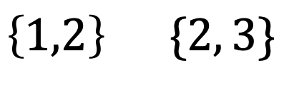

Total Order (non-strict)
Definition: An order $⊑$ on a set $S$ is total if and only if for any pair of elements of $x, y∈S$, either $x⊑y$ or $y⊑x$.
$$≤$$
$$≥$$
✓
$$⊆$$
$$⊇$$
❌
$$\left\{1,2\right\} \{2, 3\}$$

Slide 5
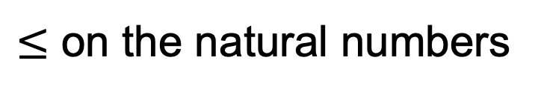


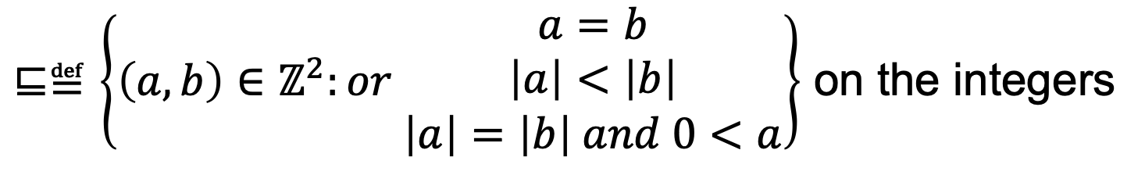
Well-Order
Definition: A well-order is a total order $⊑$ on a set $S$, such that every non-empty subset $s$ of $S$ has a smallest element:
There is some $x∈S$ such that for all $y∈S$ we have $x⊑y$.
$≤$ on the natural numbers
$⊑≝\left\{\left(a,b\right)∈ℤ^{2}:or \begin{matrix}a=b \\ \left|a\right|<\left|b\right| \\ \left|a\right|=\left|b\right| and 0<a\end{matrix}\right\}$ on the integers
$$0, 1, −1, 2, −2, 3, −3, …$$

Slide 6

Smallest Counter-Example
Definition: Let $⊑$ be a well order on a set $S$, and $P(x)$ be a predicate over elements of $S$. The smallest counter-example (if one exists) is the smallest element of the set $\left\{x∈S:¬P(x)\right\}$.
Let $P\left(n\right)=n$ is even. 1 is the smallest Counter-Example
Let $P\left(n\right)=n$ is odd. 0 is the smallest Counter-Example

Slide 7
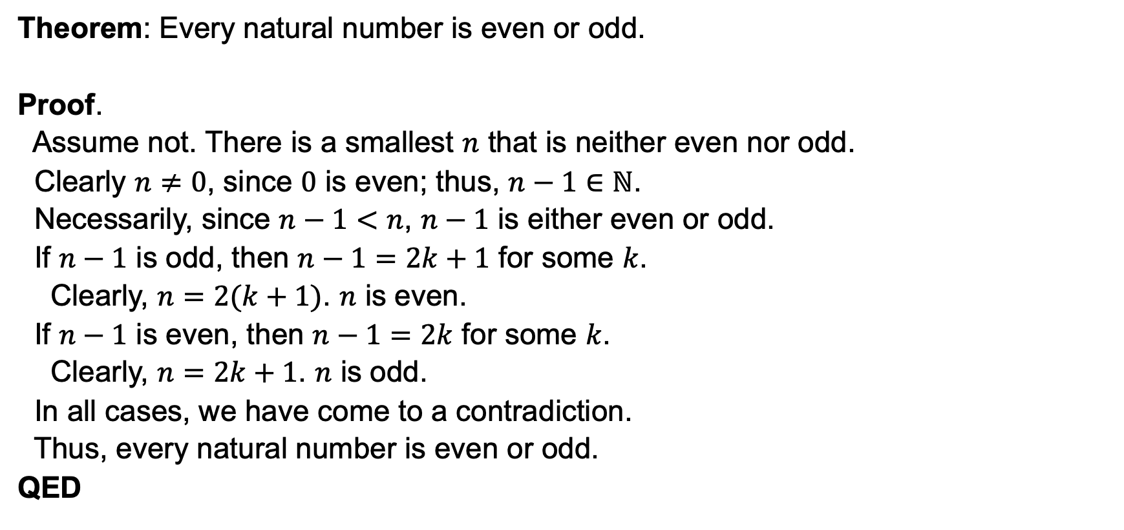
Smallest Counter-Example Proof Technique
Theorem: Every natural number is even or odd.
Proof.
Assume not. There is a smallest $n$ that is neither even nor odd.
Clearly $n≠0$, since $0$ is even; thus, $n−1∈ℕ$.
Necessarily, since $n−1<n$, $n−1$ is either even or odd.
If $n−1$ is odd, then $n−1=2k+1$ for some $k$.
Clearly, $n=2(k+1)$. $n$ is even.
If $n−1$ is even, then $n−1=2k$ for some $k$.
Clearly, $n=2k+1$. $n$ is odd.
In all cases, we have come to a contradiction.
Thus, every natural number is even or odd.
QED

Slide 8
Group Exercises
Form groups of 3-4

