Slide 1
Induction March 2, 2026
CSCI 246: Discrete Structures
Textbook Reference: Ch 4. Sec 22

Slide 2
Agenda
Lecture (~ 5 minutes)
Group Exercise (~45 minutes)

Slide 3
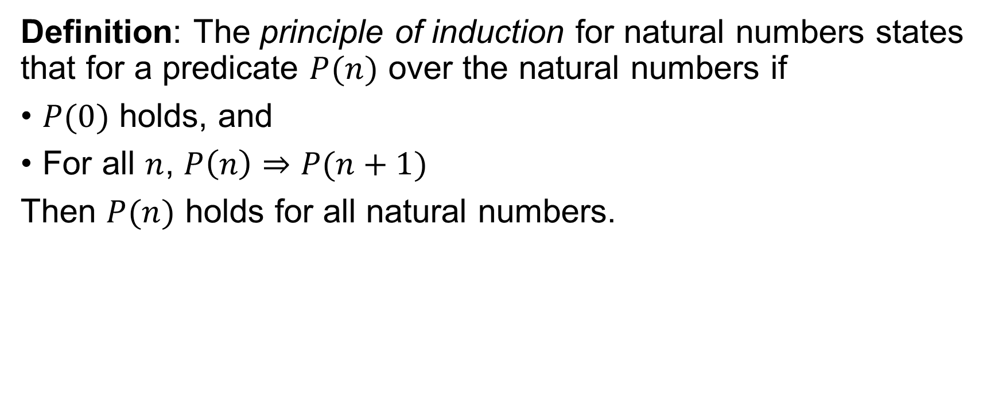
Principle of Induction
Definition: The principle of induction for natural numbers states that for a predicate $P(n)$ over the natural numbers if
$P(0)$ holds, and
For all $n$, $P\left(n\right)⇒P(n+1)$
Then $P(n)$ holds for all natural numbers.

Slide 4
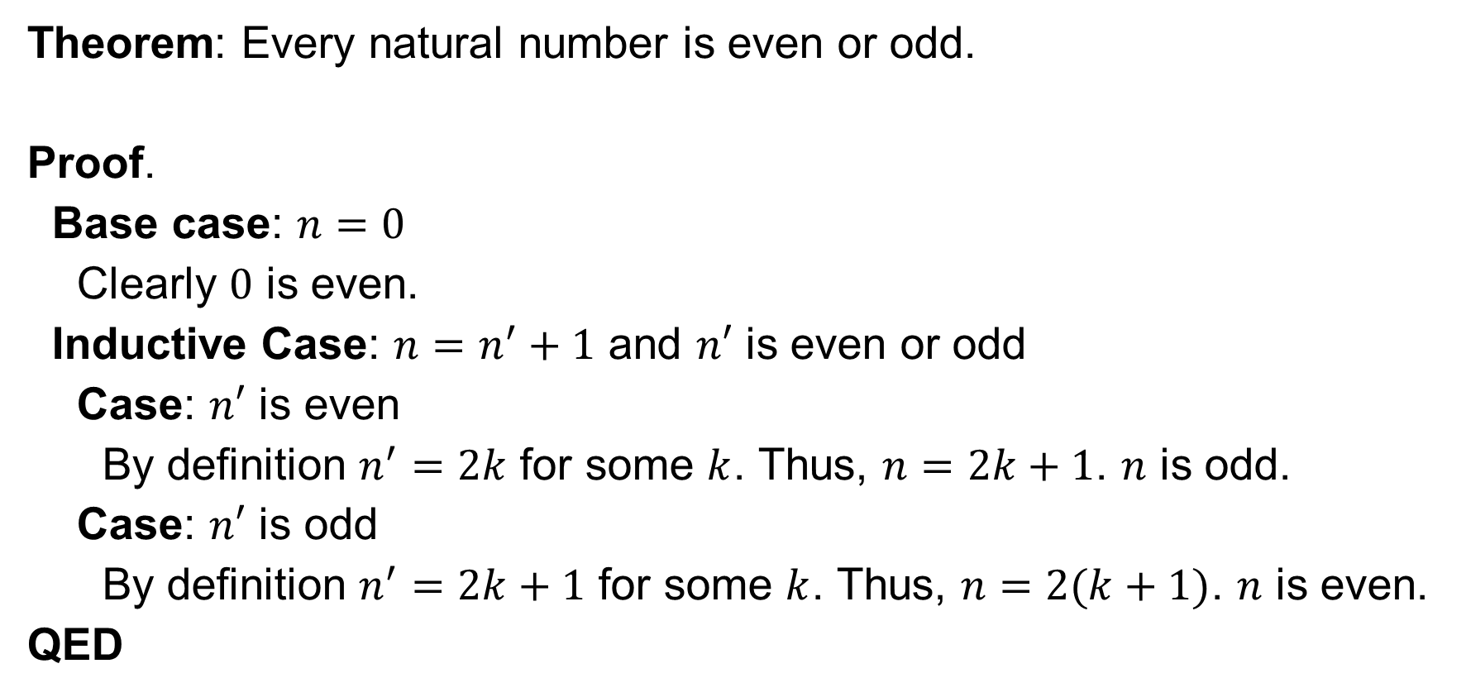
Proof by Induction
Theorem: Every natural number is even or odd.
Proof.
Base case: $n=0$
Clearly $0$ is even.
Inductive Case: $n=n^{′}+1$ and $n′$ is even or odd
Case: $n′$ is even
By definition $n^{′}=2k$ for some $k$. Thus, $n=2k+1$. $n$ is odd.
Case: $n′$ is odd
By definition $n^{′}=2k+1$ for some $k$. Thus, $n=2(k+1)$. $n$ is even.
QED

Slide 5
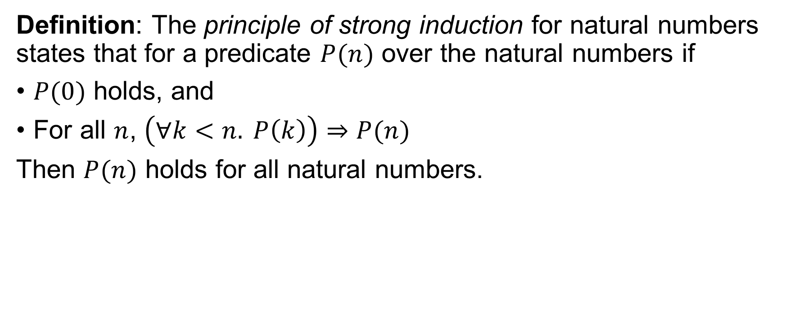
Principle of Strong Induction
Definition: The principle of strong induction for natural numbers states that for a predicate $P(n)$ over the natural numbers if
$P(0)$ holds, and
For all $n$, $\left(∀k<n. P\left(k\right)\right)⇒P(n)$
Then $P(n)$ holds for all natural numbers.

Slide 6
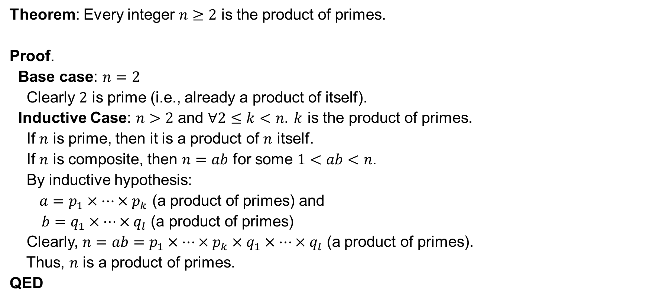
Proof by Strong Induction
Theorem: Every integer $n≥2$ is the product of primes.
Proof.
Base case: $n=2$
Clearly $2$ is prime (i.e., already a product of itself).
Inductive Case: $n>2$ and $∀2≤k<n. k$ is the product of primes.
If $n$ is prime, then it is a product of $n$ itself.
If $n$ is composite, then $n=ab$ for some $1<ab<n$.
By inductive hypothesis:
$a=p_{1}×…×p_{k}$ (a product of primes) and
$b=q_{1}×…×q_{l}$ (a product of primes)
Clearly, $n=ab=p_{1}×…×p_{k}×q_{1}×…×q_{l}$ (a product of primes).
Thus, $n$ is a product of primes.
QED

Slide 7
Group Exercises
Form groups of 3-4

