Slide 1
Graphs III April 13, 2026
CSCI 246: Discrete Structures
Textbook Reference: Ch. 9, Sec. 49

Slide 2
Agenda
Lecture (~ 10 minutes)
Group Exercise (~40 minutes)

Slide 3
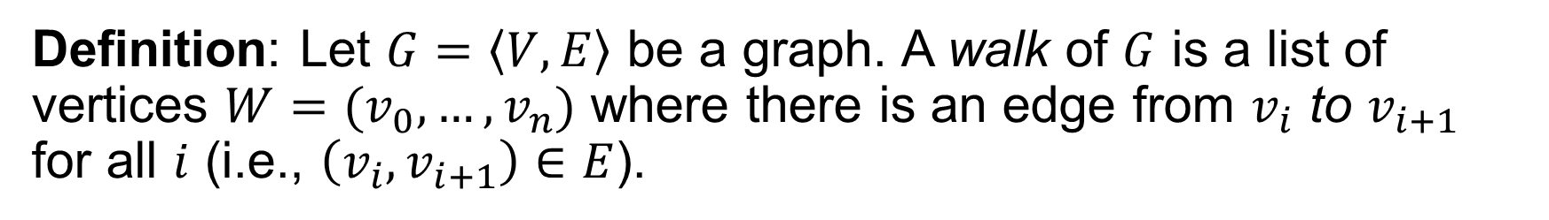

Walk
Definition: Let $G=\left\langle V,E\right\rangle$ be a graph. A walk of $G$ is a list of vertices $W=(v_{0},…,v_{n})$ where there is an edge from $v_{i}$ to $v_{i+1}$ for all $i$ (i.e., $\left(v_{i},v_{i+1}\right)∈E$).
2
6
8
$$W=1,2,4,6,7,5,3$$
4
1
7
3
9
5

Slide 4
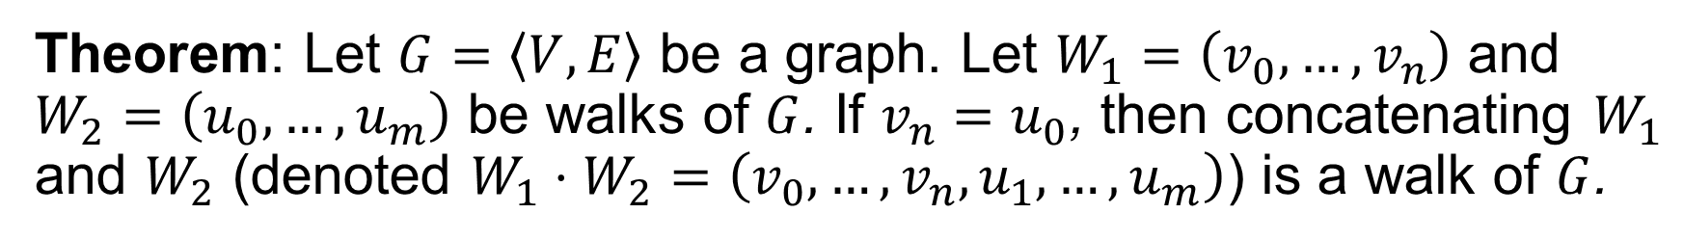



Concatenating Walks
Theorem: Let $G=\left\langle V,E\right\rangle$ be a graph. Let $W_{1}=\left(v_{0},…,v_{n}\right)$ and $W_{2}=\left(u_{0},…,u_{m}\right)$ be walks of $G$. If $v_{n}=u_{0}$, then concatenating $W_{1}$ and $W_{2}$ (denoted $W_{1}⋅W_{2}=\left(v_{0},…,v_{n},u_{1},…,u_{m}\right)$) is a walk of $G$.
2
6
8
$$W_{1}=1,2,4,6,7,5,3$$
4
$$W_{2}=3,4,7,8$$
1
7
$${W_{1}⋅W}_{2}=1,2,4,6,7,5,3,4,7,8$$
3
9
5

Slide 5
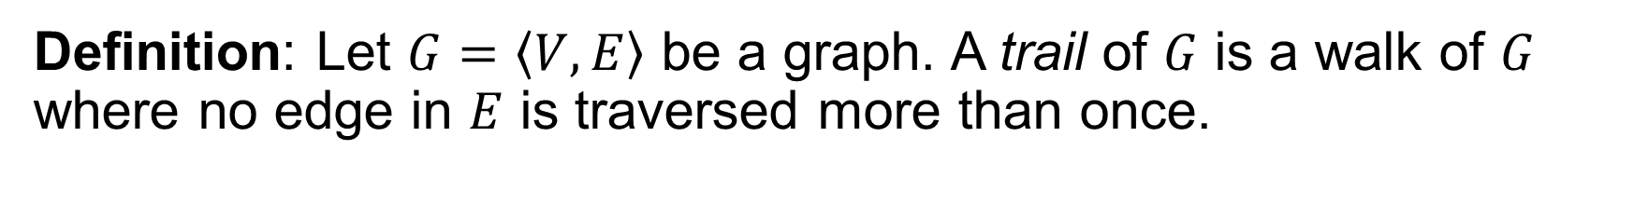
Trail
Definition: Let $G=\left\langle V,E\right\rangle$ be a graph. A trail of $G$ is a walk of $G$ where no edge in $E$ is traversed more than once.
2
6
8
$$W=1,2,4,6,7,5,3$$
4
1
7
3
9
5

Slide 6
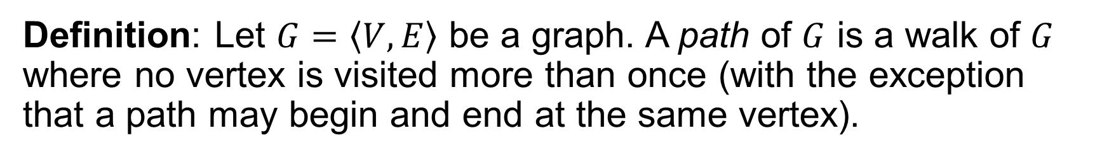

Path
Definition: Let $G=\left\langle V,E\right\rangle$ be a graph. A path of $G$ is a walk of $G$ where no vertex is visited more than once (with the exception that a path may begin and end at the same vertex).
2
6
8
$$P=1,2,4,6,7,5,3,1$$
4
1
7
3
Note: For undirected graphs, the definition of trails and paths coincide.
9
5

Slide 7


Path Graph
Definition: Let $P=\left(v_{0},…,v_{n}\right)$ be a path of some graph. $P$ is itself a graph $G_{P}=\left\langle \left\{v_{0},…,v_{n}\right\},\left\{\left(v_{i},v_{i+1}\right) :i∈\left[0,n\right)\right\}\right\rangle$
2
6
8
$$P=1,2,4,6,7,5,3$$
4
1
7
3
9
5

Slide 8


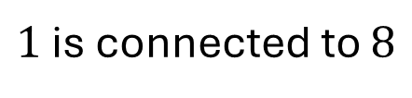
Connected To
Definition: Let $G=\left\langle V, E\right\rangle$ be a graph. We say $u$ is connected to $v$ if and only if there is a path from $u$ to $v$ in $G$.
2
6
8
$1$ is connected to $8$
4
1
7
$$P=1,2,4,6,7,8$$
3
9
5

Slide 9
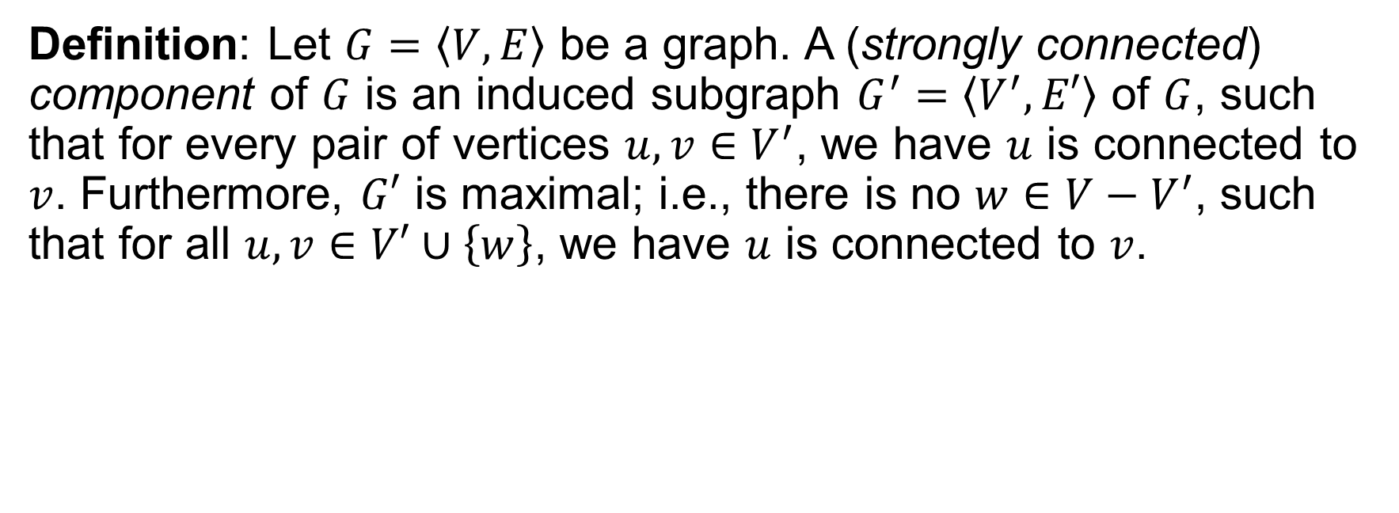
Strongly Connected Components
Definition: Let $G=\left\langle V, E\right\rangle$ be a graph. A (strongly connected) component of $G$ is an induced subgraph $G^{′}=\left\langle V^{′},E′\right\rangle$ of $G$, such that for every pair of vertices $u,v∈V^{′}$, we have $u$ is connected to $v$. Furthermore, $G′$ is maximal; i.e., there is no $w∈V−V^{′}$, such that for all $u,v∈V′∪\left\{w\right\}$, we have $u$ is connected to $v$.
2
2
7
7
1
1
9
4
9
4
5
5
6
3
6
3
8
8

Slide 10

Cut Vertex
Definition: Let $G=\left\langle V,E\right\rangle$ be a graph. A cut vertex is a vertex $v∈V$ that if removed from $G$ results in a graph $G−v$ that has more strongly connected components than the original graph $G$.
2
7
7
1
9
4
5
6
9
3
8

Slide 11

Cut Edge
Definition: Let $G=\left\langle V,E\right\rangle$ be a graph. A cut edge is an edge $e∈E$ that if removed from $G$ results in a graph $G−e$ that has more strongly connected components than the original graph $G$.
2
7
7
1
9
4
5
6
9
3
8
8

Slide 12
Group Exercises
Form groups of 3-4

