Slide 1
Partitions February 20, 2026
CSCI 246: Discrete Structures
Textbook Reference: Ch 3. Sec 16

Slide 2
Agenda
Lecture (~ 10 minutes)
Group Exercise (~40 minutes)

Slide 3







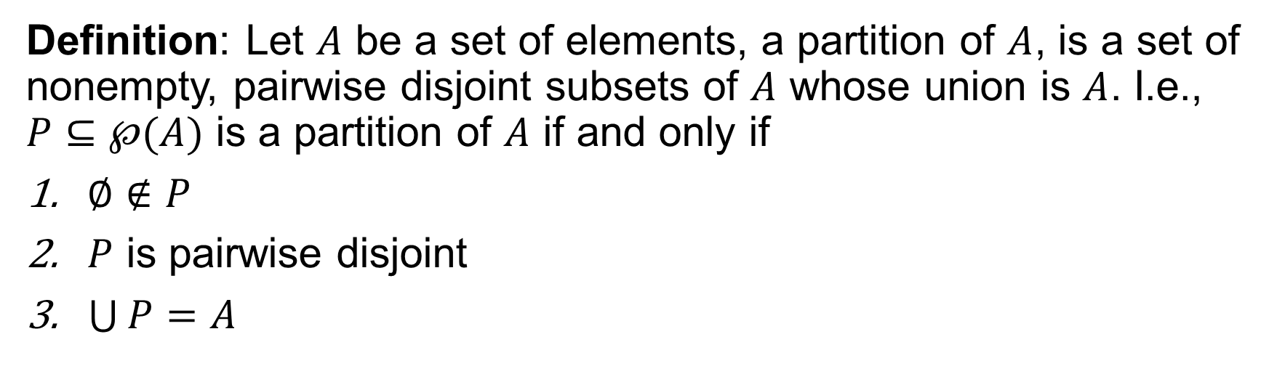









Partition
Definition: Let $A$ be a set of elements, a partition of $A$, is a set of nonempty, pairwise disjoint subsets of $A$ whose union is $A$. I.e., $P⊆℘(A)$ is a partition of $A$ if and only if
$∅∉P$
$P$ is pairwise disjoint
$\bigcup{P}=A$
$$A=\left\{1,2,3,4\right\}$$
$$P_{1}=\left\{\left\{1\right\},\left\{2\right\},\left\{3\right\}, \left\{4\right\}\right\}$$
$$P_{2}=\left\{\left\{1,2,3,4\right\}\right\}$$
$$P_{3}=\left\{\left\{1\right\},\left\{2, 3, 4\right\}\right\}$$
$$P_{5}=\left\{\left\{1, 2, 3\right\}, \{4\}\right\}$$
$$P_{4}=\left\{\left\{1, 2, 4\right\}, \left\{3\right\}\right\}$$
$$P_{6}=\left\{\left\{1, 3, 4\right\},\left\{2\right\}\right\}$$
$$P_{7}=\left\{\left\{1, 2\right\}, \left\{3, 4\right\}\right\}$$
$$P_{8}=\left\{\left\{1, 3\right\}, \left\{2, 4\right\}\right\}$$
$$P_{9}=\left\{\left\{1, 4\right\}, \left\{2, 3\right\}\right\}$$
$$P_{10}=\left\{\left\{1, 2\right\},\left\{3\right\}, \left\{4\right\}\right\}$$
$$P_{11}=\left\{\left\{1\right\},\left\{2,3\right\}, \left\{4\right\}\right\}$$
$$P_{12}=\left\{\left\{1\right\},\left\{2\right\}, \left\{3,4\right\}\right\}$$
$$P_{13}=\left\{\left\{1, 3\right\},\left\{2\right\}, \left\{4\right\}\right\}$$
$$P_{14}=\left\{\left\{1\right\},\left\{2,4\right\}, \left\{3\right\}\right\}$$
$$P_{15}=\left\{\left\{1, 4\right\},\left\{2\right\}, \left\{3\right\}\right\}$$

Slide 4
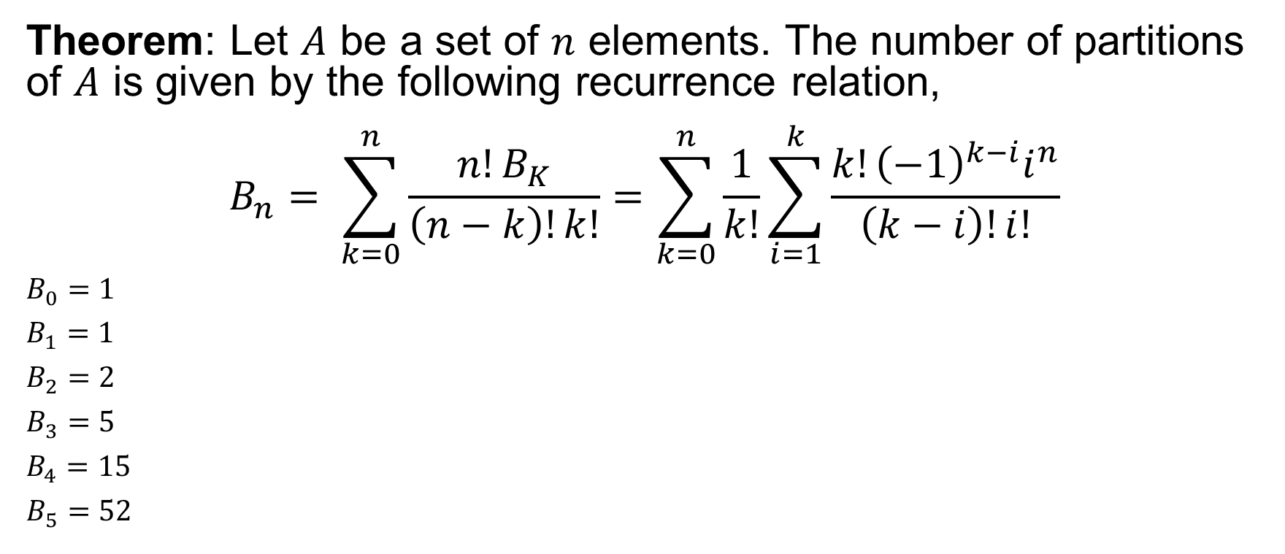
Counting Partitions
Theorem: Let $A$ be a set of $n$ elements. The number of partitions of $A$ is given by the following recurrence relation,
$$B_{n}= \sum_{k=0}^{n}{\frac{n!B_{K}}{\left(n−k\right)!k!}}=\sum_{k=0}^{n}{\frac{1}{k!}}\sum_{i=1}^{k}{\frac{{k!\left(−1\right)}^{k−i}i^{n}}{\left(k−i\right)!i!}}$$
$B_{0}=1$
$B_{1}=1$
$B_{2}=2$
$B_{3}=5$
$B_{4}=15$
$B_{5}=52$

Slide 5

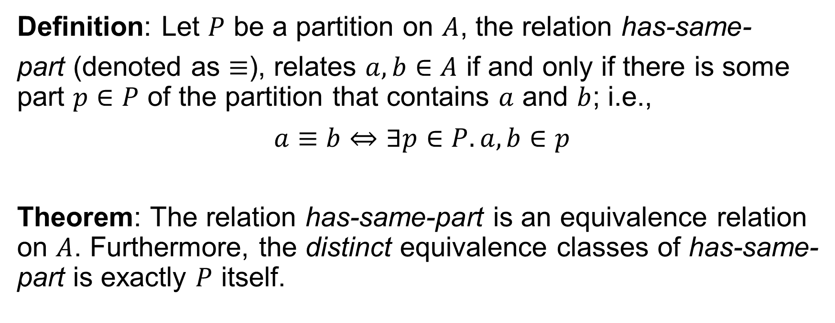

Partition Equivalence
Definition: Let $P$ be a partition on $A$, the relation has-same-
part (denoted as $≡$), relates $a,b∈A$ if and only if there is some part $p∈P$ of the partition that contains $a$ and $b$; i.e.,
$$a≡b⇔∃p∈P. a, b∈p$$
Theorem: The relation has-same-part is an equivalence relation on $A$. Furthermore, the distinct equivalence classes of has-same-part is exactly $P$ itself.
$$P$$
$$P$$

Slide 6

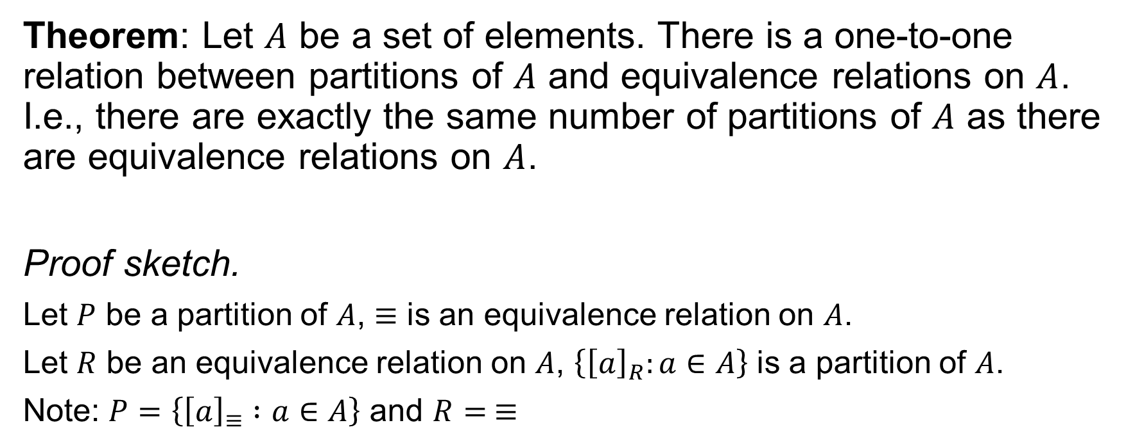


Partitions and Equivalence Relations
Theorem: Let $A$ be a set of elements. There is a one-to-one relation between partitions of $A$ and equivalence relations on $A$. I.e., there are exactly the same number of partitions of $A$ as there are equivalence relations on $A$.
Proof sketch.
Let $P$ be a partition of $A$, $≡$ is an equivalence relation on $A$.
Let $R$ be an equivalence relation on $A$, $\left\{{\left[a\right]}_{R}:a∈A\right\}$ is a partition of $A$.
Note: $P=\left\{{\left[a\right]}_{≡} :a∈A\right\}$ and $R= ≡$
$$P$$
$$\left\{{\left[a\right]}_{R}:a∈A\right\}$$
$$P$$

Slide 7
Partitions in the Wild
Connected Components of Graphs
Union-Find
Type Systems (unification)
Kruskal’s Minimum Spanning Tree
Dynamic Connectivity (Network analysis)
Buckets of hash tables/maps
Databases (group by …)
Regular Expressions:
automata minimization
Program Equivalence
E-Graphs and rewrite systems
state-space minimization
ML/Data Science:
K-means clustering
Operating Systems:
Virtual memory
Robotics/Computer Vision:
Image / object segmentation

Slide 8
Group Exercises
Form groups of 3-4

