Slide 1
Contradiction February 25, 2026
CSCI 246: Discrete Structures
Textbook Reference: Ch 4. Sec 20

Slide 2
Agenda
Lecture (~ 10 minutes)
Group Exercise (~40 minutes)

Slide 3
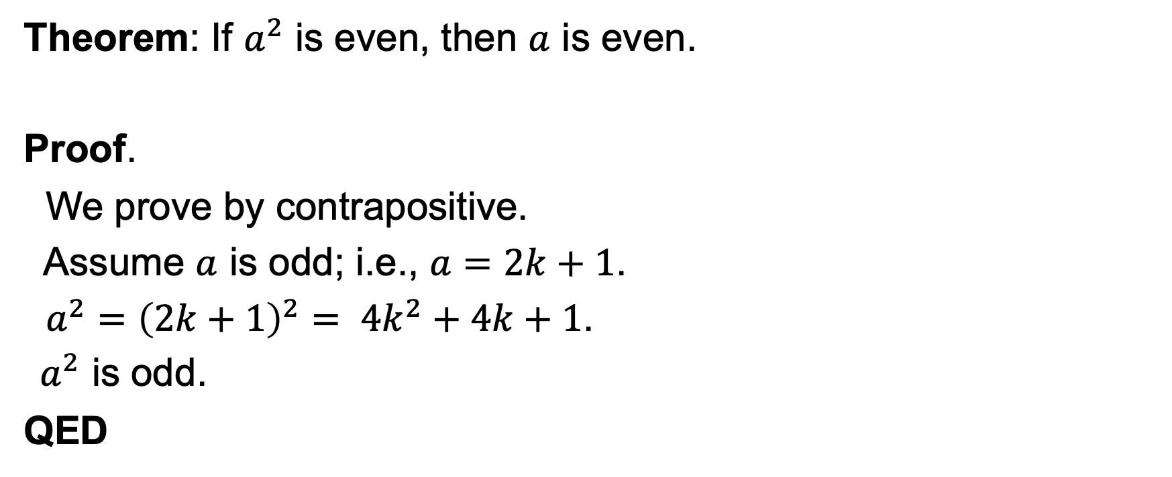
Proof By Contrapositive
Theorem: If $a^{2}$ is even, then $a$ is even.
Proof.
We prove by contrapositive.
Assume $a$ is odd; i.e., $a=2k+1$.
$a^{2}={\left(2k+1\right)}^{2}= 4k^{2}+4k+1$.
$a^{2}$ is odd.
QED

Slide 4
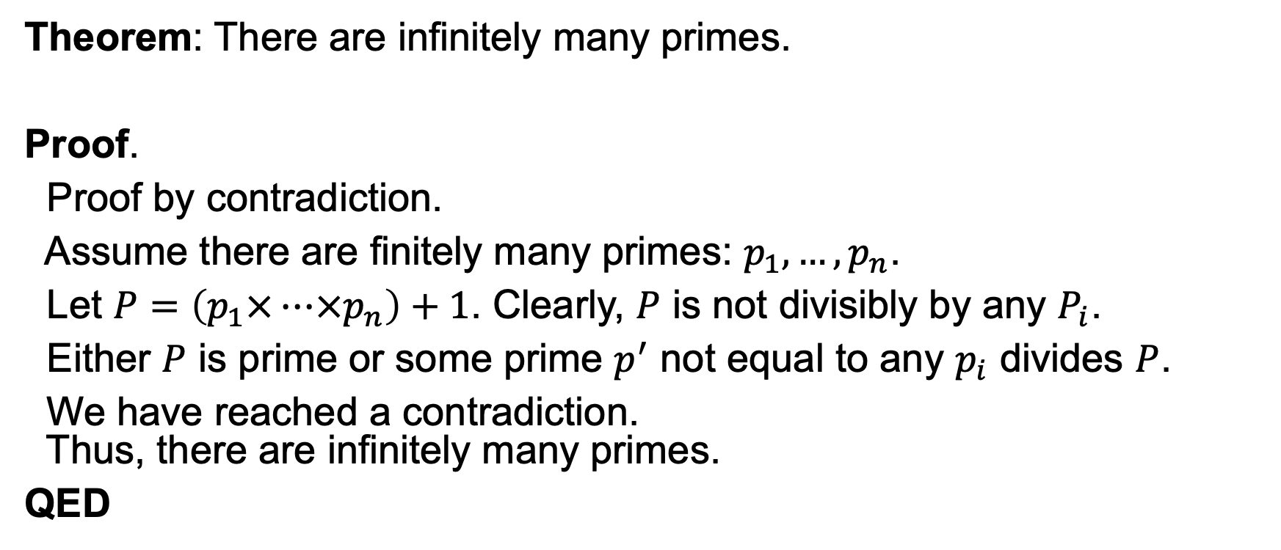
Proof by contradiction
Theorem: There are infinitely many primes.
Proof.
Proof by contradiction.
Assume there are finitely many primes: $p_{1}, …, p_{n}$.
Let $P=\left(p_{1}×…×p_{n}\right)+1$. Clearly, $P$ is not divisibly by any $P_{i}$.
Either $P$ is prime or some prime $p^{′}$ not equal to any $p_{i}$ divides $P$.
We have reached a contradiction. Thus, there are infinitely many primes.
QED

Slide 5
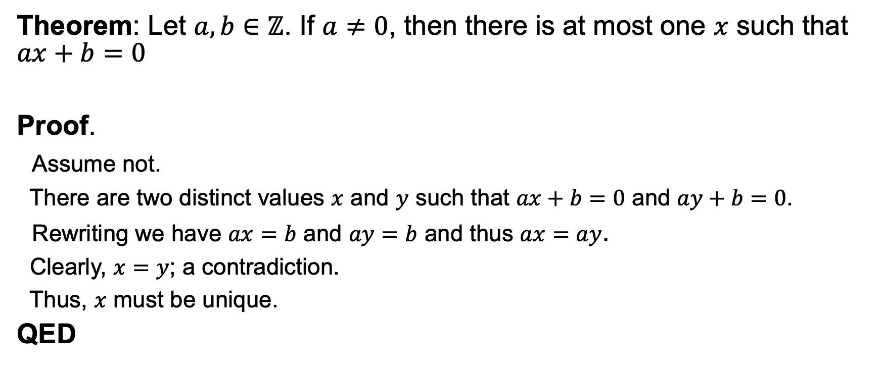
Proof of uniqueness
Theorem: Let $a, b∈ℤ$. If $a≠0$, then there is at most one $x$ such that $ax+b=0$
Proof.
Assume not.
There are two distinct values $x$ and $y$ such that $ax+b=0$ and $ay+b=0$.
Rewriting we have $ax=b$ and $ay=b$ and thus $ax=ay$.
Clearly, $x=y$; a contradiction.
Thus, $x$ must be unique.
QED

Slide 6
Group Exercises
Form groups of 3-4

