Slide 1
Big O Notation March 11, 2026
CSCI 246: Discrete Structures
Textbook Reference: Ch. 5, Sec 29/Ch. 11, Sec. 2 (Epps)

Slide 2
Agenda
Lecture (~ 10 minutes)
Group Exercise (~40 minutes)

Slide 3
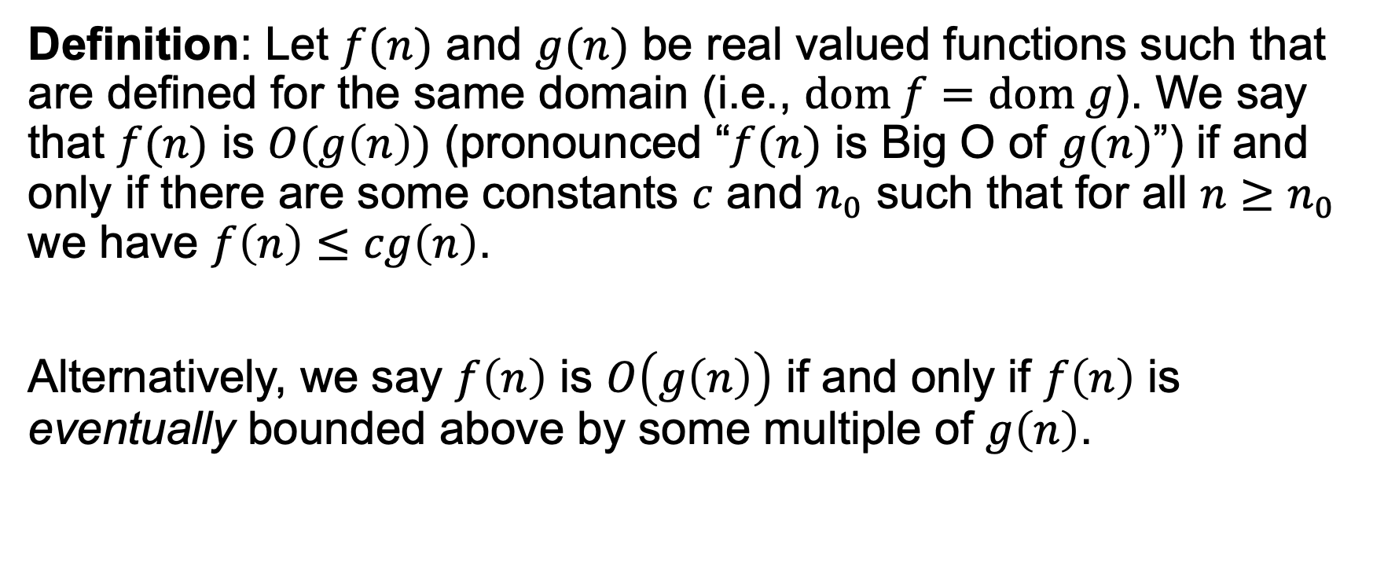
Big O
Definition: Let $f(n)$ and $g(n)$ be real valued functions such that are defined for the same domain (i.e., $dom f=dom g$). We say that $f(n)$ is $O(g\left(n\right))$ (pronounced “$f(n)$ is Big O of $g(n)$”) if and only if there are some constants $c$ and $n_{0}$ such that for all $n≥n_{0}$ we have $f\left(n\right)≤cg\left(n\right)$.
Alternatively, we say $f\left(n\right)$ is $O\left(g\left(n\right)\right)$ if and only if $f\left(n\right)$ is eventually bounded above by some multiple of $g\left(n\right)$.

Slide 4
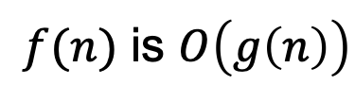






Big O
$$y$$
$$3g(n)$$
$$f(n)$$
$f(n)$ is $O\left(g\left(n\right)\right)$
$$0$$
$$x$$
$$n_{0}$$

Slide 5
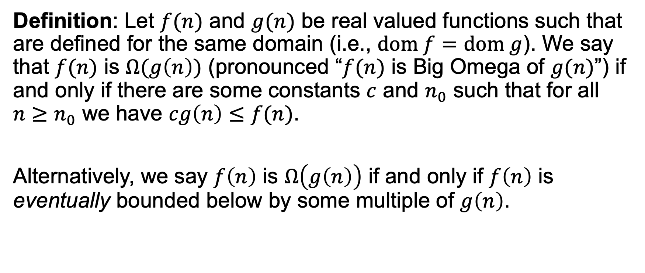
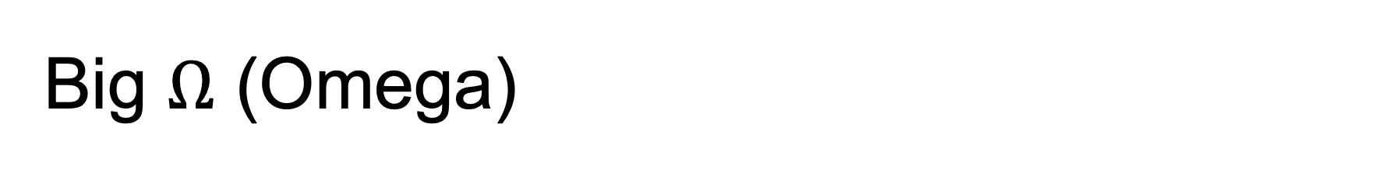
Big $Ω$ (Omega)
Definition: Let $f(n)$ and $g(n)$ be real valued functions such that are defined for the same domain (i.e., $dom f=dom g$). We say that $f(n)$ is $Ω(g\left(n\right))$ (pronounced “$f(n)$ is Big Omega of $g(n)$”) if and only if there are some constants $c$ and $n_{0}$ such that for all $n≥n_{0}$ we have $cg\left(n\right)≤f(n)$.
Alternatively, we say $f\left(n\right)$ is $Ω\left(g\left(n\right)\right)$ if and only if $f\left(n\right)$ is eventually bounded below by some multiple of $g\left(n\right)$.

Slide 6

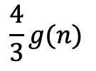
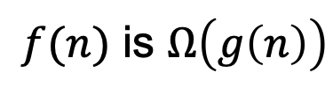
Big $Ω$ (Omega)
$$y$$
$$f(n)$$
$f(n)$ is $Ω\left(g\left(n\right)\right)$
$$\frac{4}{3}g(n)$$
$$0$$
$$x$$
$$n_{0}$$

Slide 7
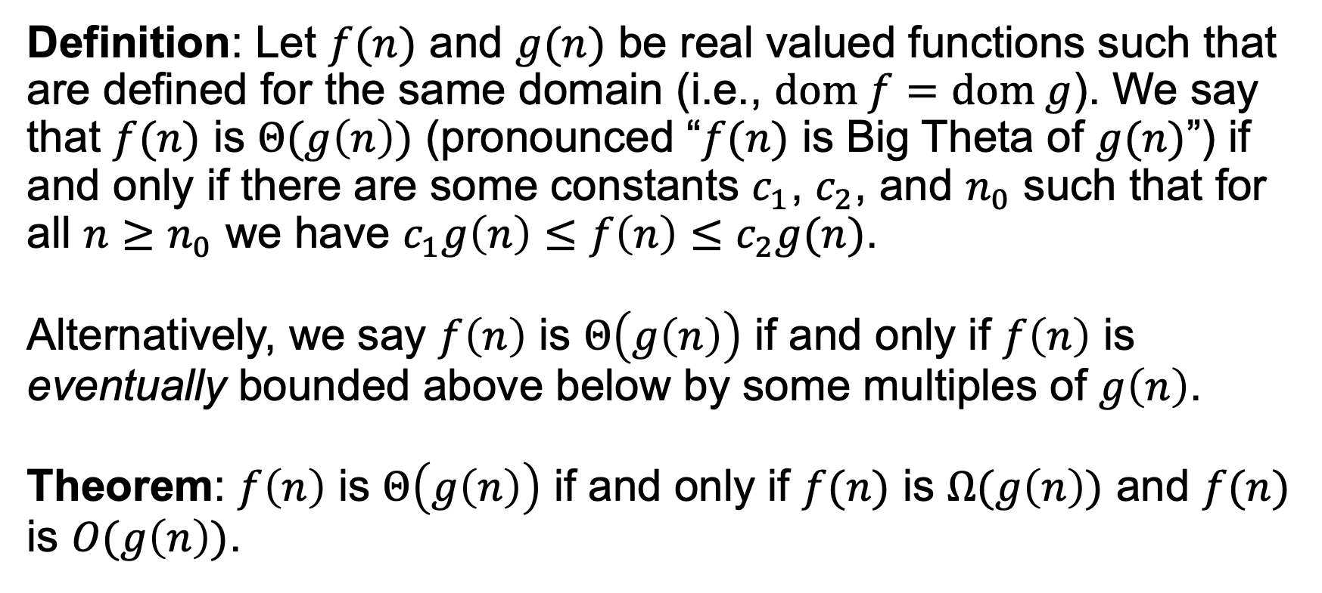
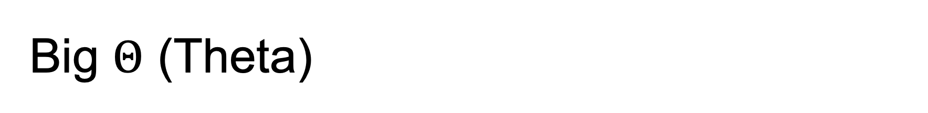
Big $Θ$ (Theta)
Definition: Let $f(n)$ and $g(n)$ be real valued functions such that are defined for the same domain (i.e., $dom f=dom g$). We say that $f(n)$ is $Θ(g\left(n\right))$ (pronounced “$f(n)$ is Big Theta of $g(n)$”) if and only if there are some constants $c_{1}$, $c_{2}$, and $n_{0}$ such that for all $n≥n_{0}$ we have $c_{1}g\left(n\right)≤f\left(n\right)≤c_{2}g(n)$.
Alternatively, we say $f\left(n\right)$ is $Θ\left(g\left(n\right)\right)$ if and only if $f\left(n\right)$ is eventually bounded above below by some multiples of $g\left(n\right)$.
Theorem: $f\left(n\right)$ is $Θ\left(g\left(n\right)\right)$ if and only if $f(n)$ is $Ω(g\left(n\right))$ and $f(n)$ is $O(g\left(n\right))$.

Slide 8
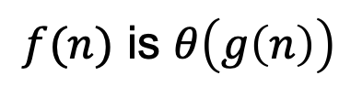
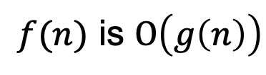
Big $Θ$ (Theta)
$$y$$
$$3g(n)$$
$f(n)$ is $O\left(g\left(n\right)\right)$
$$f(n)$$
$f(n)$ is $Ω\left(g\left(n\right)\right)$
$f(n)$ is $θ\left(g\left(n\right)\right)$
$$\frac{4}{3}g(n)$$
$$0$$
$$x$$
$$n_{0}$$

Slide 9



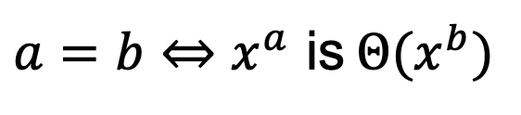


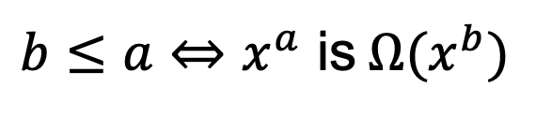

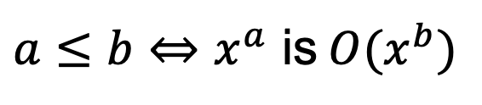


Big O and Power Functions
$$y=x$$
$$y$$
$$y=x^{2}$$
$a≤b⇔x^{a}$ is $O(x^{b})$
$b≤a⇔x^{a}$ is $Ω(x^{b})$
$a=b⇔x^{a}$ is $Θ(x^{b})$
$$y=\sqrt{x}$$
$$y=1$$
$$0$$
$$x$$
$$n_{0}$$

Slide 10
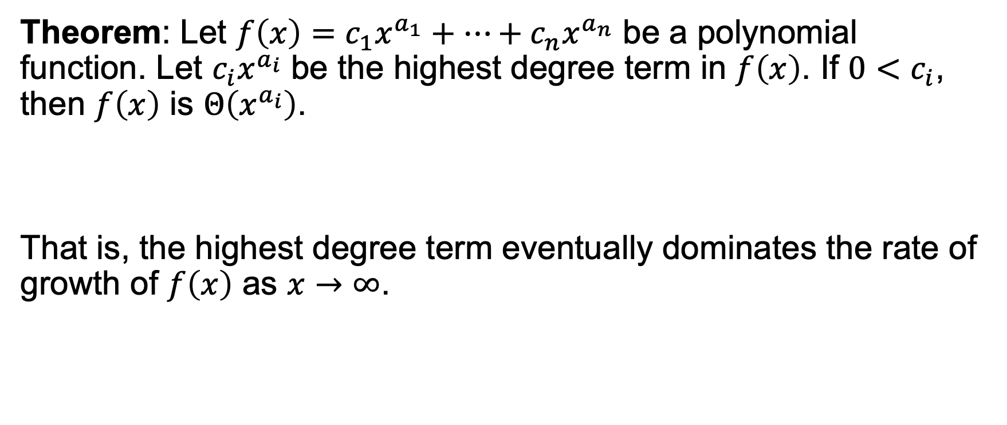
Big O and Polynomial Functions
Theorem: Let $f\left(x\right)=c_{1}x^{a_{1}}+…+c_{n}x^{a_{n}}$ be a polynomial function. Let $c_{i}x^{a_{i}}$ be the highest degree term in $f\left(x\right)$. If $0<c_{i}$, then $f\left(x\right)$ is $Θ\left(x^{a_{i}}\right)$.
That is, the highest degree term eventually dominates the rate of growth of $f\left(x\right)$ as $x→∞$.

Slide 11
Group Exercises
Form groups of 3-4

