Slide 1
Graphs I April 8, 2026
CSCI 246: Discrete Structures
Textbook Reference: Ch. 9, Sec. 47

Slide 2
Agenda
Lecture (~ 15 minutes)
Assignment 5 – due Today
Group Exercise (~35 minutes)

Slide 3
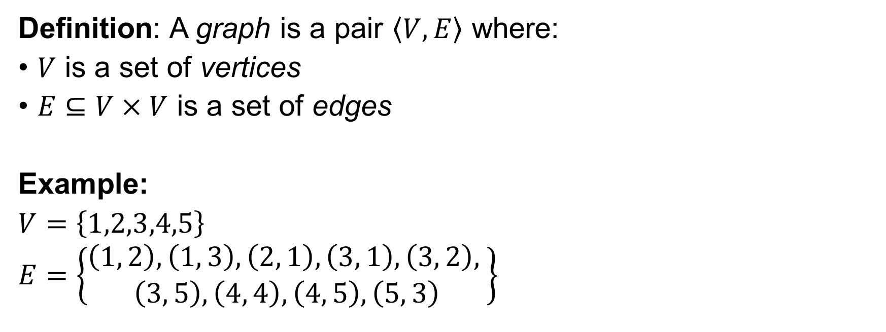
Graph
Definition: A graph is a pair $\left\langle V, E\right\rangle$ where:
$V$ is a set of vertices
$E⊆V×V$ is a set of edges
Example:
$V=\left\{1,2,3,4,5\right\}$
$E=\left\{\begin{aligned}\left(1, 2\right), \left(1, 3\right), \left(2, 1\right), \left(3, 1\right), \left(3, 2\right), \\ \left(3, 5\right), \left(4, 4\right), \left(4, 5\right), \left(5, 3\right)\end{aligned}\right\}$
2
1
3
4
5

Slide 4

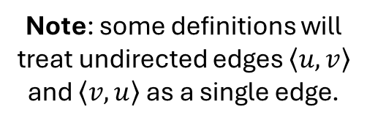
Undirected Graph
Definition: A graph $G=\left\langle V, E\right\rangle$ is undirected if and only if the set of edges $E$ is symmetric. That is $\left\langle u, v\right\rangle ∈E$ if and only if $\left\langle v, u\right\rangle ∈E$.
2
Note: some definitions will treat undirected edges $\left\langle u,v\right\rangle$ and $\left\langle v,u\right\rangle$ as a single edge.
1
3
4
5

Slide 5

Simple Graph
Definition: A graph $G=\left\langle V, E\right\rangle$ is simple if and only if the set of edges $E$ is irreflexive. That is the graph contains no self-loops.
2
Note: the textbook uses graph to mean simple undirected graph.
1
3
4
5

Slide 6

Adjacent
Definition: Let $G=\left\langle V, E\right\rangle$ be an undirected graph. We say that $u$ is adjacent to $v$ if and only if $\left(u, v\right)∈E$.
1 is adjacent to 2 and 3 2 is adjacent to 1 3 is adjacent to 3 and 5 4 is adjacent to 4 5 is adjacent to 3
2
1
3
4
5

Slide 7

Degree
Definition: Let $G=\left\langle V, E\right\rangle$ be a graph. We say that a vertex $v$ has degree $n$ if and only if $n=\left|\left\{\left(v, u\right)∈V×V:\left(v, u\right)∈E\right\}\right|$; $v$ has $n$ outgoing edges.
1 has degree 2 2 has degree 1 3 has degree 3 4 has degree 2 5 has degree 1
2
1
3
4
5

Slide 8

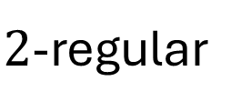
Regular Graph
Definition: Let $G=\left\langle V, E\right\rangle$ be a graph. We say that $G$ is regular if and only if every vertex in $G$ has the same degree. We say that $G$ is $r$-regular if and only if every vertex in $G$ has degree $r$.
2
$2$-regular
1
4
3
5

Slide 9

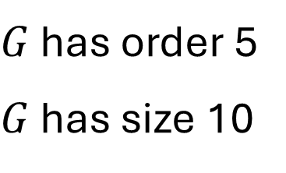
Size of a Graph
Definition: Let $G=\left\langle V, E\right\rangle$ be a graph. The order of $G$ is $|V|$ the number of vertices in $G$. The size of $G$ is $|E|$ the number of edges in $G$.
2
$G$ has order 5
$G$ has size 10
1
4
3
5

Slide 10

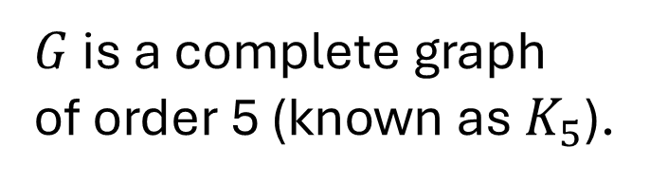
Complete Graph
Definition: Let $G=\left\langle V, E\right\rangle$ be a graph. We say $G$ is complete if and only if there is an edge between every pair of distinct edges.
2
$G$ is a complete graph
of order 5 (known as $K_{5}$).
1
4
3
5

Slide 11
Group Exercises
Form groups of 3-4

