Slide 1
Real Functions March 9, 2026
CSCI 246: Discrete Structures
Textbook Reference: Ch. 11, Sec. 1 (Epps)

Slide 2
Agenda
Lecture (~ 10 minutes)
Group Exercise (~40 minutes)

Slide 3





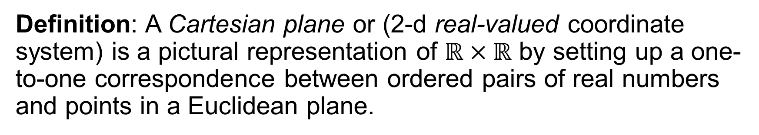







Cartesian Plane
Definition: A Cartesian plane or (2-d real-valued coordinate system) is a pictural representation of $ℝ×ℝ$ by setting up a one-to-one correspondence between ordered pairs of real numbers and points in a Euclidean plane.
y-axis
$$y$$
$$\left(1,2\right)$$
$$y=2$$
$$2$$
$$1$$
origin
$$−2$$
$$0$$
$$x$$
$$−1$$
$$1$$
$$2$$
x-axis
$$−1$$
$$−2$$
$$x=1$$

Slide 4
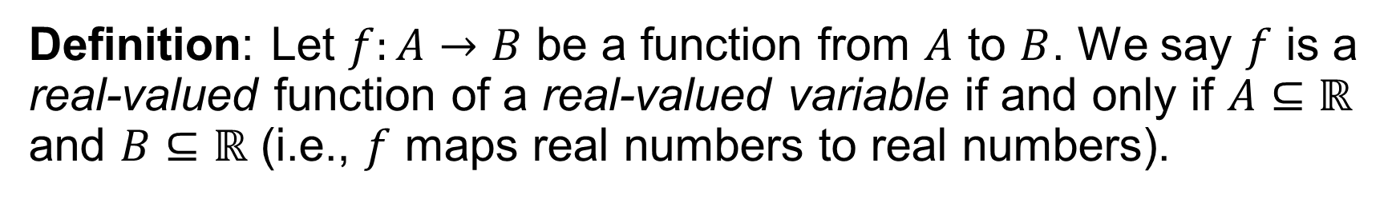
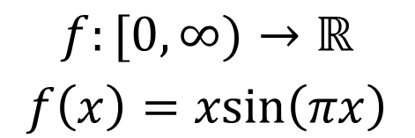
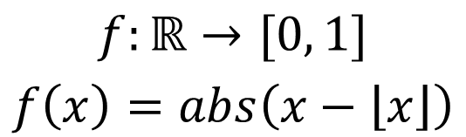
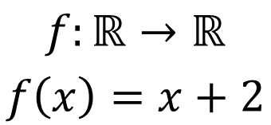
Real-Valued Function
Definition: Let $f:A→B$ be a function from $A$ to $B$. We say $f$ is a real-valued function of a real-valued variable if and only if $A⊆ℝ$ and $B⊆ℝ$ (i.e., $f$ maps real numbers to real numbers).
Interval from 0 to 1
Positive Reals
$$f:ℝ→ℝ$$
$$f\left(x\right)=x+2$$
$$f:ℝ→[0, 1]$$
$$f\left(x\right)=abs\left(x−\left\lfloor x\right\rfloor \right)$$
$$f:[0,∞)→ℝ$$
$$f\left(x\right)=xsin\left(πx\right)$$
round down

Slide 5


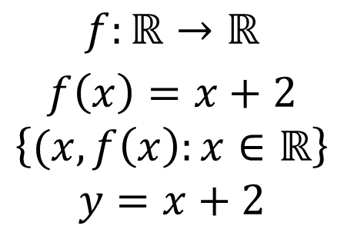









Graphing Real-Valued Functions
$$y$$
$$4$$
$$3$$
$$f:ℝ→ℝ$$
$$f\left(x\right)=x+2$$
$$\left\{(x, f\left(x\right):x∈ℝ\right\}$$
$$y=x+2$$
$$2$$
$$1$$
$$−4$$
$$−3$$
$$−2$$
$$−1$$
$$0$$
$$1$$
$$2$$
$$3$$
$$4$$
$$x$$
$$−1$$
$$−2$$
$$−3$$
$$−4$$

Slide 6
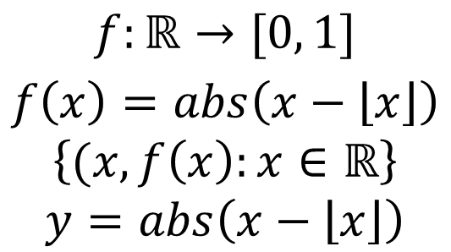

Graphing Real-Valued Functions
$$y$$
$$4$$
Open circle/points represent
discontinuities in function
(points where lines break)
$$3$$
$$f:ℝ→[0, 1]$$
$$f\left(x\right)=abs\left(x−\left\lfloor x\right\rfloor \right)$$
$$\left\{(x, f\left(x\right):x∈ℝ\right\}$$
$$y=abs\left(x−\left\lfloor x\right\rfloor \right)$$
$$2$$
$$1$$
$$−4$$
$$−3$$
$$−2$$
$$−1$$
$$0$$
$$1$$
$$2$$
$$3$$
$$4$$
$$x$$
$$−1$$
$$−2$$
$$−3$$
$$−4$$

Slide 7
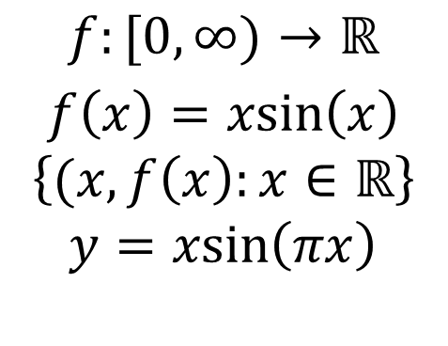
Graphing Real-Valued Functions
$$y$$
$$4$$
$$3$$
$$f:[0,∞)→ℝ$$
$$f\left(x\right)=xsin\left(x\right)$$
$$\left\{(x, f\left(x\right):x∈ℝ\right\}$$
$$y=xsin\left(πx\right)$$
$$2$$
$$1$$
$$−4$$
$$−3$$
$$−2$$
$$−1$$
$$0$$
$$1$$
$$2$$
$$3$$
$$4$$
$$x$$
$$−1$$
$$−2$$
$$−3$$
$$−4$$

Slide 8

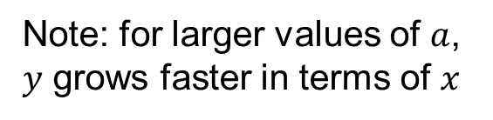



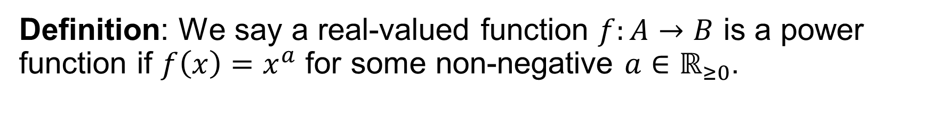




Power Functions
Definition: We say a real-valued function $f:A→B$ is a power function if $f\left(x\right)=x^{a}$ for some non-negative $a∈ℝ_{≥0}$.
$$y$$
$$y=x^{2}$$
$$y=x^{1}=x$$
$$6$$
$$5$$
Note: for larger values of $a$, $y$ grows faster in terms of $x$
$$4$$
$$3$$
$$y=x^{\frac{1}{2}}=\sqrt{x}$$
$$2$$
$$1$$
$$y=x^{0}=1$$
$$0$$
$$x$$
$$1$$
$$2$$
$$3$$
$$4$$
$$5$$
$$6$$

Slide 9




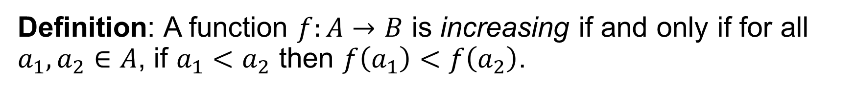







Increasing Function
Definition: A function $f:A→B$ is increasing if and only if for all $a_{1}, a_{2}∈A$, if $a_{1}<a_{2}$ then $f\left(a_{1}\right)<f\left(a_{2}\right)$.
✓
✓
$$y$$
$$y$$
$$y$$
❌
$$4$$
$$4$$
$$4$$
$$3$$
$$3$$
$$3$$
$$2$$
$$2$$
$$2$$
$$1$$
$$1$$
$$1$$
$$−4$$
$$−3$$
$$−2$$
$$−1$$
$$0$$
$$1$$
$$2$$
$$3$$
$$4$$
$$x$$
$$−4$$
$$−3$$
$$−2$$
$$−1$$
$$0$$
$$1$$
$$2$$
$$3$$
$$4$$
$$x$$
$$−4$$
$$−3$$
$$−2$$
$$−1$$
$$0$$
$$1$$
$$2$$
$$3$$
$$4$$
$$x$$
$$−1$$
$$−1$$
$$−1$$
$$−2$$
$$−2$$
$$−2$$
$$−3$$
$$−3$$
$$−3$$
$$−4$$
$$−4$$
$$−4$$

Slide 10
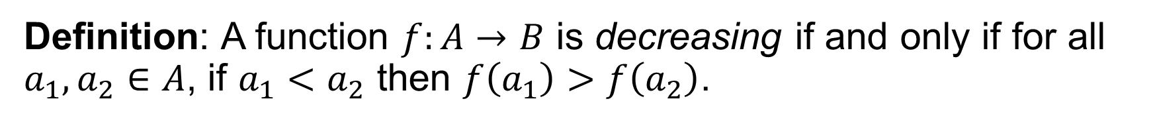
Decreasing Function
Definition: A function $f:A→B$ is decreasing if and only if for all $a_{1}, a_{2}∈A$, if $a_{1}<a_{2}$ then $f\left(a_{1}\right)>f\left(a_{2}\right)$.
✓
✓
$$y$$
$$y$$
$$y$$
❌
$$4$$
$$4$$
$$4$$
$$3$$
$$3$$
$$3$$
$$2$$
$$2$$
$$2$$
$$1$$
$$1$$
$$1$$
$$−4$$
$$−3$$
$$−2$$
$$−1$$
$$0$$
$$1$$
$$2$$
$$3$$
$$4$$
$$x$$
$$−4$$
$$−3$$
$$−2$$
$$−1$$
$$0$$
$$1$$
$$2$$
$$3$$
$$4$$
$$x$$
$$−4$$
$$−3$$
$$−2$$
$$−1$$
$$0$$
$$1$$
$$2$$
$$3$$
$$4$$
$$x$$
$$−1$$
$$−1$$
$$−1$$
$$−2$$
$$−2$$
$$−2$$
$$−3$$
$$−3$$
$$−3$$
$$−4$$
$$−4$$
$$−4$$

Slide 11
Group Exercises
Form groups of 3-4

