Slide 1
Recurrence Relations March 4, 2026
CSCI 246: Discrete Structures
Textbook Reference: Ch 4. Sec 23

Slide 2
Agenda
Lecture (~ 10 minutes)
Group Exercise (~40 minutes)

Slide 3

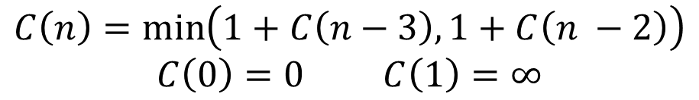

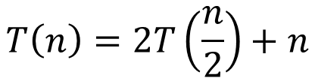


Recurrence Relations
Definition: A recurrence relation is an equation that defines a sequence in terms of previous terms.
First-Order (linear) Recurrence Relations
Second-Order (linear) Recurrence Relations
$a_{n}=a_{n−1}+1$
$a_{0}=0$
$a_{n}={3a}_{n−1}+2$
$a_{0}=3$
$a_{n}={3a}_{n−1}+2a_{n−2}$
$a_{1}=3$
$a_{0}=2$
$a_{n}=a_{n−1}+a_{n−2}$
$a_{1}=1$
$a_{0}=1$
$$T\left(n\right)=2T\left(\frac{n}{2}\right)+n$$
$$C\left(n\right)=\min\left(1+C\left(n−3\right), 1+C\left(n −2\right)\right)$$
$C\left(0\right)=0$ $C\left(1\right)=∞$

Slide 4
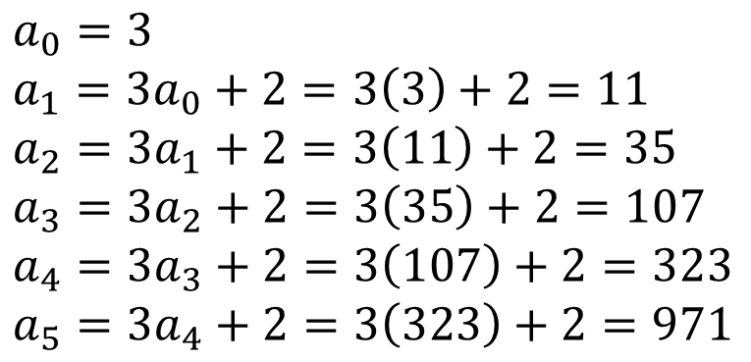
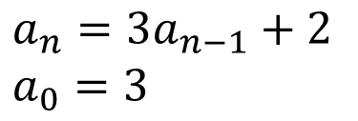
Evaluating Recurrence Relations
$a_{0}=3$
$a_{1}={3a}_{0}+2=3\left(3\right)+2=11$
$a_{2}={3a}_{1}+2=3\left(11\right)+2=35$
$a_{3}={3a}_{2}+2=3\left(35\right)+2=107$
$a_{4}={3a}_{3}+2=3\left(107\right)+2=323$
$a_{5}={3a}_{4}+2=3\left(323\right)+2=971$
$a_{n}={3a}_{n−1}+2$
$a_{0}=3$

Slide 5
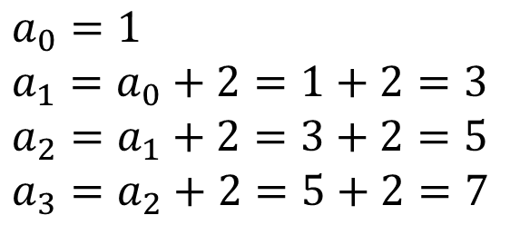
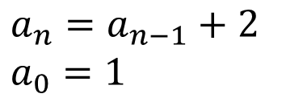

First-Order Recurrence Relations
$a_{n}=a_{n−1}+2$
$a_{0}=1$
$$a_{n}=2n+1$$
$a_{0}=1$
$a_{1}=a_{0}+2=1+2=3$
$a_{2}=a_{1}+2=3+2=5$
$a_{3}=a_{2}+2=5+2=7$
Note: each is 2 more than the
previous, on step n we add 2n

Slide 6

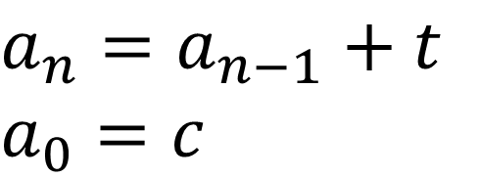
First-Order Recurrence Relations
$a_{n}=a_{n−1}+t$
$a_{0}=c$
$a_{n}=tn+a_{0}$

Slide 7
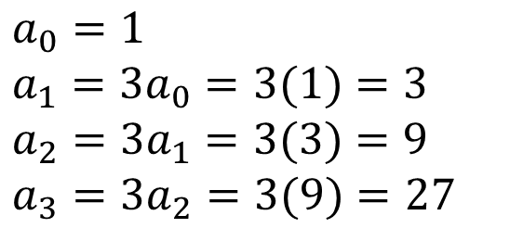
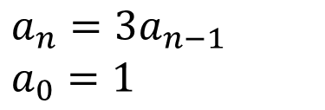

First-Order Recurrence Relations
$a_{n}={3a}_{n−1}$
$a_{0}=1$
$$a_{n}=3^{n}$$
$a_{0}=1$
$a_{1}={3a}_{0}=3(1)=3$
$a_{2}=3a_{1}=3(3)=9$
$a_{3}={3a}_{2}=3(9)=27$
Note: each is 3 times the last

Slide 8

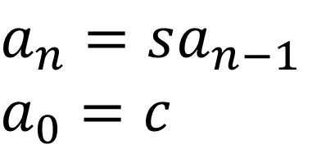
First-Order Recurrence Relations
$a_{n}=sa_{n−1}$
$a_{0}=c$
$a_{n}={cs}^{n}$

Slide 9
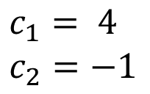
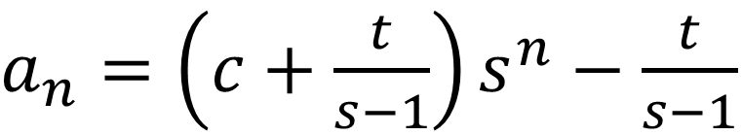

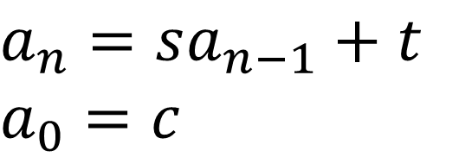
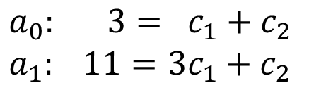
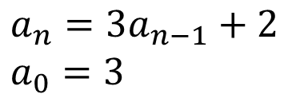
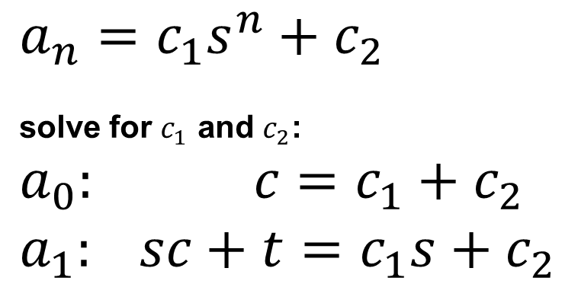
First-Order Recurrence Relations
$a_{n}=sa_{n−1}+t$
$a_{0}=c$
$a_{n}=\left(c+\frac{t}{s−1}\right)s^{n}−\frac{t}{s−1}$
$a_{n}={3a}_{n−1}+2$
$a_{0}=3$
$$a_{n}=4\left(3^{n}\right)−1$$
$a_{n}=c_{1}s^{n}+c_{2}$
solve for $c_{1}$ and $c_{2}$:
$a_{0}: c=c_{1}+c_{2}$
$a_{1}: sc+t=c_{1}s+c_{2}$
$a_{0}: 3= c_{1}+c_{2}$
$a_{1}: 11={3c}_{1}+c_{2}$
$c_{1}= 4$
$c_{2}=−1$

Slide 10

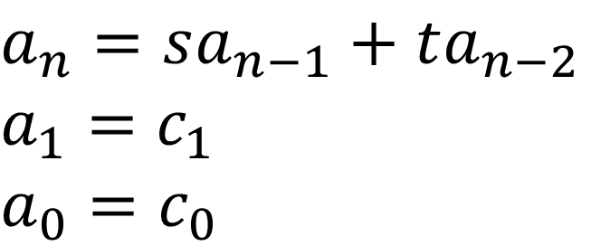


Second-Order Recurrence Relations
Possible Solutions:
$a_{n}=sa_{n−1}+ta_{n−2}$
$a_{1}=c_{1}$
$a_{0}=c_{0}$
$a_{n}=0$
$$a_{n}=\left(x_{0}+x_{1}n\right)r^{n}$$
$a_{n}=x_{0}r_{0}^{n}+x_{1}r_{1}^{n}$

Slide 11
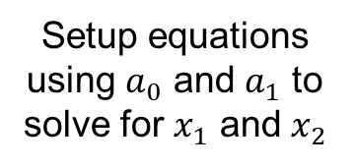
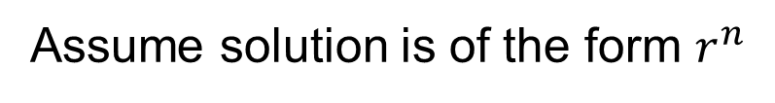
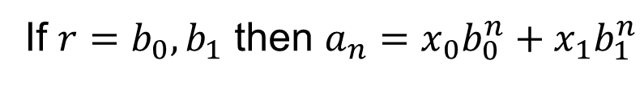
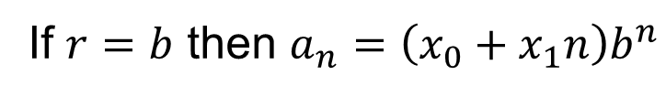
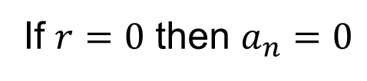
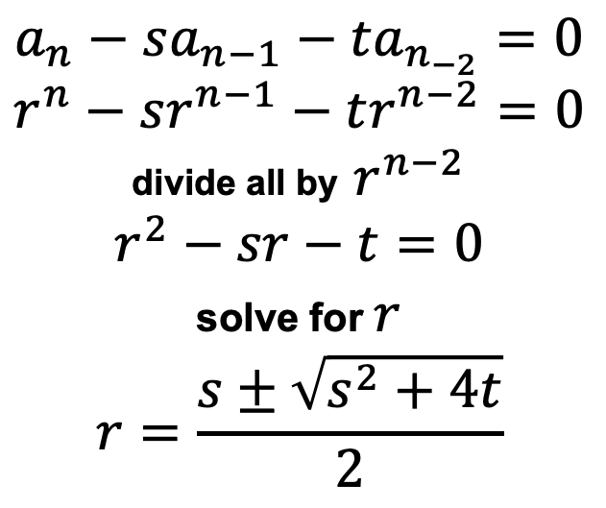
Second-Order Recurrence Relations
Assume solution is of the form $r^{n}$
$a_{n}=sa_{n−1}+ta_{n−2}$
$a_{1}=c_{1}$
$a_{0}=c_{0}$
$$a_{n}−sa_{n−1}−ta_{n_{−2}}=0$$
$$r^{n}−sr^{n−1}−tr^{n−2}=0$$
divide all by $r^{n−2}$
$$r^{2}−sr−t=0$$
solve for $r$
$$r=\frac{s±\sqrt{s^{2}+4t}}{2}$$
Setup equations using $a_{0}$ and $a_{1}$ to solve for $x_{1}$ and $x_{2}$
If $r=0$ then $a_{n}=0$
If $r=b$ then $a_{n}=\left(x_{0}+x_{1}n\right)b^{n}$
If $r=b_{0}, b_{1}$ then $a_{n}=x_{0}b_{0}^{n}+x_{1}b_{1}^{n}$

Slide 12
Group Exercises
Form groups of 3-4

