Slide 1
Functions March 6, 2026
CSCI 246: Discrete Structures
Textbook Reference: Ch 4. Sec 24

Slide 2
Agenda
Lecture (~ 10 minutes)
Assignment 3 returned
Group Exercise (~40 minutes)

Slide 3

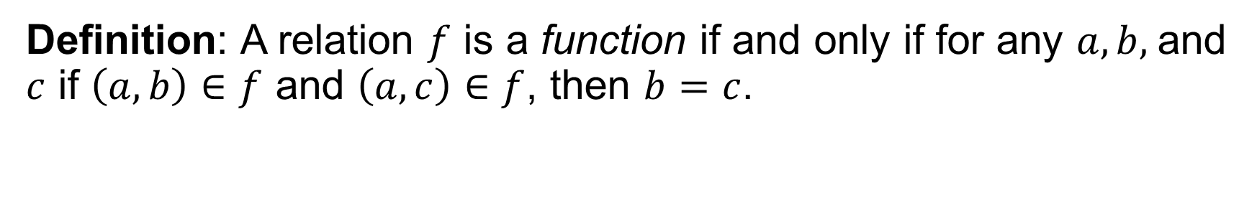

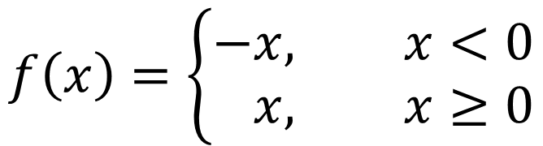
Function
Definition: A relation $f$ is a function if and only if for any $a,b,$ and $c$ if $\left(a,b\right)∈f$ and $\left(a,c\right)∈f$, then $b=c$.
$$f\left(x\right)=\left\{\begin{aligned}−&x, x<0 \\ &x, x≥0\end{aligned}\right.$$
$$f\left(x\right)=3x+1$$
$$f\left(A\right)=|A|$$

Slide 4


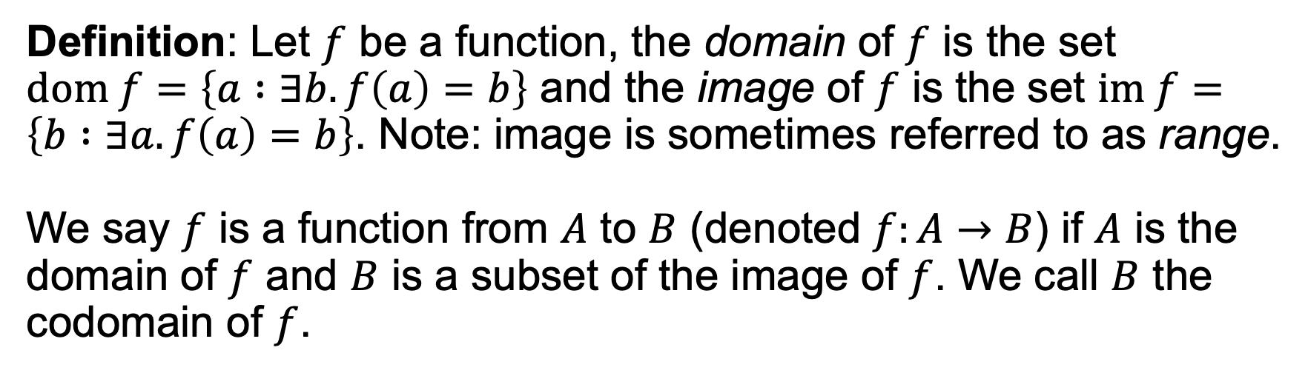

Domain, Image
Definition: Let $f$ be a function, the domain of $f$ is the set $dom f=\left\{a :∃b. f\left(a\right)=b\right\}$ and the image of $f$ is the set $im f=\left\{b :∃a. f\left(a\right)=b\right\}$. Note: image is sometimes referred to as range.
We say $f$ is a function from $A$ to $B$ (denoted $f:A→B$) if $A$ is the domain of $f$ and $B$ is a subset of the image of $f$. We call $B$ the codomain of $f$.
$$f:ℕ→ℕ$$
$$f:ℤ→ℕ$$
$$f:2^{U}→ℕ$$
$$f\left(x\right)=\left\{\begin{aligned}−&x, x<0 \\ &x, x≥0\end{aligned}\right.$$
$$f\left(x\right)=3x+1$$
$$f\left(A\right)=|A|$$

Slide 5
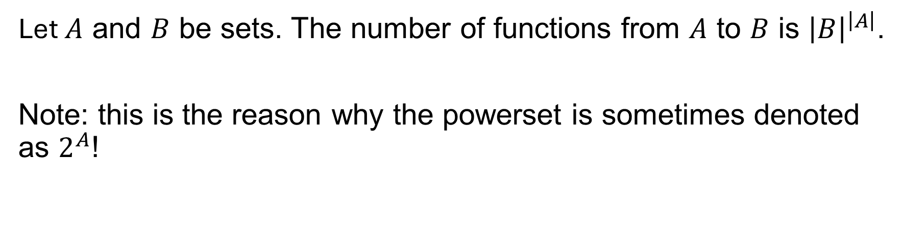
Counting Functions
Let $A$ and $B$ be sets. The number of functions from $A$ to $B$ is ${\left|B\right|}^{\left|A\right|}$.
Note: this is the reason why the powerset is sometimes denoted as $2^{A}$!

Slide 6

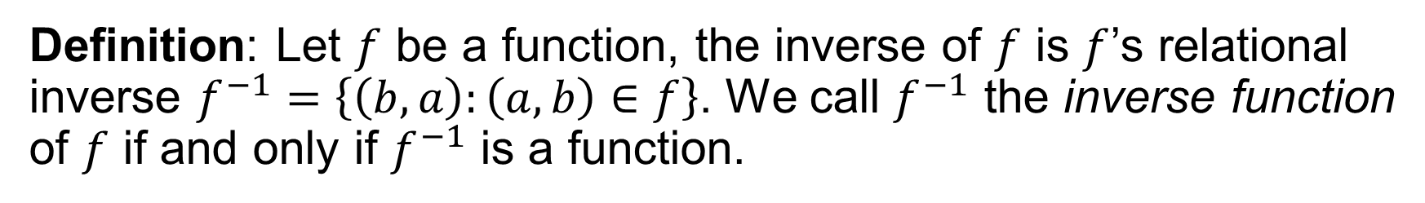
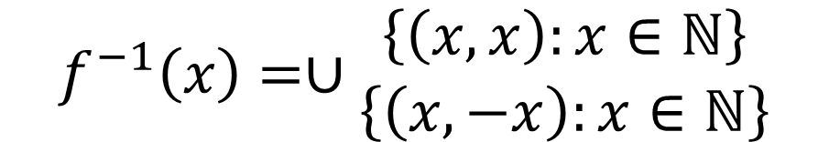
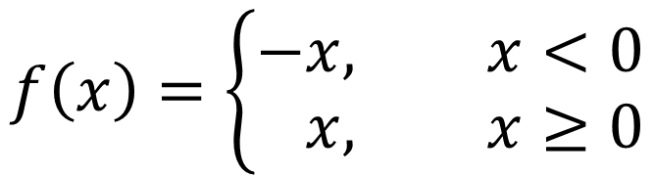
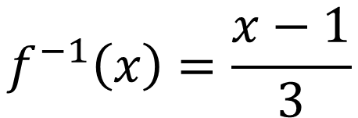
Inverse Function
Definition: Let $f$ be a function, the inverse of $f$ is $f$’s relational inverse $f^{−1}=\left\{\left(b, a\right):\left(a, b\right)∈f\right\}$. We call $f^{−1}$ the inverse function of $f$ if and only if $f^{−1}$ is a function.
$$f\left(x\right)=\left\{\begin{aligned}−&x, x<0 \\ &x, x≥0\end{aligned}\right.$$
$$f\left(x\right)=3x+1$$
✓
❌
$$f^{−1}\left(x\right)=\frac{x−1}{3}$$
$$f^{−1}\left(x\right)=∪\begin{matrix}\left\{\left(x,x\right):x∈ℕ\right\} \\ \left\{\left(x,−x\right):x∈ℕ\right\}\end{matrix}$$

Slide 7



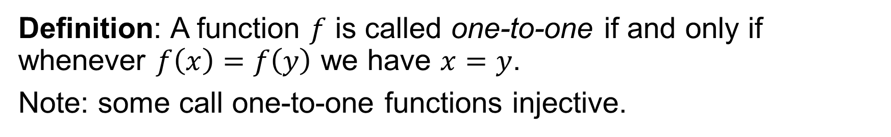



One-to-one
Definition: A function $f$ is called one-to-one if and only if whenever $f\left(x\right)=f\left(y\right)$ we have $x=y$.
Note: some call one-to-one functions injective.
$$A$$
$$f$$
$$B$$
$$A$$
$$f$$
$$B$$
1
2
3
4
5
6
7
1
2
3
4
5
6
7
1
2
3
4
5
6
7
1
2
3
4
5
6
7
✓
❌

Slide 8
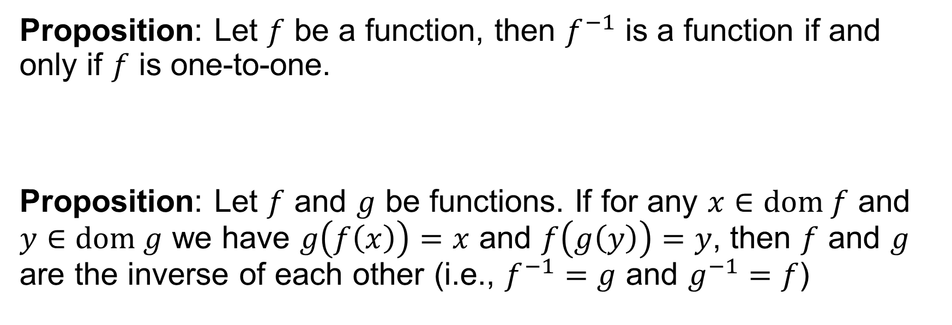
One-to-one
Proposition: Let $f$ be a function, then $f^{−1}$ is a function if and only if $f$ is one-to-one.
Proposition: Let $f$ and $g$ be functions. If for any $x∈dom f$ and $y∈dom g$ we have $g\left(f\left(x\right)\right)=x$ and $f\left(g\left(y\right)\right)=y$, then $f$ and $g$ are the inverse of each other (i.e., $f^{−1}=g$ and $g^{−1}=f$)

Slide 9

Onto
Definition: A function $f:A→B$ from $A$ to $B$ is onto if and only if for every $b∈B$, there is some $a∈A$ such that $f\left(a\right)=b$.
Note: some call onto functions surjective.
$$A$$
$$f$$
$$B$$
$$A$$
$$f$$
$$B$$
1
2
3
4
5
6
7
1
2
3
4
5
6
7
1
2
3
4
5
6
7
1
2
3
4
5
6
7
✓
❌
6

Slide 10




Bijection
Definition: A function $f:A→B$ from $A$ to $B$ is a bijection if and only if $f$ is one-to-one and onto.
$$A$$
$$f$$
$$B$$
1
2
3
4
5
6
7
1
2
3
4
5
6
7

Slide 11
Group Exercises
Form groups of 3-4

