Slide 1
Expectation and Variance April 6, 2026
CSCI 246: Discrete Structures
Textbook Reference: Ch. 6, Sec. 34

Slide 2
Agenda
Lecture (~ 15 minutes)
Assignment 4 – returned; corrections due Monday April 13
Assignment 5 – due Wednesday April 8
Group Exercise (~35 minutes)

Slide 3
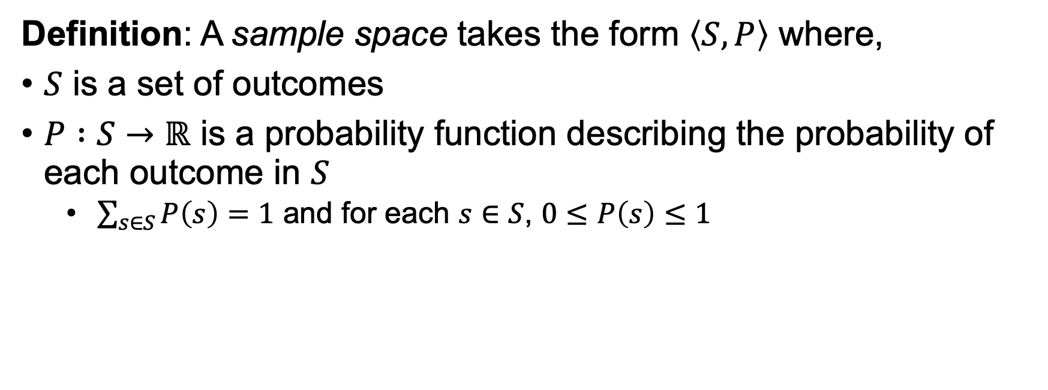
Sample Space (Recap)
Definition: A sample space takes the form $\left\langle S, P\right\rangle$ where,
$S$ is a set of outcomes
$P :S→ℝ$ is a probability function describing the probability of each outcome in $S$
$\sum_{s∈S}{P\left(s\right)}=1$ and for each $s∈S$, $0≤P\left(s\right)≤1$

Slide 4
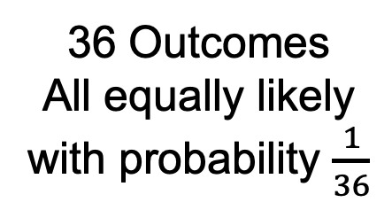
Sample Space (Recap)
36 Outcomes
All equally likely
with probability $\frac{1}{36}$

Slide 5
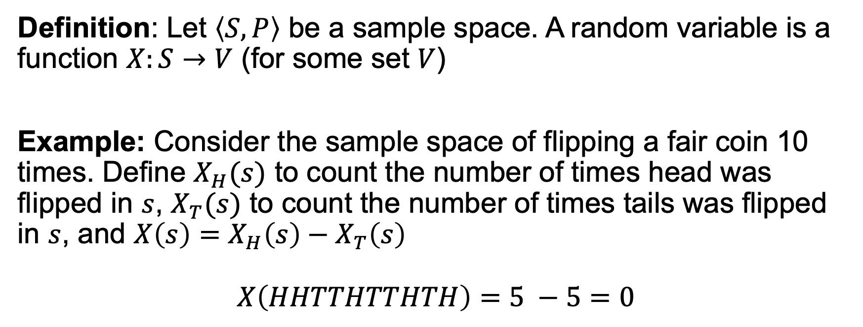
Random Variables (Recap)
Definition: Let $\left\langle S,P\right\rangle$ be a sample space. A random variable is a function $X:S→V$ (for some set $V$)
Example: Consider the sample space of flipping a fair coin 10 times. Define $X_{H}(s)$ to count the number of times head was flipped in $s$, $X_{T}(s)$ to count the number of times tails was flipped in $s$, and $X\left(s\right)=X_{H}\left(s\right)−X_{T}\left(s\right)$
$$X\left(HHTTHTTHTH\right)=5 −5=0$$

Slide 6
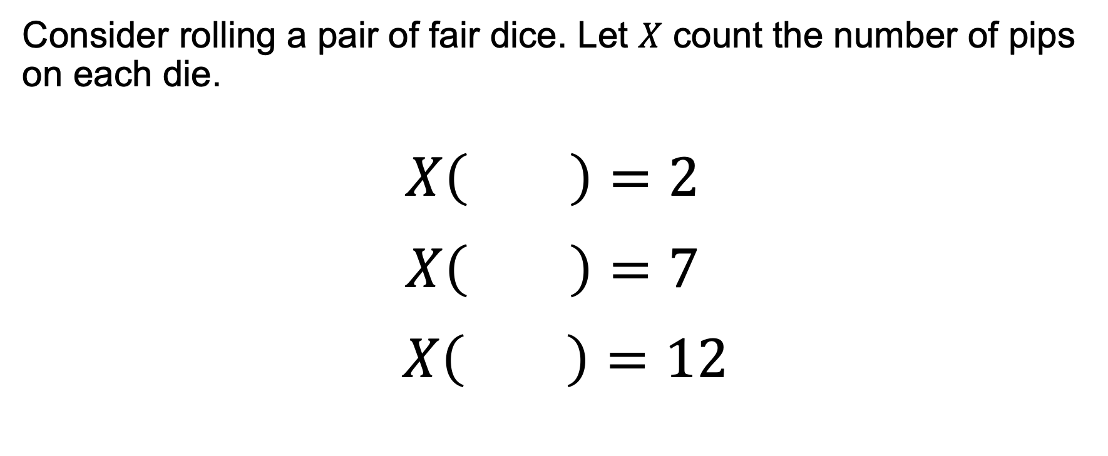
Random Variables (Recap)
Consider rolling a pair of fair dice. Let $X$ count the number of pips on each die.
$$X\left( \right)=2$$
$$X\left( \right)=7$$
$$X\left( \right)=12$$

Slide 7
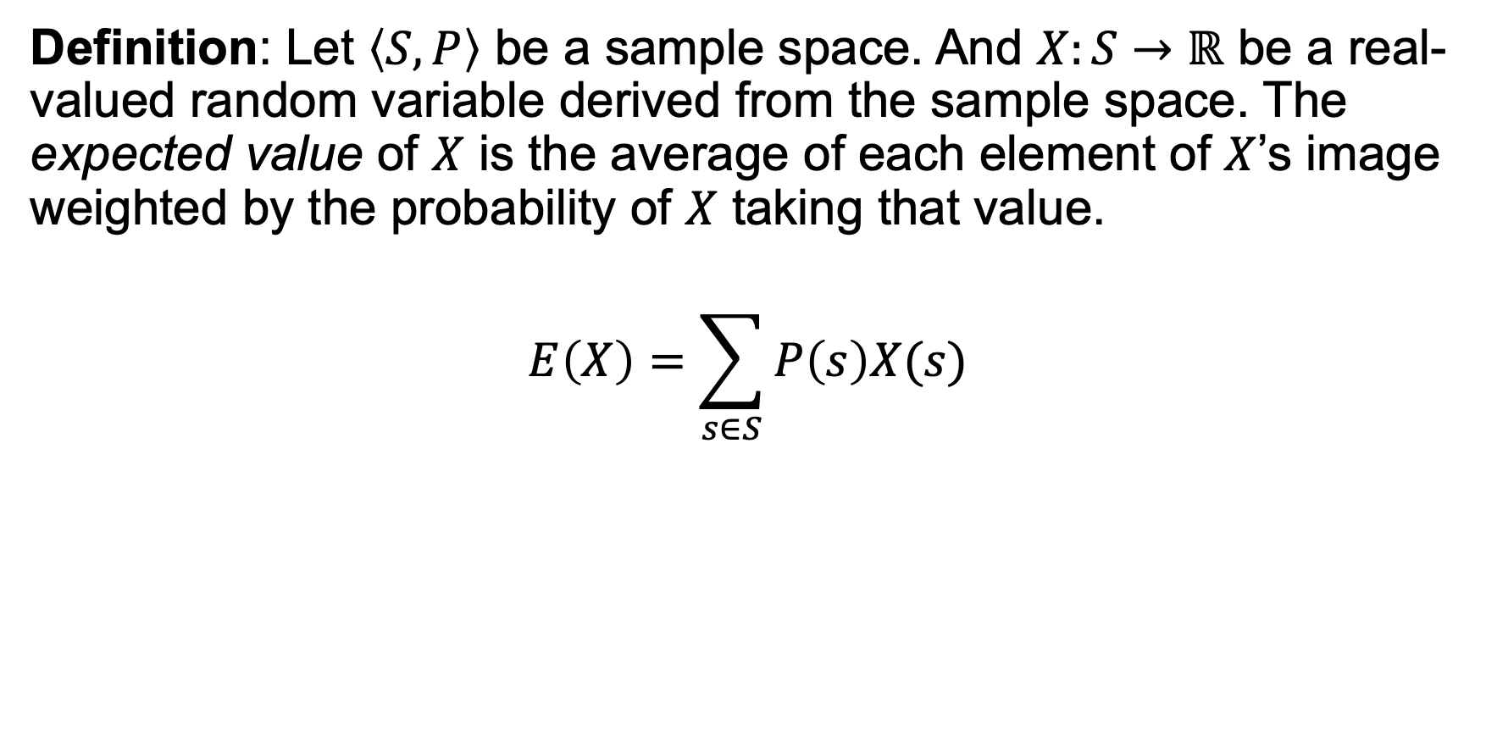
Expectation
Definition: Let $\left\langle S,P\right\rangle$ be a sample space. And $X:S→ℝ$ be a real-valued random variable derived from the sample space. The expected value of $X$ is the average of each element of $X$’s image weighted by the probability of $X$ taking that value.
$$E\left(X\right)=\sum_{s∈S}{P\left(s\right)X(s)}$$

Slide 8
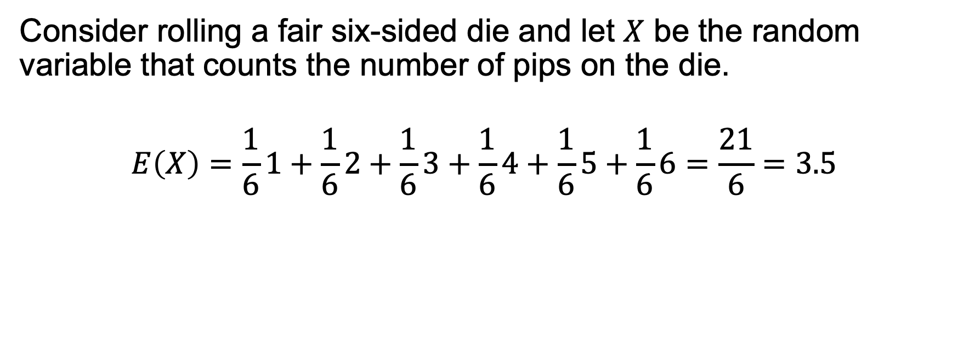
Expectation
Consider rolling a fair six-sided die and let $X$ be the random variable that counts the number of pips on the die.
$$E\left(X\right)=\frac{1}{6}1+\frac{1}{6}2+\frac{1}{6}3+\frac{1}{6}4+\frac{1}{6}5+\frac{1}{6}6=\frac{21}{6}=3.5$$

Slide 9
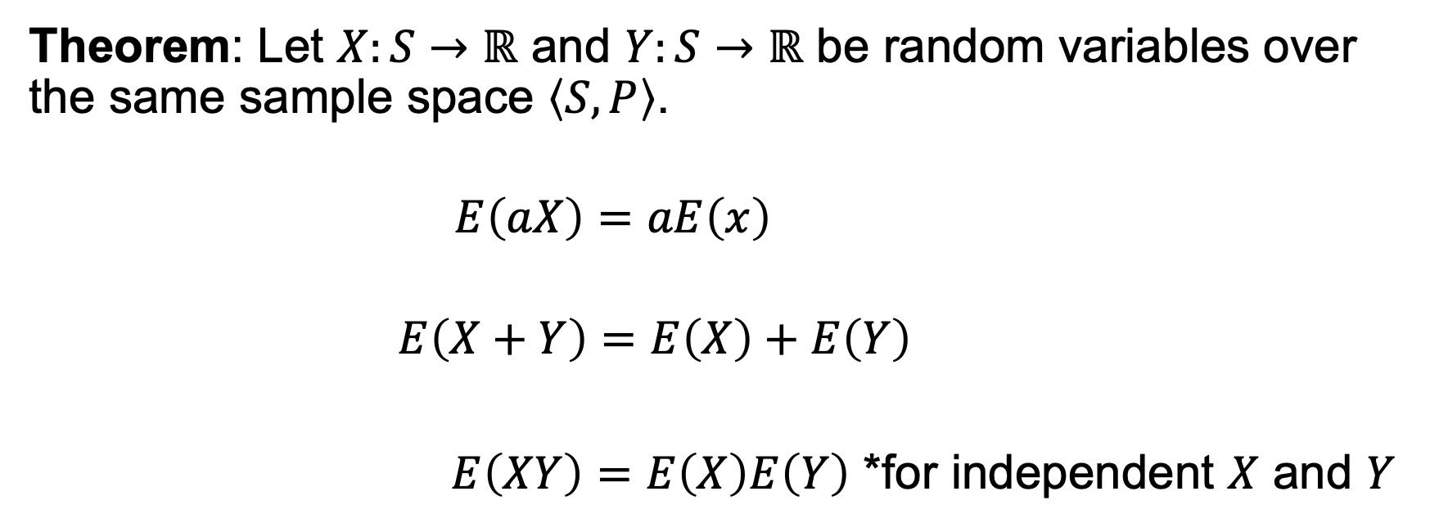
Expectation
Theorem: Let $X:S→ℝ$ and $Y:S→ℝ$ be random variables over the same sample space $\left\langle S,P\right\rangle$.
$$E\left(aX\right)=aE\left(x\right)$$
$$E\left(X+Y\right)=E\left(X\right)+E\left(Y\right)$$
$E\left(XY\right)=E\left(X\right)E\left(Y\right)$ *for independent $X$ and $Y$

Slide 10
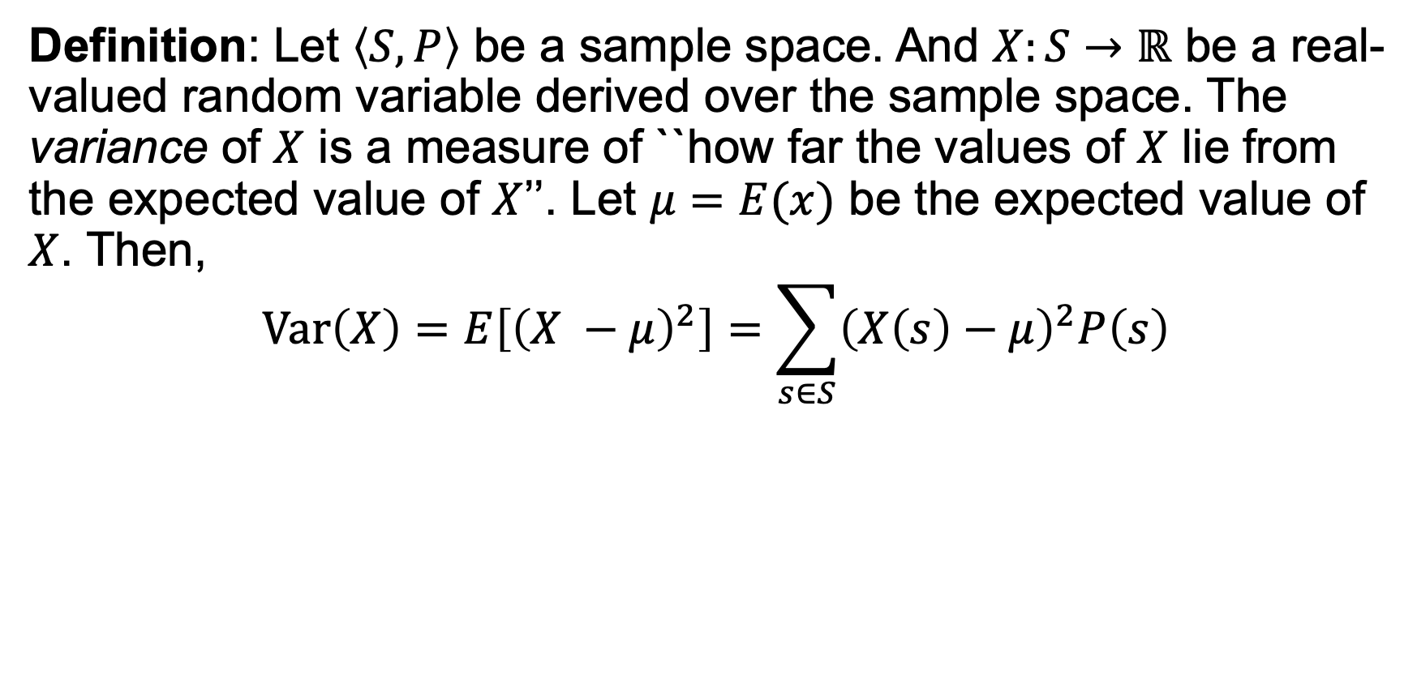
Variance
Definition: Let $\left\langle S,P\right\rangle$ be a sample space. And $X:S→ℝ$ be a real-valued random variable derived over the sample space. The variance of $X$ is a measure of ``how far the values of $X$ lie from the expected value of $X$’’. Let $μ=E(x)$ be the expected value of $X$. Then,
$$Var\left(X\right)=E\left[{\left(X −μ\right)}^{2}\right]=\sum_{s∈S}{{\left(X\left(s\right)−μ\right)}^{2}P\left(s\right)}$$

Slide 11
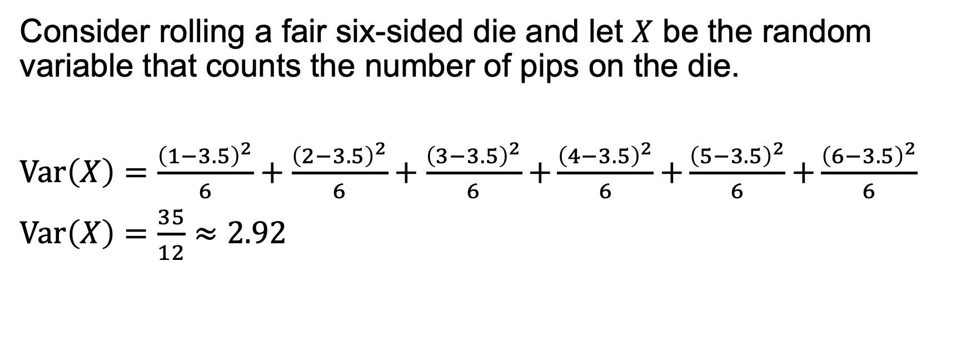
Variance
Consider rolling a fair six-sided die and let $X$ be the random variable that counts the number of pips on the die.
$Var\left(X\right)=\frac{{\left(1−3.5\right)}^{2}}{6}+\frac{{\left(2−3.5\right)}^{2}}{6}+\frac{{\left(3−3.5\right)}^{2}}{6}$ $+\frac{{\left(4−3.5\right)}^{2}}{6}$ $+\frac{{\left(5−3.5\right)}^{2}}{6}$ $+\frac{{\left(6−3.5\right)}^{2}}{6}$
$Var\left(X\right)=\frac{35}{12}≈2.92$

Slide 12
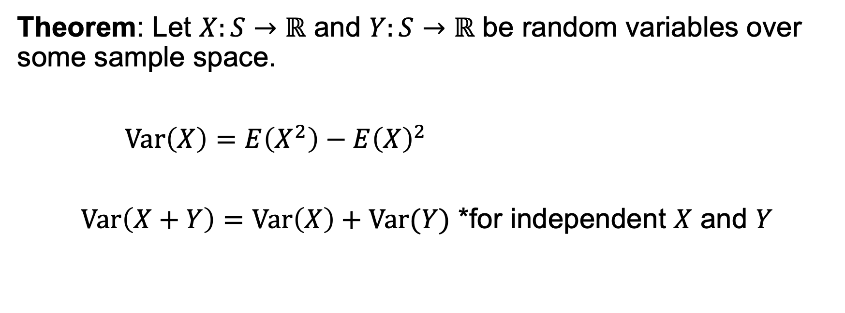
Variance
Theorem: Let $X:S→ℝ$ and $Y:S→ℝ$ be random variables over some sample space.
$Var\left(X\right)=E\left(X^{2}\right)−E{\left(X\right)}^{2}$
$Var\left(X+Y\right)=Var\left(X\right)+Var(Y)$ *for independent $X$ and $Y$

Slide 13
Group Exercises
Form groups of 3-4

