Slide 1
Graphs II April 10, 2026
CSCI 246: Discrete Structures
Textbook Reference: Ch. 9, Sec. 48

Slide 2
Agenda
Lecture (~ 10 minutes)
Assignment 6
Released today.
Now, due Friday April 17
Group Exercise (~40 minutes)

Slide 3
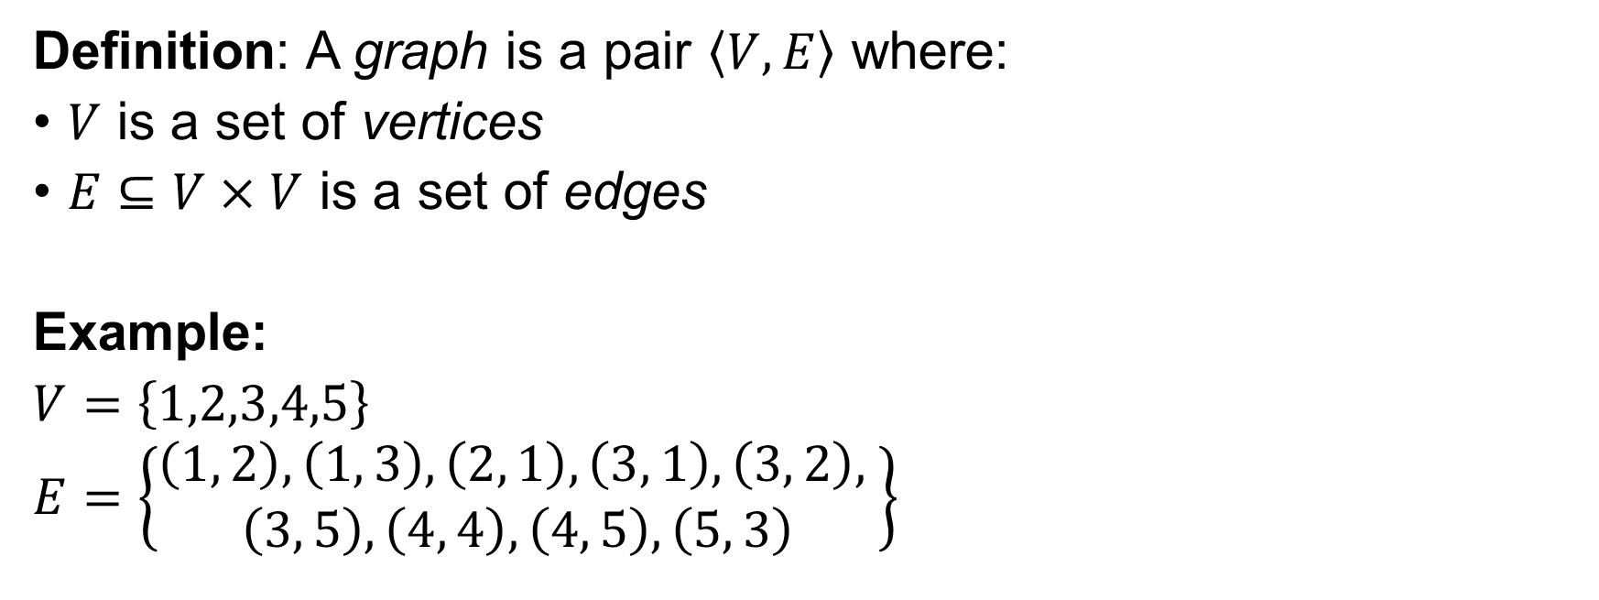
Graph (recap)
Definition: A graph is a pair $\left\langle V, E\right\rangle$ where:
$V$ is a set of vertices
$E⊆V×V$ is a set of edges
Example:
$V=\left\{1,2,3,4,5\right\}$
$E=\left\{\begin{aligned}\left(1, 2\right), \left(1, 3\right), \left(2, 1\right), \left(3, 1\right), \left(3, 2\right), \\ \left(3, 5\right), \left(4, 4\right), \left(4, 5\right), \left(5, 3\right)\end{aligned}\right\}$
2
1
3
4
5

Slide 4



Subgraph
Definition: Let $H=\left\langle V, E\right\rangle$ be a graph. We say $G=\left\langle V′, E′\right\rangle$ is a subgraph of $H$ if and only if $G$ is a graph, $V^{′}⊆V$, and $E^{′}⊆E$.
$$G$$
$$H$$
2
2
1
1
3
3
5
5
4

Slide 5

Spanning Subgraph
Definition: Let $H=\left\langle V, E\right\rangle$ be a graph. We say $G=\left\langle V′, E′\right\rangle$ is a spanning subgraph of $H$ if and only if $G$ is a subgraph of $H$ and $V^{′}=V$.
$$G$$
$$H$$
2
2
1
1
3
3
5
4
5
4

Slide 6
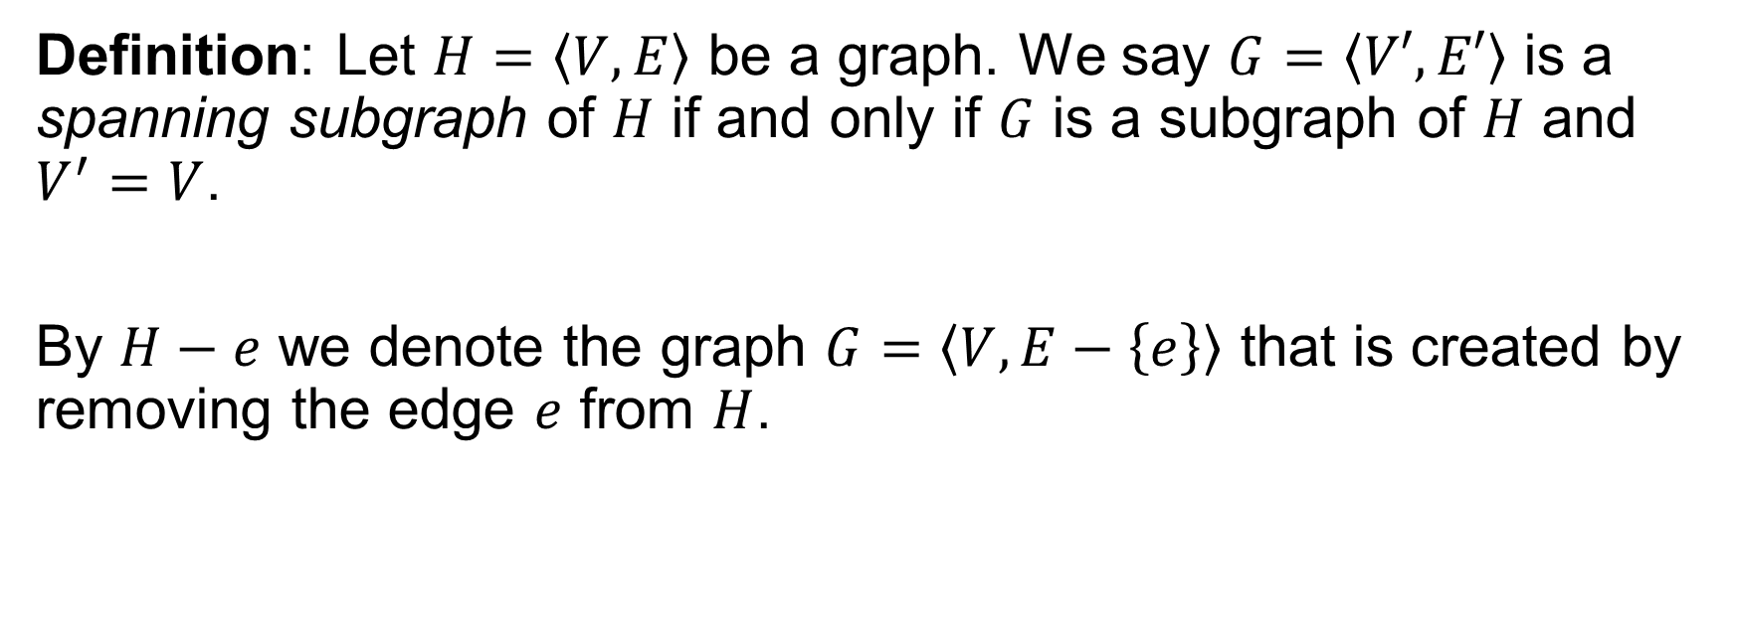
Spanning Subgraph
Definition: Let $H=\left\langle V, E\right\rangle$ be a graph. We say $G=\left\langle V′, E′\right\rangle$ is a spanning subgraph of $H$ if and only if $G$ is a subgraph of $H$ and $V^{′}=V$.
By $H−e$ we denote the graph $G=\left\langle V, E−\left\{e\right\}\right\rangle$ that is created by removing the edge $e$ from $H$.

Slide 7

Induced Subgraph
Definition: Let $H=\left\langle V, E\right\rangle$ be a graph. We say $G=\left\langle V′, E′\right\rangle$ is an induced subgraph of $H$ if and only if $G$ is a subgraph of $H$, $V^{′}⊆V$, and $E^{′}=\left\{\left(u, v\right)∈E :u∈V^{′}∧v∈V^{′}\right\}$.
$$G$$
$$H$$
2
2
1
1
3
3
4
5
4

Slide 8
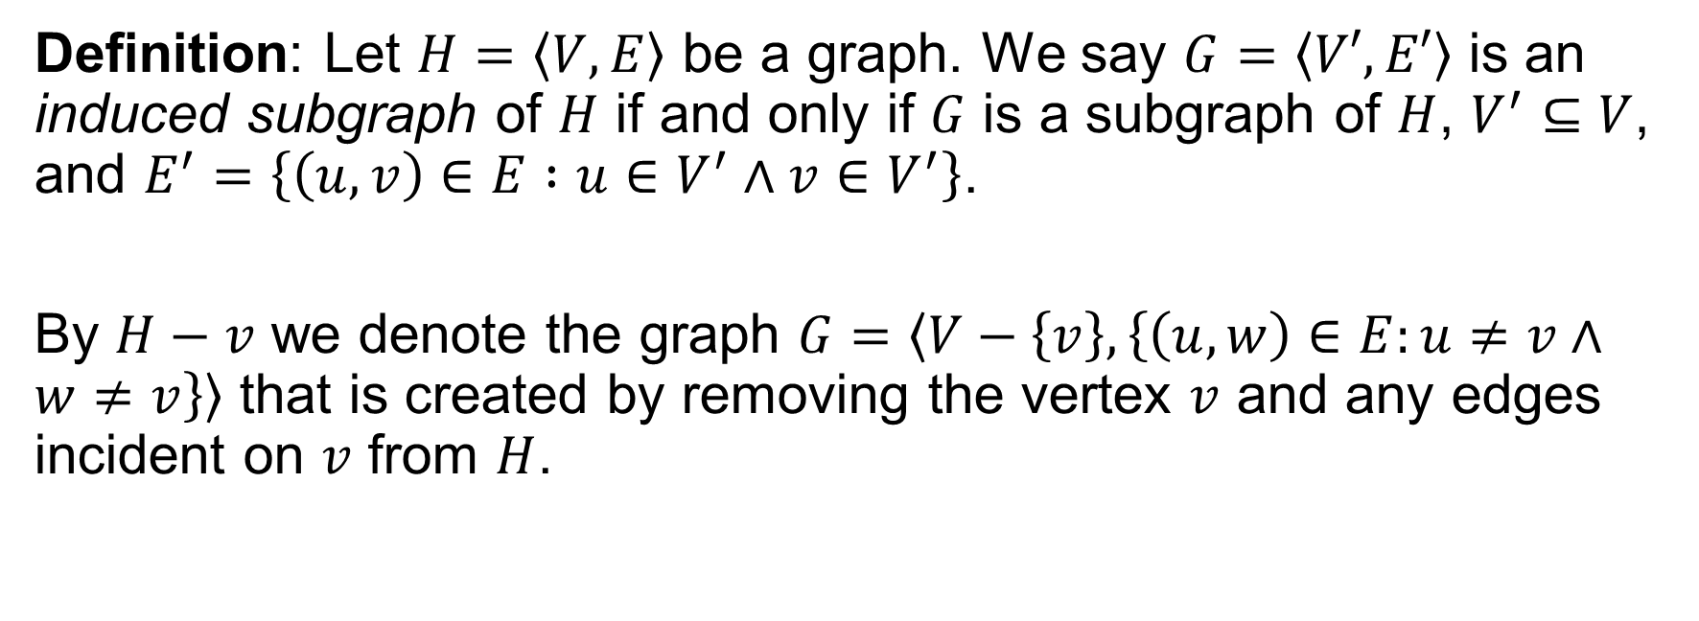
Induced Subgraph
Definition: Let $H=\left\langle V, E\right\rangle$ be a graph. We say $G=\left\langle V′, E′\right\rangle$ is an induced subgraph of $H$ if and only if $G$ is a subgraph of $H$, $V^{′}⊆V$, and $E^{′}=\left\{\left(u, v\right)∈E :u∈V^{′}∧v∈V^{′}\right\}$.
By $H−v$ we denote the graph $G=\left\langle V−\left\{v\right\}, \left\{\left(u,w\right)∈E:u≠v∧w≠v\right\}\right\rangle$ that is created by removing the vertex $v$ and any edges incident on $v$ from $H$.

Slide 9

Clique
Definition: Let $G=\left\langle V, E\right\rangle$ be a graph. We say $S⊆V$ is a clique of $G$ if and only if for all $u≠v∈S$ we have $\left(u,v\right)∈E$.
2
2
1
1
3
3
5
4

Slide 10

Independent Set
Definition: Let $G=\left\langle V, E\right\rangle$ be a graph. We say $I⊆V$ is an independent set of $G$ if and only if for all $u≠v∈I$ we have $\left(u,v\right)∉E$.
2
1
1
3
5
5
4

Slide 11


Complement
Definition: Let $G=\left\langle V, E\right\rangle$ be a graph. We use $\overline{G}=\left\langle V, E′\right\rangle$ to denote the complement of $G$ where $E^{′}=V×V−E$.
$$G$$
$$\overline{G}$$
Note: for simple graphs,
self loops are ignored
2
2
1
1
3
3
5
4
5
4

Slide 12

Cliques and Independent Sets
Theorem: Let $G$ be a graph. $S$ is a clique of $G$ if and only if $S$ is an independent set of $\overline{G}$.
$$G$$
$$\overline{G}$$
2
2
2
2
1
1
1
1
3
3
3
3
5
4
5
4

Slide 13
Group Exercises
Form groups of 3-4

