Slide 1
Relations February 13, 2026
CSCI 246: Discrete Structures
Textbook Reference: Ch 3. Sec 14

Slide 2
Agenda
Lecture (~ 10 minutes)
Group Exercise (~40 minutes)

Slide 3


Relation
Definition: A relation $R$ is a set of ordered pairs.
$$R≝\left\{\left(0,1\right),\left(0,2\right),(3,4)\right\}$$
$$\left(0, 1\right)∈R \left(0,2\right)∈R \left(3,4\right)∈R \left(4,5\right)∉R$$
$$0 R 1 0 R 2 3 R 4 4 R 5$$
0 is related to 1 by R
4 is not related to 5 by R

Slide 4
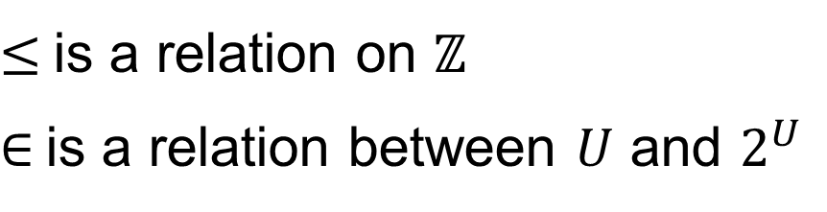

Relation On / Relation Between
Definition: Let $A$ and $B$ be sets. We say $R$ is a relation on $A$ if and only if $R⊆A×A$. We say $R$ is a relation between $A$ and $B$ if and only if $R⊆A×B$.
$≤$ is a relation on $ℤ$
$∈$ is a relation between $U$ and $2^{U}$

Slide 5
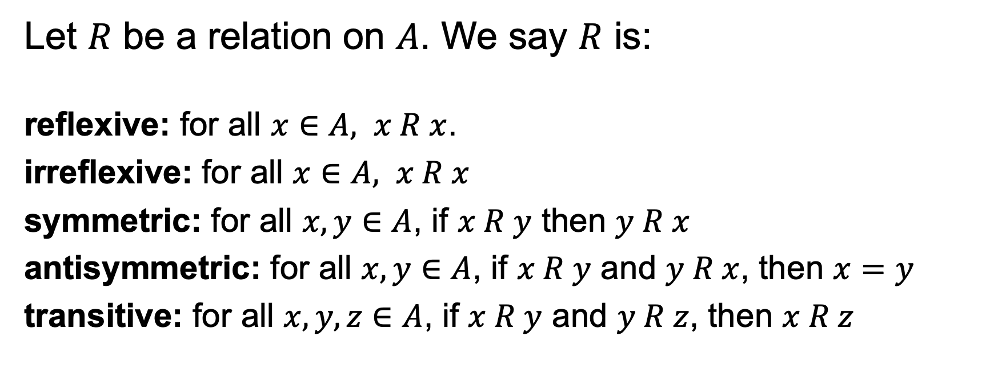
Properties of Relations
Let $R$ be a relation on $A$. We say $R$ is:
reflexive: for all $x∈A, x R x$.
irreflexive: for all $x∈A, x R x$
symmetric: for all $x, y∈A$, if $x R y$ then $y R x$
antisymmetric: for all $x, y∈A$, if $x R y$ and $y R x$, then $x=y$
transitive: for all $x,y,z∈A$, if $x R y$ and $y R z$, then $x R z$

Slide 6

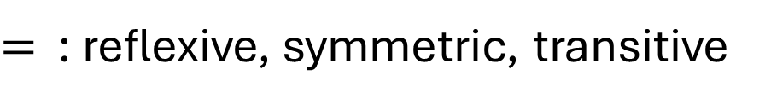

Properties of Relations
$=$ : reflexive, symmetric, transitive
$≤,≥$ : reflexive, antisymmetric, transitive
$<,>$ : irreflexive, antisymmetric, transitive

Slide 7

Inverse Relation
Definition: Let $R⊆A×B$ be a relation. The inverse relation of $R$ is the relation $R^{−1}⊆B×A≝\left\{\left(x, y\right):y R x\right\}$
$$R=\left\{\left(0,a\right),\left(1,b\right),\left(3,c\right),\left(4,d\right)\right\}$$
$$R^{−1}=\left\{\left(a,0\right),\left(b,1\right),\left(c,3\right),\left(d,4\right)\right\}$$

Slide 8


Relational Composition
Definition: Let $R⊆A×B$ be a relation between $A$ and $B$, and $S⊆B×C$ be a relation between $B$ and $C$. The composition of $R$ and $S$ is the relation $R∘Q⊆A×C≝\left\{\left(x,z\right):∃y∈B. x R y∧y S z\right\}$.
$$R=\left\{\left(0,a\right),\left(1,b\right),\left(3,c\right),\left(4,d\right)\right\}$$
$$S=\left\{\left(a,α\right),\left(b,σ\right),\left(c,β\right)\right\}$$
$$R∘S=\left\{\left(0,α \right),\left(1,σ\right),\left(3,β\right)\right\}$$

Slide 9
Group Exercises
Form groups of 3-4

