Slide 1
Algorithmic Analysis I March 11, 2026
CSCI 246: Discrete Structures
Textbook Reference: Ch. 11, Sec. 3 (Epps)

Slide 2
Agenda
Lecture (~ 15 minutes)
Assignment 4 Due
Group Exercise (~35 minutes)

Slide 3
Runtime Analysis
The goal of runtime analysis of algorithms is to determine how long an algorithm operates in terms of the number of elementary operations performed.
Elementary operations: comparison, addition, subtraction, multiplication, etc. (operations that take constant time)
We express runtime complexity as a function of the input size.

Slide 4





Sequential Search
$$a\left[1\right]=x?$$
no
$$a\left[2\right]=x?$$
no
$$a\left[3\right]=x?$$
no
$$a\left[4\right]=x?$$
no
$$a\left[5\right]=x?$$
yes
Done
How many comparisons will the algorithm perform?

Slide 5





Best Case Analysis
$$…$$
$$a\left[1\right]=x?$$
$$a\left[2\right]=x?$$
$$a\left[3\right]=x?$$
$$a\left[n\right]=x?$$
yes
Done
Best case: $x$ is in the first position of the array
search algorithm does a single comparison
$$f\left(n\right)=1$$
Algorithm takes constant time in the best case
$$f\left(n\right) is Θ(1)$$

Slide 6

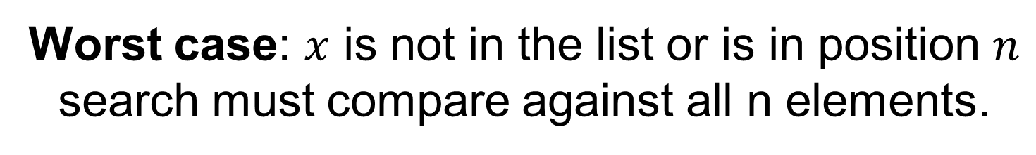

Worst Case Analysis
$$…$$
$$a\left[1\right]=x?$$
no
$$a\left[2\right]=x?$$
no
$$a\left[3\right]=x?$$
no
no
$$a\left[n\right]=x?$$
yes
Done
Worst case: $x$ is not in the list or is in position $n$
search must compare against all n elements.
$$f\left(n\right)=n$$
Algorithm takes linear time in the worst case
$$f\left(n\right) is Θ(n)$$

Slide 7
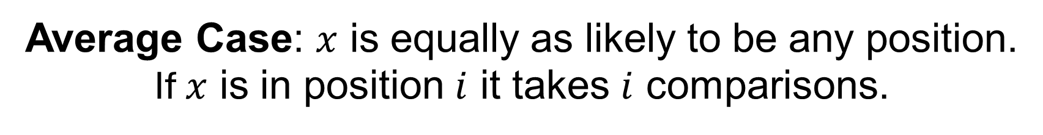

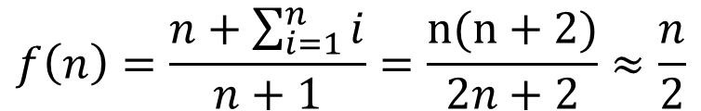
Average Case Analysis
$$…$$
$$a\left[1\right]=x?$$
$$a\left[2\right]=x?$$
$$a\left[3\right]=x?$$
$$a\left[n\right]=x?$$
Average Case: $x$ is equally as likely to be any position.
If $x$ is in position $i$ it takes $i$ comparisons.
$$f\left(n\right)=\frac{n+\sum_{i=1}^{n}{i}}{n+1}=\frac{n(n+2)}{2n+2}≈\frac{n}{2}$$
Algorithm takes linear time in the average case
$$f\left(n\right) is Θ(n)$$

Slide 8
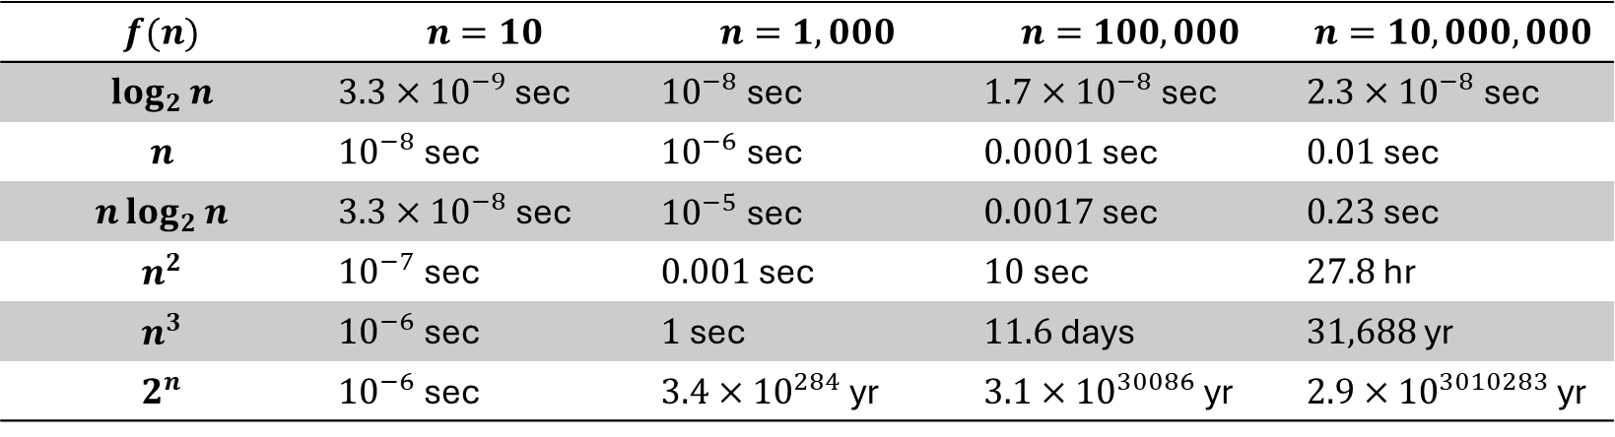
Execution Time of Operations
$$f(n)$$ | $$n=10$$ | $$n=1,000$$ | $$n=100,000$$ | $$n=10,000,000$$
$$\log_{2}{n}$$ | $3.3×{10}^{−9}$ sec | ${10}^{−8}$ sec | $1.7×{10}^{−8}$ sec | $2.3×{10}^{−8}$ sec
$$n$$ | ${10}^{−8}$ sec | ${10}^{−6}$ sec | $0.0001$ sec | $0.01$ sec
$$n\log_{2}{n}$$ | $3.3×{10}^{−8}$ sec | ${10}^{−5}$ sec | $0.0017$ sec | $0.23$ sec
$$n^{2}$$ | ${10}^{−7}$ sec | $0.001$ sec | $10$ sec | $27.8$ hr
$$n^{3}$$ | ${10}^{−6}$ sec | $1$ sec | $11.6$ days | $31,688$ yr
$$2^{n}$$ | ${10}^{−6}$ sec | $3.4×{10}^{284}$ yr | $3.1×{10}^{30086}$ yr | $2.9×{10}^{3010283}$ yr
Time to execute $f(n)$ operations if each operation takes $1$ns.

Slide 9
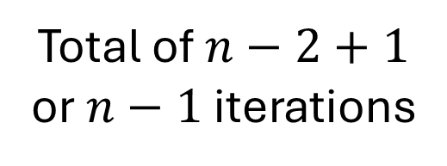
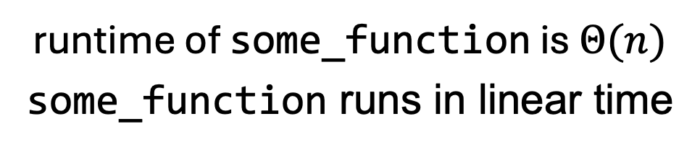
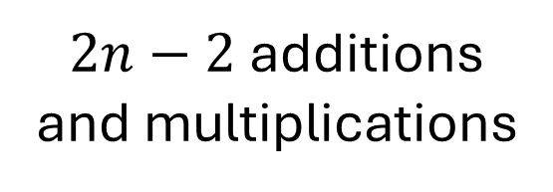
Runtime Analysis of Loops
How many additions and multiplications does this function perform?
def some_function(n):
p := 0, x := 2
for i := 2 to n
p := (p + i)*x
next i
Total of $n−2+1$
or $n−1$ iterations
$2n−2$ additions
and multiplications
2 per iteration
runtime of some_function is $Θ(n)$
some_function runs in linear time

Slide 10
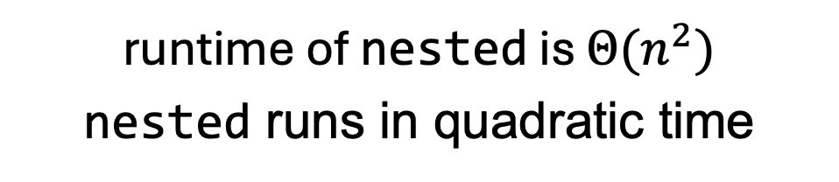
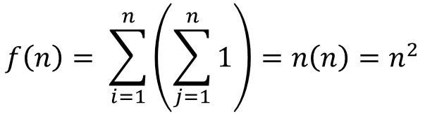
Runtime Analysis of Nested Loops
How many additions does nested perform?
def nested(n):
s := 0
for i := 1 to n
for j := 1 to n
s := s + 1
next j
next i
n iterations
n iterations per outer iteration
$$f\left(n\right)= \sum_{i=1}^{n}{\left(\sum_{j=1}^{n}{1}\right)=n\left(n\right)=n^{2}}$$
once per inner iteration
runtime of nested is $Θ(n^{2})$
nested runs in quadratic time

Slide 11
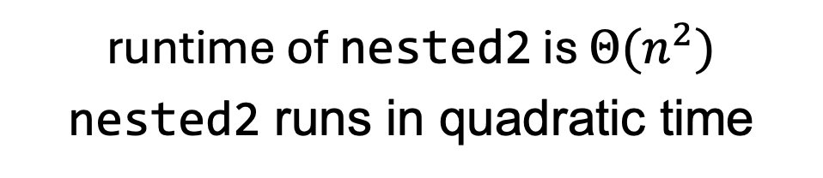
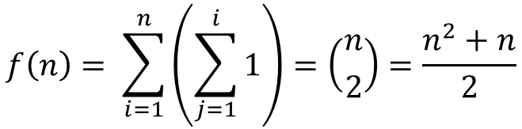
Runtime Analysis of Nested Loops
How many additions does nested2 perform?
def nested2(n):
s := 0
for i := 1 to n
for j := 1 to i
s := s + 1
next j
next i
n iterations
i iterations for ith outer iteration
$$f\left(n\right)= \sum_{i=1}^{n}{\left(\sum_{j=1}^{i}{1}\right)=\left({n \atop 2}\right)}=\frac{n^{2}+n}{2}$$
once per inner iteration
runtime of nested2 is $Θ(n^{2})$
nested2 runs in quadratic time

Slide 12
Group Exercises
Form groups of 3-4

