Slide 1
Graph Coloring April 15, 2026
CSCI 246: Discrete Structures
Textbook Reference: Ch. 9, Sec. 52

Slide 2
Agenda
Lecture (~ 10 minutes)
Assignment 6: Due Friday
Group Exercise (~40 minutes)

Slide 3
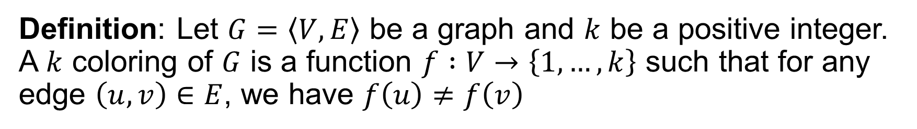




Coloring
Definition: Let $G=\left\langle V,E\right\rangle$ be a graph and $k$ be a positive integer. A $k$ coloring of $G$ is a function $f :V→\left\{1,…,k\right\}$ such that for any edge $\left(u, v\right)∈E$, we have $f\left(u\right)≠f\left(v\right)$
2
6
8
$$1,4,5 → 1$$
4
$$2,3,7 → 2$$
1
7
$$6,9 → 3$$
3
9
$$8→ 4$$
5

Slide 4
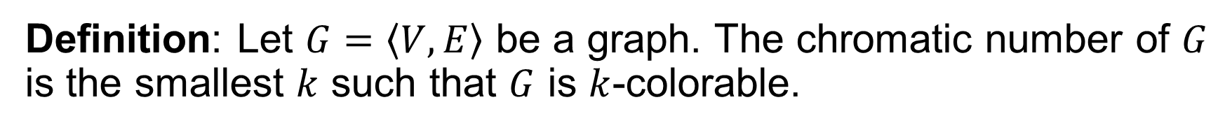
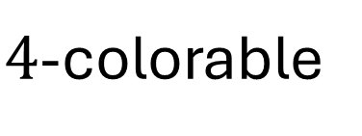
Chromatic Number
Definition: Let $G=\left\langle V,E\right\rangle$ be a graph. The chromatic number of $G$ is the smallest $k$ such that $G$ is $k$-colorable.
2
6
8
$4$-colorable
4
1
7
3
9
5

Slide 5
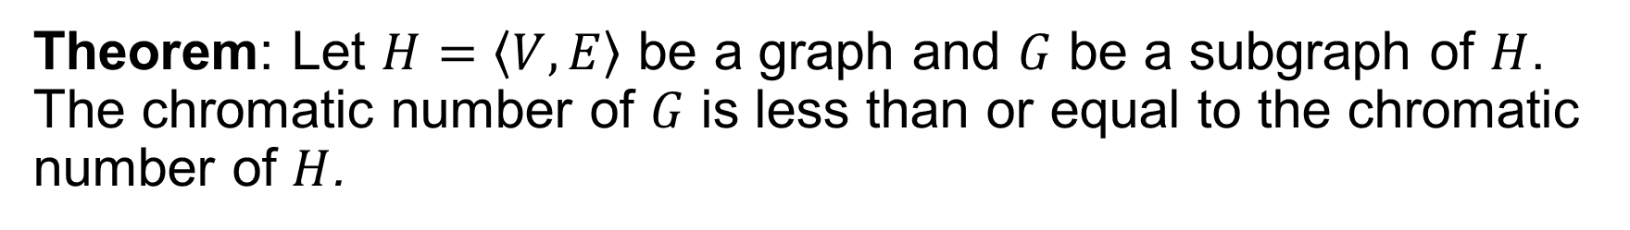
Chromatic Number and Subgraphs
Theorem: Let $H=\left\langle V,E\right\rangle$ be a graph and $G$ be a subgraph of $H$. The chromatic number of $G$ is less than or equal to the chromatic number of $H$.

Slide 6
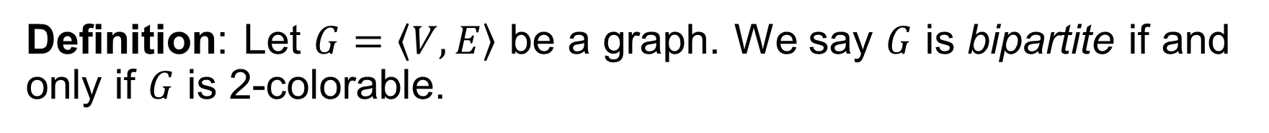
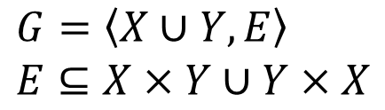


Bipartite Graph
Definition: Let $G=\left\langle V,E\right\rangle$ be a graph. We say $G$ is bipartite if and only if $G$ is 2-colorable.
$$Y$$
$$X$$
a
1
b
$G=\left\langle X∪Y,E\right\rangle$
$E⊆X×Y∪Y×X$
2
c
3
d
4
e

Slide 7
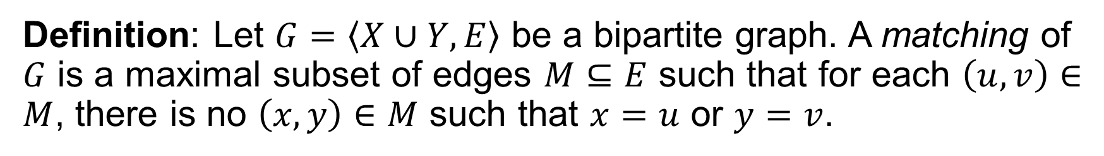


Matching
Definition: Let $G=\left\langle X∪Y,E\right\rangle$ be a bipartite graph. A matching of $G$ is a maximal subset of edges $M⊆E$ such that for each $\left(u, v\right)∈M$, there is no $\left(x, y\right)∈M$ such that $x=u$ or $y=v$.
$$Y$$
$$X$$
a
1
b
2
c
3
d

Slide 8
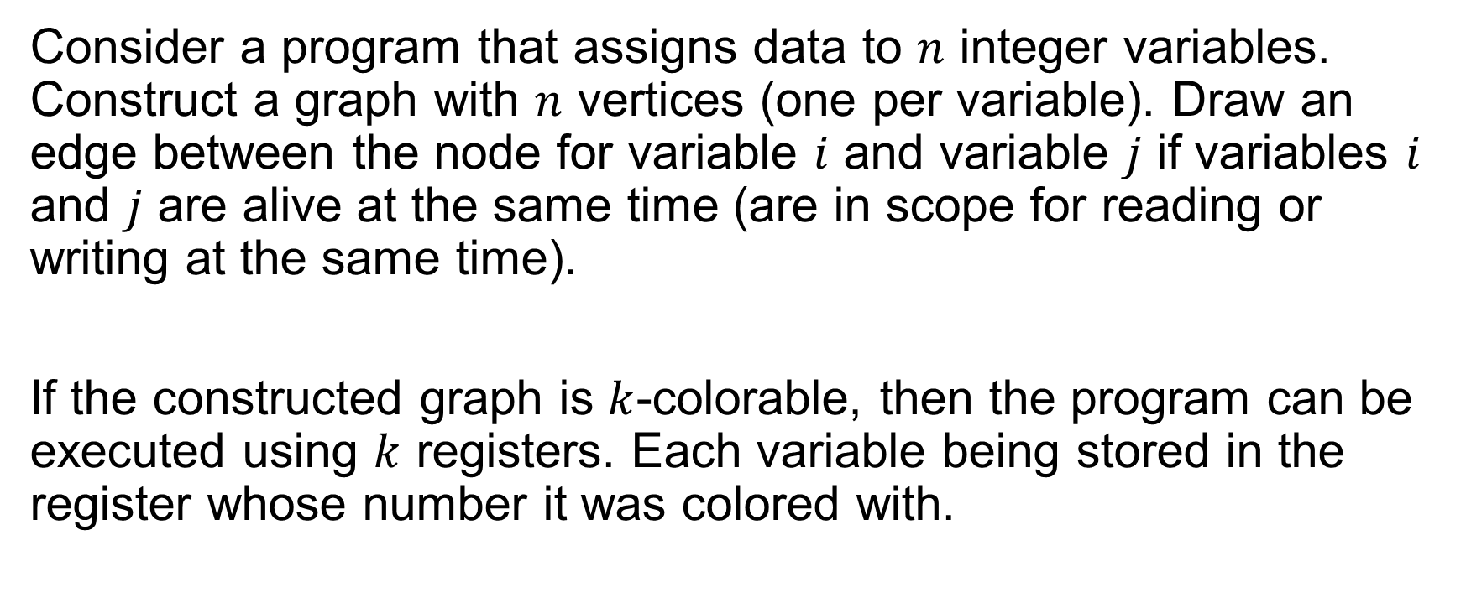
Register Allocation
Consider a program that assigns data to $n$ integer variables. Construct a graph with $n$ vertices (one per variable). Draw an edge between the node for variable $i$ and variable $j$ if variables $i$ and $j$ are alive at the same time (are in scope for reading or writing at the same time).
If the constructed graph is $k$-colorable, then the program can be executed using $k$ registers. Each variable being stored in the register whose number it was colored with.

Slide 9
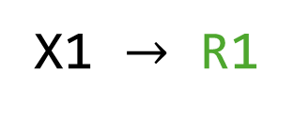
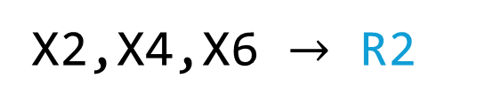
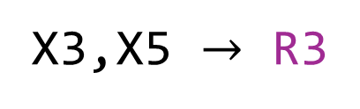
Register Allocation
func main() {
Var x1;
if … {
Var x2, x3;
} else {
Var x4, x5;
}
Var x6;
}
4
2
X1 $→$ R1
1
X2,X4,X6 $→$ R2
5
3
X3,X5 $→$ R3
6

Slide 10
Matching Applications
Match workers to open job positions, items to consumers, etc.
Image matching (matching keypoints to keypoints)
Useful for scheduling tasks on virtual machines in cloud services

Slide 11
Group Exercises
Form groups of 3-4

