Slide 1
Geographic Map System
Introduction:
What : Geographic Map System (GMS)
Why : Study/implement 2 main components of Geographic Information Systems (GIS)
How : Develop a series of utilities, written in C++, to access a database of raw geographic data
Tim MacAndrew
Spring 2000
Committee:
CT Lin
M. Barnes
D. Salomon
Notes:
Hello, Welcome,
I’ll be presenting an overview of my MS project
My committee is:
Dr. CT Lin
Dr. Barnes
Dr. Salomon (chair)
My name is …
What:
I’ve developed 2 software toolkits
1) One is used to access a database of raw geographic information
2) The second is used to manipulate the data for graphical presentation
Why:
For a while I’ve been interested in the architecture and implementation of GIS

Slide 2
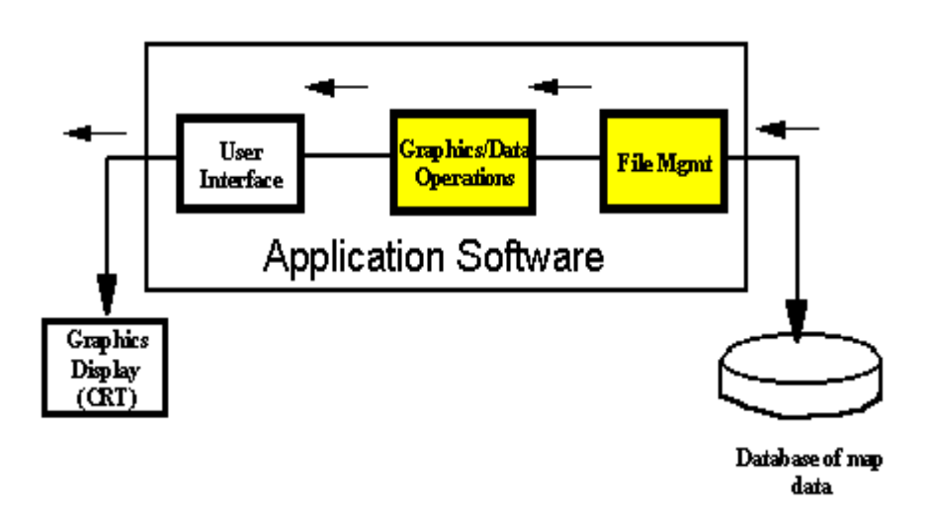
Geographic Map System
Geographic Information Systems:
Software systems that:
  visually present geographic information.
  perform geographic-based calculations.
Basic GIS Architecture
Examples of Use:
Planning for civil engineering projects
Air Traffic Control Systems
Mission planning for military
Examples of GIS Products:
MCG & I Display System (MDS) (Sanders Corp. of Lockheed-Martin)
Terrain Evaluation Module (TEM) (Mitre Corp)
InterMAPhics (Gallium Software Inc)
Mapping Applications Client Server (Sterling Software)
Notes:
Geographic Information Systems:
That’s the short definition
GIS’s can be quite complex and sophisticated
Examples of Use:
Also, Line-of-Sight calculations between
antenna on mountain tops
Basic GIS Architecture:
Most of my experience has been in the 3rd component.
The 1st and 2nd were usually purchased as COTS
An API is presented at component 2, but the implementation
was always hidden. Also, access to the first component was
not allowed … for proprietary reasons
Examples of GIS Products:
Worked with first two, smaller degree with the other two

Slide 3
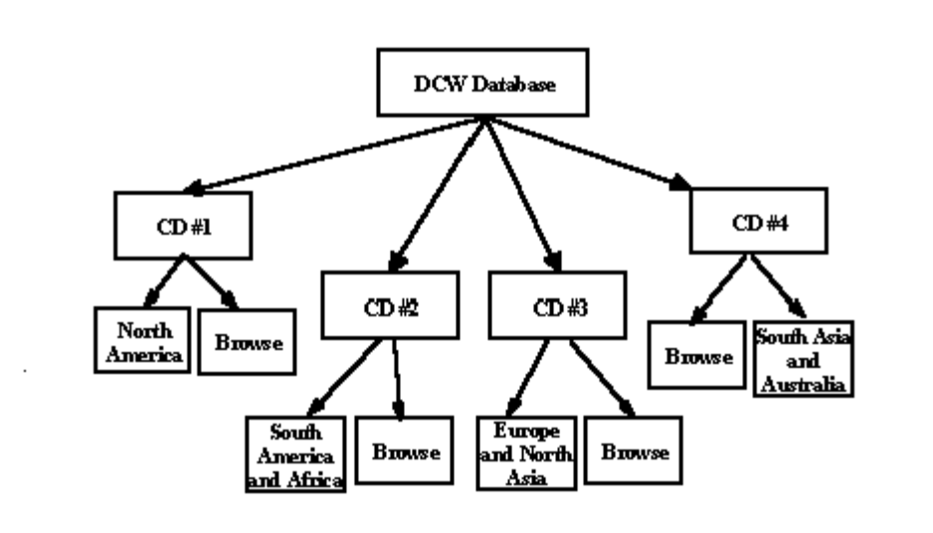
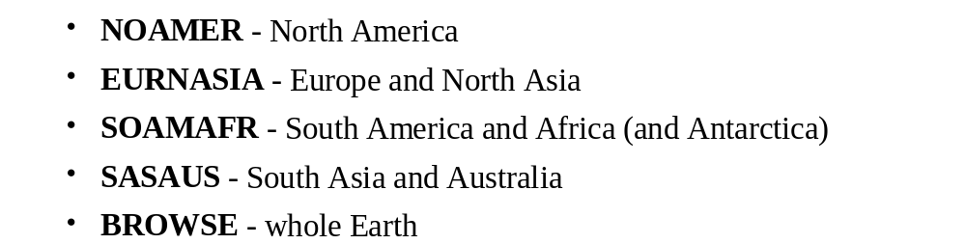
Geographic Map System
The Digital Chart of the World (DCW) Database:
4 CD-ROMs (1600 Mbytes)
17 Themes
From NIMA (via US Geological Survey)
Vector Product Format
Libraries:
Notes:
Chose the DCW database … one of many
Scanned maps … ADRG series
3D systems … DTED
Theme ==> kinds of geographic data (e.g. geo/political borders, population centers, inland bodies of water, etc)
Vector Product Format ==> a formal government standard in which geographic data is stored as arrays (I.e. vectors) of [lat, lon] tuples.
Libraries
NORAMER = CD1
EURNASIA = CD2, etc
BROWSE = whole earth, duplicated on each CD

Slide 4
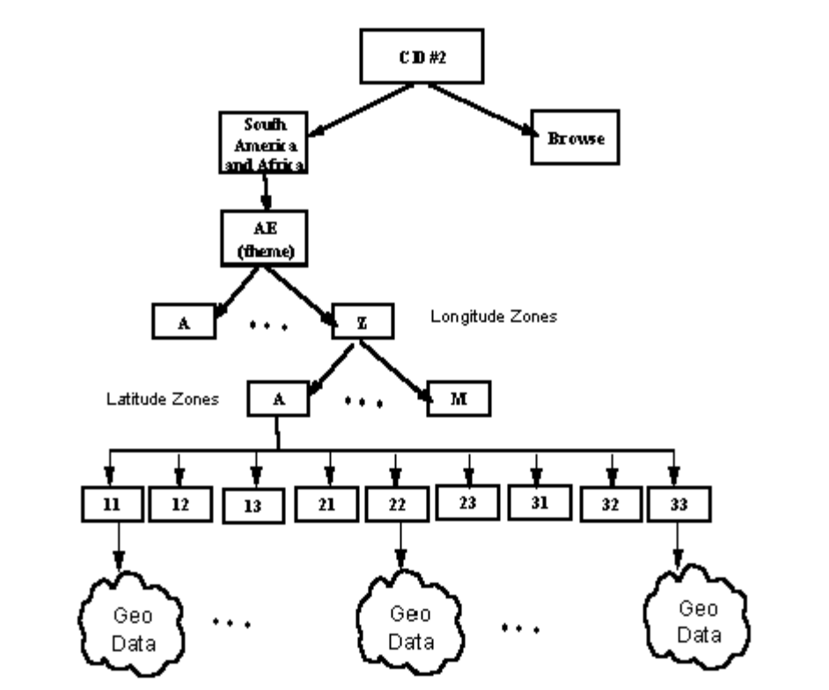
Geographic Map System
Library Architecture:
Kinds of DCW Files:
Based on “Geographic Reference System” (GEOREF)
Primitive Tables:
Edge
Node
Face
Text
Coverage Tables:
Value Description Tables
Feature Tables (Area, Point, Line, Text)
Other Tables:
Query Tables
Feature Class Schema Tables
Narrative Tables
Notes:
GEOREF is: 1) earth is flat 2) it’s divided into 15 x 15 degree tiles
Longitude A .. Z (skipping I and O) Latitude A .. M (skipping I)
3) Each tile is further sub-divided into 5 x 5 degree subtiles
When talking about a particular region, you say LG31, for example
*** Draw sub-tile scheme on board (if there is one) ***
AE ==> Aeronautical - data on airports
_____________________________________________________
Edge ==> vectors of lat/long Node ==> points (towns, cities)
Face ==> regions within a subtile
Text ==> annotations to geographic entities (e.g. “Pacific Ocean”)
VDT ==> general description of geographic entities (e.g. oil rigs)
Feature Tables ==> relation/join tables connecting primitives to VDTs
*** Draw schema diagram ***
FCS ==> defines how tables are related in a particular theme
_______________________________________________________
For those who are RDBMS people … I’m no RDBMS expert. DCW is not a real RDBMS in the pure definition … rather it’s a database that contains files of relational information.

Slide 5
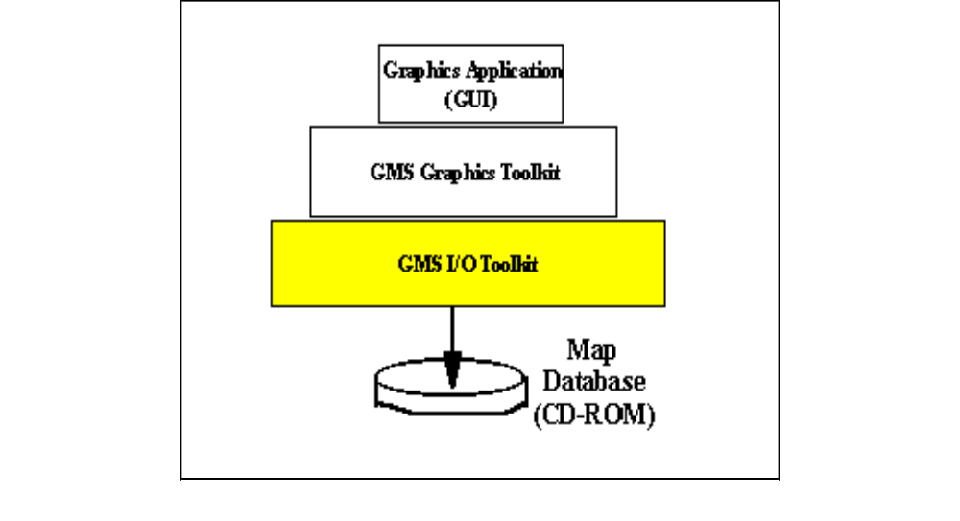
Geographic Map System
GMS Toolkits:
Extabula Toolkit
A series of utilities to open/read the files of the DCW database.
DCW Graphics Toolkit
A series of utilities to manipulate the DCW data for graphical presentation.
Requirements:
ANSI C/C++
Portable - any platform with Std C/C++ libs (NT, Windows 9X, UNIX)
Client uses any raster based graphics system
Notes:
Extabula
1) Written in C
2) There’s a software component for each “type” of table from DCW
3) Open, read, free.
4) The details of building the data structure are hidden from the caller
DCW Graphics
1) Written in C++
2) Allows the caller to convert the geographic data into a form that can be projected as an image … I.e. to help render a map
A client can develop applications using the DCW Graphics Toolkit only, or develop more powerful apps using both toolkits

Slide 6
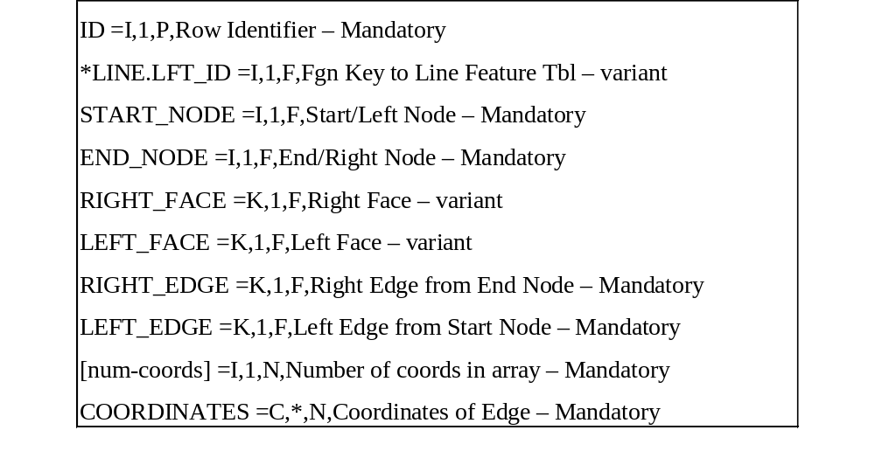
Geographic Map System
GMS Extabula Toolkit:
Example : Format of “Edge Record”:
Name of Line-Feature-Table
“Relational Data” used to connect edge tables, order start/end nodes, etc.
Array of n coordinate tuples (lat/long)
Notes:
1) This slide shows the “format” of edge records from the DCW database.
2) An “edge table” is a file with N edge-records in it.
3) There are several “kinds” of edge records … depending on the theme.
4) Each “edge-record” contains an array of M coordinates
5) Thus, an edge record is both a variant record (some attributes are present, some are not) and a variant-length record.

Slide 7
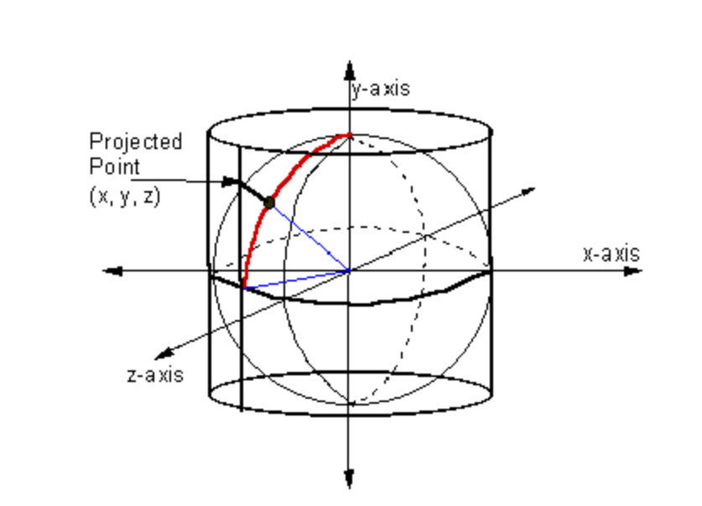
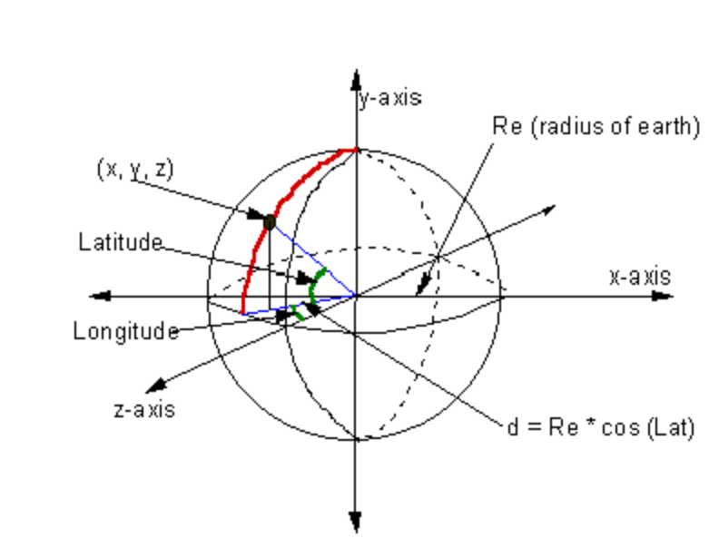
Geographic Map System
GMS DCW Graphics Toolkit:
Mercator (Cylindrical) Model
x = longitude * (Π * Re / 180)
y = Re * sin(latitude)
Spherical Model
x = Re * cos(PHI) * sin(LAMBDA)
y = Re * sin(PHI)
z = Re * cos(PHI) * cos(LAMBDA)
where:
Re is the radius of the earth
PHI is latitude
LAMBDA is longitude.
Notes:
1) DCW gives geographic points as tuples of [lat, lon], called geodetic coordinates.
2)However, it’s easier to do graphics operations using Cartesian coordinates (x,y, z).
3) Thus, use an earth-model to convert between coordinate systems.
Thus, chose 3 earth models: flat, spherical, ellipsoid
___________________________________________________________
Mercator Projection:
Sphere in a cylinder. Accurate at equator, but at poles, the projection is infinite. Set the limits to be -R .. R. Then, take the sine of the geodetic latitude and that is how much of R is used to define the y value
Disadvantage ==> distortion at the poles. Antarctica is severely distorted. Regions above/below 70 degrees are considered inaccurate.
____________________________________________________________
Spherical Model:
Good model. More accurate than Cylindrical projection. For more accurate image, use the ellipsoid mode … cause that’s a better approximation to the shape of the earth.

Slide 8
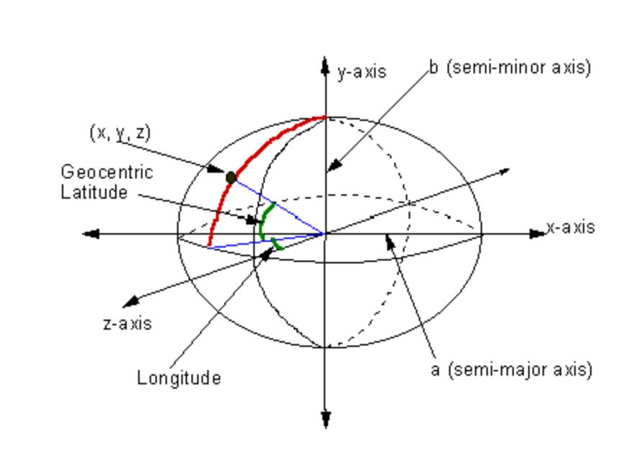
Geographic Map System
Ellipsoid Model
x = (N + h) * cos(PHI) * sin(LAMBDA)
y = ( (b²/a²) * N + h) * sin(PHI)
z = (N + h) * cos(PHI) * cos(LAMBDA)
where:
PHI = geodetic latitude LAMBDA = geodetic longitude h = altitude a = semi-major axis = 6378137.0 meters b = semi-minor axis = 6356752.0 meters N = a / sqrt( 1 - e² * sin²(PHI) ) e = first eccentricity = sqrt(2 * f - f²) f = earth-flattening = (a - b) / a
Mil-Std 2401 Department of Defense World Geodetic System, National Imagery and Mapping Agency, 8613 Lee Highway, Fairfax, VA, 22031-2137, 11-Jan-94 (http://www.nima.mil/publications/specs/printed/wgs84/wgs84.html)
Notes:
The previous 2 models are relatively easy to derive yourself.
I tried to derive the conversion utilities but couldn’t get solution.
Had to use equations from WGS-84 document
Analogy is there to spherical model. The R value from the spherical model becomes a function of R, semi-major/minor axes, latitude, etc.
x : R ==> N + h
y : R ==> (…)
z : R ==> N + h

Slide 9
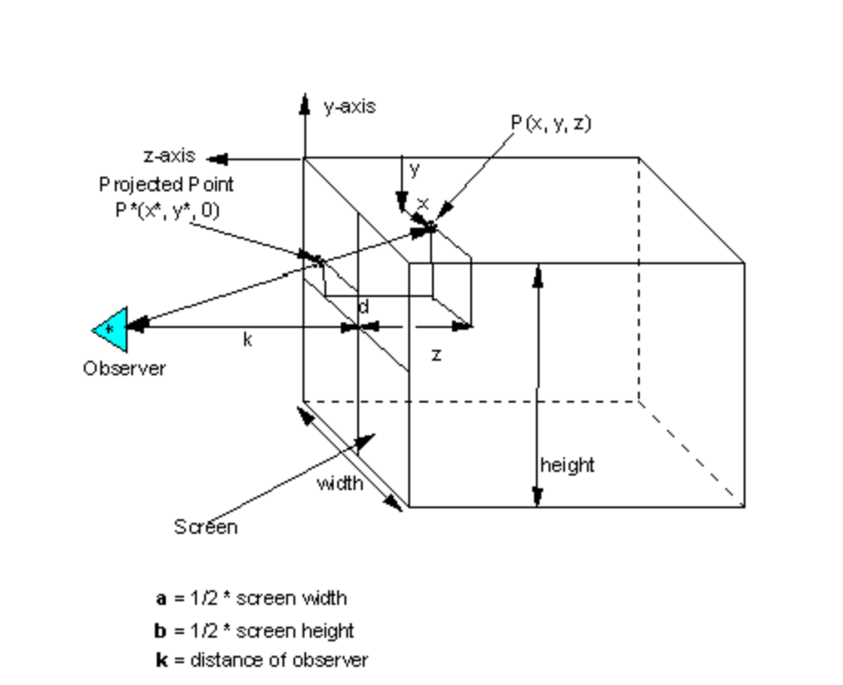
Geographic Map System
Screen Projection(3D to 2D):
    a z + k x
    x* = ------------
    k + z
    b z + k y
    y* = ------------
    k + z
Notes:
Once you have the (x,y,z) coordinates, use screen-projection algorithm to project 3D image onto screen
… if you’ve taken CS465, you’ve seen this before.

Slide 10
Geographic Map System
Conclusions:
1) The GMS offers a set of software utilities that can be used in the construction of Geographic Information Systems (using the DCW database).
2) Two Toolkits
    Extabula Toolkit - access the DCW database
    DCW Graphics Toolkit - to support 2D and 3D rendering
3) Portable
    Written in C/C++.
    Can be used with any raster-based graphics system.
    Depends only on ANSI C/C++ libraries.
    Tested on NT, Windows 9X, HP UNIX, SUN UNIX
… and when Alexander saw the breadth of his domain, he wept, for there were no more worlds to conquer.
Notes:
Demo :
1) GEOREF (Tile-ref)
2) flat-browse
3) ellipsoid browse
4) soamafr
Questions:
Thank you - C-ya!

