Slide 1
Risk
The Fighting Mongooses
Dylan Hall
Trevor Mack

Slide 2
Description of Risk
2 or more players, turn-based board game
World map divided into territories
Each territory has an army
Players use armies to attempt to capture enemy territories
Winner is the last player standing

Slide 3
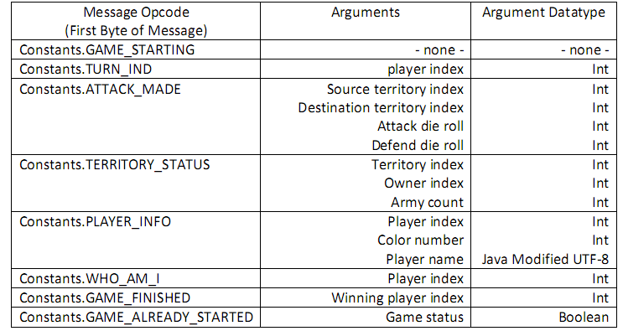
Server → Client Messages

Slide 4
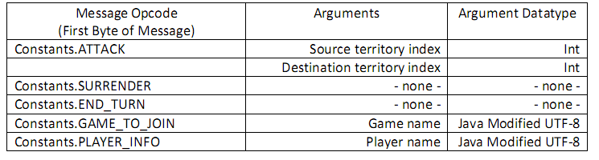
Client → Server Messages

Slide 5
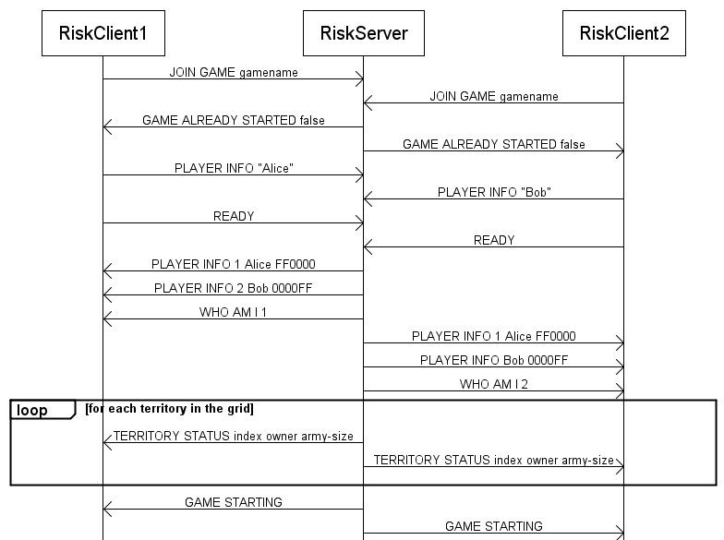

Slide 6
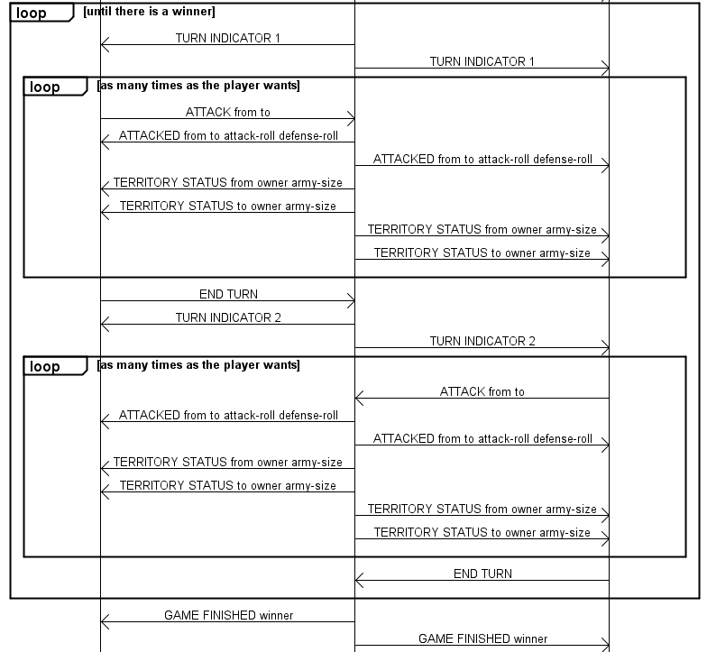

Slide 7
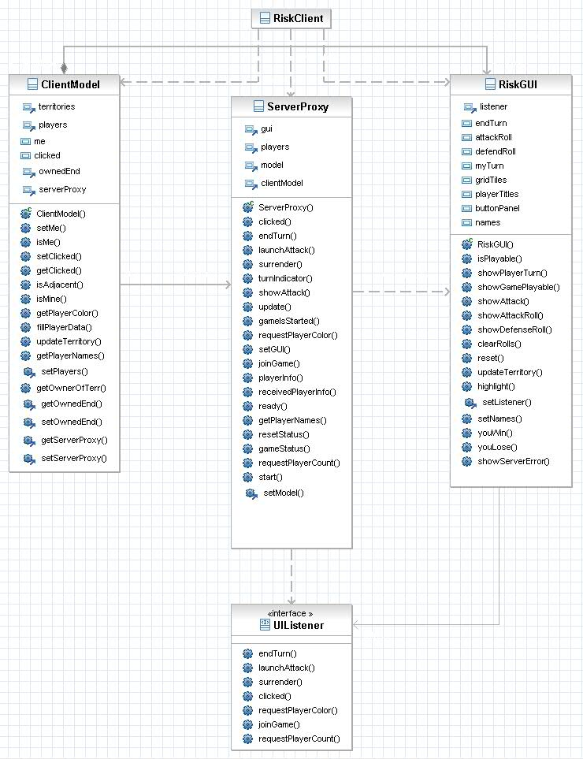

Slide 8
