Slide 1
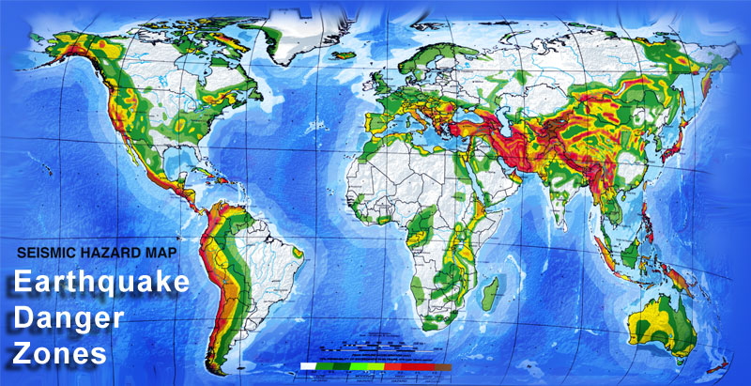
Assignment 5
Tanushree Mahadani

Slide 2
Agenda
Introduction
Data Analysis
Conclusion

Slide 3
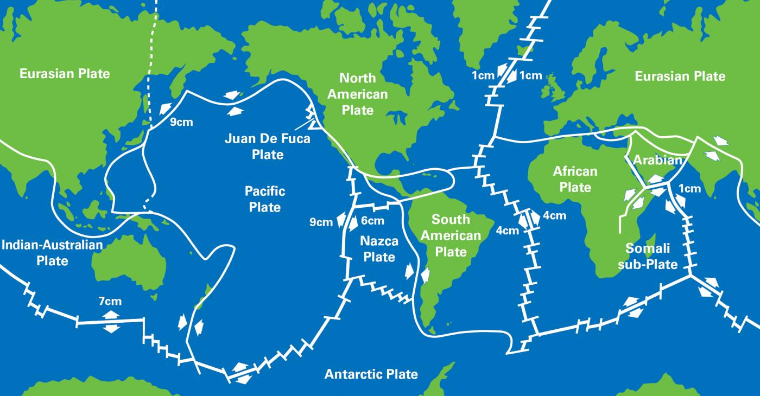
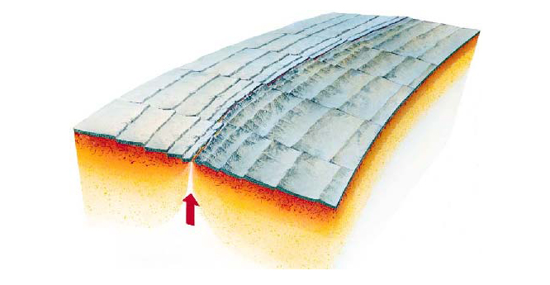
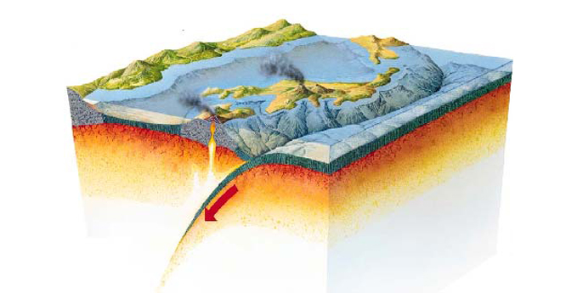
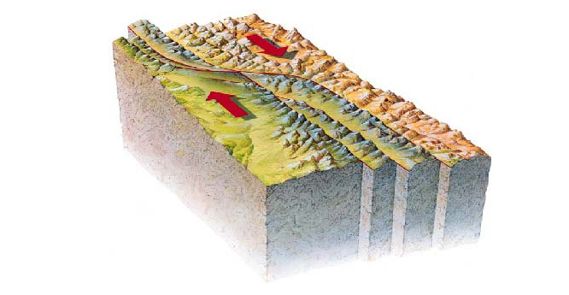
Introduction
Slowly moving tectonic plates get stuck at their edges releasing the energy in the form of Earthquakes.
Most earthquakes are associated with tectonic plate boundaries.
Divergent Boundary
Convergent Boundary
Transform Boundary

Slide 4
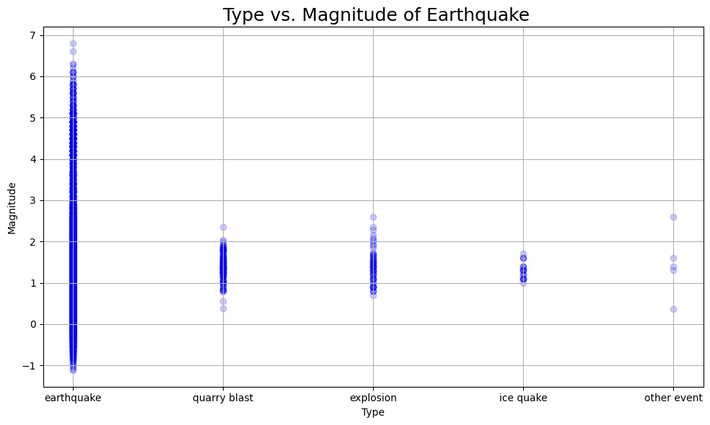
Type of Events Causing Ground Shake
Earthquake is the main cause for the Ground Shaking and the magnitudes can vary from 0 to 7.

Slide 5
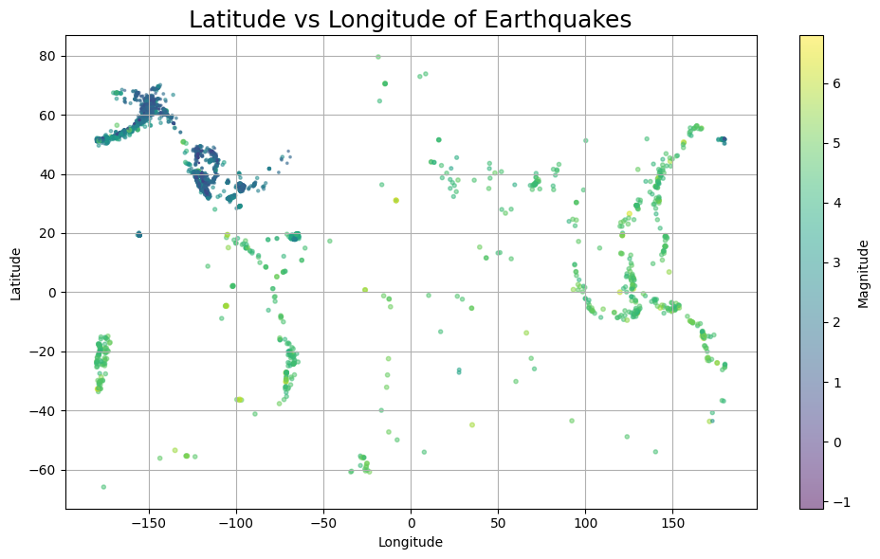
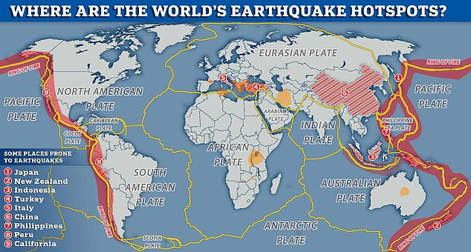
Global Distribution of Earthquakes
Earthquake Latitude and Longitude map has a good relationship with the plate tectonics boundaries (mostly in the convergent boundaries). It suggests that tectonic movements are the main cause for Earthquakes.

Slide 6
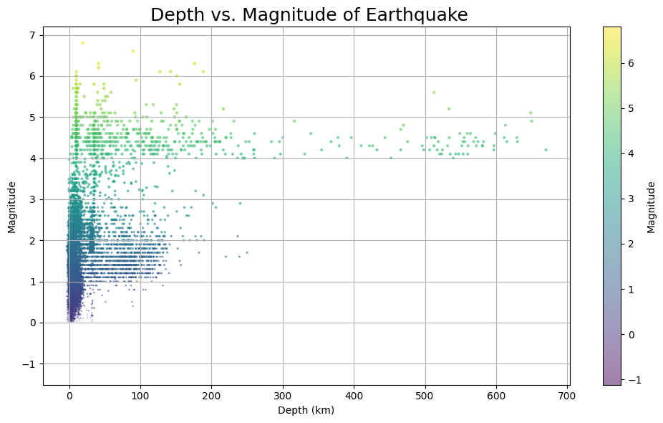
Magnitudes of Earthquake with Depth
Earthquake mostly occurs from the Shallow Depths (<10km) & low in magnitudes (0 to 2.5)
As the depth of the epicentre goes high (>250km) the magnitude of the earthquake is high (>4) and it may cause more damage.

Slide 7
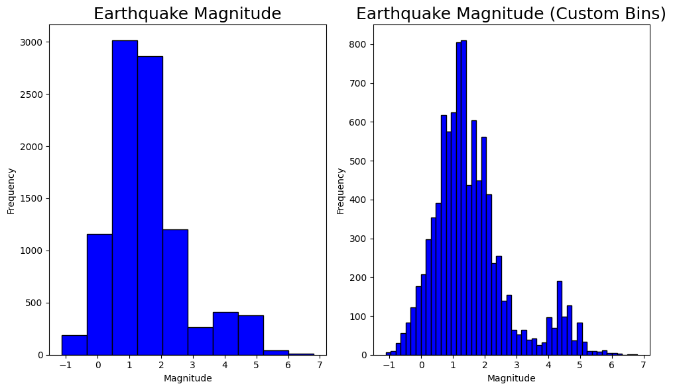
Histogram of Magnitudes of Earthquake
Earthquakes are mostly low in magnitudes (0 to 2.5)

Slide 8
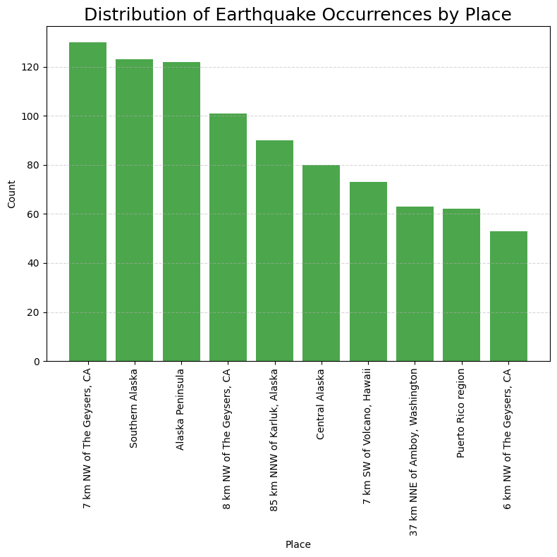
Earthquake Prone Zones
Alaska and Canada has most earthquake occurrences in this year.

Slide 9
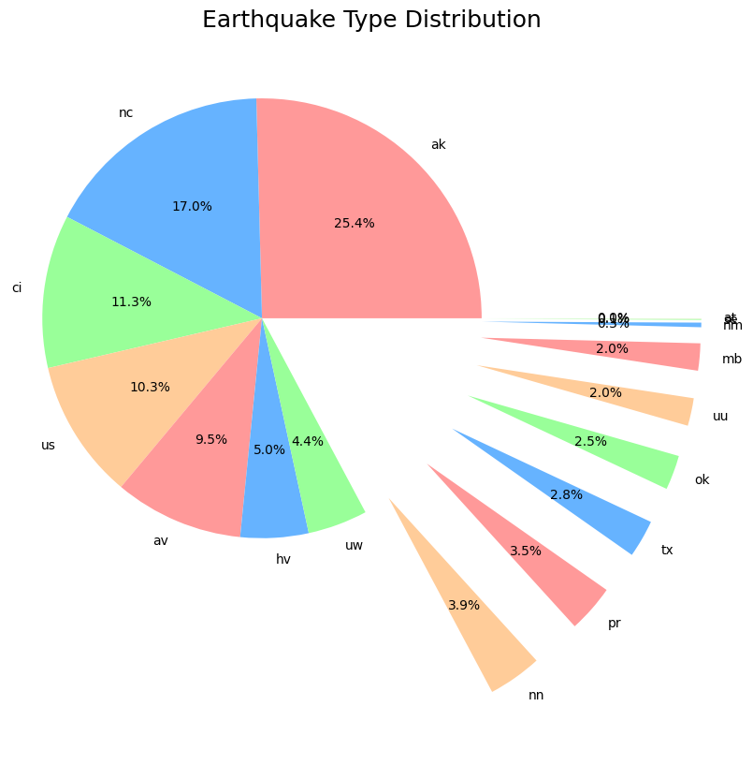
Earthquake Prone Zones
Alaska and Canada has most earthquake occurrences in this year.

Slide 10
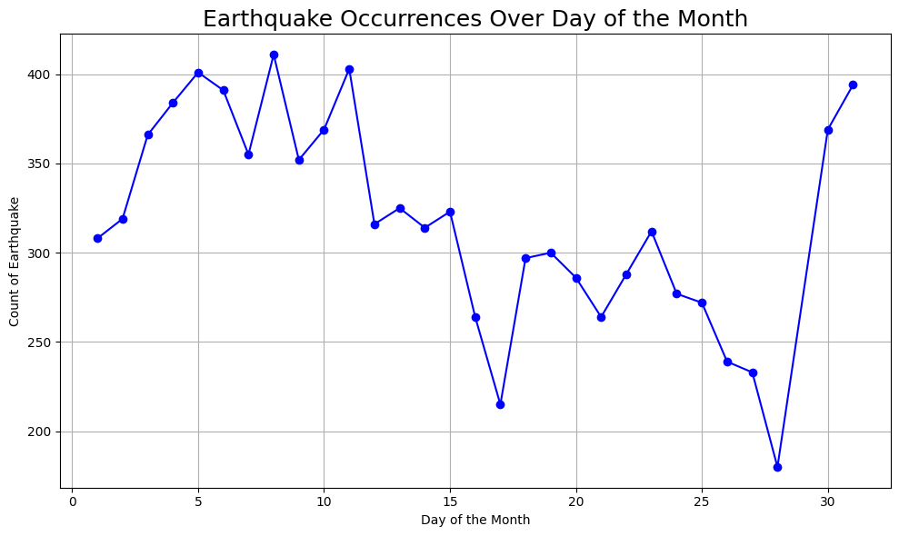
Earthquake Over Day of the Month
Earthquakes mostly occur within the first 10 days of the months

Slide 11
Conclusion
Earthquake is the main cause for the Ground Shaking.
Global Distribution of Earthquake has a close relationship with the Earth Plate Boundaries.
Earthquake mostly occurs from the Shallow Depths (<10km) & low in magnitudes (0 to 2.5)
As the depth of the epicenters goes high (>250km) the magnitude of the Earthquake is high (>4) and it may cause more damage.
In this year Canada, Alaska has most occurrences of Earthquakes and they can be considered as Earthquake prone Zones.

