Slide 1

Safe to Eat or Deadly Poisonous- A Machine Learning Approach for Mushroom classification
DR. Tanushree Mahadani

Slide 2
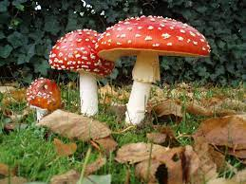
Introduction
Mushroom is one of the fungi types food that has the most potent nutrients on the plant.
Mushrooms have major medical advantages such as killing cancer cells.
This study aims to find the most appropriate technique for mushroom classification, and mushroom will be classified into two categories, poisonous and edible.

Slide 3
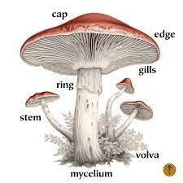
Mushroom Features
The dataset contains mentioned features of the mushroom which can be seen in the image
This project aims at developing a machine-learning algorithm that will determine if a certain mushroom is edible or poisonous by its specifications like cap shape, cap color, gill color etc using different classifiers. I have used the following classification methods:
Logistic Regression classifier
Naive Bayes Gaussian Classifier
Random Forest Classifier
Decision Tree Classifier
SVM Classifier

Slide 4
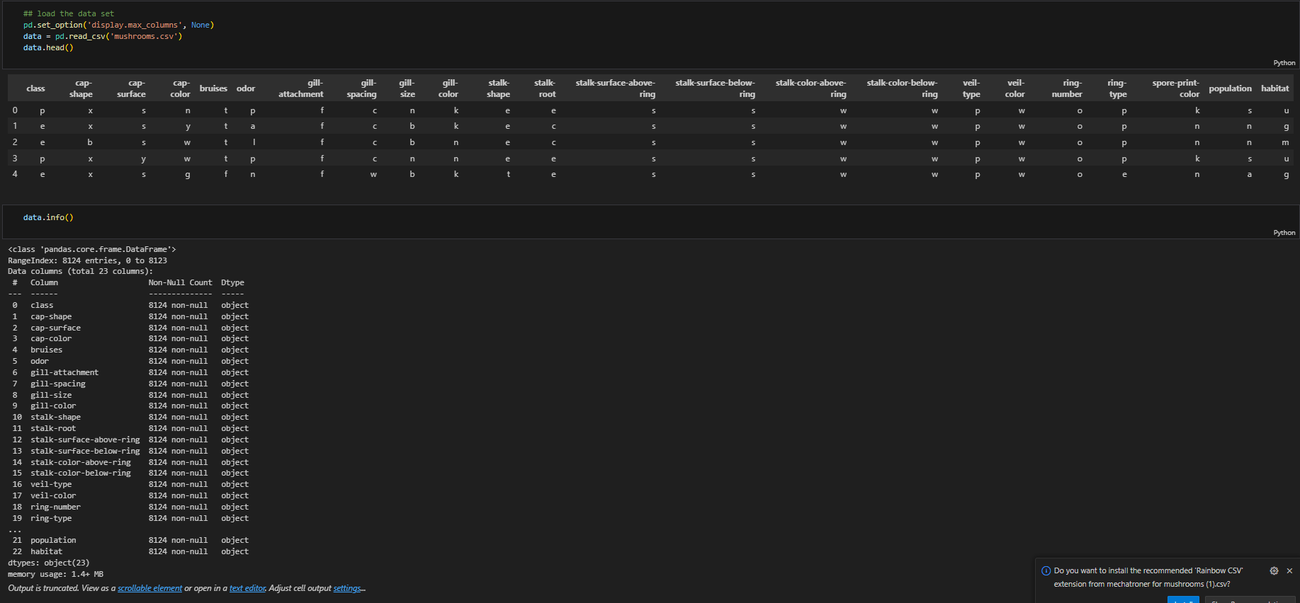
Dataset

Slide 5
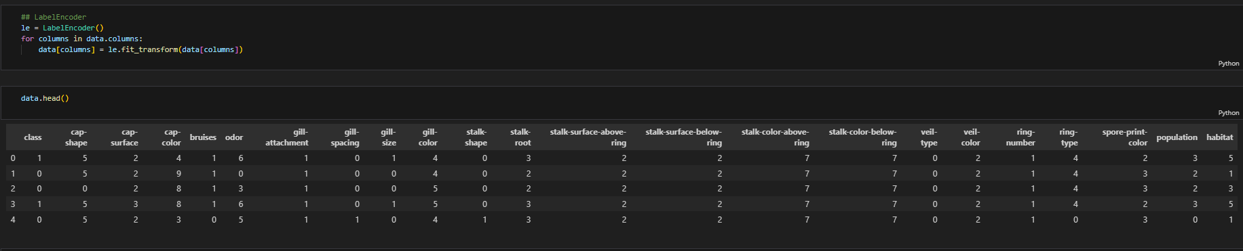
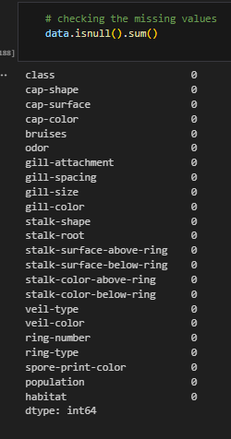
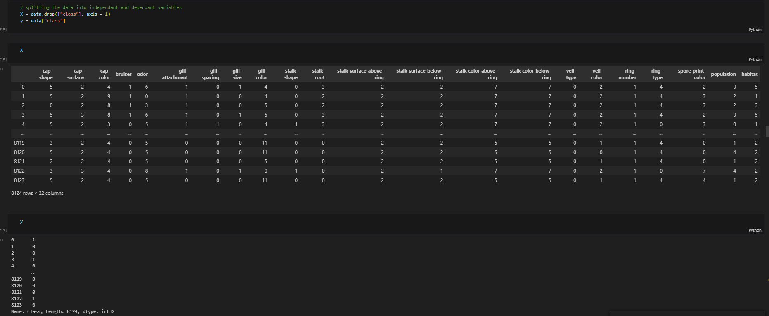
Data Processing
Processes done in this step
Check for missing values
Convert categorical attributes to numerical format
Split the data into features and target variable
2
1
3

Slide 6
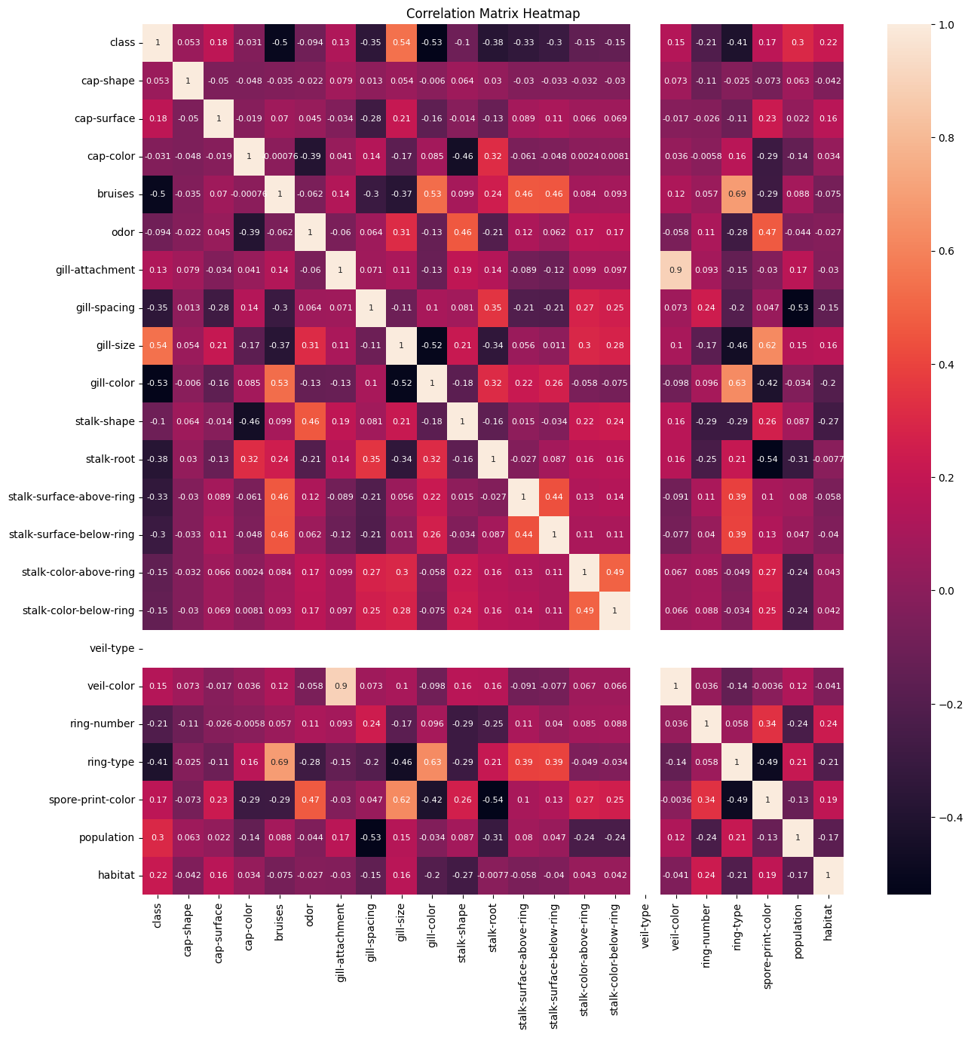
HeatMap

Slide 7
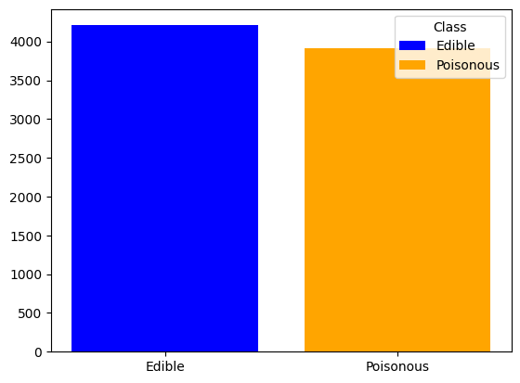
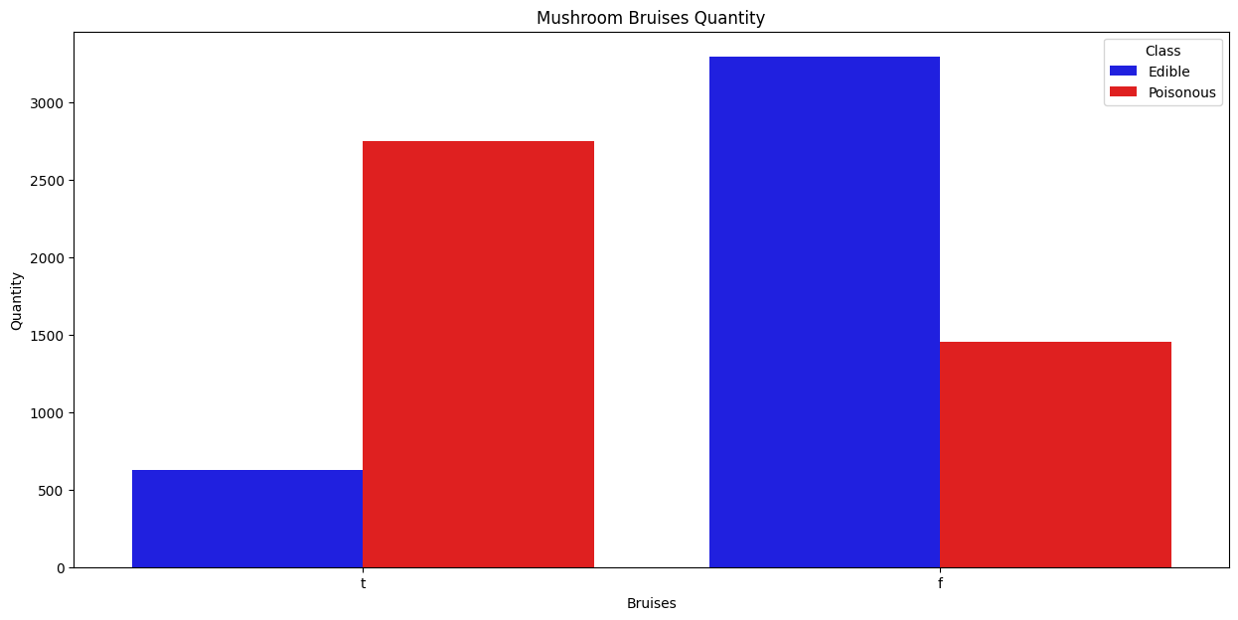
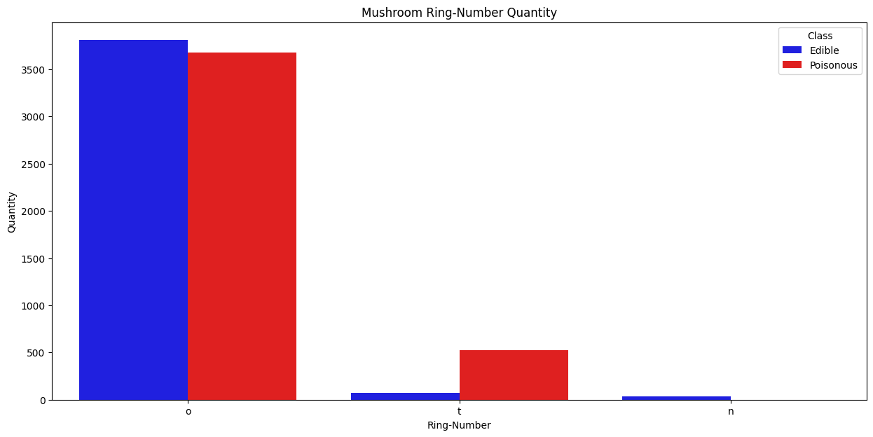
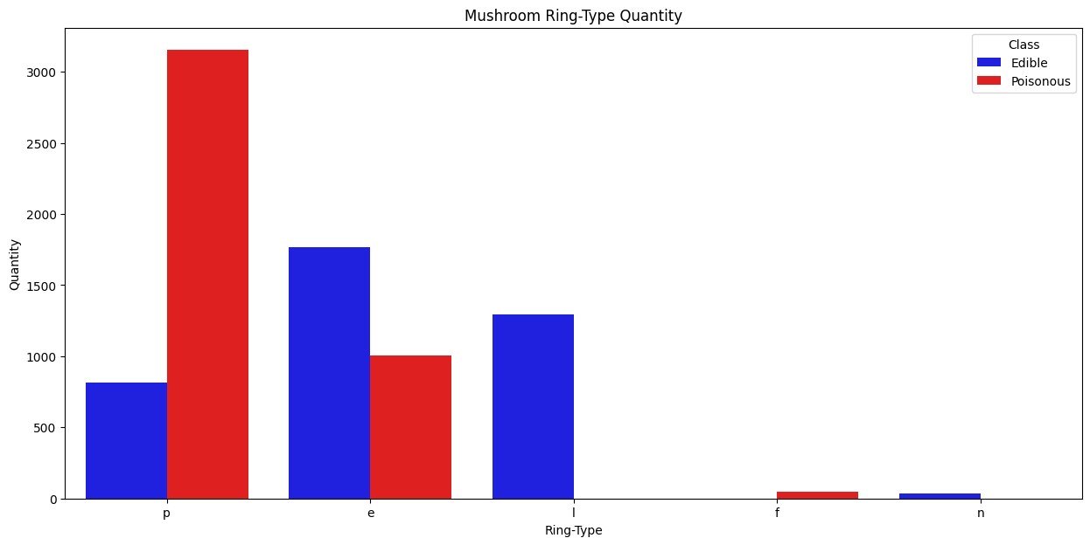
Visualization
Distribution class for Mushroom

Slide 8
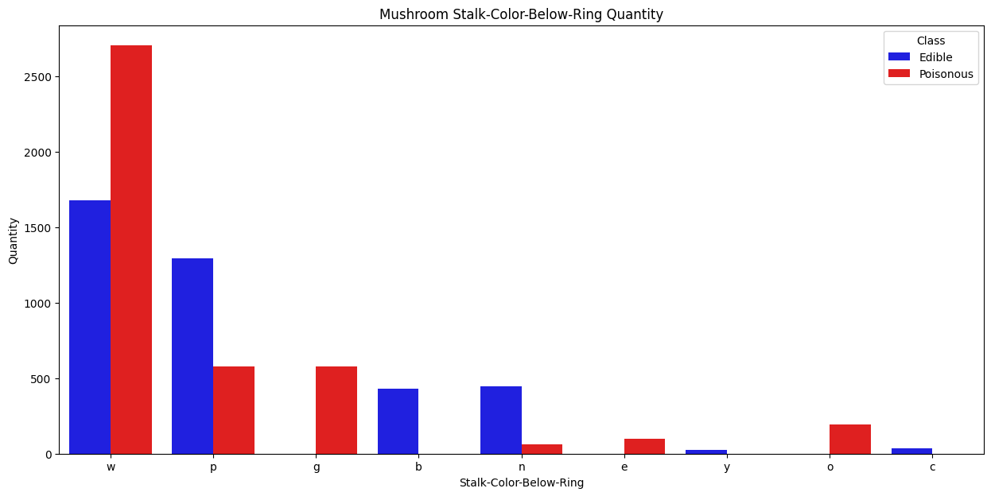
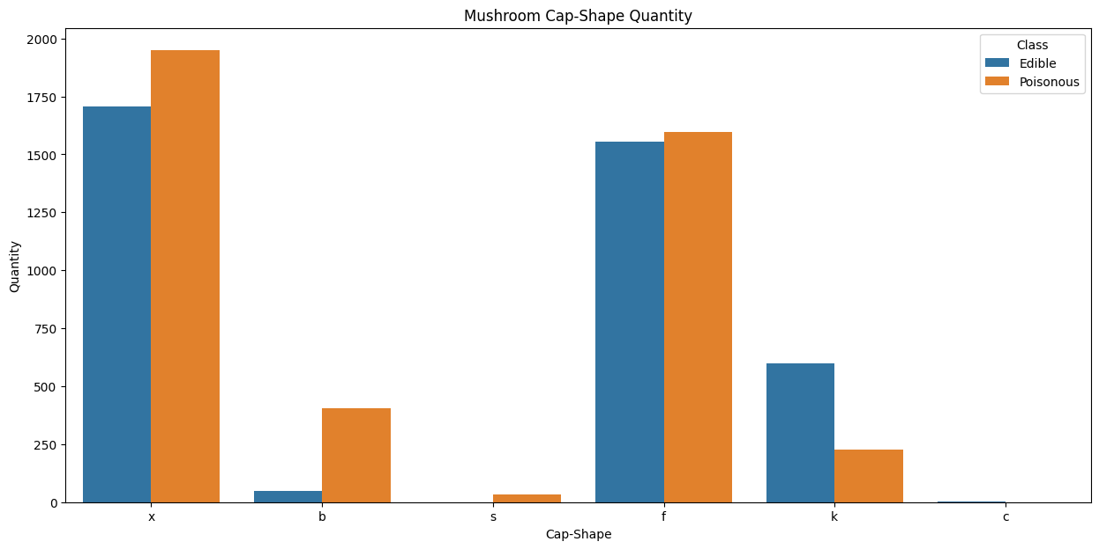
Visualization

Slide 9
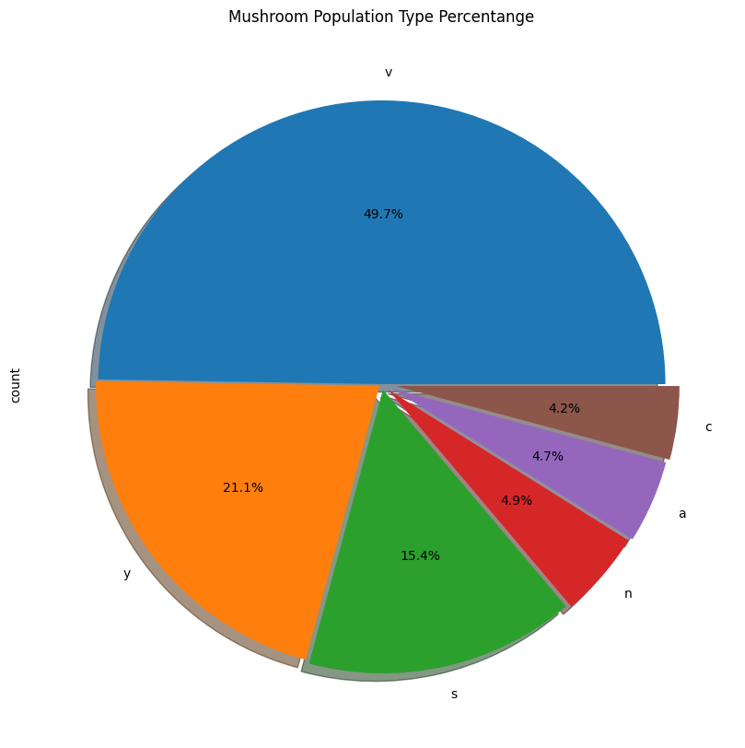
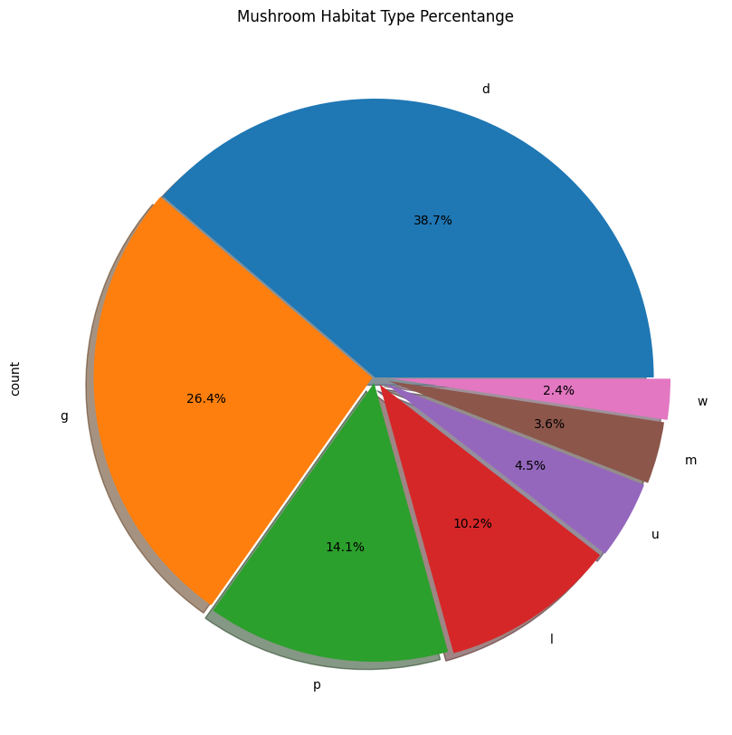
Visualization

Slide 10
Split Data
# splitting the data into independant and dependant variables
X = data.drop(["class"], axis = 1)
y = data["class"]
## Split the data into train and test split
X_train, X_test, y_train, y_test = train_test_split(X, y, test_size=0.20,random_state=32)
Prediction Model
Logistic Regression Model
Naive Bayes Model(Gaussian)
Random Forest Model
Support vector machine
DecisionTreeClassifier

Slide 11
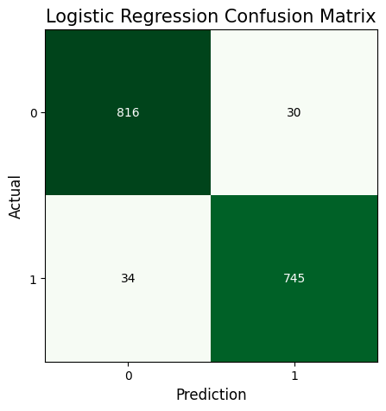
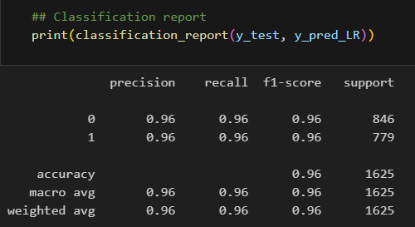
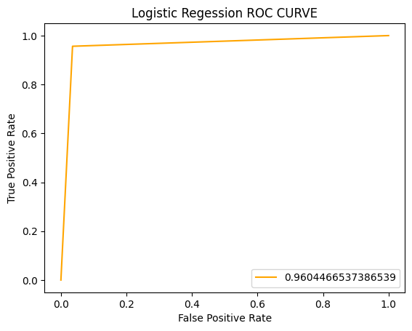
Prediction Model
Logistic Regression Model
## Train the model
model_LR = LogisticRegression()
model_LR.fit(X_train, y_train)

Slide 12
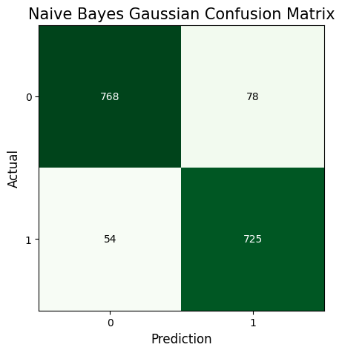
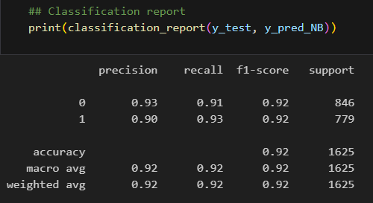
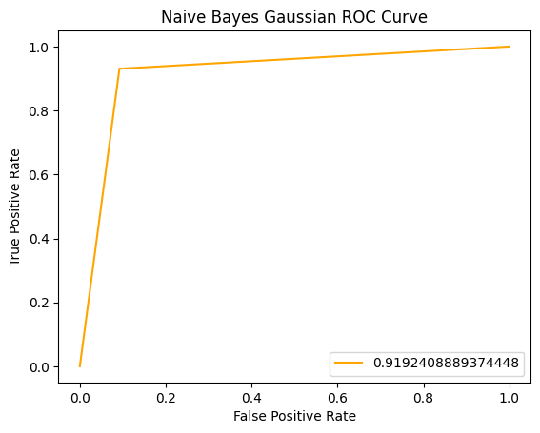
Prediction Model
Naive Bayes Model(Gaussian)
## Create our Naive Bayes model
model_NB = GaussianNB()
## using training data for fitting
model_NB.fit(X_train, y_train)

Slide 13
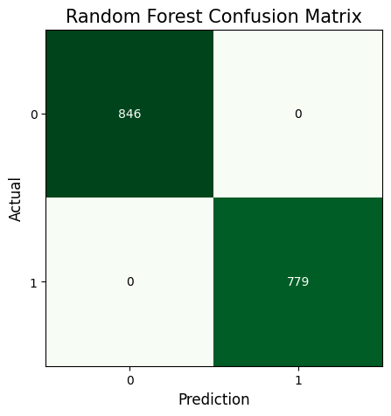
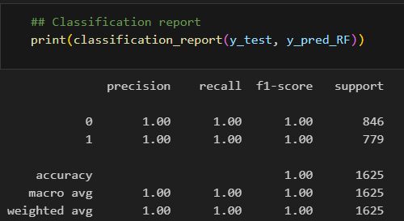
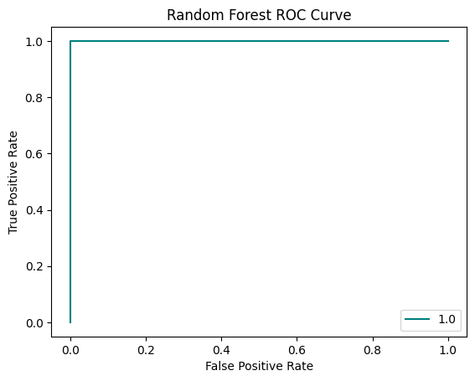
Prediction Model
Random Forest Model
## Train the model
RF_model = RandomForestClassifier()
RF_model.fit(X_train, y_train)

Slide 14
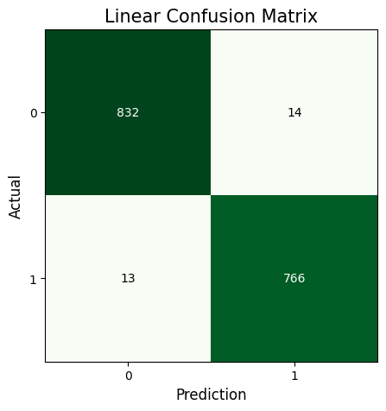
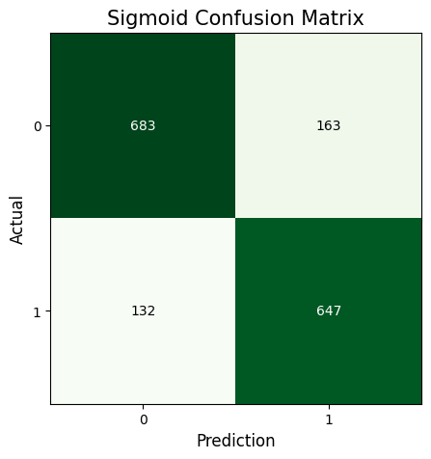

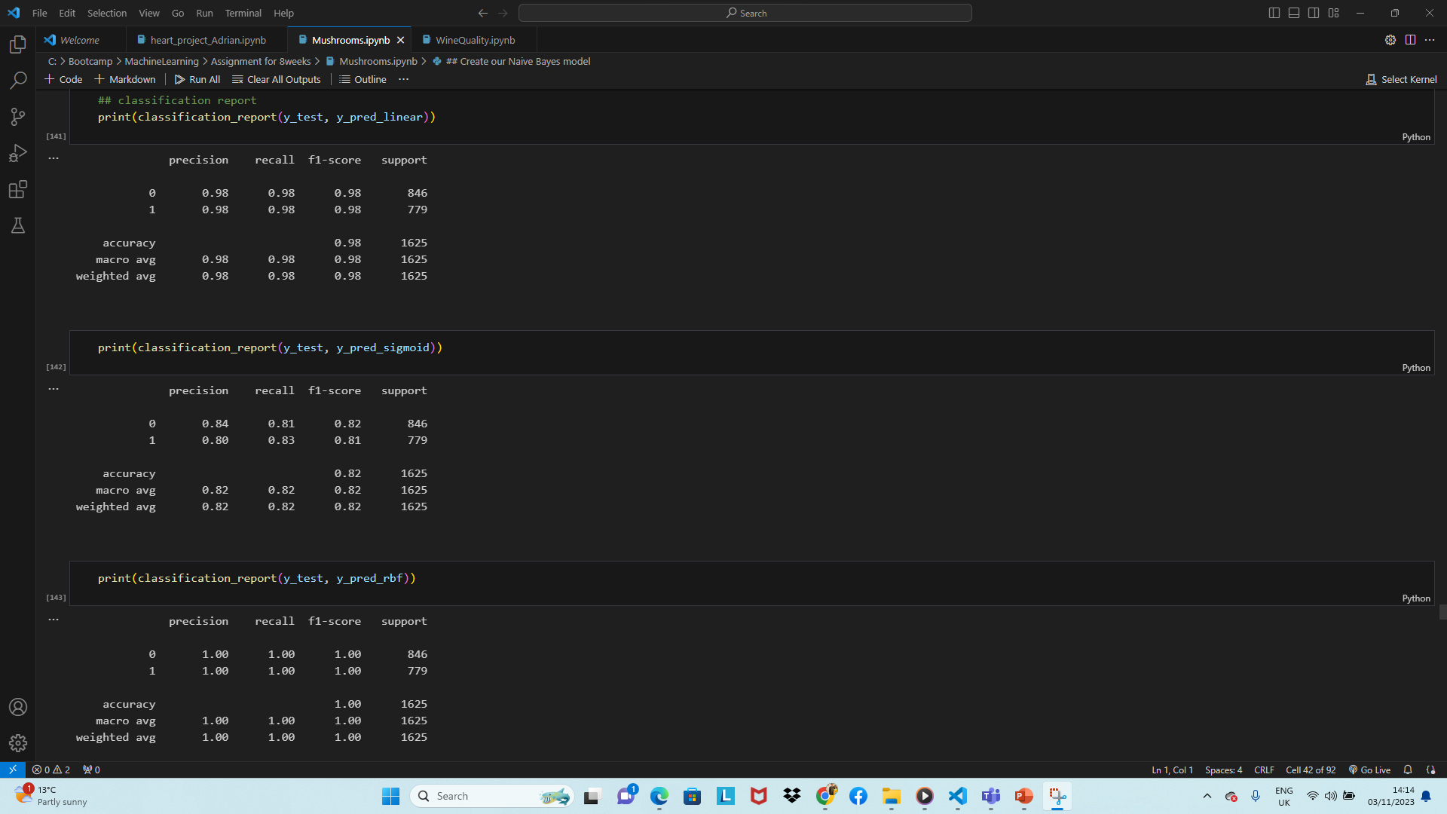
Prediction Model
Support vector machine

Slide 15



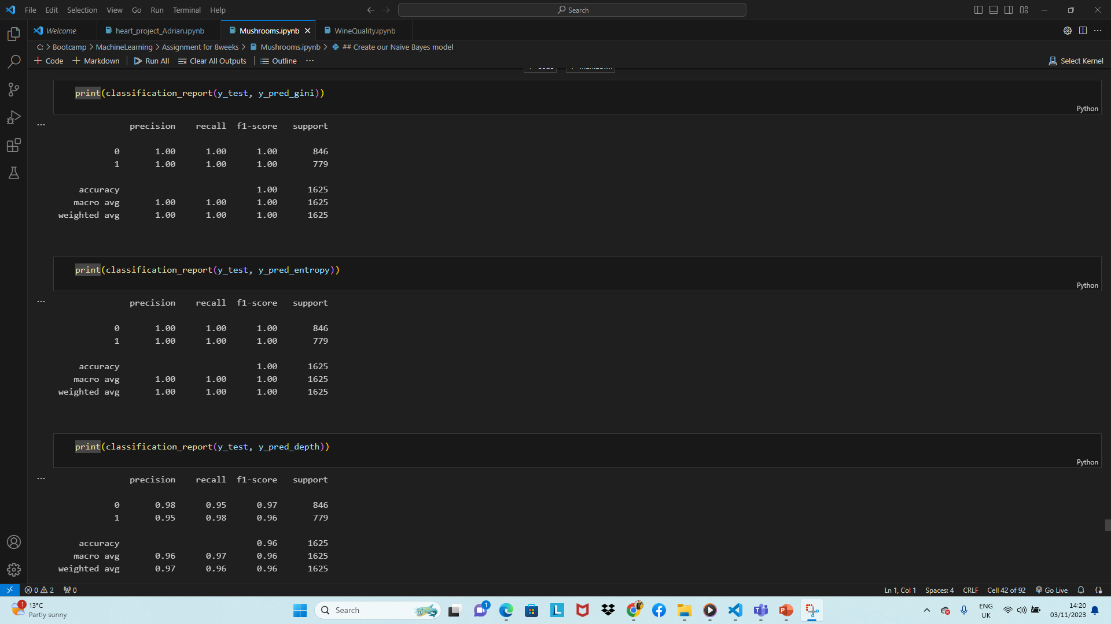
Prediction Model
DecisionTreeClassifier

Slide 16
Accuracy of Model
Model | Accurancy
Regression Model | 96%
Random Forest | 99%
Naive Bayes Model(Gaussian) | 92%
Support vector machine | Accurancy
Linear Kernel | 98%
Sigmoid Kernel | 82%
RBF Kernel | 99%
DecisionTreeClassifier | Accurancy
gini | 99%
entropy | 99%
depth | 96%

Slide 17
Thank u

Slide 18
Methodology
Upload Data set
Check the missing value
Feature Identification
Data splitting
80%Training set
20% Testing set
Model Training
Model Testing
Model Evaluation

