Slide 1
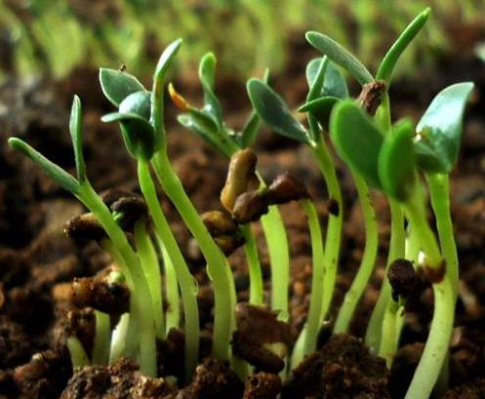
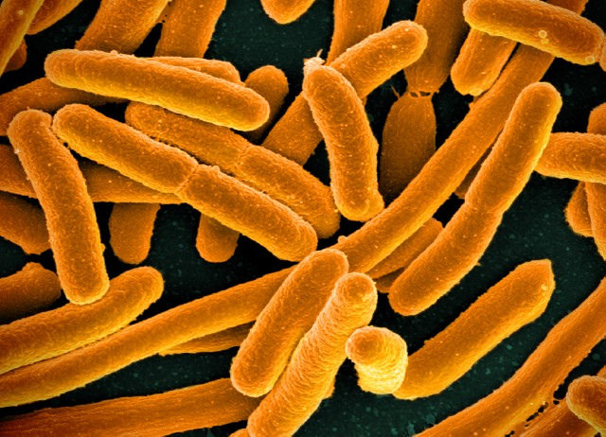
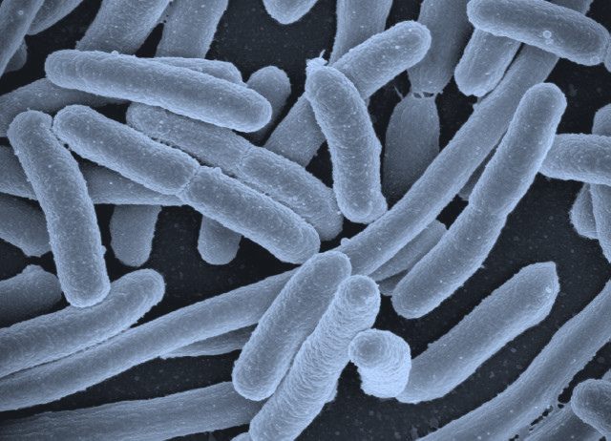
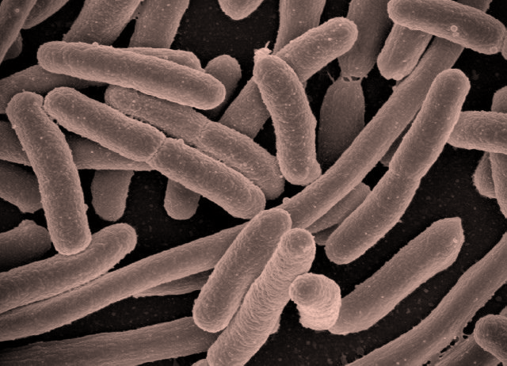
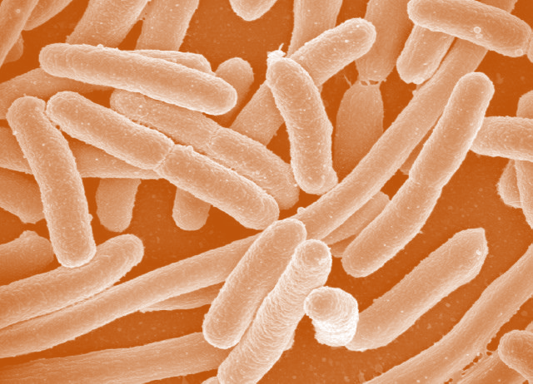
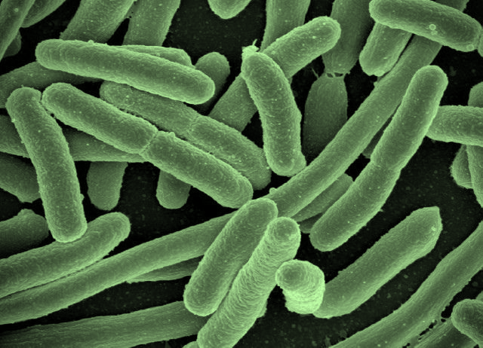
a) Metagenomics
b) Plate sweep metagenomics
c) Whole-genome sequencing
Environmental sample
Initial culture
Isolated cultures
Library preparation (x1)
Library preparation (x1)
Library preparation (x3)
Sequencing (x1)
Sequencing (x1)
Sequencing (x3)

